Slide 1
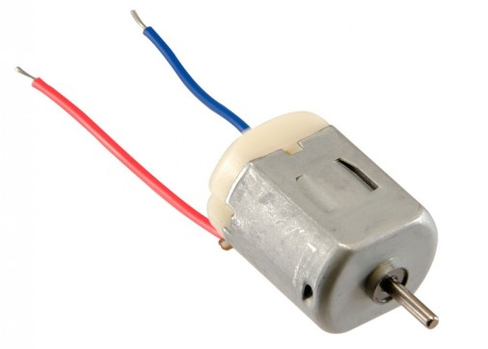
DC motori

Slide 2
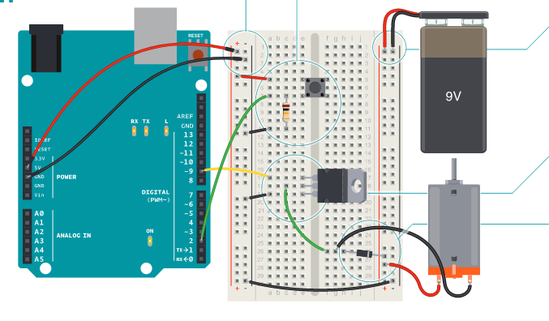
Primer 1. Povezivanje

Slide 3
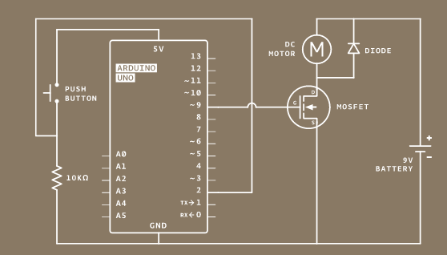
Primer 1. Šema

Slide 4
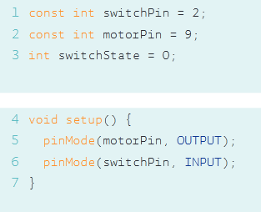
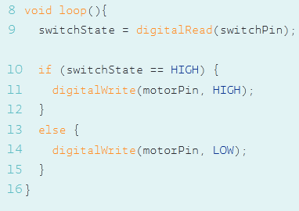
Primer 1. Programski kod

Slide 5
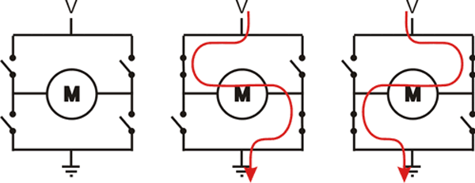
Upravljanje motorima, H-bridge

Slide 6
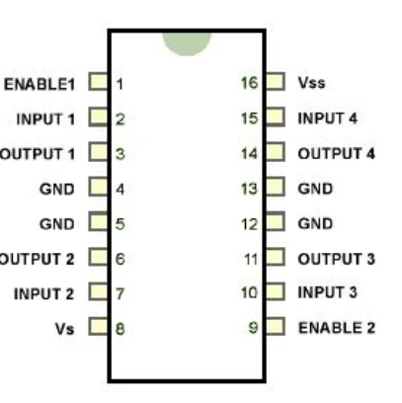
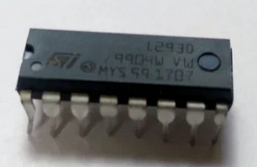
H-bridge, L293D
Motor drajver je mali pojačavač struje čija je funkcija da malu upravljačku struju
pretvori u veću struju koja može da upravlja motorom.
L293D je tipični drajver koji može da upravlja paralelno sa 2 DC motora.

Slide 7
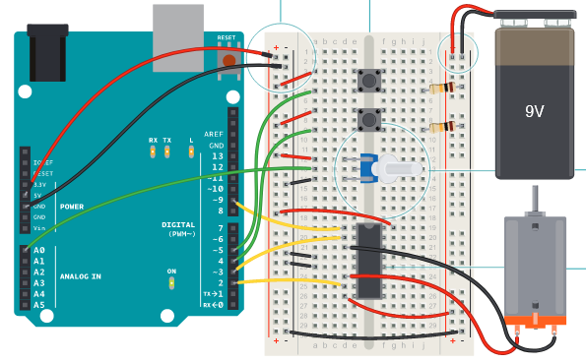
Primer 2. Upravljanje DC motorom pomoću H-bridge-a

Slide 8
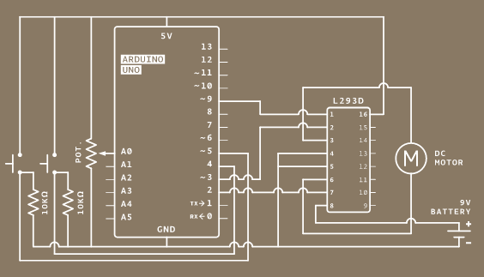
Primer 2. Upravljanje DC motorom pomoću H-bridge-a
H-bridge 1 (Enable): 5V = motor ON
0V = motor OFF
PWM – control speed
I/O 2, I/O 3 -> direction
3-LOW, 2-HIGH: one direction
2-LOW, 3-HIGH: oppos. direction

Slide 9
Primer 2. Prograsmki kod
const int controlPin1 = 2; // connected to pin 7 on the H-bridge
const int controlPin2 = 3; // connected to pin 2 on the H-bridge
const int enablePin = 9; // connected to pin 1 on the H-bridge
const int directionSwitchPin = 4; // connected to the switch for direction
const int onOffSwitchStateSwitchPin = 5; // connected to the switch for turning the motor on and off
const int potPin = A0; // connected to the potentiometer's output
int onOffSwitchState = 0; // current state of the on/off switch
int previousOnOffSwitchState = 0; // previous position of the on/off switch
int directionSwitchState = 0; // current state of the direction switch
int previousDirectionSwitchState = 0; // previous state of the direction switch
int motorEnabled = 0; // Turns the motor on/off
int motorSpeed = 0; // speed of the motor
int motorDirection = 1; // current direction of the motor

Slide 10
Primer 2. Prograsmki kod
void setup() {
// initialize the inputs and outputs
pinMode(directionSwitchPin, INPUT);
pinMode(onOffSwitchStateSwitchPin, INPUT);
pinMode(controlPin1, OUTPUT);
pinMode(controlPin2, OUTPUT);
pinMode(enablePin, OUTPUT);
// pull the enable pin LOW to start
digitalWrite(enablePin, LOW);
}

Slide 11
Primer 2. Prograsmki kod
void loop() {
// read the value of the on/off switch
onOffSwitchState = digitalRead(onOffSwitchStateSwitchPin);
delay(1);
// read the value of the direction switch
directionSwitchState = digitalRead(directionSwitchPin);
// read the value of the pot and divide by 4 to get a value that can be
// used for PWM
motorSpeed = analogRead(potPin) / 4;
// if the on/off button changed state since the last loop()
if (onOffSwitchState != previousOnOffSwitchState) {
// change the value of motorEnabled if pressed
if (onOffSwitchState == HIGH) {
motorEnabled = !motorEnabled;
}
}

Slide 12
Primer 2. Prograsmki kod
// if the direction button changed state since the last loop()
if (directionSwitchState != previousDirectionSwitchState) {
// change the value of motorDirection if pressed
if (directionSwitchState == HIGH) {
motorDirection = !motorDirection;
}
}
// change the direction the motor spins by talking to the control pins
// on the H-Bridge
if (motorDirection == 1) {
digitalWrite(controlPin1, HIGH);
digitalWrite(controlPin2, LOW);
} else {
digitalWrite(controlPin1, LOW);
digitalWrite(controlPin2, HIGH);
}

Slide 13
Primer 2. Prograsmki kod
// if the motor is supposed to be on
if (motorEnabled == 1) {
// PWM the enable pin to vary the speed
analogWrite(enablePin, motorSpeed);
} else { // if the motor is not supposed to be on
//turn the motor off
analogWrite(enablePin, 0);
}
// save the current on/off switch state as the previous
previousDirectionSwitchState = directionSwitchState;
// save the current switch state as the previous
previousOnOffSwitchState = onOffSwitchState;
}

Slide 14
Primer 3. Kontrola DC motora h-bridge-om i džojstik-om
Precrtati prekidače i potmetar, dodati džojstik na A0

Slide 15
Primer 3. Kontrola DC motora h-bridge-om i džojstik-om
const int controlPin1 = 2; // connected to pin 7 on the H-bridge
const int controlPin2 = 3; // connected to pin 2 on the H-bridge
const int enablePin = 9; // connected to pin 1 on the H-bridge
const int joystick_press = 5;
void setup() {
pinMode(controlPin1, OUTPUT);
pinMode(controlPin2, OUTPUT);
pinMode(enablePin, OUTPUT);
pinMode(joystick_press, INPUT);
digitalWrite(joystick_press, HIGH);
}
void loop() {
if (digitalRead(joystick_press)==LOW){
digitalWrite(enablePin, HIGH);
digitalWrite(controlPin1, HIGH);
digitalWrite(controlPin2, LOW);
analogWrite(enablePin, 100);
}
if (digitalRead(joystick_press)==HIGH){
digitalWrite(enablePin, LOW);
}
}

Slide 16
Primer 4. Kontrola smera obrtanja DC motora džojstik-om
const int controlPin1 = 2; // connected to pin 7 on the H-bridge
const int controlPin2 = 3; // connected to pin 2 on the H-bridge
const int enablePin = 9; // connected to pin 1 on the H-bridge
const int joystick_X = A0; // connected to the potentiometer's output
const int joystick_press = 5;
int motorEnabled = 0; // Turns the motor on/off
int motorSpeed = 0; // speed of the motor
void setup() {
pinMode(controlPin1, OUTPUT);
pinMode(controlPin2, OUTPUT);
pinMode(enablePin, OUTPUT);
pinMode(joystick_press, INPUT);
digitalWrite(joystick_press, HIGH);
digitalWrite(enablePin, HIGH);
// pull the enable pin LOW to start
}

Slide 17
Primer 4. Kontrola smera obrtanja DC motora džojstik-om
void loop() {
//if (digitalRead(joystick_press)==LOW){
//digitalWrite(enablePin, HIGH);
if (analogRead(joystick_X)<400){
digitalWrite(controlPin1, HIGH);
digitalWrite(controlPin2, LOW);
analogWrite(enablePin, analogRead(joystick_X)/4);
}
if (analogRead(joystick_X)>600){
digitalWrite(controlPin1, LOW);
digitalWrite(controlPin2, HIGH);
analogWrite(enablePin, analogRead(joystick_X)/4);
}
}

