Slide 1
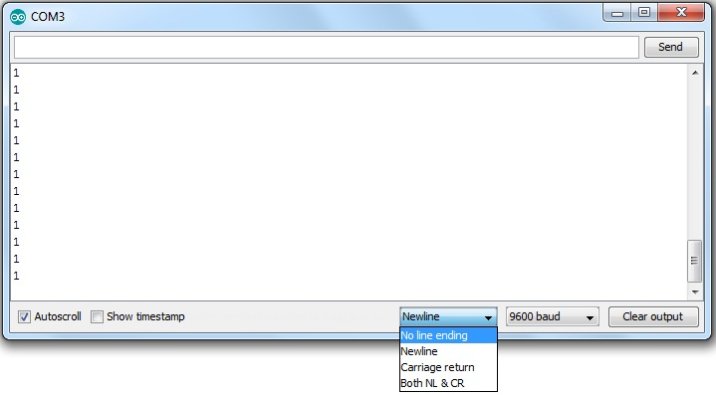
Serial read problem

Slide 2
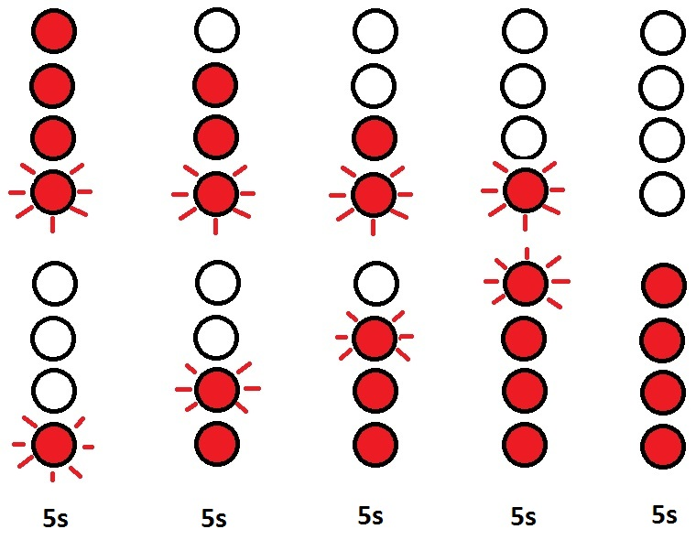

Digitalni peščanik

Slide 3
Digitalni peščanik
https://people.vts.su.ac.rs/~pmiki/_DALJINSKA_NASTAVA_MIKROKONTROLERI/28.04/pescanikReal.mp4
https://people.vts.su.ac.rs/~pmiki/_DALJINSKA_NASTAVA_MIKROKONTROLERI/28.04/pescanik.mp4

Slide 4
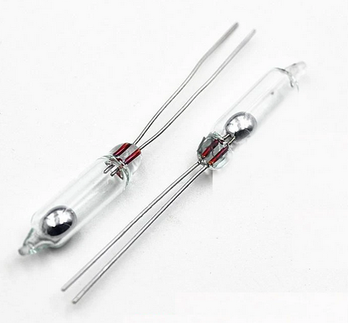
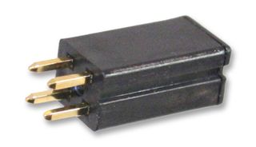
Tilt switch
https://people.vts.su.ac.rs/~pmiki/_DALJINSKA_NASTAVA_MIKROKONTROLERI/28.04/tilt.mp4

Slide 5
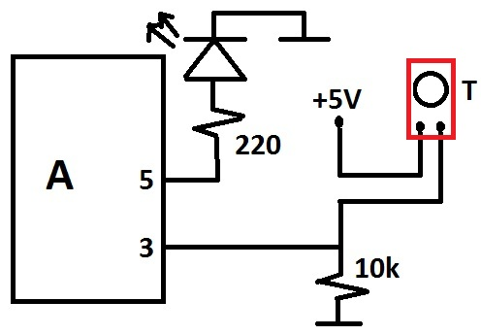
Tilt switch
void setup() {
pinMode(3, INPUT);
pinMode(5, OUTPUT);
Serial.begin(9600);
}
void loop() {
int sensorValue = digitalRead(3);
if (sensorValue == 1){
digitalWrite(5, HIGH);
}
else{
digitalWrite(5, LOW);
}
Serial.println(sensorValue);
delay(500);
}

Slide 6
Prekidi (interapti)

Slide 7
Prekidi
Polling (mailbox example)
Softverski (tajmer)
Hardverski (izazvani spoljnim uticajem, npr. pritisak tastera)
Arduino Uno (digitalne nožice 2 i 3)

Slide 8
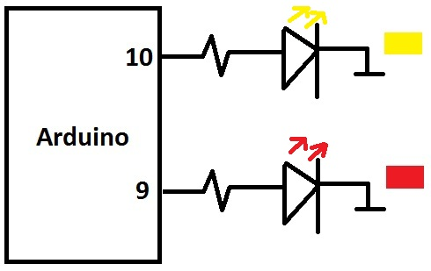
Softverski prekid
#include <TimerOne.h>
String LEDStatus = "OFF";
int RedLED = 9;
int YellowLED = 10;
void setup() {
pinMode(YellowLED, OUTPUT);
pinMode(RedLED, OUTPUT);
Timer1.initialize(1000000);
Timer1.attachInterrupt(BlinkYellow);
Serial.begin(9600);
}
https://people.vts.su.ac.rs/~pmiki/_DALJINSKA_NASTAVA_MIKROKONTROLERI/28.04/intBlink.mp4

Slide 9
Softverski prekid
void loop() {
digitalWrite(RedLED, HIGH);
delay(250);
digitalWrite(RedLED, LOW);
delay(250);
}
void BlinkYellow(){
if(LEDStatus=="ON"){
digitalWrite(YellowLED, LOW);
LEDStatus="OFF";
return;
}
if(LEDStatus=="OFF"){
digitalWrite(YellowLED, HIGH);
LEDStatus="ON";
return;
}
}

Slide 10
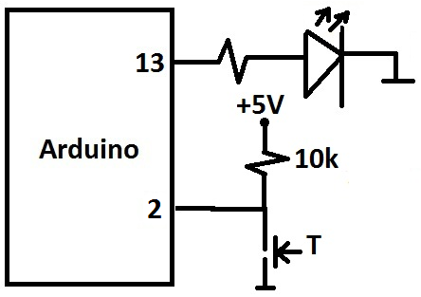
Hardverski prekid
volatile boolean ledOn = false;
void setup() {
pinMode(13, OUTPUT);
pinMode(2, INPUT);
attachInterrupt(digitalPinToInterrupt(2), buttonPressed, RISING);
}
void loop() {
}
void buttonPressed(){
if(ledOn){
ledOn = false;
digitalWrite(13, LOW);
}
else{
ledOn = true;
digitalWrite(13, HIGH);
}
}
https://people.vts.su.ac.rs/~pmiki/_DALJINSKA_NASTAVA_MIKROKONTROLERI/28.04/pressButton.mp4

