Slide 1
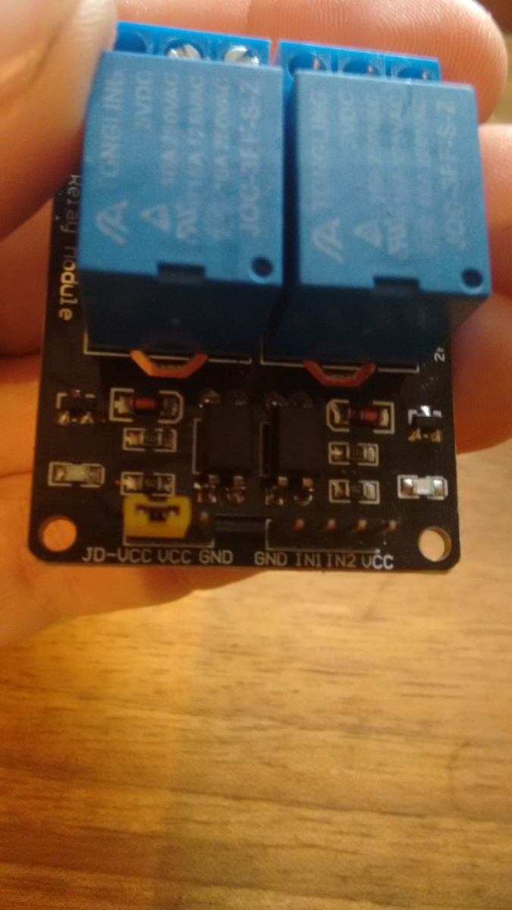
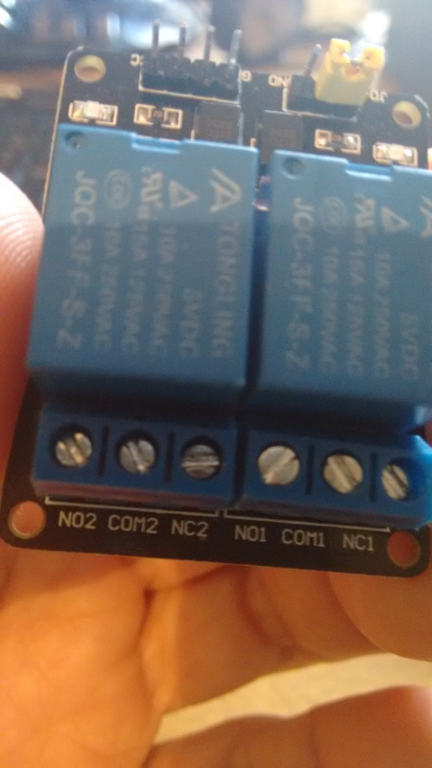
Releji

Slide 2
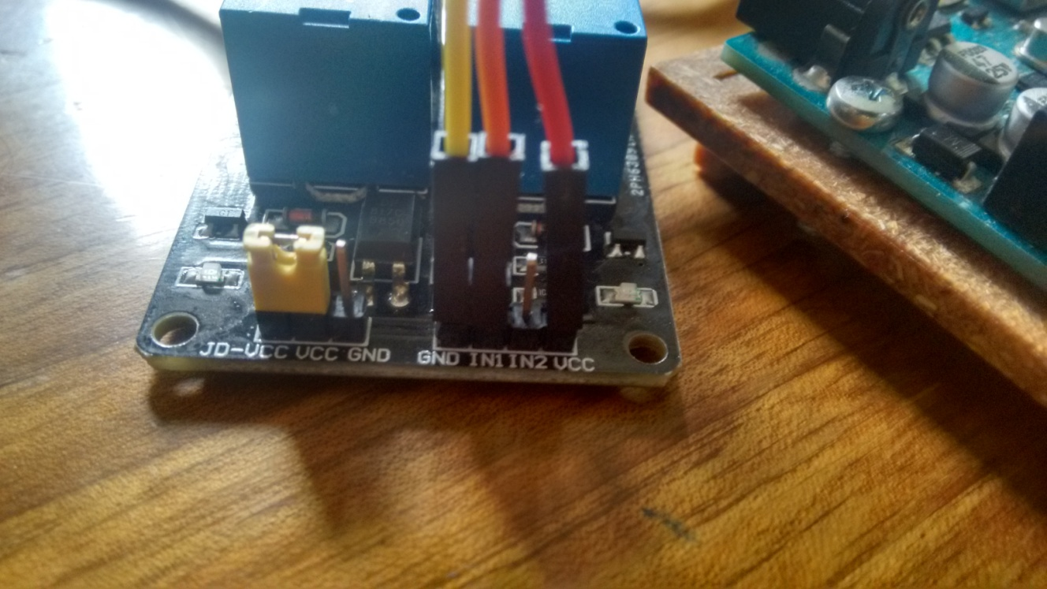
Releji

Slide 3
Relej – Primer 1.
int relayPin = 3;
void setup() {
pinMode(relayPin, OUTPUT);
digitalWrite(relayPin, HIGH); // initial OFF
Serial.begin(9600);
delay(2000);
}
void loop() {
digitalWrite(relayPin, LOW);
Serial.println("Relay is ON");
Serial.println("");
delay(2000);
digitalWrite(relayPin, HIGH);
Serial.println("Relay is OFF");
Serial.println("");
delay(1000);
}

Slide 4
Relej – Primer 2.
int relayPin = 3;
int loopDelay = 1000;
int lightSensor = A0;
void setup() {
pinMode(relayPin, OUTPUT);
digitalWrite(relayPin, HIGH); // initial OFF
Serial.begin(9600);
delay(2000);
}
void loop() {
int lightSensorValue = analogRead(A0);
Serial.println(lightSensorValue);
delay(1000);
if (lightSensorValue<400){
digitalWrite(relayPin, LOW);
Serial.println("Relay is ON");
Serial.println("");
delay(2000);
} else {
digitalWrite(relayPin, HIGH);
Serial.println("Relay is OFF");
Serial.println("");
delay(1000);
}
}

Slide 5
Joystick
const int SW_pin = 2; // digital pin connected to SW
const int X_pin = 0; // analog pin connected to VRx
const int Y_pin = 1; // analog pin connected to VRy
void setup() {
pinMode(8, OUTPUT);
pinMode(9, OUTPUT);
pinMode(10, OUTPUT);
pinMode(11, OUTPUT);
pinMode(12, OUTPUT);
pinMode(SW_pin, INPUT);
digitalWrite(SW_pin, HIGH);
Serial.begin(9600);
}
void loop() {
Serial.print("X: ");
Serial.print(analogRead(X_pin));
Serial.print(" Y: ");
Serial.print(analogRead(Y_pin));
Serial.print(" Z: ");
Serial.println(digitalRead(SW_pin));
if (analogRead(X_pin)<100){
digitalWrite(10, HIGH);
delay(300);
digitalWrite(10, LOW);
Serial.println("LEFT!");
}
if (analogRead(X_pin)>900){
digitalWrite(11, HIGH);
delay(300);
digitalWrite(11, LOW);
Serial.println("RIGHT!");
}
if (analogRead(Y_pin)<100){
digitalWrite(8, HIGH);
delay(300);
digitalWrite(8, LOW);
Serial.println("UP!");
}
if (analogRead(Y_pin)>900){
digitalWrite(9, HIGH);
delay(300);
digitalWrite(9, LOW);
Serial.println("DOWN!");
}
if (digitalRead(SW_pin)==LOW){
digitalWrite(12, HIGH);
delay(300);
digitalWrite(12, LOW);
Serial.println("PRESS!");
}
delay(250);
}

Slide 6
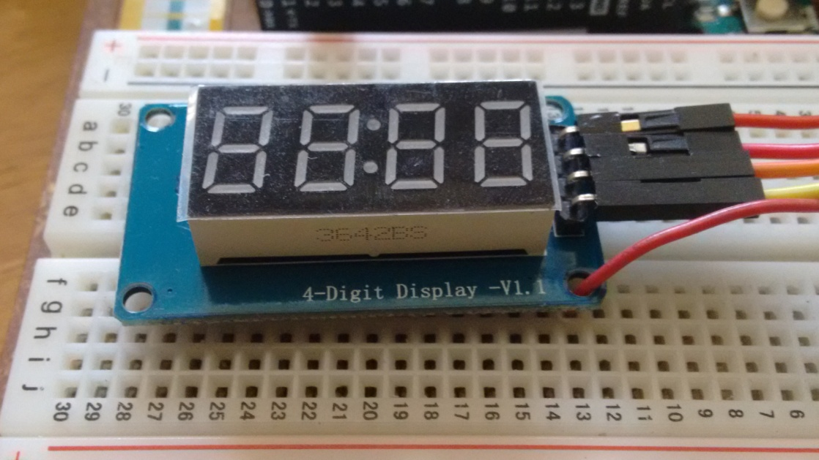
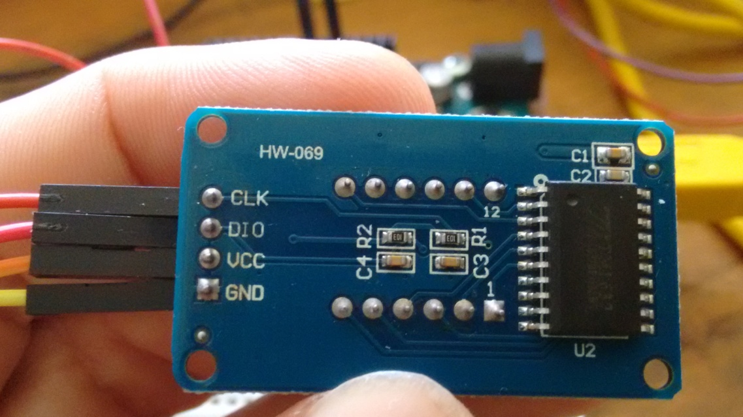
Displej TM1637

Slide 7
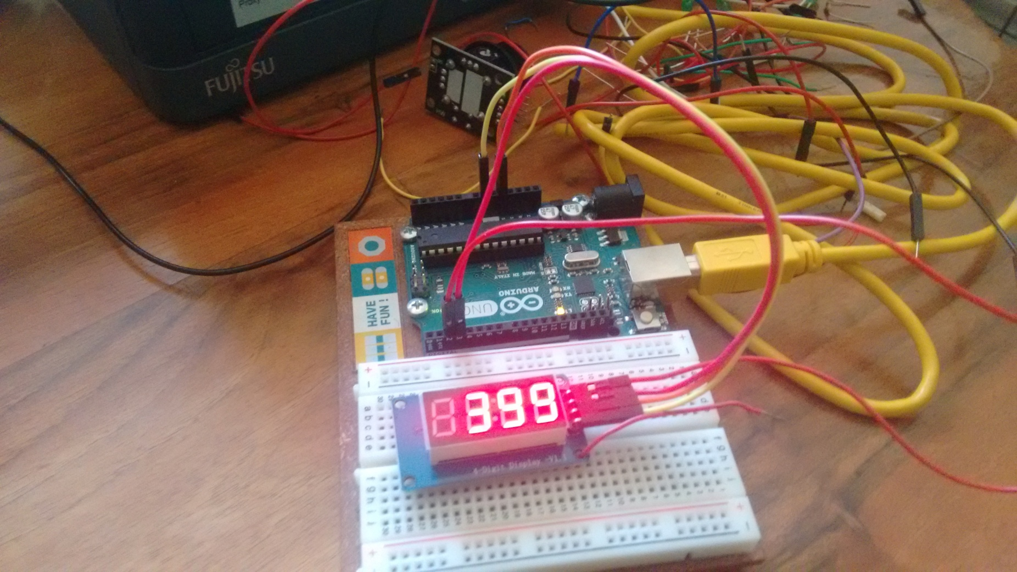
Displej TM1637

Slide 8
Displej TM1637 – Primer 1.
#include <TM1637Display.h>
#define CLK 2
#define DIO 3
TM1637Display display(CLK, DIO);
#define TEST_DELAY 2000
void setup() {
}
void loop() {
display.setBrightness(7);
for (int i=0; i<400; i++){
display.showNumberDec(i);
delay(20);
}
while(true);
}

Slide 9
Displej TM1637 – Primer 2.
void loop()
{
int k;
uint8_t data[] = { 0xff, 0xff, 0xff, 0xff };
uint8_t blank[] = { 0x00, 0x00, 0x00, 0x00 };
display.setBrightness(0x0f);
// All segments on
display.setSegments(data);
delay(TEST_DELAY);
// Selectively set different digits
data[0] = display.encodeDigit(0);
data[1] = display.encodeDigit(1);
data[2] = display.encodeDigit(2);
data[3] = display.encodeDigit(3);
display.setSegments(data);
delay(TEST_DELAY);
/*
for(k = 3; k >= 0; k--) {
display.setSegments(data, 1, k);
delay(TEST_DELAY);
}
*/
#include <Arduino.h>
#include <TM1637Display.h>
// Module connection pins (Digital Pins)
#define CLK 2
#define DIO 3
// The amount of time (in milliseconds) between tests
#define TEST_DELAY 2000
const uint8_t SEG_DONE[] = {
SEG_B | SEG_C | SEG_D | SEG_E | SEG_G, // d
SEG_A | SEG_B | SEG_C | SEG_D | SEG_E | SEG_F, // O
SEG_C | SEG_E | SEG_G, // n
SEG_A | SEG_D | SEG_E | SEG_F | SEG_G // E
};
TM1637Display display(CLK, DIO);
void setup()
{
}

Slide 10
Displej TM1637 – Primer 2.
display.showNumberDec(301, true); // Expect: 0301
delay(TEST_DELAY);
display.clear();
display.showNumberDec(14, false, 2, 1); // Expect: _14_
delay(TEST_DELAY);
display.clear();
display.showNumberDec(4, true, 2, 2); // Expect: __04
delay(TEST_DELAY);
display.showNumberDec(-1, false); // Expect: __-1
delay(TEST_DELAY);
display.showNumberDec(-12); // Expect: _-12
delay(TEST_DELAY);
display.showNumberDec(-999); // Expect: -999
delay(TEST_DELAY);
display.clear();
display.showNumberDec(-5, false, 3, 0); // Expect: _-5_
delay(TEST_DELAY);
display.showNumberHexEx(0xf1af); // Expect: f1Af
delay(TEST_DELAY);
display.showNumberHexEx(0x2c); // Expect: __2C
delay(TEST_DELAY);
display.showNumberHexEx(0xd1, 0, true); // Expect: 00d1
delay(TEST_DELAY);
display.clear();
display.showNumberHexEx(0xd1, 0, true, 2); // Expect: d1__
delay(TEST_DELAY);
display.clear();
display.setSegments(data+2, 2, 2);
delay(TEST_DELAY);
display.clear();
display.setSegments(data+2, 2, 1);
delay(TEST_DELAY);
display.clear();
display.setSegments(data+1, 3, 1);
delay(TEST_DELAY);
// Show decimal numbers with/without leading zeros
display.showNumberDec(0, false); // Expect: ___0
delay(TEST_DELAY);
display.showNumberDec(0, true); // Expect: 0000
delay(TEST_DELAY);
display.showNumberDec(1, false); // Expect: ___1
delay(TEST_DELAY);
display.showNumberDec(1, true); // Expect: 0001
delay(TEST_DELAY);
display.showNumberDec(301, false); // Expect: _301
delay(TEST_DELAY);

Slide 11
Displej TM1637 – Primer 2.
// Run through all the dots
for(k=0; k <= 4; k++) {
display.showNumberDecEx(0, (0x80 >> k), true);
delay(TEST_DELAY);
}
// Brightness Test
for(k = 0; k < 4; k++)
data[k] = 0xff;
for(k = 0; k < 7; k++) {
display.setBrightness(k);
display.setSegments(data);
delay(TEST_DELAY);
}
// On/Off test
for(k = 0; k < 4; k++) {
display.setBrightness(7, false); // Turn off
display.setSegments(data);
delay(TEST_DELAY);
display.setBrightness(7, true); // Turn on
display.setSegments(data);
delay(TEST_DELAY);
}
// Done!
display.setSegments(SEG_DONE);
while(1);
}

