Slide 1
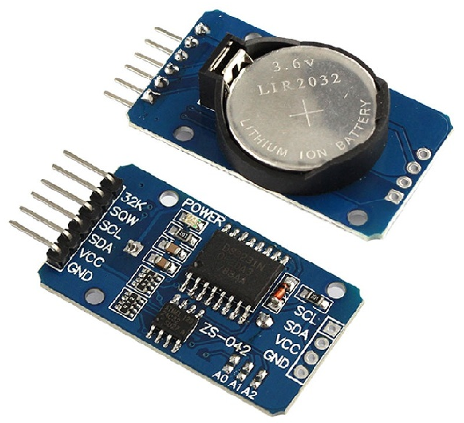
Real Time Clock

Slide 2
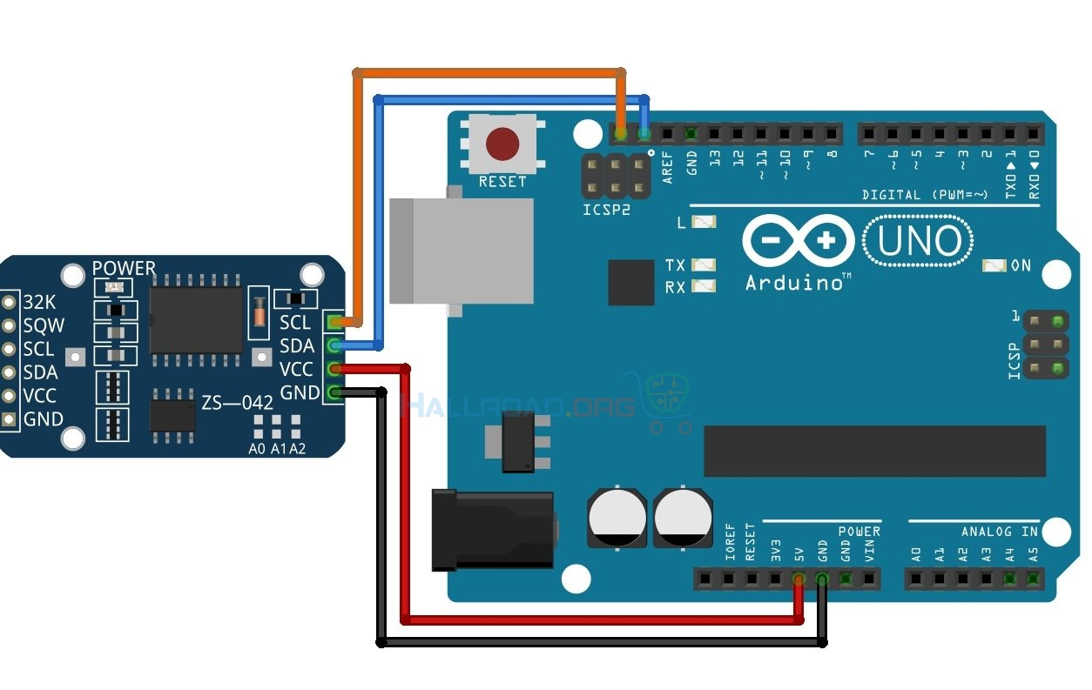
RTC3231 modul

Slide 3
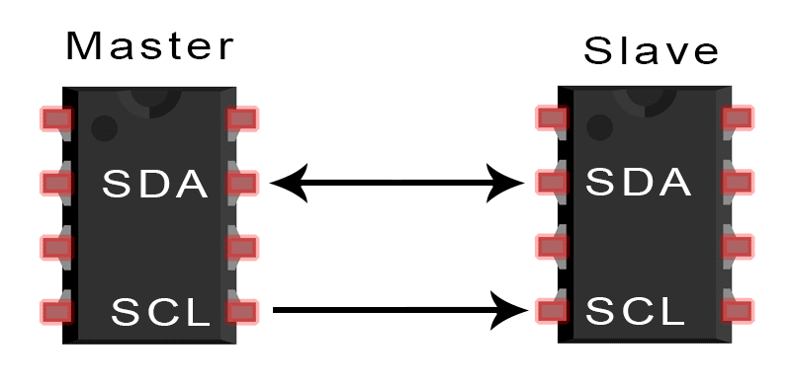
I²C protokol (Philips, 1982)
I²C ili IIC – Inter Integrated Circuits
SCL – Serial CLock
SDA – Serial DAta

Slide 4
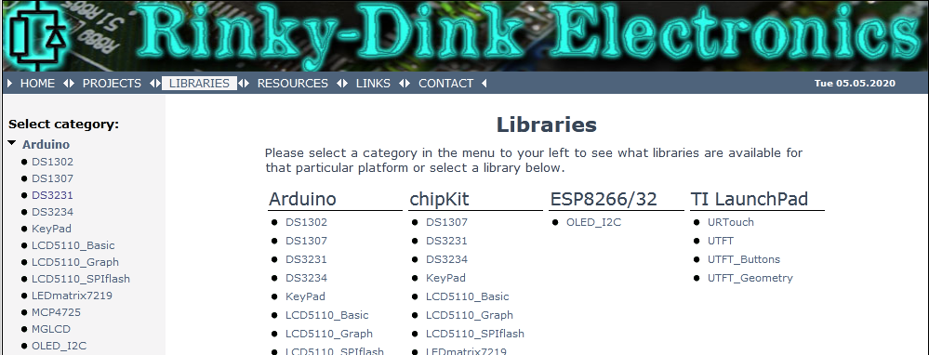
Arduino I²C
Wire biblioteka
#include <wire.h>
Postoje i druge biblioteke za I²C komunikaciju:
rinkydinkelectronics.com, <DS3231.h>
PDF!

Slide 5
Test 01
#include <DS3231.h>
// Init the DS3231 using the hardware interface
DS3231 rtc(SDA, SCL);
void setup()
{
// Setup Serial connection
Serial.begin(9600);
// Uncomment the next line if you are using an Arduino Leonardo
//while (!Serial) {}
// Initialize the rtc object
rtc.begin();
// The following lines can be uncommented to set the date and time
//rtc.setDOW(SUNDAY); // Set Day-of-Week to SUNDAY
//rtc.setTime(13, 10, 00); // Set the time to 12:00:00 (24hr format)
//rtc.setDate(03, 05, 2020); // Set the date to January 1st, 2014
}

Slide 6
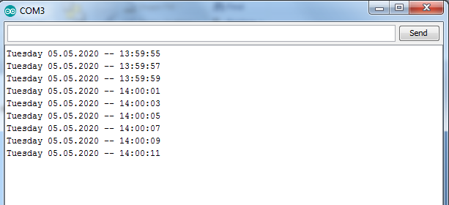
Test 01
void loop()
{
// Send Day-of-Week
Serial.print(rtc.getDOWStr());
Serial.print(" ");
// Send date
Serial.print(rtc.getDateStr());
Serial.print(" -- ");
// Send time
Serial.println(rtc.getTimeStr());
// Wait one second before repeating :)
delay (2000);
}

Slide 7
Test 02
#include <DS3231.h>
// Init the DS3231 using the hardware interface
DS3231 rtc(SDA, SCL);
// Init a Time-data structure
Time t;
void setup()
{
pinMode(13, OUTPUT);
// Setup Serial connection
Serial.begin(9600);
// Uncomment the next line if you are using an Arduino Leonardo
//while (!Serial) {}
// Initialize the rtc object
rtc.begin();
// The following lines can be uncommented to set the date and time
//rtc.setDOW(SUNDAY); // Set Day-of-Week to SUNDAY
//rtc.setTime(13, 50, 00); // Set the time to 12:00:00 (24hr format)
//rtc.setDate(03, 05, 2020); // Set the date to January 1st, 2014
}

Slide 8
Test 02
void loop()
{
// Get data from the DS3231
t = rtc.getTime();
// Send date over serial connection
Serial.print("Today is the ");
Serial.print(t.date, DEC); // date
Serial.print(". day of ");
Serial.print(rtc.getMonthStr()); // rtc.getMonthStr()
Serial.print(" in the year ");
Serial.print(t.year, DEC); // year
Serial.println(".");
// Send Day-of-Week and time
Serial.print("It is the ");
Serial.print(t.dow, DEC);
Serial.print(". day of the week (counting monday as the 1th), and it has passed ");
Serial.print(t.hour, DEC);
Serial.print(" hour(s), ");
Serial.print(t.min, DEC);
Serial.print(" minute(s) and ");
Serial.print(t.sec, DEC);
Serial.println(" second(s) since midnight.");

Slide 9
Test 02
// Send a divider for readability
Serial.println(" - - - - - - - - - - - - - - - - - - - - -");
// Wait one second before repeating :)
delay (1000);
if (t.hour>0 && t.hour<7){
Serial.println("NIGHT");
}
if (t.hour>=7 && t.hour<10){
Serial.println("MORNING");
}
if (t.hour>=10 && t.hour<18){
Serial.println("DAY");
}
if (t.hour>=18 && t.hour<24){
Serial.println("EVENING");
}
delay(1000);
Serial.println(rtc.getTemp());
delay(1000);
}

Slide 10
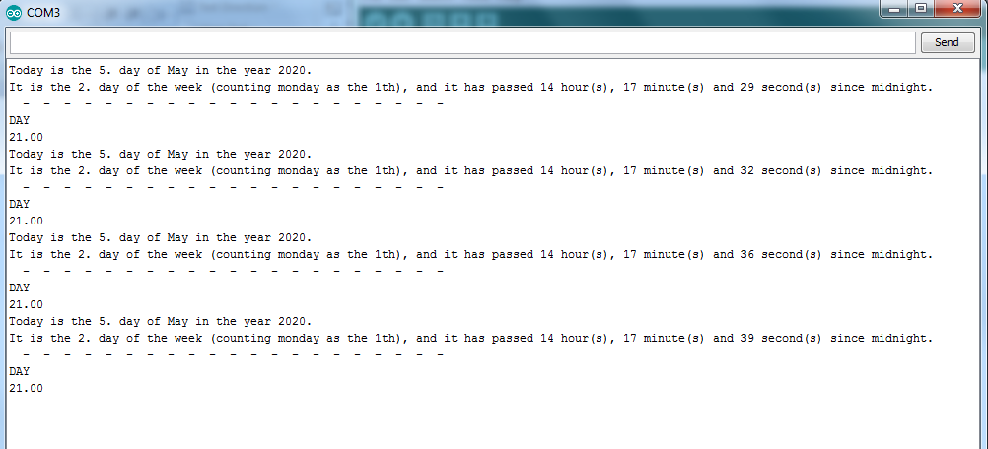
Test 02

Slide 11
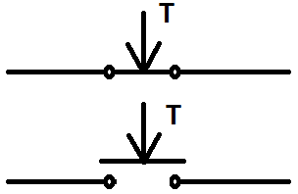
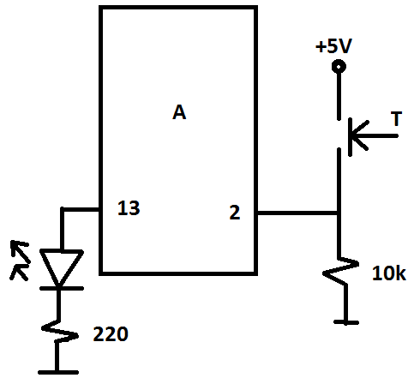
Bounce
const int buttonPin = 2;
const int ledPin = 13;
int ledState = LOW;
boolean buttonState = LOW;
int numPress = 0;
void setup() {
pinMode(ledPin, OUTPUT);
pinMode(buttonPin, INPUT);
}
void loop() {
if(digitalRead(buttonPin)==HIGH && buttonState==LOW){
numPress++;
buttonState = HIGH;
}
if(digitalRead(buttonPin)==LOW && buttonState==HIGH){
buttonState=LOW;
}
if(numPress == 10){
digitalWrite(ledPin, HIGH);
}
}
Buttonstate -> HIGH
Buttonstate -> LOW

Slide 13
Debounce
const int ledPin = 13;
int ledState = LOW;
boolean buttonState = LOW;
int numPress = 0;
void setup() {
pinMode(ledPin, OUTPUT);
pinMode(buttonPin, INPUT);
}
void loop() {
if(debounceButton(buttonState)==HIGH && buttonState==LOW){
numPress++;
buttonState = HIGH;
}
//else{
if(debounceButton(buttonState)==LOW && buttonState==HIGH){
buttonState=LOW;
}
//}
if(numPress == 10){
digitalWrite(ledPin, HIGH);
}
}
boolean debounceButton(boolean state){
boolean stateNow = digitalRead(buttonPin);
if(state != stateNow){
delay(10);
stateNow = digitalRead(buttonPin);
}
return stateNow;
}

Slide 14
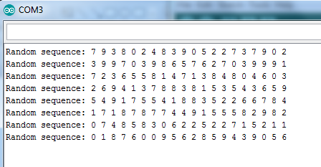
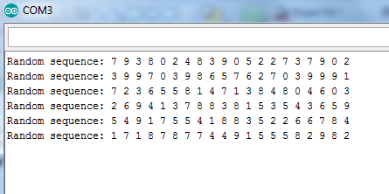
“Slučajna” sekvenca brojeva
int myRandomArray[100];
void setup() {
Serial.begin(9600);
}
void loop() {
Serial.print("Random sequence: ");
for(int i=1; i<21; i++){
myRandomArray[i-1]=random(10);
Serial.print(myRandomArray[i-1]);
Serial.print(" ");
}
Serial.println("");
delay(1000);
}
Prvo izvršavanje
Drugo izvršavanje

Slide 15
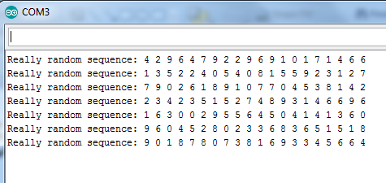
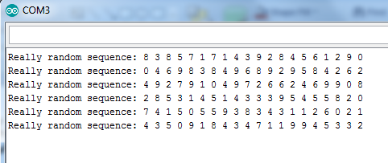
Slučajna sekvenca brojeva
int myRandomArray[100];
void setup() {
pinMode(A0, INPUT);
randomSeed(analogRead(A0));
Serial.begin(9600);
}
void loop() {
Serial.print("Really random sequence: ");
for(int i=1; i<21; i++){
myRandomArray[i-1]=random(10);
Serial.print(myRandomArray[i-1]);
Serial.print(" ");
}
Serial.println("");
delay(1000);
//while(true);
}
Prvo izvršavanje
Drugo izvršavanje

Slide 16
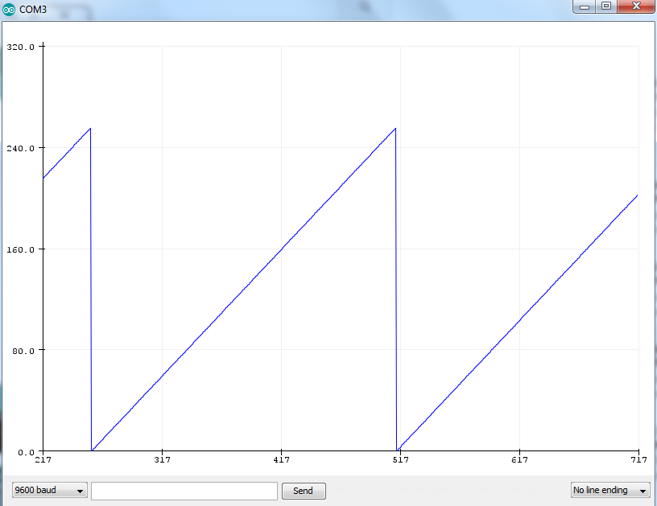
Serial plotter
// Sawtooth
byte b=0;
void setup() {
Serial.begin(9600);
}
void loop() {
Serial.println(b++);
delay(20);
}

Slide 17
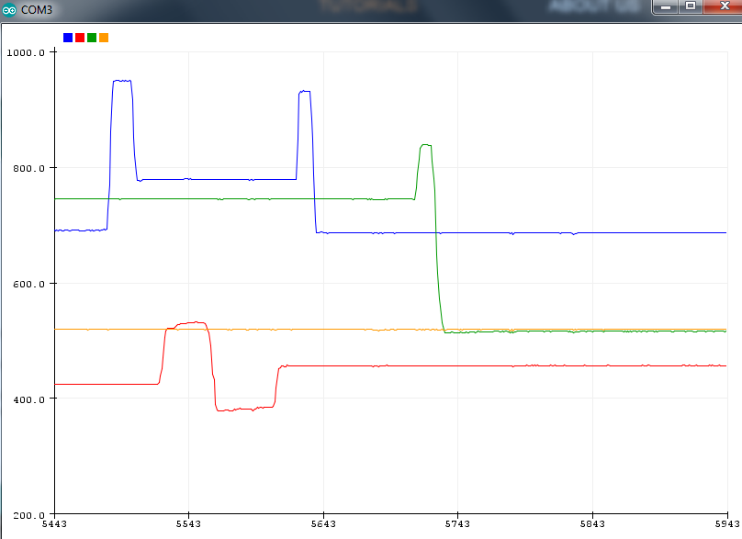
Serial plotter
void setup() {
Serial.begin(9600);
}
void loop() {
int y1 = analogRead(A0);
int y2 = analogRead(A1);
int y3 = analogRead(A2);
int y4 = analogRead(A3);
Serial.print(y1);
Serial.print(" ");
Serial.print(y2);
Serial.print(" ");
Serial.print(y3);
Serial.print(" ");
Serial.println(y4);
delay(100);
}

Slide 18
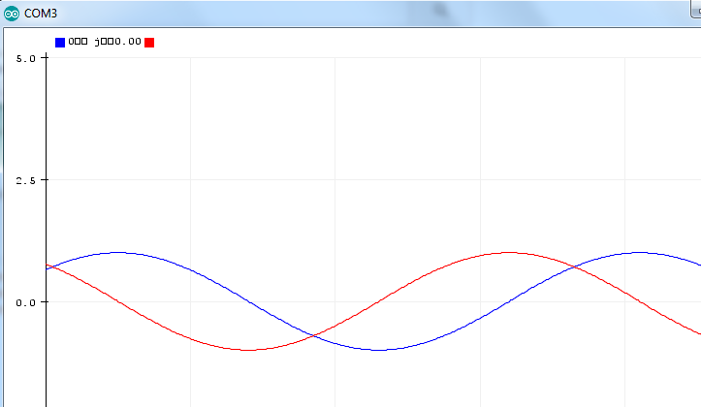
Serial plotter
void setup() {
Serial.begin(9600);
}
void loop() {
for(int j=0; j<360; j++){
Serial.print(sin(j*(PI/180)));
Serial.print(" ");
Serial.println(cos(j*(PI/180)));
}
}

