Slide 1
Kockica za bacanje

Slide 2
Hardver

Slide 3
Programski kod
//Pin to to turn dice on & off
int button = 2;
//LED for DICE
int bottomLeft = 3;
int middleLeft = 4;
int upperLeft = 5;
int middle = 6;
int bottomRight = 7;
int middleRight = 8;
int upperRight = 9;
int state = 0;
long randNumber;
//Initial setup
void setup(){
pinMode(bottomLeft, OUTPUT);
pinMode(middleLeft, OUTPUT);
pinMode(upperLeft, OUTPUT);
pinMode(middle, OUTPUT);
pinMode(bottomRight, OUTPUT);
pinMode(middleRight, OUTPUT);
pinMode(upperRight, OUTPUT);
pinMode(button, INPUT);
Serial.begin(9600);
randomSeed(analogRead(0));
}
void loop(){
//Read our button if high then run dice
if (digitalRead(button) == HIGH && state == 0){
state = 1;
randNumber = random(1, 7);
delay(100);
Serial.println(randNumber);

Slide 4
Programski kod
if (randNumber == 6){
six();
}
if (randNumber == 5){
five();
}
if (randNumber == 4){
four();
}
if (randNumber == 3){
three();
}
if (randNumber == 2){
two();
}
if (randNumber == 1){
one();
}
delay(5000);
clearAll();
state = 0;
}
}
//Create a function for each of our
"sides" of the die
void six()
{
digitalWrite(bottomLeft, HIGH);
digitalWrite(middleLeft, HIGH);
digitalWrite(upperLeft, HIGH);
digitalWrite(bottomRight, HIGH);
digitalWrite(middleRight, HIGH);
digitalWrite(upperRight, HIGH);
}
void five()
{
digitalWrite(upperLeft, HIGH);
digitalWrite(bottomLeft, HIGH);
digitalWrite(middle, HIGH);
digitalWrite(upperRight, HIGH);
digitalWrite(bottomRight, HIGH);
}
void four()
{
digitalWrite(upperLeft, HIGH);
digitalWrite(bottomLeft, HIGH);
digitalWrite(upperRight, HIGH);
digitalWrite(bottomRight, HIGH);
}
void three()
{
digitalWrite(upperLeft, HIGH);
digitalWrite(middle, HIGH);
digitalWrite(bottomRight, HIGH);
}
void two()
{
digitalWrite(bottomRight, HIGH);
digitalWrite(upperLeft, HIGH);
}
void one(){
digitalWrite(middle, HIGH);
}

Slide 5
Programski kod
void clearAll(){
digitalWrite(bottomLeft, LOW);
digitalWrite(middleLeft, LOW);
digitalWrite(upperLeft, LOW);
digitalWrite(middle,LOW);
digitalWrite(bottomRight, LOW);
digitalWrite(middleRight, LOW);
digitalWrite(upperRight, LOW);
}

Slide 6
Arduino memory
FLASH 32kB, stores the compiled sketch, 10.000 write cycles
RAM 2kB (volatile)
EEPROM 1kB, 100.000 write cycles
After compile:
Sketch uses 444 bytes (1%) of program storage space. Maximum is 32256 bytes.
Global variables use 9 bytes (0%) of dynamic memory, leaving 2039 bytes for local variables. Maximum is 2048 bytes.

Slide 7
EEPROM
EEPROM – Electrically Erasable Programmable Read-Only Memory
Non-volatile (data stays)
Developed in 1973, patented by NEC in 1975
Two transistors per bit (SLOW)
Serial or parallel data bus
Microcontroller - Internal EEPROM

Slide 8
EEPROM
ROM – burned at factory
EPROM – user programmed, UV light, special EPROM burner
EEPROM – electrically erased, no burned, in-circuit programming
Limited number of re-writes
Typical 100.000-2.000.000
Data remains 10 years at room temperature

Slide 9
EEPROM pot update
#include <EEPROM.h>
int address = 0;
void setup() {
}
void loop() {
int val = analogRead(0) / 4;
EEPROM.update(address, val);
address = address + 1;
if (address = EEPROM.length()){
address = 0;
}
delay(100);
}

Slide 10
EEPROM pot read
#include <EEPROM.h>
// start reading from the first byte (address 0) of the EEPROM
int address = 0;
byte value;
void setup() {
// initialize serial and wait for port to open:
Serial.begin(9600);
while (!Serial) {
}
}
void loop() {
// read a byte from the current address of the EEPROM
value = EEPROM.read(address);
Serial.print(address);
Serial.print("\t");
Serial.print(value, DEC);
Serial.println();
address = address + 1;
if (address == EEPROM.length()) {
address = 0;
}
delay(50);
}

Slide 11
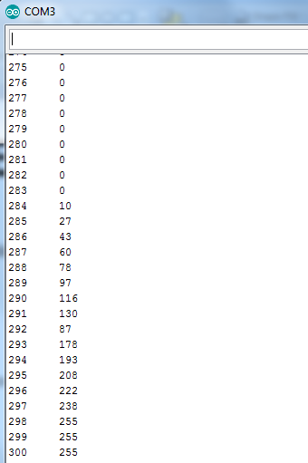
EEPROM pot Serial

Slide 12
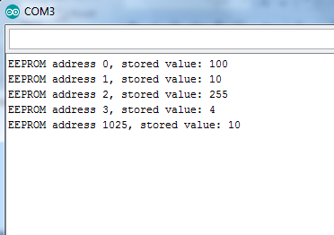
EEPROM test
#include <EEPROM.h>
void setup() {
// put your setup code here, to run once:
Serial.begin(9600);
EEPROM.write(0, 100);
EEPROM.write(1, 'A');
EEPROM.write(2, 255);
EEPROM.write(3, 260);
EEPROM.write(1025, 10);
delay(3000);
}
void loop() {
// put your main code here, to run repeatedly:
Serial.print("EEPROM address 0, stored value: ");
Serial.println(EEPROM.read(0));
Serial.print("EEPROM address 1, stored value: ");
Serial.println(EEPROM.read(1));
Serial.print("EEPROM address 2, stored value: ");
Serial.println(EEPROM.read(2));
Serial.print("EEPROM address 3, stored value: ");
Serial.println(EEPROM.read(3));
Serial.print("EEPROM address 1025, stored value: ");
Serial.println(EEPROM.read(1025));
delay(2000);
Serial.println(" ");
while(true);
}

Slide 13
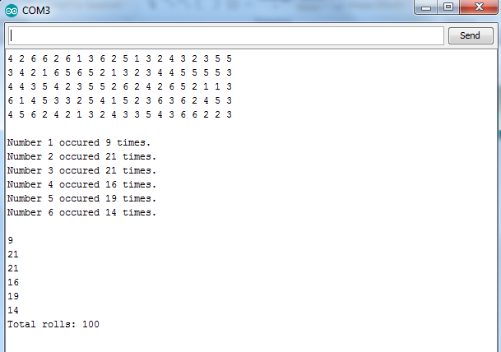
Dice 100 rolls

Slide 14
Program code
// EEPROM dice
// Roll the dice 100 times, store each roll into EEPROM (address 0-99).
// Calculate which number occurred how many times.
#include <EEPROM.h>
byte diceRolledNumbers [6]={0,0,0,0,0,0};
void setup() {
randomSeed(analogRead(A0));
Serial.begin(9600);
}
void loop() {
for(int i=1; i<101; i++){
byte currentNum = random(1, 7);
EEPROM.write(i-1, currentNum);
if (currentNum==1){
diceRolledNumbers[0]++;
}
if (currentNum==2){
diceRolledNumbers[1]++;
}
if (currentNum==3){
diceRolledNumbers[2]++;
}
if (currentNum==4){
diceRolledNumbers[3]++;
}
if (currentNum==5){
diceRolledNumbers[4]++;
}
if (currentNum==6){
diceRolledNumbers[5]++;
}
}

Slide 15
Program code
for (int i=1; i<101; i++){
Serial.print(EEPROM.read(i-1));
Serial.print("");
if ((i%20)==0){
Serial.println(" ");
}
}
Serial.println("");
for (int j=1; j<7; j++){
Serial.print("Number ");
Serial.print(j);
Serial.print(" occured ");
Serial.print(diceRolledNumbers[j-1]);
Serial.println(" times.");
}
Serial.println("");
int rollSum = 0;
for (int k=1; k<7; k++){
rollSum=rollSum+diceRolledNumbers[k];
}
Serial.println(diceRolledNumbers[0]);
Serial.println(diceRolledNumbers[1]);
Serial.println(diceRolledNumbers[2]);
Serial.println(diceRolledNumbers[3]);
Serial.println(diceRolledNumbers[4]);
Serial.println(diceRolledNumbers[5]);
while(true);
}

