Slide 1

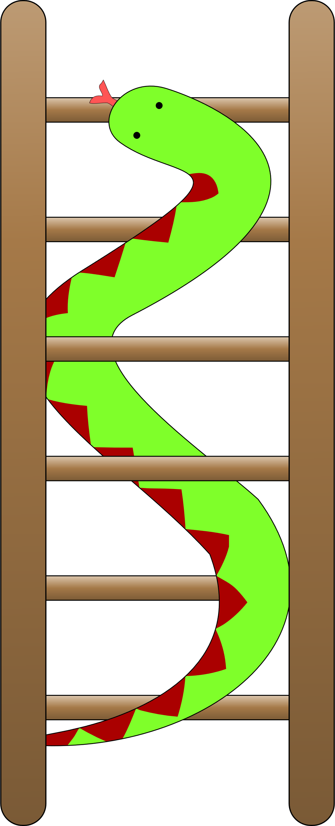
Snakes and ladders
David Kendell
Mayk Al-Ghrawi

Slide 2
Problems to solve
Representing the dice roll
Representing the board
Player
Snakes
Ladders
Squares
Logic for traversal of the board (moving across, moving up)
Moving across horizontally w.r.t. row player is on based on dice roll (positive/negative increments)
Moving vertically when you reach the end of the row
Moving up when you land on a ladder
Moving down when you land on a snake
Player turn switching
Win condition (staying still if you didn’t hit exactly from your position on the last row or winning when you do)

Slide 3
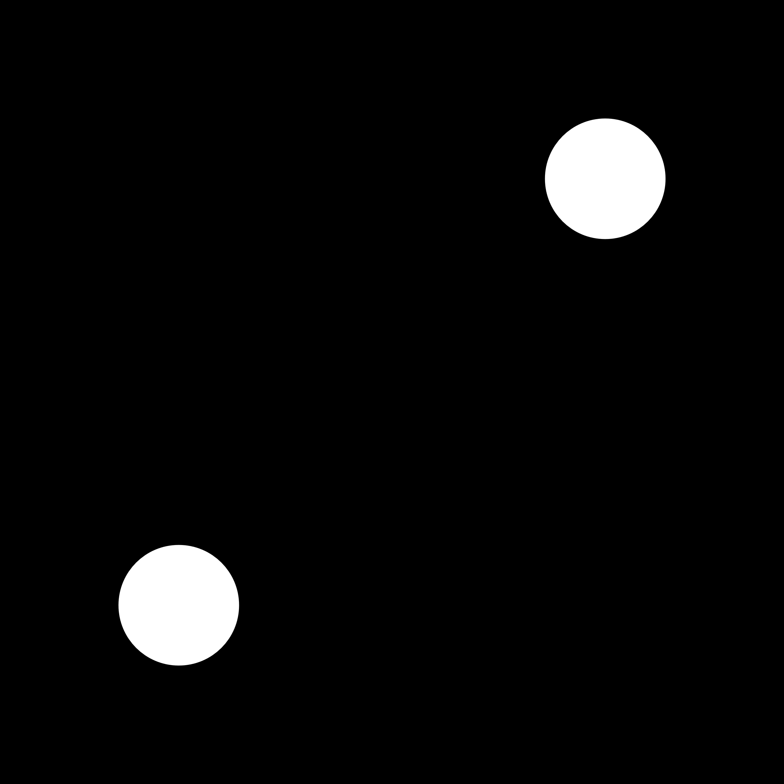
Representing the dice roll
Solution:
Generate random number between 0 and RAND_MAX (essentially max int).
Generated number modulus 6 and add 1. (add 1 because a dice roll can’t be 0).
Save to int variable.
Example:
Generate 1312 -> 1312 % 6 = 4 -> 4 + 1 = 5
You rolled a 5.
Generate 36 -> 36 % 6 = 0 -> 0 + 1 = 1
You rolled a 1.

Slide 4
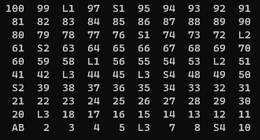
Representing the board
Player A denoted by character ‘A’, Player B denoted by character ‘B’.
Squares represented by characters between 1-100
Ladders represented by odd characters between 101-107
Snakes represented by even characters between 102-106
*Character variable can hold 1 byte which is 8 bits, 2^8=256 so it can represent numbers from: -128 -> 127

Slide 5
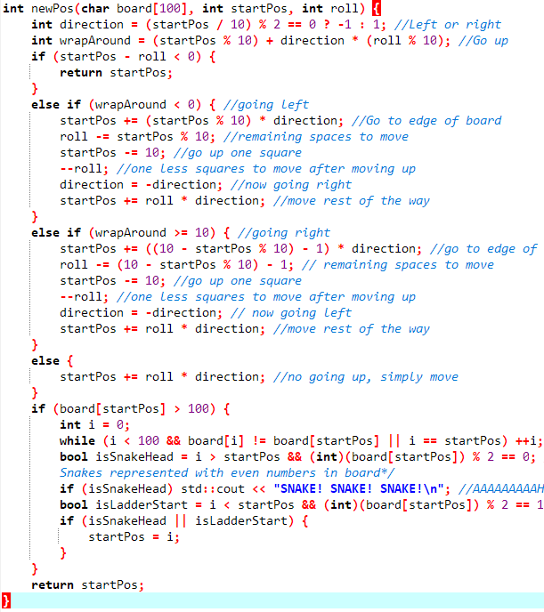
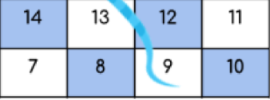
Logic traversal of the board
The first two lines of the function calculate the direction the player is moving in based on the starting position. If the starting position is on an even row (i.e. 0-9, 20-29, 40-49, 60-69, or 80-89), the direction will be set to -1 (left), and if it's on an odd row (i.e. 10-19, 30-39, 50-59, 70-79, or 90-99), the direction will be set to 1 (right).
If the new position is off the left side of the board, the function will move the player to the edge of the board, then up one row, then move the remaining number of squares. If the new position is off the right side of the board, the function will move the player to the edge of the board, then up one row, then move the remaining number of squares. If the new position is still on the board, the function will simply move the player the number of squares indicated by the roll.
The final section of the function checks if the new position is the start of a snake or the start of a ladder.
Example: Player A [position : 7 | Index: 96 | rolls: 6 |
Index: 96

Slide 6
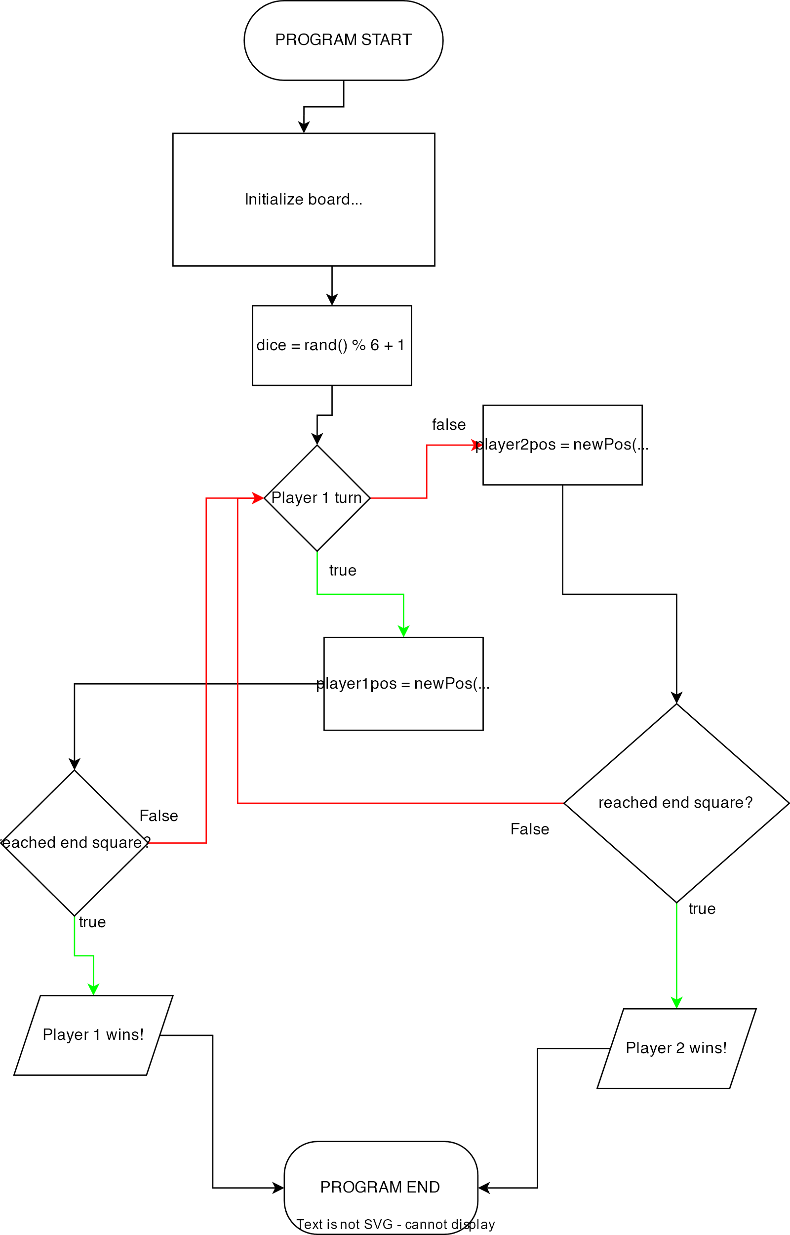
Main function game loop
A character array called board is defined with 100 elements. Each element of the array represents a square on the board, and its value indicates the number of the square that the player will reach after climbing a ladder or descending a snake.
The initial position of both players is set to 90.
The game loop starts with a while statement that runs as long as the user does not enter the character 'q'.
Inside the loop, the printBoard function is called to display the current state of the board, showing the positions of the two players.
A do-while loop is used to allow each player to take turns rolling the die and moving their token across the board.
The newPos function is called to calculate the new position of the player after rolling the die.
After each turn, the printBoard function is called again to display the updated positions of both players.
The do-while loop continues until one of the players reaches the last square on the board, which is square number 0.
The player who reaches square number 0 first wins the game.
The user is prompted to enter the character 'q' to quit the game or any other character to play again.

