Slide 1
NXP POWERPOINT TEMPLATE SECRET
GUIDELINES FOR PRESENTATIONS
PRESENTERS NAME
SUBJECT OF PRESENTATION
PROJECT NAME
DAY, MONTH, YEAR

Slide 2
COMPANY SECRET
Secret information is information which is known only to a special and usually small group, has high business value, and which NXP desires, or is legally obliged to, keep secret and which may cause severe damage to NXP or its staff by unauthorized use and/or disclosure.
Some Examples:
Domain | Information
Customers | Financial information such as credit limits, solvability checks and - reports, payment terms and conditions, confidential and critical customer information
Suppliers | Financial information as solvency checks, payment terms, confidential and critical supplier information
Finance | Financial reports before release M&A plans and data before announcement
Sales | New pricing tables (not published) Investment reports
R&D | New research programs
HR | M&A data

Slide 3
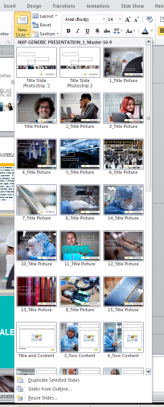
ALTERNATIVE TITLE SLIDE WITH FULL PAGE IMAGE
SELECT FROM THE NEW SLIDE DROP-DOWN

Slide 4
TALENT

Slide 5
ONE FOCUS
ONE NXP

Slide 6
TALENT –
ONE FOCUS, ONE NXP
Talent is at our heart: finding and keeping it is essential to our growth. NXP HR is tasked with enabling every employee to be the best that they can be. This helps create a high performance environment, where performance is rewarded, and potential talent is attracted

Slide 7
ENGAGEMENT

Slide 8
GLOBAL CONNECTIONS,
POSITIVE ASPIRATIONS

Slide 9
ENGAGEMENT –
GLOBAL CONNECTIONS, POSITIVE ASPIRATIONS
Engaged employees are connected to their work, with pride, understanding of company goals and a real sense of teamwork. NXP is committed to enhancing engagement, encouraging employees to align with company values and mission. This enriches the positive culture of the company, while boosting productivity.

Slide 10
THE NXP BRAND

Slide 11
A UNIQUE ICON
ON THE LEADING EDGE

Slide 12
THE NXP BRAND –
A UNIQUE ICON ON THE LEADING EDGE
NXP stands for quality and excellence, innovation, agility in thinking, responsiveness and honesty. To employees, partners and customers alike, we represent the leading edge of technology. We pride ourselves on fresh thinking, bold design, as a leading example of a strong employer- and customer-focused brand

Slide 13
INNOVATION

Slide 14
CREATING
THE FUTURE

Slide 15
INNOVATION –
CREATING THE FUTURE
Innovation protects our competitive edge, influencing the unique applications that positively affect modern life. We work in the future of energy efficiency, connected devices, security and health. By aligning our innovations to these areas, we key into growth-market revenue streams for NXP and our customers.

Slide 16
RESEARCH & DEVELOPMENT

Slide 17
THE LIFE-BLOOD
OF OUR BRAND

Slide 18
RESEARCH & DEVELOPMENT –
THE LIFE-BLOOD OF OUR BRAND
We overcome multiple challenges in our many markets. Making this possible in a timely manner is our strong global R&D network. Our 6 testing / R&D sites serve more than 3,000 dedicated R&D professionals and design engineering teams in 21 locations—for customers across the world.

Slide 19
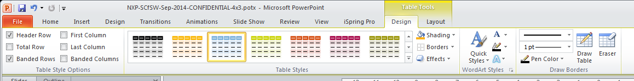
Quickly change table style colours within NXP Palette

Slide 20
Quickly change table style colours within NXP Palette

Slide 21
Quickly change table style colours within NXP Palette

Slide 22
Chart 1

Slide 23
Chart 2

