Slide 1
EN.601.414/614 Computer Networks Exercise and Lab
Xin Jin
Fall 2020 (TuTh 1:30-2:45pm on Zoom)
https://github.com/xinjin/course-net
Notes:
Slides adapted from similar courses at Princeton, Stanford, UC Berkeley, University of Michigan, etc.

Slide 2
True or False
The Internet is a network of networks. The Internet ties together different networks with the TCP protocol.

Slide 3
True or False
The Internet is a network of networks. The Internet ties together different networks with the TCP protocol.
False. With the IP protocol.

Slide 4
True or False
End-systems and networks are connected by switches, instead of directly connecting them.

Slide 5
True or False
End-systems and networks are connected by switches, instead of directly connecting them.
True. This is for scalability. Directly connecting N nodes to each other would require N² links.

Slide 6
True or False
End-systems, switches and routers implement all five layers.

Slide 7
True or False
End-systems, switches and routers implement all five layers.
False. Switches only implement physical and datalink layers, and routers only implement physical, datalink and network layers.

Slide 8
True or False
HTTP is a stateless protocol. As a result, there is no way to keep state.

Slide 9
True or False
HTTP is a stateless protocol. As a result, there is no way to keep state.
False. We can use cookies.

Slide 10
True or False
CDNs are only useful for web pages that contain static content.

Slide 11
True or False
CDNs are only useful for web pages that contain static content.
False. They can still serve the static parts of a web page that also includes dynamic content. Moreover, some CDNs can perform some dynamic processing on behalf of the content provider.

Slide 12
Network Measurement
Two end-points (A and B) communicate by a path of 5 routers. The packet size is 1500 bytes. The distance between A and B is 6000 km. The bit propagation speed is 2x10⁸ m/s. Assume 1 Mb/s = 10⁶ bit/s and 1 Gb/s = 10⁹ bit/s.
(1) What are the four components to evaluate network delay?
(2) Assume there is no queueing delay and processing delay. Assume all links run at 10Mb/s. What is the end-to-end delay (one way, not round trip) for sending a packet?
(3) Assume there is no queueing delay and processing delay. Assume all links run at 10Gb/s. What is the end-to-end delay (one way, not round trip) for sending a packet?
(4) Assume there is no processing delay. Assume all links run at 10Mb/s. Assume the buffer size in each router is 10 packets. What is the maximum end-to-end delay (one way, not round trip) for sending a packet?

Slide 13
Network Measurement
Two end-points (A and B) communicate by a path of 5 routers. The packet size is 1500 bytes. The distance between A and B is 6000 km. The bit propagation speed is 2x10⁸ m/s. Assume 1 Mb/s = 10⁶ bit/s and 1 Gb/s = 10⁹ bit/s.
(1) What are the four components to evaluate network delay?
Transmission delay, propagation delay, queuing delay, and processing delay.

Slide 14
Network Measurement
Two end-points (A and B) communicate by a path of 5 routers. The packet size is 1500 bytes. The distance between A and B is 6000 km. The bit propagation speed is 2x10⁸ m/s. Assume 1 Mb/s = 10⁶ bit/s and 1 Gb/s = 10⁹ bit/s.
(2) Assume there is no queueing delay and processing delay. Assume all links run at 10Mb/s. What is the end-to-end delay (one way, not round trip) for sending a packet?
Transmission delay = 1500x8 / (10x10⁶) = 1.2 ms
Propagation delay = 6000000/(2x10⁸) = 30 ms
Delay = propagation delay + transmission delay x 6 hops = 37.2 ms

Slide 15
Network Measurement
Two end-points (A and B) communicate by a path of 5 routers. The packet size is 1500 bytes. The distance between A and B is 6000 km. The bit propagation speed is 2x10⁸ m/s. Assume 1 Mb/s = 10⁶ bit/s and 1 Gb/s = 10⁹ bit/s.
(3) Assume there is no queueing delay and processing delay. Assume all links run at 10Gb/s. What is the end-to-end delay (one way, not round trip) for sending a packet?
Transmission delay = 1500x8 / (10x10⁹) = 0.0012 ms
Propagation delay = 6000000/(2x10⁸) = 30 ms
Delay = propagation delay + transmission delay x 6 hops = 30.0072 ms

Slide 16
Network Measurement
Two end-points (A and B) communicate by a path of 5 routers. The packet size is 1500 bytes. The distance between A and B is 6000 km. The bit propagation speed is 2x10⁸ m/s. Assume 1 Mb/s = 10⁶ bit/s and 1 Gb/s = 10⁹ bit/s.
(4) Assume there is no processing delay. Assume all links run at 10Mb/s. Assume the buffer size in each router is 10 packets. What is the maximum end-to-end delay (one way, not round trip) for sending a packet?
Transmission delay = 1500x8 / (10x10⁶) = 1.2 ms
Propagation delay = 6000000/(2x10⁸) = 30 ms
Queueing delay = 9 * 1.2 = 10.8ms
Delay = propagation delay + transmission delay x 6 hops + queueing delay x 5 routers = 91.2ms

Slide 17
HTTP Performance
A user would like to download 100 objects from the server using HTTP. There are a few different methods: one-at-a-time, concurrent (assume using 10 concurrent connections), persistent, and pipelined. Assume the RTT is 100 ms, and assume the objects are small objects. What are the latencies to download the objects with each method?

Slide 18
HTTP Performance
A user would like to download 100 objects from the server using HTTP. There are a few different methods: one-at-a-time, concurrent (assume using 10 concurrent connections), persistent, and pipelined. Assume the RTT is 100 ms, and assume the objects are small objects. What are the latencies to download the objects with each method?
One-at-a-time: 2 * RTT * 100 objects = 20 s
Concurrent: 2 * RTT * 100 objects / 10 concurrent connections = 2 s
Persistent: 2 * RTT (first object) + 1 * RTT * 99 (other objects) = 10.1 s
Pipelined: 2* RTT = 200ms

Slide 19
HTTP Performance
Now assume the objects are large. All objects have the same size of 100 MB (i.e., 10⁸ bytes). Assume the bandwidth for each TCP connection is 10 Mb/s (i.e., 10⁷ bit/s). What are the latencies to download the objects with each method?

Slide 20
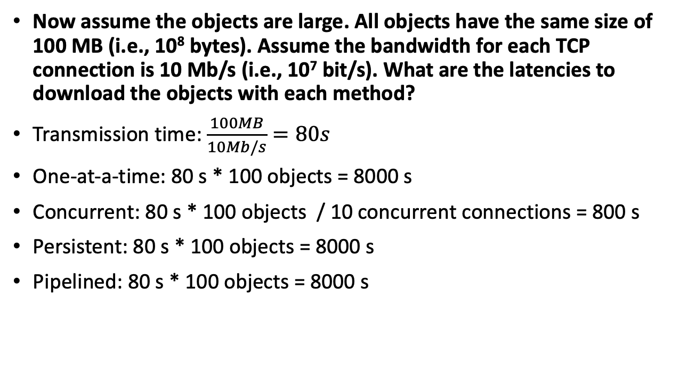
HTTP Performance
Now assume the objects are large. All objects have the same size of 100 MB (i.e., 10⁸ bytes). Assume the bandwidth for each TCP connection is 10 Mb/s (i.e., 10⁷ bit/s). What are the latencies to download the objects with each method?
Transmission time: $\frac{100MB}{10Mb/s}=80s$
One-at-a-time: 80 s * 100 objects = 8000 s
Concurrent: 80 s * 100 objects / 10 concurrent connections = 800 s
Persistent: 80 s * 100 objects = 8000 s
Pipelined: 80 s * 100 objects = 8000 s

Slide 21
Assignment Tips
Do I get a full score?
Pass all test cases in test_client_server.sh
What to submit?
4 files.
server-c.c, client-c.c
server-python.py, client-python.py

Slide 22
Assignment Tips
Search error messages on Google
Restart the VM
Don’t forget to compile C program
Notes:
For software issues, we recommend that you should check the first page of Google results before asking TAs, because TAs also need to search on Google.

Slide 23
Assignment Tips
How to read stdin?
n = fread(buffer, sizeof(char), SEND_BUFFER_SIZE, stdin)
buffer = sys.stdin.read(SEND_BUFFER_SIZE)
Why does my program fail on BINARY message?
There might be characters like EOL(\n) or NULL(\0)

Slide 24
Thanks! Q&A

