Slide 1
EN.601.414/614 Computer Networks Data Link Layer
Xin Jin
Fall 2020 (TuTh 1:30-2:45pm on Zoom)
https://github.com/xinjin/course-net
Notes:
Slides adapted from similar courses at Princeton, Stanford, UC Berkeley, University of Michigan, etc.

Slide 2
Agenda
Data link layer

Slide 3
Data link layer
Present everywhere
Transfers data between adjacent nodes or between nodes on the same local area network
Application
Application
Transport
Transport
Network
Network
Network
Datalink
Datalink
Datalink
Physical
Physical
Physical
End system
Switch
End system

Slide 4
Data link layer
Provides four primary services
Framing
Encapsulates network layer data
Link access
Medium access control (MAC) protocol defines when to transmit frames
Reliable delivery
Primarily for mediums with high error rates (e.g., wireless)
Error detection and correction

Slide 5
Packets are now “frames”
data
sending
node
link layer protocol
receiving
node
frame
frame
network
adaptor
network
adaptor
Frames encapsulate network layer packets
Link layer protocols are implemented in h/w
Frame formats can change based on link layer protocol

Slide 6
Point-to-point vs. broadcast medium
Point-to-point: dedicated pairwise communication
E.g., long-distance fiber link
E.g., point-to-point link b/n Ethernet switch and host
Broadcast: shared wire or wireless medium
Traditional Ethernet (pre ~2000)
802.11 wireless LAN

Slide 7
Multiple access algorithm
Context: a shared broadcast channel
Must avoid having multiple nodes speaking at once
Otherwise, collisions lead to garbled data
Need distributed algorithm to determine which node can transmit
Three classes of techniques
Channel partitioning: divide channel into pieces
Taking turns: scheme for deciding who transmits
Random access: allow collisions, and then recover
More in the Internet style!

Slide 8
Random access MAC protocols
When node has packet to send
Transmit at full channel data rate w/o coordination
Two or more transmitting nodes ⇒ collision
Data lost
Random access MAC protocol specifies
How to detect and recover from collisions
Examples
ALOHA and Slotted ALOHA
CSMA, CSMA/CD, CSMA/CA (wireless)

Slide 9
Ethernet
Invented as a broadcast technology
Hosts share channel
Each packet received by all attached hosts
CSMA/CD for media access control
Modern Ethernets are “switched” (later)
Point-to-point links between switches and between a host and switch
No sharing ⇒ no CSMA/CD
Uses “self learning” and “spanning tree” algorithms for routing

Slide 10
CSMA (Carrier Sense Multiple Access)
CSMA: listen before transmit
If channel sensed idle: transmit entire frame
If channel sensed busy, defer transmission
Human analogy: don’t interrupt others!
Does not eliminate all collisions
Why?

Slide 11
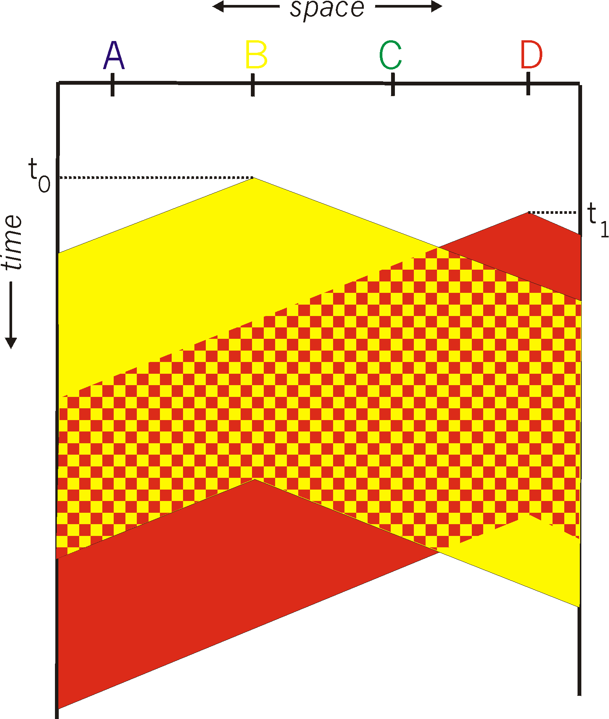

CSMA collisions
Propagation delay: two nodes may not hear each other before sending
CSMA reduces but does not eliminate collisions
Collision: entire packet transmission time wasted
Distance and propagation delay affect collision probability
Spatial layout of nodes

Slide 12
CSMA/CD (Collision Detection)
CSMA/CD: carrier sensing, deferral as in CSMA
Collisions detected within short time
Colliding transmissions aborted, reducing wastage
Collision detection easy in wired (broadcast) LANs
Compare transmitted, received signals
Collision detection difficult in wireless LANs
Later!
Notes:
wireless: because reception while tx is difficult . broadcast isn’t perfect so collisions local

Slide 13
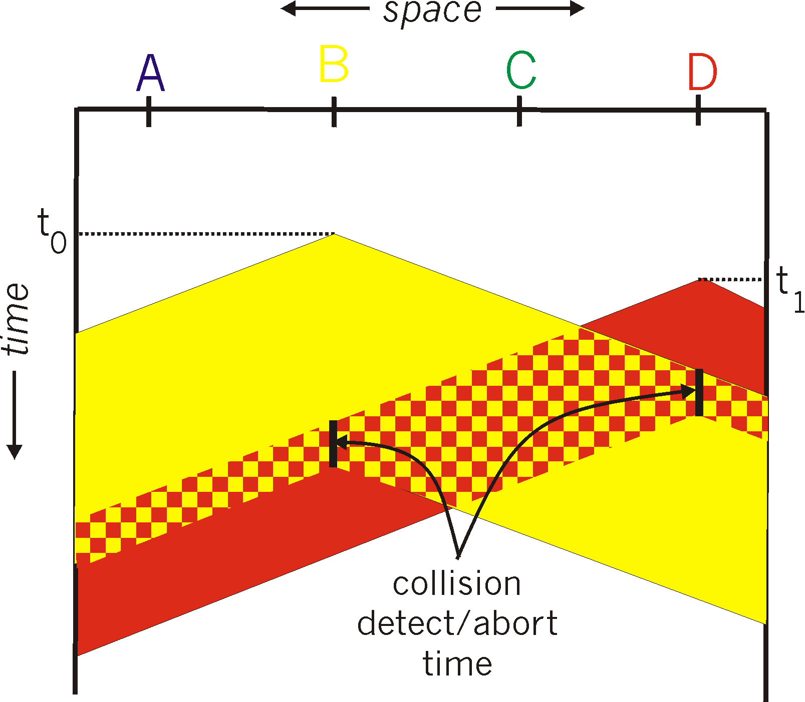
CSMA/CD (Collision Detection)
For this to work, need restrictions on minimum frame size and maximum distance
Why?
Spatial layout of nodes

Slide 14
Limits on CSMA/CD network length
A
B
latency d
Latency depends on physical length of link
Time to propagate a frame from one end to other
Suppose A sends a frame at time t
And B sees an idle line at a time just before t + d
… so B happily starts transmitting a frame
B detects a collision, and sends jamming signal
But A cannot see collision until t + 2d

Slide 15
Limits on CSMA/CD network length
A
B
latency d
A needs to wait for time 2d to detect collision
So, A should keep transmitting during this period
AND keep an eye out for a possible collision
Imposes restrictions; e.g., for 10 Mbps Ethernet
Maximum length of the wire: 2,500 meters
Minimum length of a frame: 512 bits (64 bytes)

Slide 16
Three key ideas of random access
Carrier sense
Listen before speaking and don’t interrupt
Checking if someone else is already sending data
… and waiting till the other node is done
Collision detection
If someone else starts talking at the same time, stop
Make sure everyone knows there was a collision!
Realizing when two nodes are transmitting at once
…by detecting that the data on the wire is garbled

Slide 17
Three key ideas of random access
Randomness
Don’t start talking again right away
Waiting for a random time before trying again

Slide 18
How long should you wait?
Should it be immediate?
Should it be a random number with a fixed distribution?

Slide 19
Ethernet: CSMA/CD Protocol
Carrier sense: wait for link to be idle
Collision detection: listen while transmitting
No collision: transmission is complete
Collision: abort transmission & send jam signal
Random access: binary exponential back-off
After collision, wait a random time before retrying
After m^{th} collision, choose K randomly from {0, …, 2^{m}-1}
Wait for K*512 bit times before trying again
If transmission occurring when ready to send, wait until end of transmission (CSMA)

Slide 20
Efficiency of CSMA/CD
Efficiency is defined as the long-run fraction of time during which frames are being transmitted without collision
d_{prop} = max propagation time between two adapters
d_{trans} = time to transmit a max-sized frame
1
Efficiency ≈
1 + 5 d_{prop} / d_{trans}

Slide 21
Efficiency of CSMA/CD
d_{prop} → 0
Efficiency approaches 1
Colliding nodes abort immediately
d_{trans} → ∞
Efficiency approaches 1
Each frames uses the channel for a long time
d_{trans}
Efficiency ≈
d_{trans} + 5 d_{prop}

Slide 22
Switched Ethernet

Slide 23
Broadcast vs. switched Ethernet
Invented as a broadcast technology
Hosts share channel
Each packet received by all attached hosts
CSMA/CD for media access control
Modern Ethernets are “switched”
Point-to-point links between switches and between a host and switch
No sharing ⇒ no CSMA/CD
Uses “self learning” and “spanning tree” algorithms for routing

Slide 24

Why switched Ethernet?
Enables concurrent communication
Host A can talk to C, while B talks to D
No collisions and no need for CSMA/CD
No constraints on link lengths, etc.
B
A
C
Ethernet switch
D

Slide 25
The evolution of Ethernet
Changed almost everything except the frame format
From the shared media coax cables to dedicated links
From 3 Mbit/s to 100 Gbit/s
From electrical signaling to optical
Lesson: the right interface can accommodate many changes
Evolve the implementation while maintaining the interface (backward compatibility)

Slide 26
Topics
Frames and framing
Addressing
Routing
Forwarding
Discovery

Slide 27
Ethernet “Frames”
Encapsulates IP datagram
Preamble: 7 bytes for clock synchronization and 1 byte to indicate start of frame
Addresses: 6 bytes
Type: 2 bytes, higher-layer protocol (e.g., IP)
Data payload: max 1500 bytes, min 46 bytes
CRC: 4 bytes for error detection
Preamble
Dst Address
Source Address
Data
CRC
type

Slide 28
Framing frames
Physical layer puts bits on a link
But, two hosts connected on the same physical medium need to be able to exchange frames
Service provided by the link layer
Implemented by the network adaptor
Framing problem: how does the link layer determine where each frame begins and ends?

Slide 29
Simple approach: Count bytes
Sender includes number of bytes in header
Receiver extracts this number of bytes of body
What if the Count field is corrupted?
L2 will frame the wrong bytes → a framing error
CRC tells you to discard this frame, but what about the next one?
53
Body
80
Body
53 bytes of data
80 bytes of data
Bogus count field
61
Body
80
???
Body
61 bytes of data misdelivered
??? bytes of data misdelivered

Slide 30
Desynchronization
Once framing on a link is desynchronized, it can stay that way
Need a method to resynchronize

Slide 31
Framing with sentinel bits
Delineate frame with special “sentinel” bit pattern
e.g., 01111110 ⇒ start, 01111111 ⇒ end
What if sentinel occurs within frame?
Solution: bit stuffing
Sender always inserts a 0 after five 1s in the frame contents
Receiver always removes a 0 appearing after five 1s
01111110
Frame contents
01111111
Notes:
6 one’s → start
7 one’s → end

Slide 32
When receiver sees five 1s…
If next bit 0, remove it; begin counting again
Because this must be a stuffed bit; we can’t be at beginning/end of frame (those had six or seven 1s)
If next bit 1 (i.e., we’ve seen six 1s) then:
If following bit is 0, this is start of frame
Because the receiver has seen 01111110
If following bit is 1, this is end of frame
Because the receiver has seen 01111111
01111110
Frame content
01111111

Slide 33
Example: sentinel bits
Original data, including start/end of frame:
01111110011111101111101111100101111111
Sender rule: five 1s → insert a 0
After bit stuffing at the sender:
01111110011111010111110011111000101111111
Receiver rule: five 1s and next bit 0 → remove 0
01111110011111101111101111100101111111

Slide 34
Topics
Frames and framing
Addressing
Routing
Forwarding
Discovery

Slide 35
Medium Access Control (MAC) Address
MAC address
Numerical address associated with a network adapter
Flat name space of 48 bits (e.g., 00-15-C5-49-04-A9 in HEX)
Unique, hard-coded in the adapter when it is built
Hierarchical Allocation
Blocks: assigned to vendors (e.g., Dell) by the IEEE
First 24 bits (e.g., 00-15-C5-**-**-**)
Adapter: assigned by the vendor from its block
Last 24 bits

Slide 36
MAC address vs. IP address
MAC Addresses
IP Addresses
Hard-coded when adapter is built
Flat name space of 48 bits (e.g., 00-0E-9B-6E-49-76)
Like a social security number
Portable, and can stay the same as the host moves
Used to get packet between interfaces on same network
Configured, or learned dynamically
Hierarchical name space of 32 bits (e.g., 12.178.66.9)
Like a postal mailing address
Not portable, and depends on where the host is attached
Used to get a packet to destination IP subnet

Slide 37
Topics
Frames and framing
Addressing
Routing
Forwarding
Discovery

Slide 38
Routing with switched Ethernet?
A_{MAC}
B_{MAC}
C_{MAC}
F_{MAC}
D_{MAC}
E_{MAC}

Slide 39
Why does Ethernet not use LS/DV?
Concerns over scalability
Flat MAC addresses cannot be aggregated like IP addresses
Legacy

Slide 40
“Routing” with broadcast Ethernet
A_{MAC}
B_{MAC}
C_{MAC}
D_{MAC}
E_{MAC}
F_{MAC}
Sender transmits frame onto broadcast link
Each receiver’s link layer passes the frame to the network layer:
If destination address matches the receiver’s MAC address OR if the destination address is the broadcast MAC address (ff:ff:ff:ff:ff:ff)

Slide 41
“Routing” with broadcast Ethernet
A_{MAC}
B_{MAC}
C_{MAC}
D_{MAC}
E_{MAC}
F_{MAC}
Ethernet is “plug-n-play”
A new host plugs into the Ethernet and is good to go
No configuration by users or network operators
Broadcast as a means of bootstrapping communication

Slide 42
Why does Ethernet not use LS/DV?
Concerns over scalability
Flat MAC addresses cannot be aggregated like IP addresses
Legacy
Backward compatibility with broadcast Ethernet
Desire to maintain Ethernet’s plug-n-play behavior
How broadcast Ethernet evolved

Slide 43
Routing in extended LANs
Local-Area Network (LAN)
Bridges relay broadcasts from one LAN to the other

Slide 44

The “broadcast storm” problem
Radia Perlman
Perlman’s idea: eliminate loops in the topology

Slide 45
Easiest way to avoid loops
Use a topology where loops are impossible!
Take arbitrary topology and build a spanning tree
Sub-graph that includes all vertices but contains no cycles
Links not in the spanning tree are not used to forward frames

Slide 46
Consider a graph

Slide 47
A spanning tree

Slide 48
Another spanning tree

Slide 49
Yet another spanning tree

Slide 50
Spanning tree protocol (Perlman’85)
Protocol by which bridges construct a spanning tree
Nice properties
Zero configuration (by operators or users)
Self healing
Still used today

Slide 51
From extended LANs to switched Ethernet

Slide 52
Switched Ethernet
Constraints (for backward compatibility)
No changes to end-hosts
Maintain plug-n-play aspect
Earlier Ethernet achieved plug-n-play by leveraging a broadcast medium
Can we do the same in a switched topology?

Slide 53
Group Discussion
Topic: Ethernet routing
How does Ethernet do routing? What are the pros and cons of the approach?
Discuss in groups, and each group chooses a leader to summarize the discussion
Everyone should speak.
Turn on your audio and video. Do not mute.

Slide 54
Summary
Data link layer transfers data between adjacent nodes or nodes connected to the same switch
Ethernet evolved from a broadcast medium to switched
Next week: Link layer wrap up + putting everything together

Slide 55
Thanks! Q&A

