Slide 1
EN.601.414/614 Computer Networks Software-Defined Networking
Xin Jin
Spring 2018 (TTh 12:00-1:15pm in Shaffer 301)
https://github.com/xinjin/course-net
Notes:
Slides adapted from similar courses at Princeton, Stanford, UC Berkeley, University of Michigan, etc.

Slide 2
Tutorial on Assignment 4
Exercise 1:
Write P4 code and replace the one under p4src
Add rules for your table to commands.txt
Exercise 2:
Write a new one (say) kv.p4
Create a new script based on run_demo.sh to run it
Debug:
Validate: p4-validate p4src/source_routing.p4
Compile: ~/proj4/p4c-bmv2/p4c_bm/__main__.py p4src/source_routing.p4 --json source_routing.json
Switch log: sudo ~/proj4/bmv2/tools/nanomsg_client.py --thrift-port 22222 > log

Slide 3
Agenda
Software-defined networking (SDN)

Slide 4
A tale of two planes
Data plane: forwarding packets
Based on local forwarding state
Control plane: computing that forwarding state
Involves coordination with rest of system

Slide 5
Original goals for the control plane
Basic connectivity: route packets to destination
Local state computed by routing protocols
Globally distributed algorithms
Inter-domain policy: find policy-compliant paths
Done by globally distributed BGP
What other goals are there in running a network?

Slide 6
Extended roles of the control plane
Performs various network management tasks
For example,
Where to route?
How much to route?
At what rate to route?
Should we route at all?
…

Slide 7
Traffic engineering
Want to avoid persistent overloads on links
Choose routes to spread traffic load across links

Slide 8

Traffic engineering: Difficult
5
3
v
w
5
2
u
2
1
z
3
1
2
x
y
1
Q: What if network operator wants u-to-z traffic to flow along uvwz, x-to-z traffic to flow xwyz?
A: Need to define link weights so traffic routing algorithm computes routes accordingly (or need a new routing algorithm)!
Link weights are only control “knobs”
Notes:
Note: implicit assumption here: destination based forwarding

Slide 9
Traffic engineering: Difficult
5
3
v
w
5
2
u
2
1
z
3
1
2
x
y
1
Q: What if network operator wants to split u-to-z traffic along uvwz and uxyz (load balancing)?
A: Can’t do it (or need a new routing algorithm)
Notes:
Note: implicit assumption here: destination based forwarding

Slide 10
Network management has many goals
Achieving these goals is job of the control plane…
…which currently involves many mechanisms
Globally distributed: Routing algorithms
Manual/scripted configuration: ACLs
Centralized computation: Traffic engineering

Slide 11
Bottom line
Many different control plane mechanisms
Each designed from scratch for their intended goal
Encompassing a wide variety of implementations
Distributed, manual, centralized,…
None of them particularly well designed
Network control plane is a complicated mess!

Slide 12
Analogy: Mainframe to PC evolution
Vertical integration, closed
Open interfaces
Specialized application
Specialized operating system
Specialized hardware
Arbitrary applications
Commodity operating systems
Microprocessor
We want the same for networking!

Slide 13
Many control plane mechanisms
Variety of goals, no modularity
Routing: distributed routing algorithms
Isolation: ACLs, Firewalls,…
Traffic engineering: adjusting weights,…
Control Plane: mechanism without abstraction
Too many mechanisms, not enough functionality

Slide 14
Task: Compute forwarding state
Consistent with low-level hardware/software
Which might depend on particular vendor
Based on entire network topology
Because many control decisions depend on topology
For all routers/switches in network
Every router/switch needs forwarding state

Slide 15
Our current approach
Design one-off mechanisms that solve all three
Other fields would define abstractions for each subtask
…and so should we!

Slide 16
Separate concerns with abstractions
Be compatible with low-level hardware/software
Need an abstraction for general forwarding model
Make decisions based on entire network
Need an abstraction for network state
Compute configuration of each physical device
Need an abstraction that simplifies configuration

Slide 17
#1: Forwarding abstraction
Express intent independent of implementation
Don’t want to deal with proprietary HW and SW
OpenFlow is current proposal for forwarding
Standardized interface to switch
Configuration in terms of flow entries: <header, action>
Design details concern exact nature of:
Header matching
Allowed actions

Slide 18
Two important facets to OpenFlow
Switches accept external control messages
Not closed, proprietary boxes
Standardized flow entry format
So switches are interchangeable

Slide 19
Separate concerns with abstractions
Be compatible with low-level hardware/software
Need an abstraction for general forwarding model
Make decisions based on entire network
Need an abstraction for network state
Compute configuration of each physical device
Need an abstraction that simplifies configuration

Slide 20
#2: Network state abstraction
Abstract away various distributed mechanisms
Abstraction: global network view
Annotated network graph provided through an API
Creates a logically centralized view of the network (Network Operating System)
Runs on replicated servers in network (“controllers”)
Information flows both ways
Information from routers/switches to form “view”
Configurations to routers/switches to control forwarding

Slide 21
Network Operating System
Think of it as a centralized link-state algorithm
Switches send connectivity info to controller
Controller computes forwarding state
Some control program that uses the topology as input
Controller sends forwarding state to switches
Controller is replicated for resilience
System is only “logically centralized”
Complicated protocols replaced with simple graph algorithms

Slide 22
Separate concerns with abstractions
Be compatible with low-level hardware/software
Need an abstraction for general forwarding model
Make decisions based on entire network
Need an abstraction for network state
Compute configuration of each physical device
Need an abstraction that simplifies configuration

Slide 23
#3: Specification abstraction
Control mechanism expresses desired behavior
Whether it be isolation, access control, or QoS
It should not be responsible for implementing that behavior on physical network infrastructure
Requires configuring the forwarding tables in each switch
Abstract view of network
Models only enough detail to specify goals
Will depend on task semantics

Slide 24
Separate concerns with abstractions
Be compatible with low-level hardware/software
Forwarding abstraction
Make decisions based on entire network
Network state abstraction
Compute configuration of each physical device
Specification abstraction

Slide 25
Traditional fully decentralized control plane
Individual routing algorithm components in every router interact in the control plane
Control
Plane
Data
Plane
Dst | Next Hop
JHU | 0
UCB | 0
MIT | 0
NYU | 0
111010010
MIT

Slide 26
Logically centralized control plane
A distinct (typically remote) controller interacts with local control agents (CAs)
Remote Control
Control
Plane
Data
Plane
Dst | Next Hop
UMICH | 0
UCB | 0
MIT | 0
NYU | 0
111010010
MIT

Slide 27
Each goal is an app via specification abstraction
What if an operator wants X?
What if a customer wants to do weighted traffic splitting?
…
There is an app for it!
Write your own routing protocol, load balancing algorithm, access control policies

Slide 28
Reason about each app via network state abstraction
Now that the network is not distributed anymore and is a simple graph, we can verify whether whatever we specified…
…makes sense
…likely to work
…likely to work with the rest
No more umm-I don’t no-maybe

Slide 29
Logically centralized control plane
A distinct (typically remote) controller interacts with local control agents (CAs)
Each router contains a flow table
Each entry of the flow table defines a match-action rule
Entries of the flow table is computed and distributed by the (logically) centralized controller

Slide 30
OpenFlow data plane abstraction
Flow is defined by header fields
Generalized forwarding: simple packet-handling rules
Pattern: match values in packet header fields
Actions: for matched packet: drop, forward, modify, matched packet or send matched packet to controller
Priority: disambiguate overlapping patterns
Counters: #bytes and #packets
src=1.2.*.*, dest=3.4.5.* → drop
src = *.*.*.*, dest=3.4.*.* → forward(2)
3. src=10.1.2.3, dest=*.*.*.* → send to controller

Slide 31
OpenFlow: Flow table entries
Rule
Action
Stats
Packet + byte counters
Forward packet to port(s)
Encapsulate and forward to controller
Drop packet
Send to normal processing pipeline
Modify Fields
Switch
Port
VLAN
ID
MAC
src
MAC
dst
Eth
type
IP
Src
IP
Dst
IP
Prot
TCP
sport
TCP
dport
Link layer
Network layer
Transport layer
Notes:
Now I’ll describe the API that tries to meet these goals.
31

Slide 32
Forwarding abstraction
Match + Action: unifies different kinds of devices
Router
Match: longest destination IP prefix
Action: forward out a link
Switch
Match: destination MAC address
Action: forward or flood
Firewall
Match: IP addresses and TCP/UDP port numbers
Action: permit or deny
NAT
Match: IP address and port
Action: rewrite address and port

Slide 33

OpenFlow example
Example: datagrams from hosts h5 and h6 should be sent to h3 or h4, via s1 and from there to s2
match
action
Host h6
10.3.0.6
IP Src = 10.3.*.*
IP Dst = 10.2.*.*
forward(3)
1
s3
2
3
4
Host h5
10.3.0.5
1
s1
s2
1
2
Host h4
10.2.0.4
4
2
4
Host h1
10.1.0.1
3
3
Host h2
10.1.0.2
match
action
match
action
Host h3
10.2.0.3
ingress port = 2
IP Dst = 10.2.0.3
ingress port = 2
IP Dst = 10.2.0.4
forward(3)
ingress port = 1
IP Src = 10.3.*.*
IP Dst = 10.2.*.*
forward(4)
forward(4)

Slide 34
OpenFlow protocol
OpenFlow Controller
Operates between controller, switch
TCP used to exchange messages
Optional encryption

Slide 35
OpenFlow: Controller-to-switch messages
Key controller-to-switch messages
Features: controller queries switch features, switch replies
Configure: controller queries/sets switch configuration parameters
Modify-state: add, delete, modify flow entries in the OpenFlow tables
Packet-out: controller can send this packet out of specific switch port

Slide 36
OpenFlow: Switch-to-controller messages
Key switch-to-controller messages
Packet-in: transfer packet (and its control) to controller.
Flow-removed: flow table entry deleted at switch
Port status: inform controller of a change on a port
Network operators do not “program” switches by creating/sending OpenFlow messages directly.
Instead, they use higher-level abstraction at controller

Slide 37
SDN: Many challenges remain
Hardening the control plane: reliable, high performance, scalable, secure distributed system
Robustness to failures: leverage strong theory of reliable distributed system for control plane
Security: “baked in” from day one?
Networks, protocols meeting mission-specific requirements
E.g., real-time, ultra-reliable, ultra-secure
Internet-scaling

Slide 38
Some progress for SDN in the wide area
Google and Microsoft use SDN to manage traffic between datacenters
One centralized controller to rule the entire world (well, their world)

Slide 39
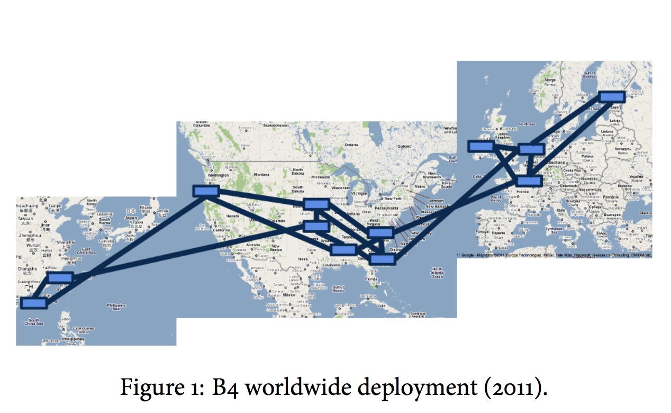
Google’s WAN-SDN (B4)

Slide 40
Software-defined IXP (SDX)
More expressive policies where ASes meet
https://noise-lab.net/projects/software-defined-networking/sdx/

Slide 41
Summary
Abstractions beget modularity
Modularity is (almost always) good
Next lecture: security

Slide 42
Thanks! Q&A

