Slide 1
Slide 1
This is a simple PowerPoint presentation to test

Slide 2
Slide 2
This is bulleted list:
Item 1
Item 2

Slide 3
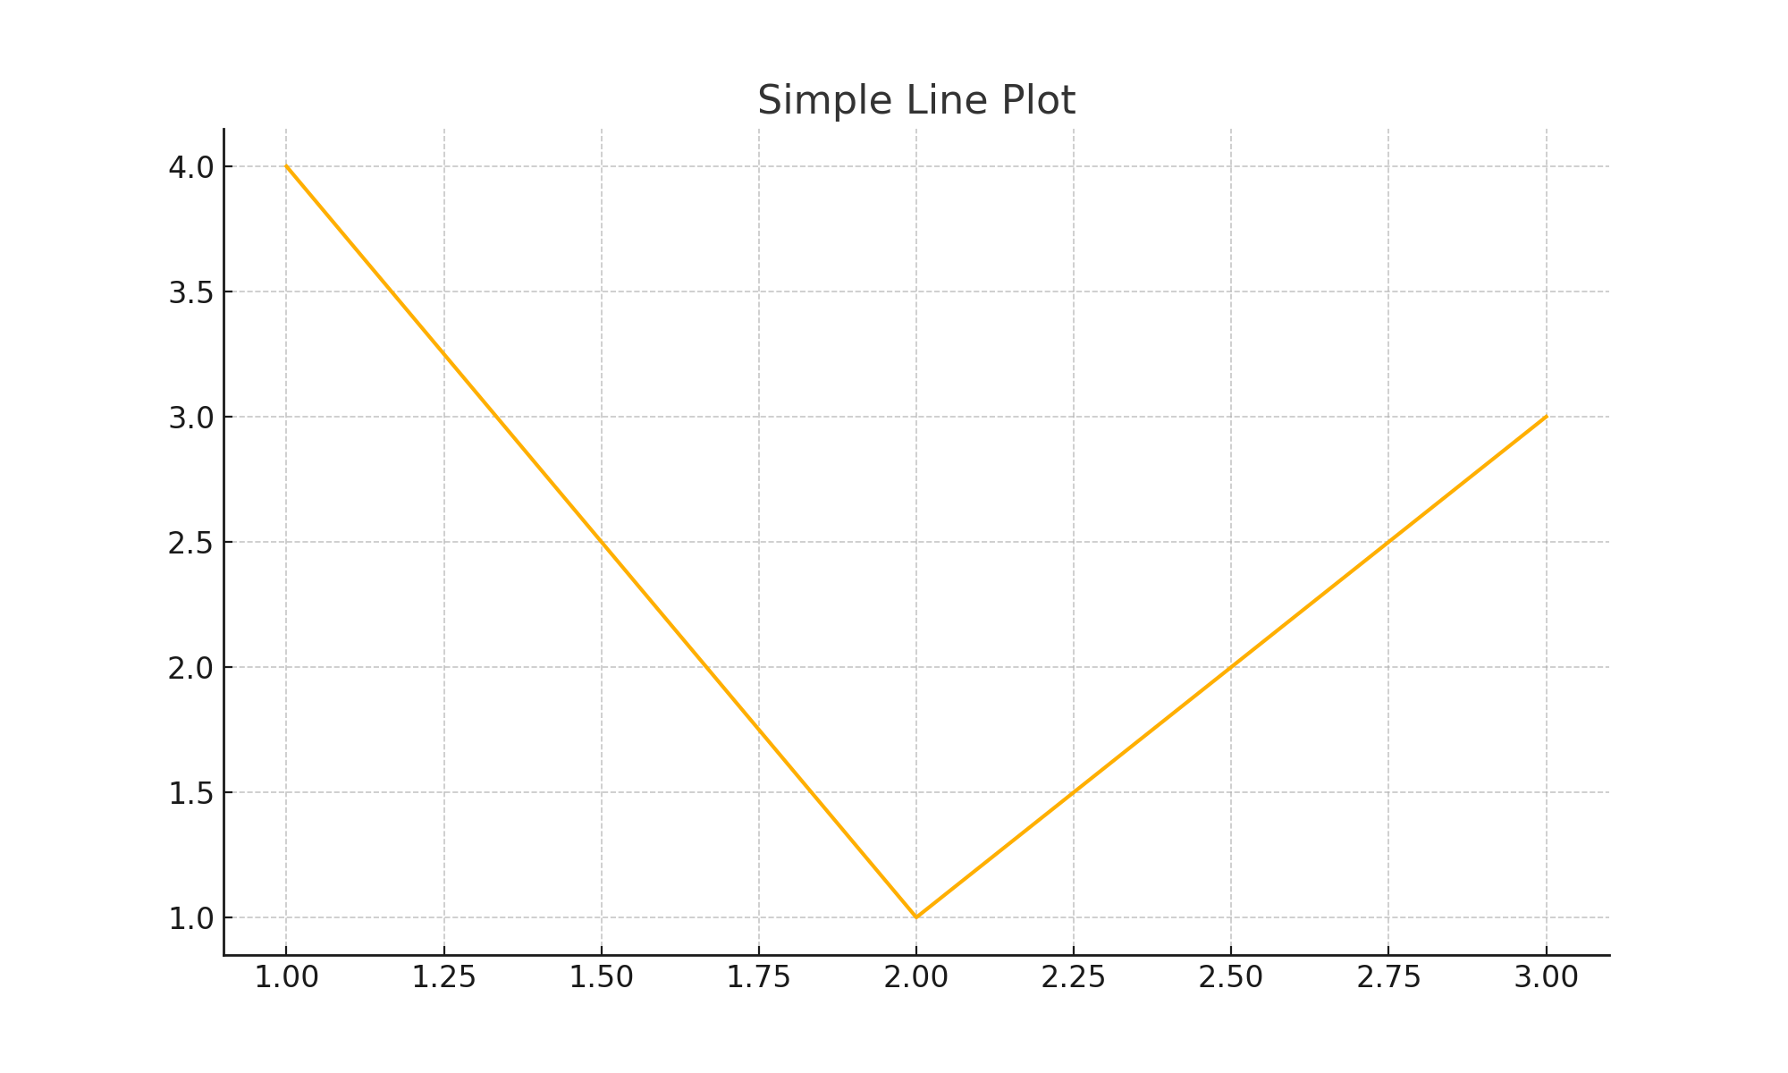
Image Slide with text
Some text relating to the image

Slide 4
Table Slide
Col 1 | Col 2 | Col 3
A | B | C
D | E | F

