Slide 1
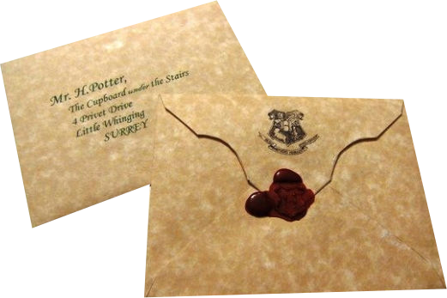
Introduction to the development

Slide 2
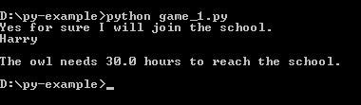
Challenge 1
The lettre:
You received a letter to inform you that you have a place at Hogwarts School.
You need to send a response by no later than the 31 July.
- Write in a variable your response and display it to the screen.
- Hogwarts School is at a distance of 1500 km. Your owl is flying at 50 km/h. How many hours it needs to reach the school.
Teacher: http://www.afterhoursprogramming.com/tutorial/Python/Variables

Slide 3

Challenge 2
Shopping:
In order to prepare for the school you need to buy:
Three Sets of Plain Work Robes – 4 Galleon each
One Plain Pointed Hat - 3 Galleon
One Pair of Protective Gloves - 2 Galleon
One Winter Cloak - 3 Galleon
You have only 22 Galleon in your Wallet.
Once you bought your uniform, you have money remaining, you can buy some candies.
Bag of Chocolate Frog – 1.5 Galleon
Bag of Bertie Bott's Every Flavour Beans – 0.75 Galleon
How much cost the uniform?
Do you have enough money to buy candies? If yes which one?
Teacher: http://www.afterhoursprogramming.com/tutorial/Python/If-Statement

Slide 4
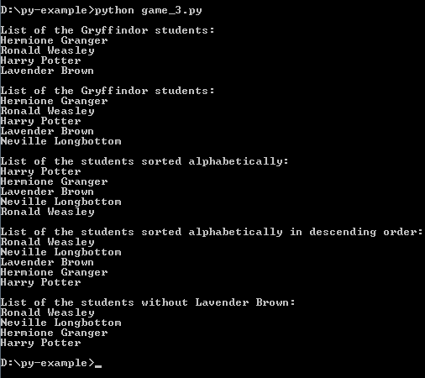
Challenge 3
Houses:
The Sorting Hat decides in which house the students go.
Create a list called Gryffindor that will contain Hermione Granger, Ronald Weasley, Harry Potter, Lavender Brown and display the list.
Add to the list: Neville Longbottom and display the list.
Sort the list alphabetically in ascending order and display it
Sort the list alphabetically in descending order and display it
Remove Lavender Brown from the list and display it
Teacher: http://www.afterhoursprogramming.com/tutorial/Python/Lists

Slide 5
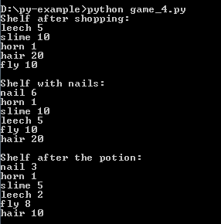
Challenge 4
First assessment: Cook the potion of invisibility
During the shopping you bought ingredients for the course of potion: leech: 5, hair: 20, horn: 1, fly: 10, slime: 15
- Put the ingredients in your shelf (Dictionary) and display it
Add the 6 nails that you forgot to put on the shelf from your bag and display it
For your potion you need 3 leeches, 10 hairs, 2 flies, 3 nails and 5cl of slime, display what sremains on the shelf
Teacher: http://www.afterhoursprogramming.com/tutorial/Python/Dictionaries

Slide 6
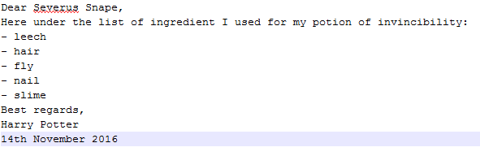
Challenge 5
Correction: Send your recipe to Severus Snape
Do the list of the ingredients you used for the potion of invincibility
Write the letter to Severus Snape in a file and list the ingredients
You forgot to add the date, Add it.
Teacher: http://www.afterhoursprogramming.com/tutorial/Python/Writing-to-Files

Slide 7

Challenge 6
Secret message:
You received a secret message (secret.txt).
Caesar will help you to read it. The key is to know the number of deathly hallows.
Hurry up, you may miss something !
Teacher: http://www.afterhoursprogramming.com/tutorial/Python/Reading-Files http://www.afterhoursprogramming.com/tutorial/Python/Strings
https://en.wikipedia.org/wiki/Caesar_cipher

