Slide 1
COVID-19 Hospitalization
Red Team
The Project, the Data, & the Dashboard

Slide 2
The Project
The Team , Collaboration, Coordination, and Content

Slide 3
The Team
Each Team Red member shared design and review functions for all aspects of the project, and each member assumed primary responsibility for delivering a segment of the project.
Member | Primary Roles
David Brandt | Database and ELTs
Jane Lee | Dashboard and Reports
Drake Lemm | Presentation and Delivery

Slide 4
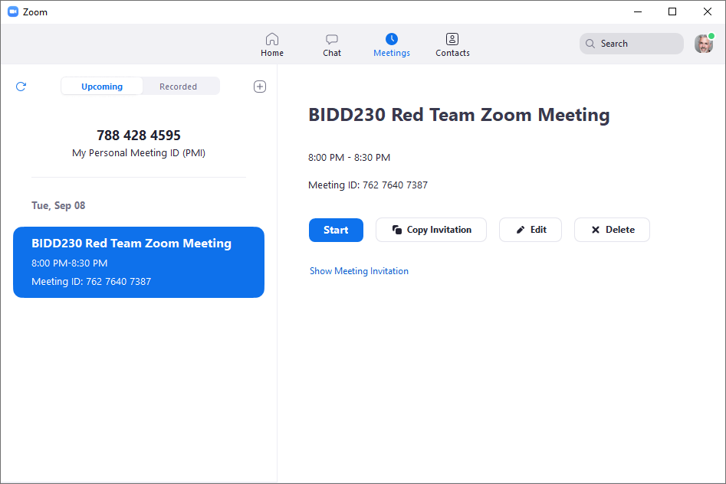
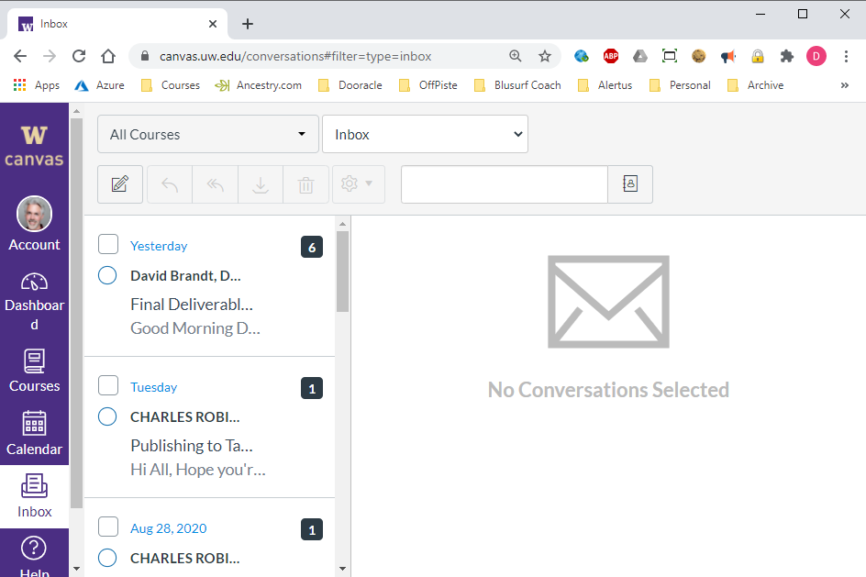
Collaboration: Zoom & Email
Collaboration for design and content was performed via Zoom conference calls and UW emails.

Slide 5
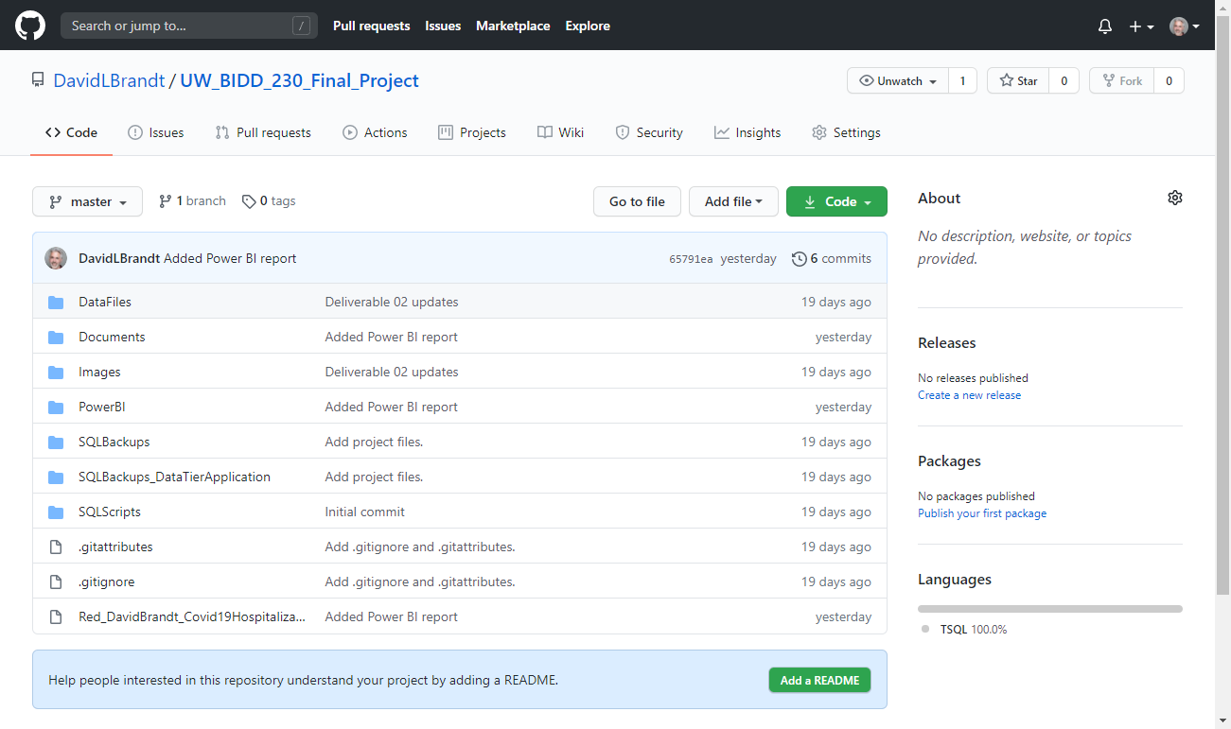
Coordination: GitHub
A GitHub repository was provisioned to the project files for ease of access and coordination.

Slide 6
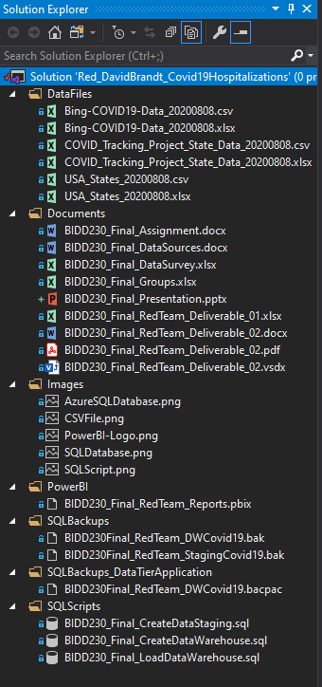
Content: Visual Studio
A Visual Studio solution was used to organize the project files. Our project included the following types of content:
Data Files: CSV & XLSX files downloaded from the source web sites
Documents: All project deliverables and support documents
Images: Supporting deliverable document and reports
Power BI: Our dashboard file
SQL Backups: backups of our staging and data warehouse databases
Data-Tier Application: SQL export of the DW for import to Azure
SQL Scripts: Scripts for creating the staging and data warehouse database as well as ETL processes

Slide 7
The Data
Data sources, pipeline, shaping, and relationships

Slide 8
Data Sources
Bing: COVID-19 Tracker
The Atlantic: The COVID Tracking Project
Reports: https://www.bing.com/covid/local/unitedstates
Data: https://github.com/microsoft/Bing-COVID-19-Data
Bing COVID-19 data includes confirmed, fatal, and recovered cases from all regions, updated daily in a .csv file. If there is an update or correction to already-published data, the data file will be updated accordingly. To ensure the stability of the data we share, it will be released with a 24-hour delay.
Reports: https://covidtracking.com/
Data: https://covidtracking.com/data
Overlaps the Bing dataset but includes these additional data points. Granularity is by state by day.
Currently hospitalized
Cumulative hospitalized
Currently in ICU
Cumulative in ICU
Currently on ventilator
Cumulative on ventilator

Slide 9
Data Pipeline

Slide 10
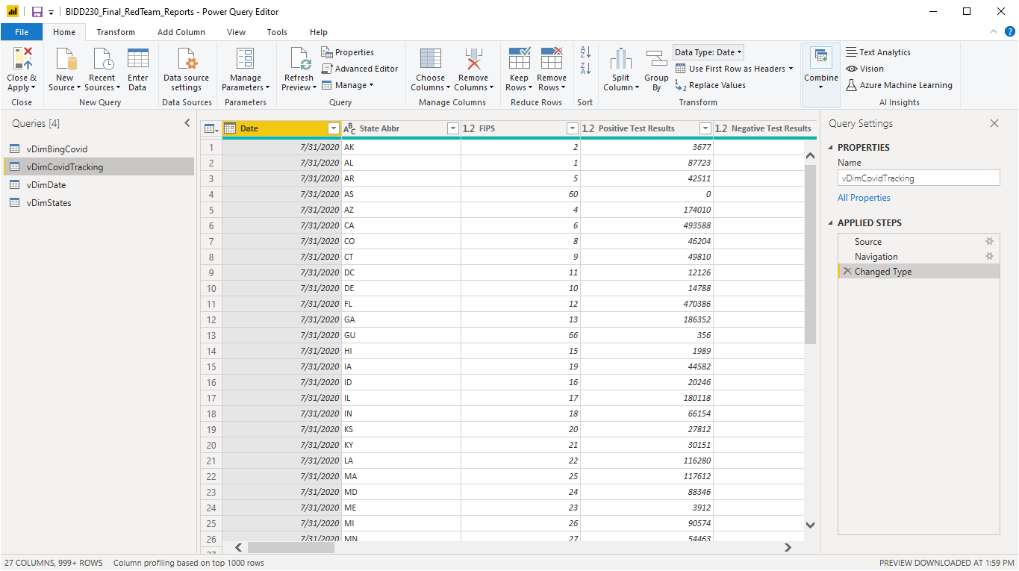
Data Shaping
Initial data shaping is performed in SQL.
The staging database reflects the data as received from the source.
The data is filtered and cleaned by the ETL to the data warehouse.
The views provide report friendly names for selected columns.
Finally the data received minor corrections at the Power BI queries.

Slide 11
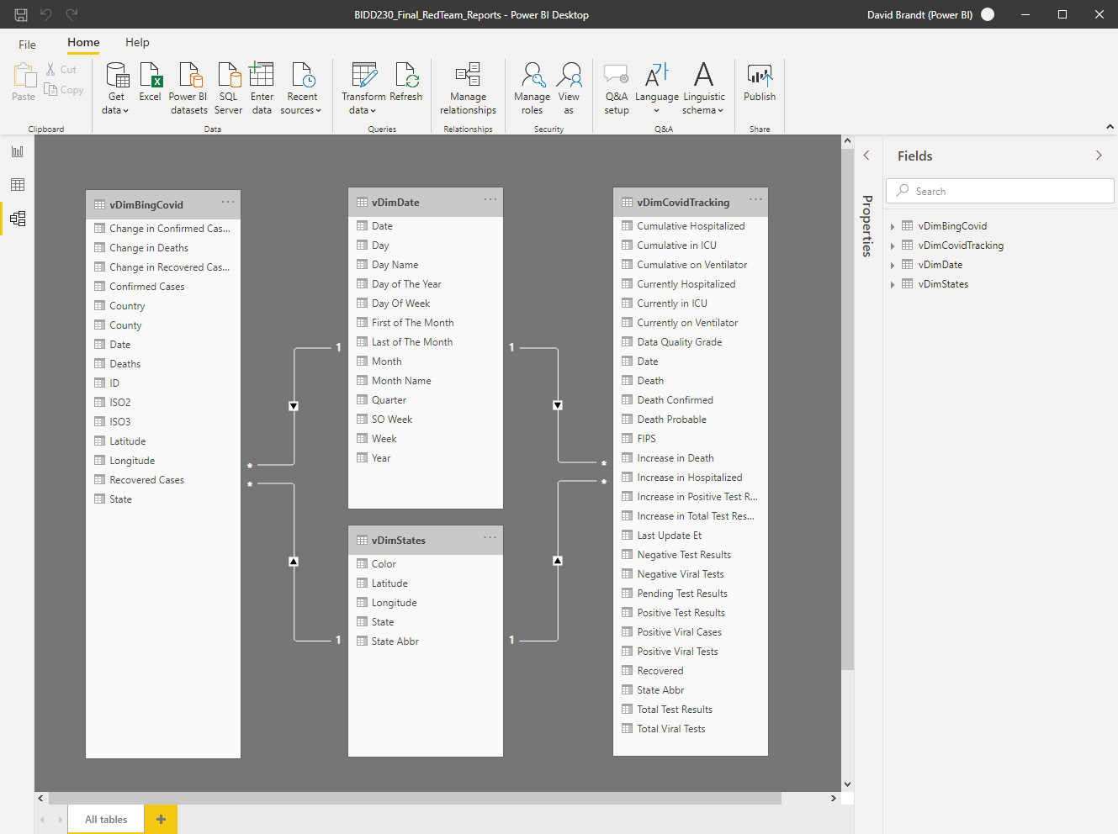
Data Relationships
Relationships between tables are defined in Power BI.
In our case both the Bing and the Atlantic data are joined Date and State dimensions.

Slide 12
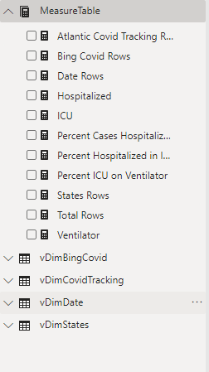
Data Measures
A dedicated table is provided for measures
Report | Measure | Description
USA | Percent Cases Hospitalized | Currently Hospitalized / Confirmed Cases
USA | Percent Hospitalized in ICU | Currently in ICU / Currently Hospitalized
USA | Percent ICU on Ventilator | Currently on Ventilator/ Currently in ICU
States | Hospitalized | Currently Hospitalized - Currently in ICU
States | ICU | Currently in ICU - Currently on Ventilator
States | Ventilator | Currently on Ventilator
Admin | Bing Covid Rows | Count of Bing Covid Rows
Admin | Atlantic Covid Tracking Rows | Count of Atlantic Covid Tracking Rows
Admin | States Rows | Count of States Rows
Admin | Dates Rows | Count of Dates Rows

Slide 13
The Dashboard
Power BI Reporting Dashboard

Slide 14
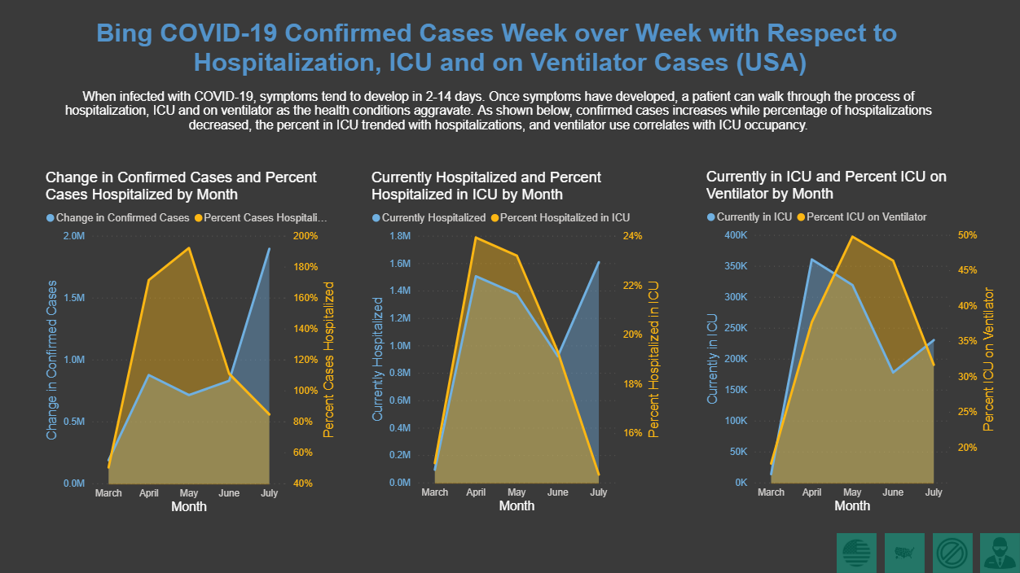

Slide 15
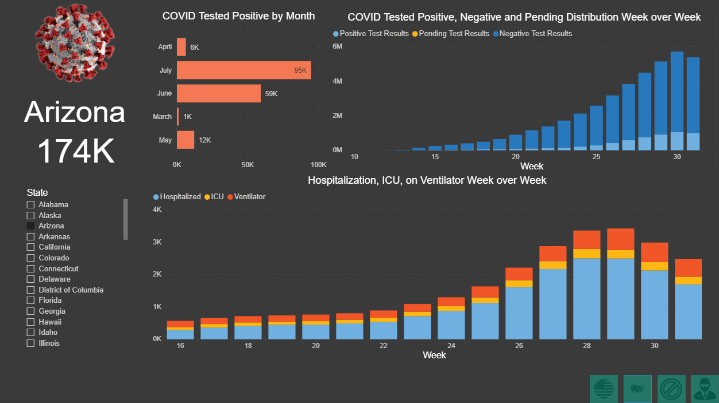

Slide 16


Slide 17
