Slide 1
Unfreedom (March 4, 2020a)
J. Bradford DeLong
Spring 2019
Evans 648
W 1:10-3:00 pm
<https://bcourses.berkeley.edu/courses/1487686/>
<https://github.com/braddelong/public-files/blob/master/econ-210a-lecture-8a.pptx>

Slide 2
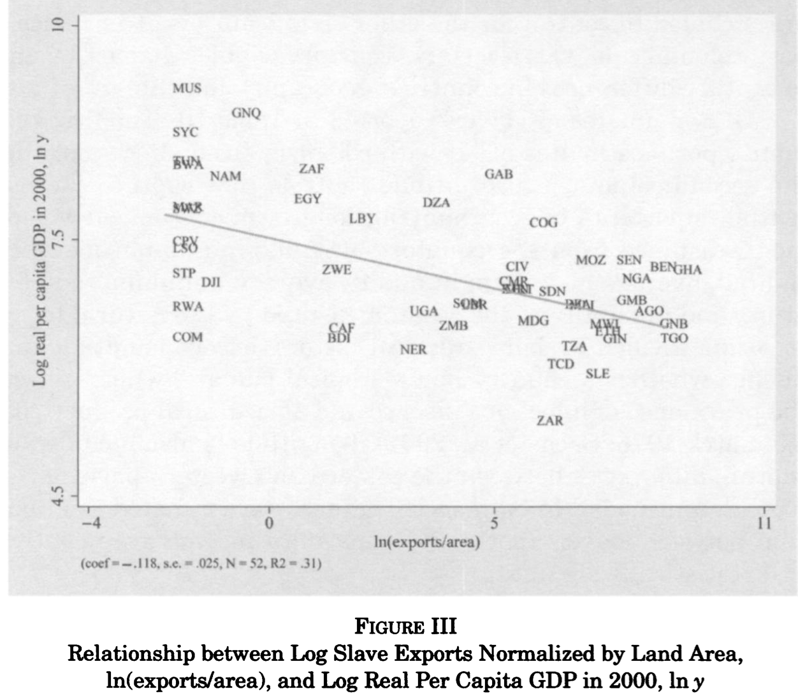
Reading Nunn
Nathan Nunn (2008): The Long-Term Effects of Africa’s Slave Trades <http://www.jstor.org/stable/pdfplus/25098896.pdf>:
From 8 to 6.5 in the natural log…
exp(1.5) = 4.5
Do we need controls?
Or, rather, what controls do we need?
What else might be going on here?

Slide 3
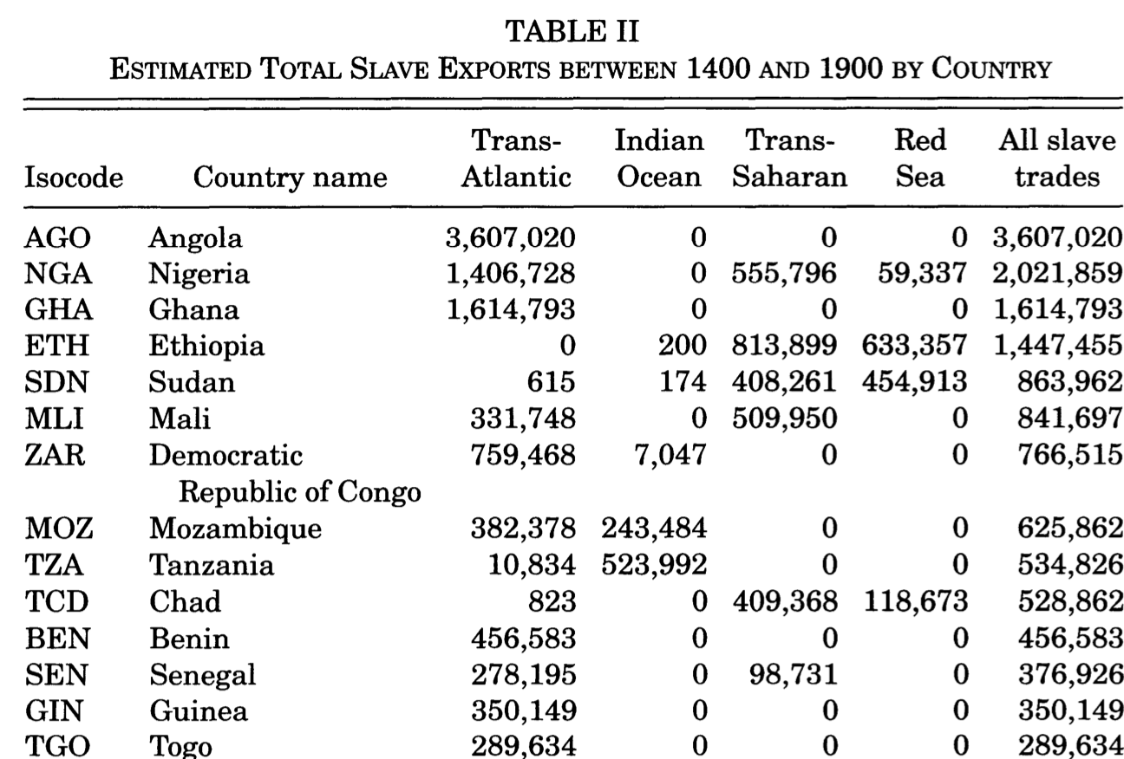
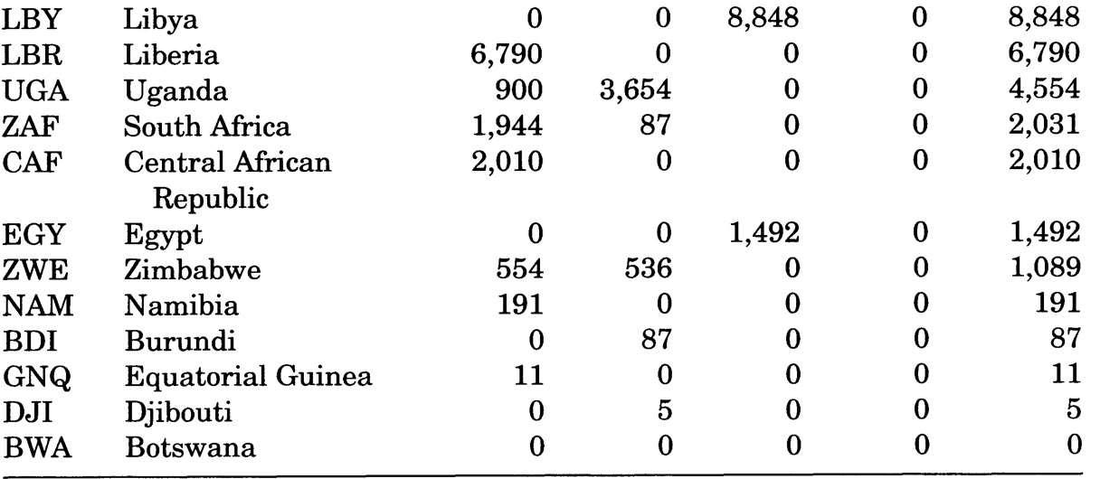
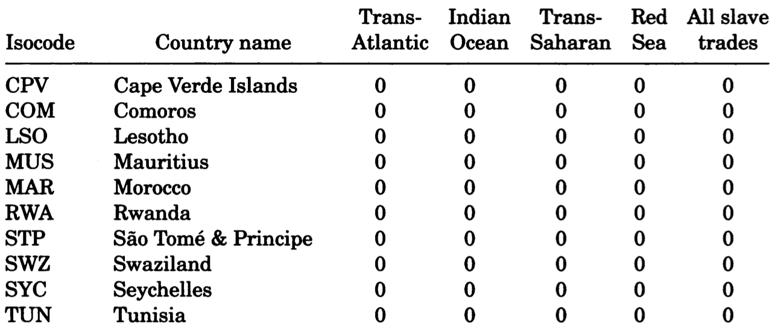
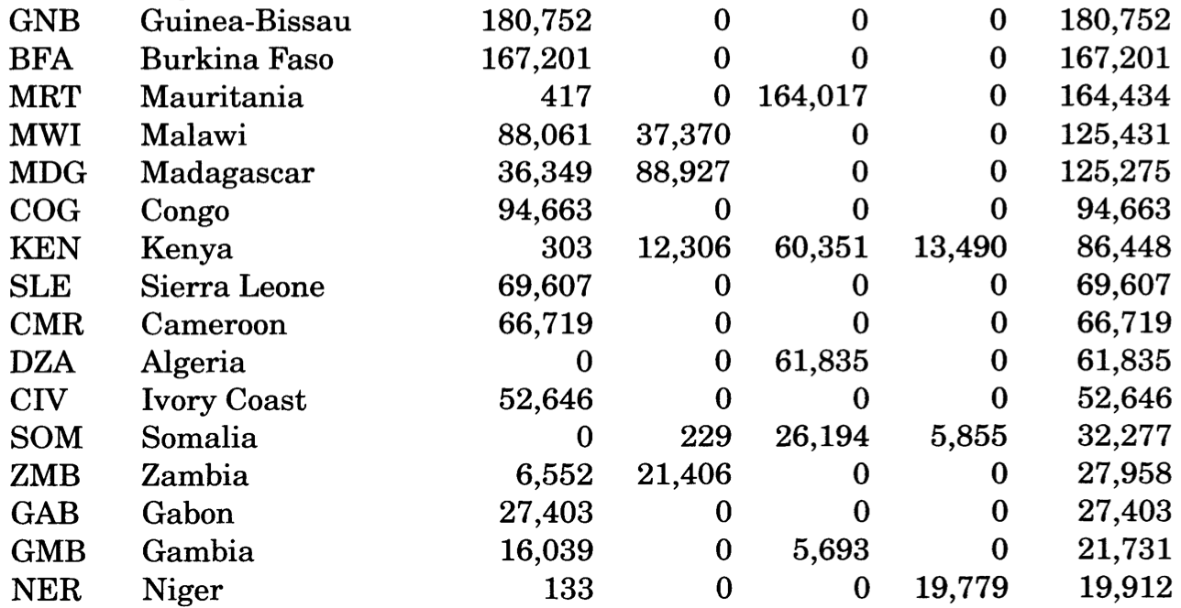
The Data

Slide 4
The Scatter
Do we need instruments?
What are our instruments?
What is our first stage?
Is this a “weak instrument”?
Under what circumstances is a strong instrument “weak”?
Do we need channels?
What are our channels?
What would a Bayesian say about the publication filter?

Slide 5
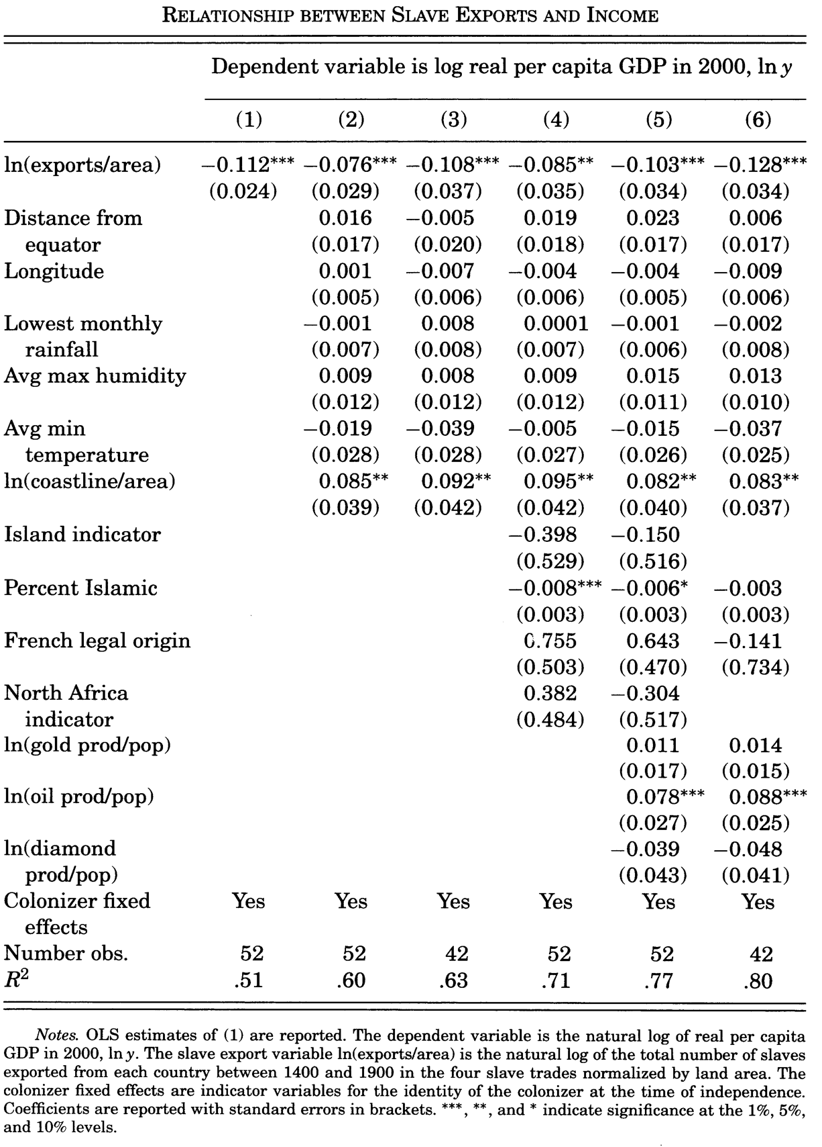
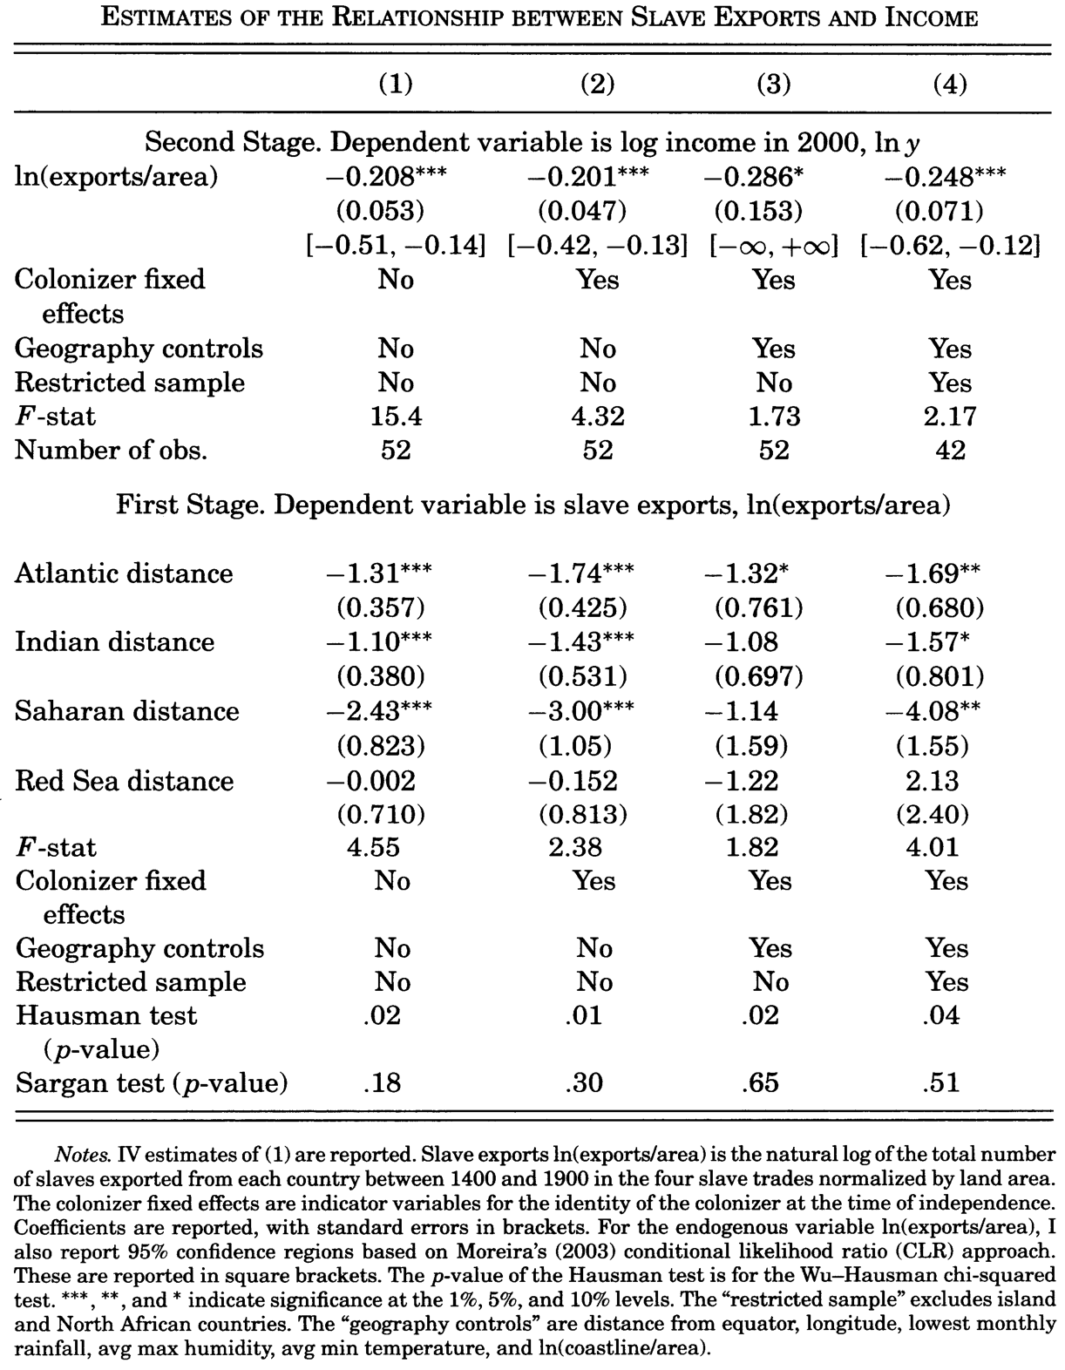
The Regressions

Slide 6
Catch Our Breath…
Ask a couple of questions?
Make a couple of comments?
Any more readings to recommend?

Slide 7
Notes…

Slide 8
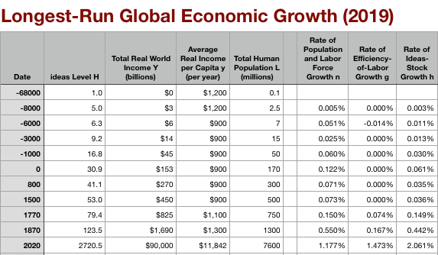
Global and “Western” Numbers
The Commercial Revolution acceleration appears everywhere
Due to globalization
And especially to the “Columbian Exchange”

Slide 9
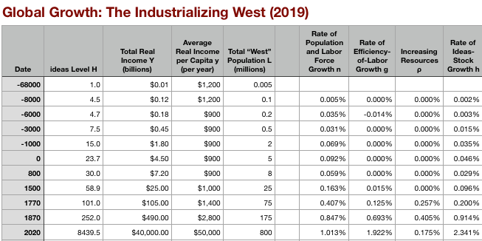
“Western” Numbers
Is ‘the west’ special between 800 and 1500?
Or is it just recovery from a Dark Age depression?

Slide 10
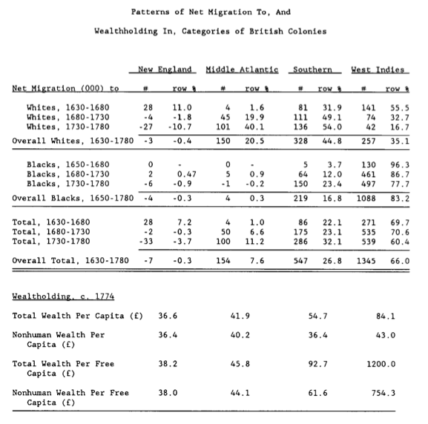
Reading Engerman and Sokoloff
Stanley Engerman and Kenneth Sokoloff (1994): Factor Endowments, Institutions and Differential Paths of Development among New World Economies <http://papers.nber.org/papers/h0066>:
Engerman and Sokoloff: A historical take on the “reversal of fortune” and “institutions” literatures…
Variables that “win” regressions:
Not in sub-Saharan Africa
Distance from the equator
Source of your colonial settler population or your colonial administrators (“legal origins”)
Investment—especially equipment investment
Look for instruments?
Adding instruments—even invalid instruments—raises the r2 of the first stage…
If you have “a lot” of instruments, you will get OLS…
Staiger and Stock: need 10-20 observations per instrument…
Tell stories?
Correlations, causal experiments, case studies…

Slide 11
Engerman and Sokoloff: “Reversal of Fortune” and “Institutions” Literatures
Variables that “win” regressions:
Not in sub-Saharan Africa
Distance from the equator
Source of your colonial settler population or your colonial administrators (“legal origins”)
Investment—especially equipment investment
Look for instruments?
Adding instruments—even invalid instruments—raises the r² of the first stage…
If you have “a lot” of instruments, you will get OLS…
Staiger and Stock: need 10-20 observations per instrument…
Tell stories?

Slide 12
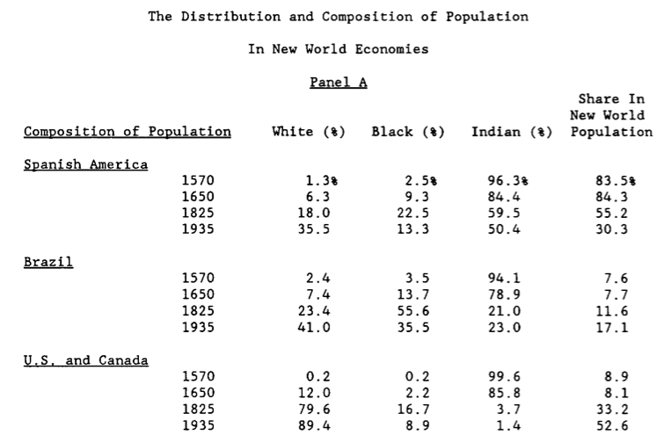
New World Populations

Slide 13
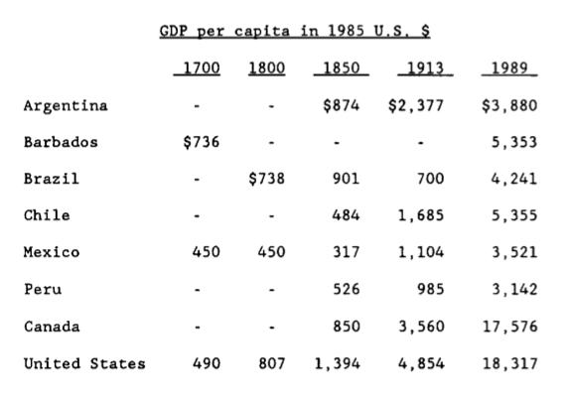
New World Growth

Slide 14
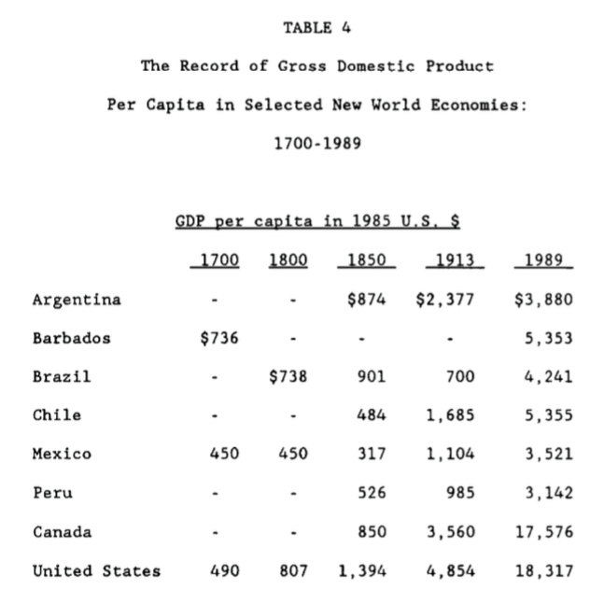
Engerman and Sokoloff: Very Long Run Consequences of Being Ruled by Slave- or Serf-Masters
Different labor systems as the result of the luck of history and “factor endowments”
How do you establish an unfree labor system?
How do you maintain an unfree labor system?
What does having an unfree labor system do to elite incentives?
Does the elite control the economy? If so, does it control it in its long-run interest?

