Slide 1
Women, Men, & Children (March 4, 2020b)
J. Bradford DeLong
Spring 2019
Evans 648
W 1:10-3:00 pm
<https://bcourses.berkeley.edu/courses/1487686/>
<https://github.com/braddelong/public-files/blob/master/econ-210a-lecture-8b.pptx>

Slide 2
Assignment: Women, Men, & Children
Essay Topic:
The most important economic change of the past two centuries has been the shift from a "Malthusian" world—in which the typical woman and her children live near subsistence, with the absence of infant formula and easy artificial family planning mechanisms plus the desire to have surviving descendants in a world where average lifespan is less than 30 leads the typical woman to have on average perhaps nine pregnancies to achieve 6.5 live births, 4 children who survive infancy, and 3 to reach near-adulthood; thus spending 20 years "eating for two"—to our current world. Discuss.
Readings:
Abigail Smith Adams (1776): Letter to John Adams 31 March - 5 April 1776 <https://www.masshist.org/digitaladams/archive/doc?id=L17760331aa>
Martha Bailey (2013): Fifty Years of Family Planning: New Evidence on the Long-Run Effects of Increasing Access to Contraception <http://www.nber.org/papers/w19493>
Claudia Goldin (1991): The Role of World War II in the Rise of Women’s Employment <https://www.jstor.org/stable/2006640>
Heather Antecol, Kelly Bedard, and Jenna Stearns (2018): Equal but Inequitable: Who Benefits from Gender-Neutral Tenure Clock Stopping Policies <https://pubs.aeaweb.org/doi/pdf/10.1257/aer.20160613>

Slide 3
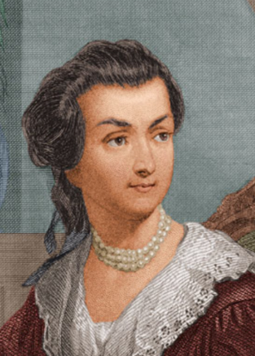
Document: Abigail Smith Adams
Letter to John Adams 31 Mar-5 Apr 1776: <https://tinyurl.com/dl20180226a>…
Things to note about the letter as you read it:
Speling…
Public concerns:
Suspicion of Virginia…
State of Boston after the occupation…
Power of the colonies to resist…
Soapmaking… saltpeter… gunpowder…
Private concerns:
Family security…
“Gorge the Eldest… Billy the youngest… Becky Peck… your brother’s youngest child lies bad with convulsion fits…”
Why don’t you write more, and at longer length?
Feminist concerns…

Slide 4
Abigail Smith and John Adams: Fecundity
Abigail Smith (20) married John Adams (30) in 1764:
Children:
Abigail ("Nabby") 1765–1813
John Quincy Adams 1767–1848
Grace Susanna ("Suky") 1768–70
Charles 1770–1800
Thomas Boylston Adams 1772–1832
Elizabeth (stillborn) 1777
Then they stopped…
She ran his Braintree-Boston operation…

Slide 5
Abigail Smith and John Adams: Terms of Partnership
She ran his Braintree-Boston operation…
Not just the inside-the-household part—pretty much the whole thing while he was being a High Politician…

Slide 6
Abigail Adams Had a Very Favored Place for an Agrarian-Age Woman…
Other women had less favored places…
Abigail Adams to Thomas Jefferson, 27 June 1787 <https://founders.archives.gov/documents/Jefferson/01-11-02-0420>:
"LONDON... I had the Honour of addressing you yesterday and informing you of the safe arrival of your daughter. She was but just come when I sent of my letter by the post, and the poor little Girl was very unhappy being wholy left to strangers. This however lasted only a few Hours, and Miss is as contented to day as she was misirable yesterday. She is indeed a fine child. I have taken her out to day and purchased her a few articles which she could not well do without and I hope they will meet your approbation.
"The Girl who is with her is quite a child, and Captain Ramsey is of opinion will be of so little Service that he had better carry her back with him. But of this you will be a judge. She seems fond of the child and appears good naturd…”
“The Girl who is with her” is Sally Hemings, then 14. Rather than have Sally Hemings continue on to Paris for a reunion with her brother, Abigail Adams wants her sent back to Virginia…

Slide 7
Document: Abigail Smith Adams
Braintree March 31, 1776: I wish you would ever write me a Letter half as long as I write you; and tell me if you may:
Where your Fleet are gone?
What sort of Defence Virginia can make against our common Enemy?
Whether it is so situated as to make an able Defence?
Are not the Gentery Lords and the common people vassals?
Are they not like the uncivilized Natives Brittain represents us to be?
I hope their Riffel Men who have shewen themselves very savage and even Blood thirsty; are not a specimen of the Generality of the people.
I [illegible] am willing to allow the Colony great merrit for having produced a Washington but they have been shamefully duped by a Dunmore.

Slide 8
Abigail Smith Adams: Virginia/Boston
I have sometimes been ready to think that the passion for Liberty cannot be Eaquelly Strong in the Breasts of those who have been accustomed to deprive their fellow Creatures of theirs. Of this I am certain that it is not founded upon that generous and christian principal of doing to others as we would that others should do unto us.
Do not you want to see Boston? I am fearfull of the small pox, or I should have been in before this time.
I got Mr. Crane to go to our House and see what state it was in. I find it has been occupied by one of the Doctors of a Regiment, very dirty, but no other damage has been done to it. The few things which were left in it are all gone. Cranch has the key which he never deliverd up. I have wrote to him for it and am determined to get it cleand as soon as possible and shut it up. I look upon it a new acquisition of property, a property which one month ago I did not value at a single Shilling, and could with pleasure have seen it in flames.

Slide 9
Abigail Smith Adams: Boston
The Town in General is left in a better state than we expected, more oweing to a percipitate flight than any Regard to the inhabitants, tho some individuals discoverd a sense of honour and justice and have left the rent of the Houses in which they were, for the owners and the furniture unhurt, or if damaged sufficent to make it good.
Others have committed abominable Ravages. The Mansion House of your President is safe and the furniture unhurt whilst both the House and Furniture of the Solisiter General have fallen a prey to their own merciless party. Surely the very Fiends feel a Reverential awe for Virtue and patriotism, whilst they Detest the paricide and traitor.

Slide 10
Abigail Smith Adams: Optimism
I feel very differently at the approach of spring to what I did a month ago. We knew not then whether we could plant or sow with safety, whether when we had toild we could reap the fruits of our own industery, whether we could rest in our own Cottages, or whether we should not be driven from the sea coasts to seek shelter in the wilderness, but now we feel as if we might sit under our own vine and eat the good of the land.
I feel a gaieti de Coar to which before I was a stranger. I think the Sun looks brighter, the Birds sing more melodiously, and Nature puts on a more chearfull countanance. We feel a temporary peace, and the poor fugitives are returning to their deserted habitations.
Tho we felicitate ourselves, we sympathize with those who are trembling least the Lot of Boston should be theirs. But they cannot be in similar circumstances unless pusilanimity and cowardise should take possession of them. They have time and warning given them to see the Evil and shun it.

Slide 11
Abigail Smith Adams: “Your Sex… Naturally Tyrannical…”
I long to hear that you have declared an independency -- and by the way in the new Code of Laws which I suppose it will be necessary for you to make I desire you would Remember the Ladies, and be more generous and favourable to them than your ancestors. Do not put such unlimited power into the hands of the Husbands. Remember all Men would be tyrants if they could. If perticuliar care and attention is not paid to the Laidies we are determined to foment a Rebelion, and will not hold ourselves bound by any Laws in which we have no voice, or Representation.
That your Sex are Naturally Tyrannical is a Truth so thoroughly established as to admit of no dispute, but such of you as wish to be happy willingly give up the harsh title of Master for the more tender and endearing one of Friend. Why then, not put it out of the power of the vicious and the Lawless to use us with cruelty and indignity with impunity? Men of Sense in all Ages abhor those customs which treat us only as the vassals of your Sex. Regard us then as Beings placed by providence under your protection and in immitation of the Supreem Being make use of that power only for our happiness.

Slide 12
Abigail Smith Adams: Stripped of Two Lovely Children in One Week
April 5: Not having an opportunity of sending this I shall add a few lines more; tho not with a heart so gay. I have been attending the sick chamber of our Neighbour Trot whose affliction I most sensibly feel but cannot discribe, striped of two lovely children in one week. Gorge the Eldest died on wedensday and Billy the youngest on fryday, with the Canker fever, a terible disorder so much like the throat distemper, that it differs but little from it. Betsy Cranch has been very bad, but upon the recovery. Becky Peck they do not expect will live out the day. Many grown persons are now sick with it, in this street. It rages much in other Towns. The Mumps too are very frequent. Isaac is now confined with it. Our own little flock are yet well. My Heart trembles with anxiety for them. God preserve them.

Slide 13
Document: Abigail Smith Adams
I want to hear much oftener from you than I do.
March 8 [John to Abigail, 08 March 1776] was the last date of any that I have yet had.
-- You inquire of whether I am making Salt peter. I have not yet attempted it, but after Soap making believe I shall make the experiment. I find as much as I can do to manufacture cloathing for my family which would else be Naked. I know of but one person in this part of the Town who has made any, that is Mr. Tertias Bass as he is calld who has got very near an hundred weight which has been found to be very good. I have heard of some others in the other parishes. Mr. Reed of Weymouth has been applied to, to go to Andover to the mills which are now at work, and has gone.
I have lately seen a small Manuscrip describing the proportions for the various sorts of powder, such as fit for cannon, small arms and pistols [illegible]. If it would be of any Service your way I will get it transcribed and send it to you.
-- Every one of your Friends send their Regards, and all the little ones.
Your Brothers youngest child lies bad with convulsion fitts. Adieu.
I need not say how much I am Your ever faithfull Friend…

Slide 14
Lots and Lots and Lots in This Letter: But Focus on:
I long to hear that you have declared an independency -- and by the way in the new Code of Laws which I suppose it will be necessary for you to make I desire you would Remember the Ladies, and be more generous and favourable to them than your ancestors. Do not put such unlimited power into the hands of the Husbands. Remember all Men would be tyrants if they could. If perticuliar care and attention is not paid to the Laidies we are determined to foment a Rebelion, and will not hold ourselves bound by any Laws in which we have no voice, or Representation.
That your Sex are Naturally Tyrannical is a Truth so thoroughly established as to admit of no dispute, but such of you as wish to be happy willingly give up the harsh title of Master for the more tender and endearing one of Friend. Why then, not put it out of the power of the vicious and the Lawless to use us with cruelty and indignity with impunity? Men of Sense in all Ages abhor those customs which treat us only as the vassals of your Sex. Regard us then as Beings placed by providence under your protection and in immitation of the Supreem Being make use of that power only for our happiness.

Slide 15
John Adams’s Reply to Abigail
As to your extraordinary code of laws, I cannot but laugh.
We have been told that our struggle has loosened the bonds of government everywhere; that children and apprentices were disobedient; that schools and colleges were grown turbulent; that Indians slighted their guardians, and negroes grew insolent to their masters.
But your letter was the first intimation that another tribe, more numerous and powerful than all the rest, were grown discontented.
This is rather too coarse a compliment, but you are so saucy, I won't blot it out.
Depend upon it, we know better than to repeal our masculine systems. Although they are in full force, you know they are little more than theory. We dare not exert our power in its full latitude. We are obliged to go fair and softly, and, in practice, you know we are the subjects.
We have only the name of masters, and rather than give up this, which would completely subject us to the despotism of the petticoat, I hope General Washington and all our brave heroes would fight.

Slide 16
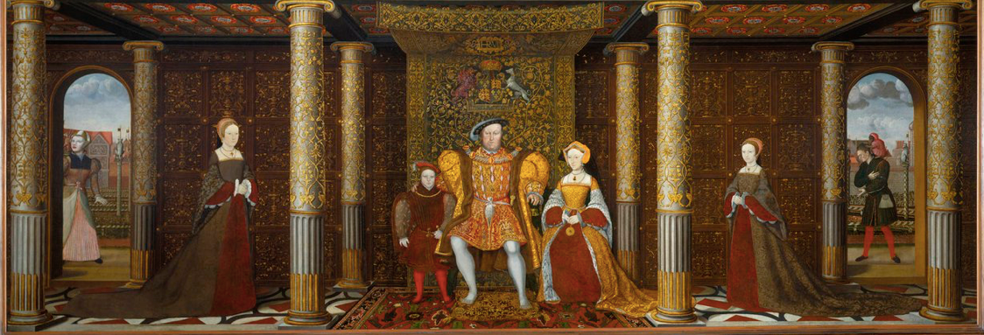
Childbed: British Queens
16 generations from Henry IV to Victoria
5 queens (or heiresses apparent) dead in childbed: Charlotte (Victoria’s generation), Catherine Parr, Jane Seymour, Elizabeth of York, Mary de Bohun
At an average of two queens per generation, this is a 16% childbed mortality rate for the most cosseted women in England
2% maternal mortality per birth
1% extra mortality from nursing sick children

Slide 17
Women in Their Place…
Biology…
16% childbed mortality; 8% excess nursing sick mortality…
3 yr x 7? 20 years eating for two?
Occupations…
(Elizabeth Wayland Barber (1995): Women's Work: The First 20,000 Years Women, Cloth, and Society in Early Times (0393035069) <http://amzn.to/2BSw3fZ>
Patriarchy…
Societal expectations…
Interactions
Disparate impact
Even in Denmark today:
7% lower employment probability
7% lower hours per week conditional on employment
7% lower wages and salaries conditional on employment and hours…

Slide 18
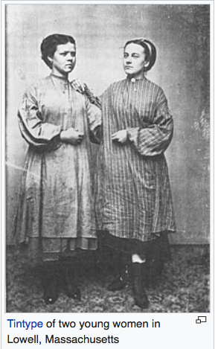
What Happened When Women’s Opportunities Opened Up—Even a Little?
Market income and factory work…
In 1840, in Lowell, unmarried young women (16-30) one quarter of the city’s industrial workforce.
Expected to attend church
“Not employ anyone… known to be guilty of immorality”
The Lowell mills in boom:
A way to acquire a dowry…
A way to have some extra freedom…
The Lowell mills in bust:
Labor organization…

Slide 19
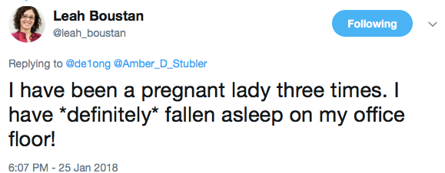
Eating for Two…
Heather Antecol, Kelly Bedard, and Jenna Stearns (2016): Equal but Inequitable: Who Benefits from Gender-Neutral Tenure Clock Stopping Policies? <https://tinyurl.com/dl20180226b>
Using a unique data set on the universe of assistant professor hires at top-50 economics departments from 1985-2004, we show that the adoption of gender-neutral tenure clock stopping policies substantially reduced female tenure rates while substantially increasing male tenure rates…

Slide 20
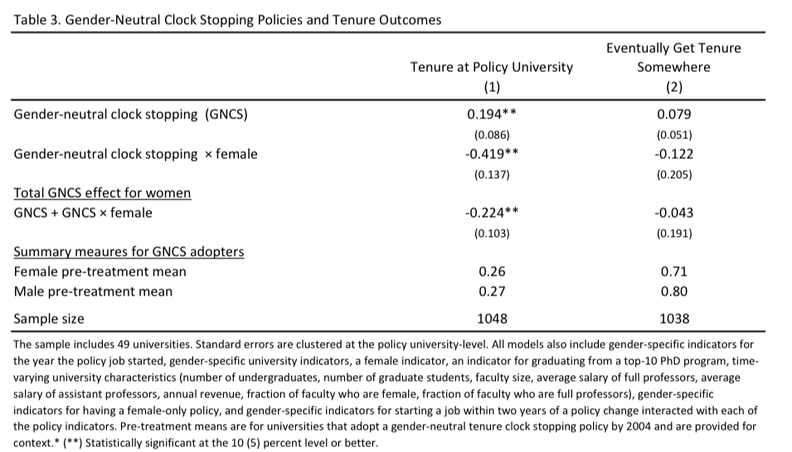
Eating for Two…

Slide 21
Family Planning
Martha Bailey (2013): Fifty Years of Family Planning: New Evidence on the Long-Run Effects of Increasing Access to Contraception <http://www.nber.org/papers/w19493>
Reliable oral contraception (the Pill) was introduced in 1957 and approved by the FDA for long-term use in 1960.
But it was available only from physicians and pharmacists, who complied with restrictive state laws because they needed state licenses.
1965 Supreme Court decision (Griswald v. Connecticut) then struck down that state’s ban on contraceptive sales on right-to-privacy grounds.
This precedent reduced compliance and enforcement nationwide and eventually led other states to liberalize their laws related to contraceptive sales.
So what effects does Bailey find?...

Slide 22
Findings
Compares changes in fertility outcomes between 1957-65 and 1966-70 in states with bans before 1966 and states without.
Documents impacts on marital fertility, timing of births, birthweight. Estimated effects are large: 40% of observed decline in marital fertility between 1955 and 1965 is due to the availability of the Pill.
Examines longer run consequences for next-generation outcomes (children’s family income, educational attainment etc.) as a function of mother having lived in a state where there was a Comstock Law ban.
Children born between 1958 & 1965 in states permitting contraceptive sales had significantly higher family incomes as adults than children born in other states.
Large effects. But are we convinced? Why might we have doubts?...

Slide 23
Questions
Bailey measures bans, not compliance and enforcement.
Diffusion took time (especially use by young single women, for reasons of social acceptance and information). Use not widespread until late 1960s.
Doesn’t model reasons for uneven timing and extent of removal of Comstock era restrictions. (Correlated with what…?)
Models elimination of Comstock Laws but not also statutes and decisions after 1969 reducing age of majority and classifying minors as “mature” enough to make decisions and thus allowing family planning services to be used without parental consent. (In 1971, a woman aged 18 could obtain the pill in 30 states, while those aged 16 could obtain it without parental consent in only 12 states).
May not control adequately for other things affecting fertility (states permitting sale of contraceptives may be the same ones experiencing rapid growth in the demand for female workers, which reduces desired fertility rates independent of the Pill, and we know that there are other mechanisms for effective fertility restraint…)
Other things” also include the rise of feminism (recall Bailey’s discussion of Margaret Sanger and the US birth control movement of the 1920s).

Slide 24
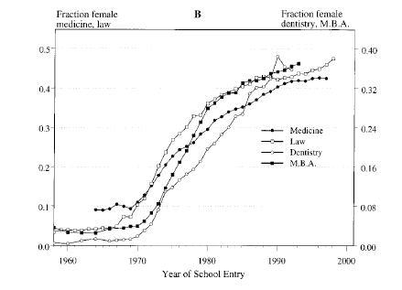
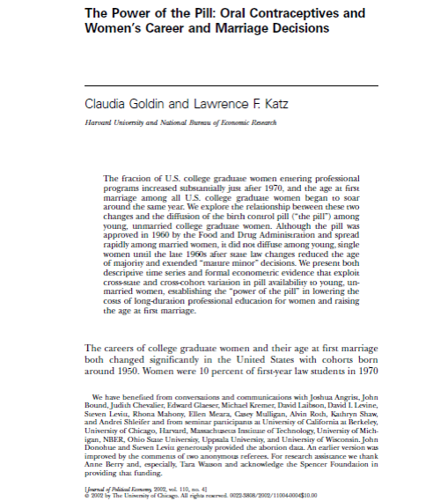
Related Literature
Bailey invokes findings by others (Goldin & Katz, here, for example) that the availability of oral contraception affected long term career investments (the number of women pursuing professional education and choice of career).
“In the absence of an almost infallible contraceptive method, young women embarking on a lengthy professional education would have to pay the penalty of abstinence or cope with considerable uncertainty regarding pregnancy.”
Where women had been only 10% of law students in 1960, they were fully 36% in 1980.

Slide 25
How much of the change in career choice can the availability of oral contraception explain?
Goldin and Katz use cross-state variations in career choices of women.
They exploit Bailey-like legal changes lowered the age of majority and expanded the rights of minors in different 1960s years in different states, as a result of which the pill diffused at different rates in different states.
They conclude that it explains the majority of changes in career choice 1970-90.
Doubts?

Slide 26
Endogeneity of relevant laws?
Goldin and Katz argue that a wide array of very different states passed early laws – California and Mississippi were both early adopters, for example – which points against factors like strength of women’s movement.
What about other factors influencing fertility control and choice of career?
Legalization of abortion, for example? Goldin and Katz acknowledge the relevance of this and attempt to control for abortion laws in their analysis.

Slide 27
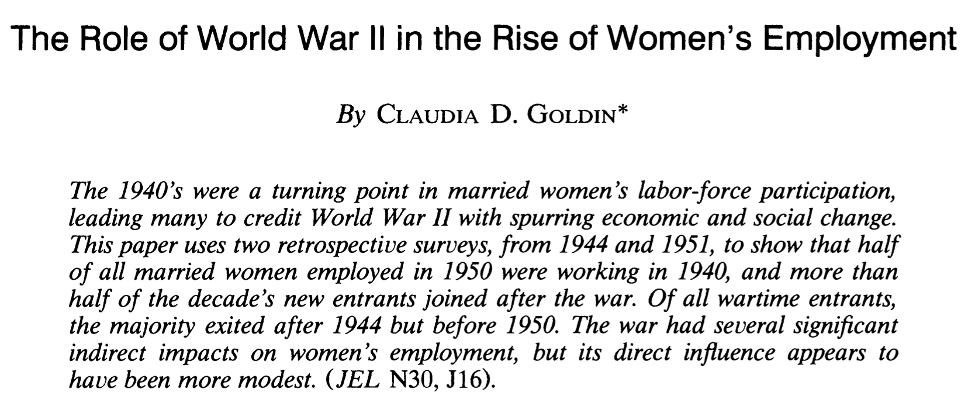
The Role of WWII
Claudia Goldin (1991): The Role of World War II in the Rise of Women’s Employment <https://www.jstor.org/stable/2006640>

Slide 28
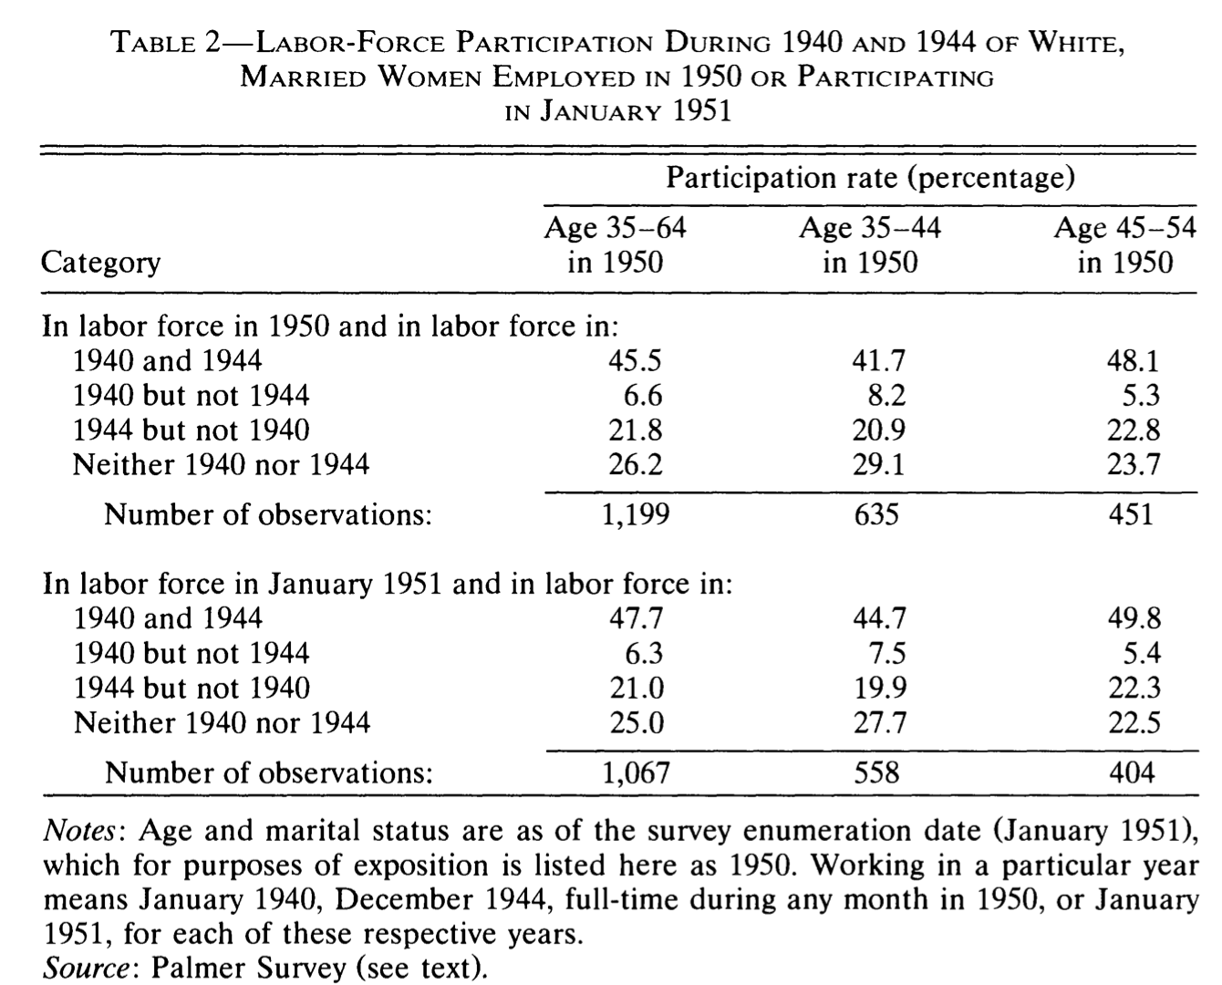
1950 and 1944 and 1940

Slide 29
Not a Watershed
The wide-ranging shift in women's economic role af- ter World War II was primarily due to longer-run factors, such as the rise of the clerical sector and increased education.
Evidence on "marriage bars" suggests that the rhetoric surrounding women's work changed only when the supply of young single women was substantially reduced and when the supply of well- educated, older, married women increased.
Demographic events culminated in the late 1940's to bring about these changes.
There is considerable evidence from a variety of sources that the war had far less direct [long-run] influence on female labor supply than was believed.
The Palmer Survey data have reinforced the conclusions of a growing literature that wartime work did not by itself greatly increase women's employment.

Slide 30
Assignment Next Time:
International Monetary Economics
Essay Topic:
Textbooks say that the gold standard had internal mechanisms that worked automatically to maintain both price and balance-of-payments stability. Is that impression borne out by the analyses you read this week?
Readings:
Michael Bordo and Hugh Rockoff (1996): The Gold Standard as a ‘Good Housekeeping Seal of Approval <https://www.jstor.org/stable/2123971?seq=1#page_scan_tab_contents>
Warren Weber (2016): A Bitcoin Standard: Lessons from the Gold Standard <http://www.bankofcanada.ca/2016/03/staff-working-paper-2016-14/>

Slide 31
Catch Our Breath…
Ask a couple of questions?
Make a couple of comments?
Any more readings to recommend?

Slide 32
Notes…

Slide 33
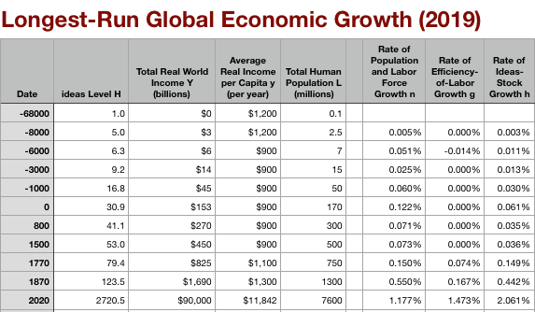
Global and “Western” Numbers
The Commercial Revolution acceleration appears everywhere
Due to globalization
And especially to the “Columbian Exchange”

Slide 34
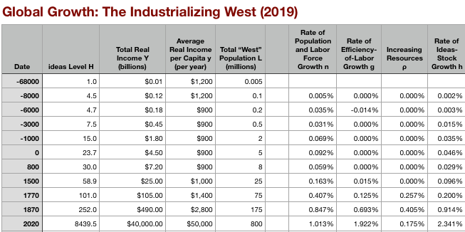
“Western” Numbers
Is ‘the west’ special between 800 and 1500?
Or is it just recovery from a Dark Age depression?

Slide 35
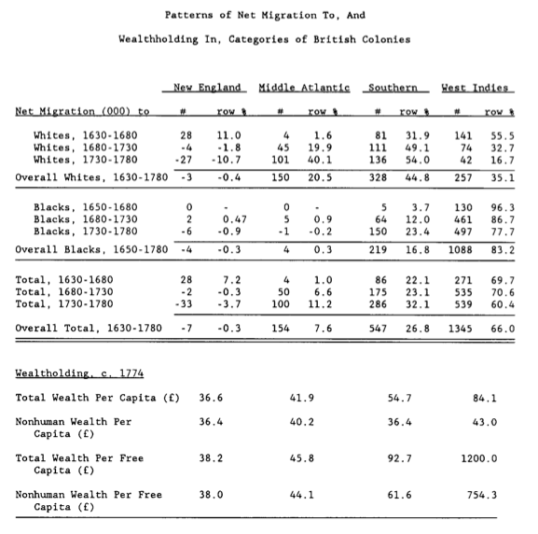
Reading Engerman and Sokoloff
Stanley Engerman and Kenneth Sokoloff (1994): Factor Endowments, Institutions and Differential Paths of Development among New World Economies <http://papers.nber.org/papers/h0066>:
Engerman and Sokoloff: A historical take on the “reversal of fortune” and “institutions” literatures…
Variables that “win” regressions:
Not in sub-Saharan Africa
Distance from the equator
Source of your colonial settler population or your colonial administrators (“legal origins”)
Investment—especially equipment investment
Look for instruments?
Adding instruments—even invalid instruments—raises the r2 of the first stage…
If you have “a lot” of instruments, you will get OLS…
Staiger and Stock: need 10-20 observations per instrument…
Tell stories?
Correlations, causal experiments, case studies…

Slide 36
Engerman and Sokoloff: “Reversal of Fortune” and “Institutions” Literatures
Variables that “win” regressions:
Not in sub-Saharan Africa
Distance from the equator
Source of your colonial settler population or your colonial administrators (“legal origins”)
Investment—especially equipment investment
Look for instruments?
Adding instruments—even invalid instruments—raises the r² of the first stage…
If you have “a lot” of instruments, you will get OLS…
Staiger and Stock: need 10-20 observations per instrument…
Tell stories?

Slide 37
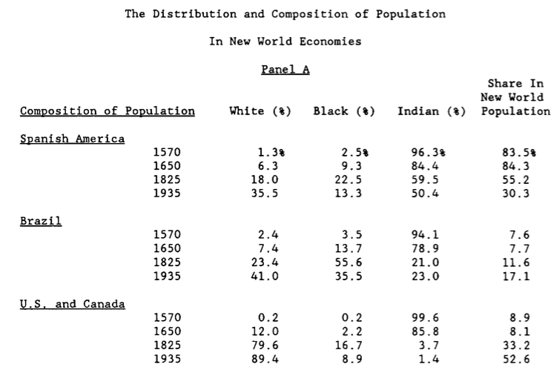
New World Populations

Slide 38
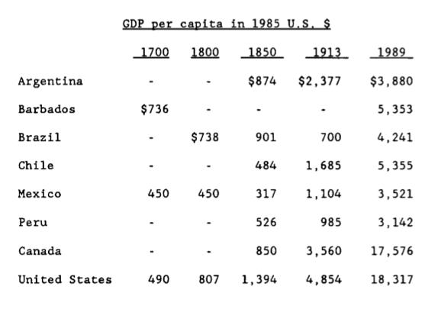
New World Growth

Slide 39
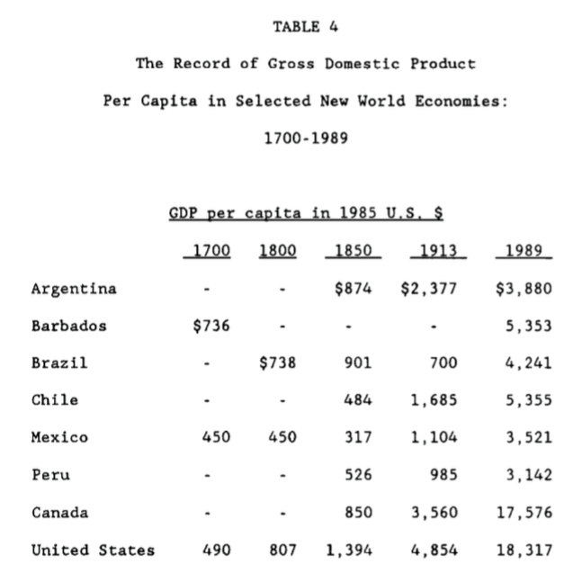
Engerman and Sokoloff: Very Long Run Consequences of Being Ruled by Slave- or Serf-Masters
Different labor systems as the result of the luck of history and “factor endowments”
How do you establish an unfree labor system?
How do you maintain an unfree labor system?
What does having an unfree labor system do to elite incentives?
Does the elite control the economy? If so, does it control it in its long-run interest?

Slide 40
On the Weblog…
Abigail Adams, Polly Jefferson, Sally Hemings, etc…. <http://www.bradford-delong.com/2018/07/abigail-adams-polly-jefferson-and-sally-hemings.html>
Women's Roles in Agrarian-Age Civilization <http://www.bradford-delong.com/2018/07/womens-roles-in-agrarian-age-civilization.html>
Reading: E. M. Halliday (2001): Understanding Thomas Jefferson <http://www.bradford-delong.com/2017/02/reading-e-m-halliday-2001-understanding-thomas-jefferson.html>
Weekend Reading/Hoisted: Reading the Soul of Thomas Jefferson <http://www.bradford-delong.com/2017/03/reading-the-soul-of-thomas-jefferson-archive-entry-from-brad-delongs-webjournal.html>: E.M. Halliday (2001): Quotes from _Understanding Thomas Jefferson_...
The Enigmas of Thomas Jefferson... <http://www.bradford-delong.com/2017/01/the-enigmas-of-thomas-jefferson.html>
Thomas Jefferson and Dumas Malone <http://www.j-bradford-delong.net/movable_type/2004-2_archives/000054.html>
Mastering the Art of French Cooking <http://www.j-bradford-delong.net/movable_type/2003_archives/001864.html>: or Thomas Jefferson as slavemaster...
Email: Slavery in America and Its Consequences <http://www.j-bradford-delong.net/email/slavery.html>: "I don't ow how others will react, but I find it offensive to refer to Sally Hemmings as a 'sex slave'" Ummm... They had sex and she was a slave. Her choices were... limited. You may find it offensive, but that doesn't keep it from being true...
Enigmas of Thomas Jefferson <https://www.icloud.com/pages/0wxmEkVZBXxWgMNIfB6wmFW0Q#>
A Note on the Jeffersonian Road Not Taken in American Economic History <http://www.bradford-delong.com/2016/11/the-jeffersonian-vision.html>
John Adams: Jefferson and the French Revolution: Noted for October 12, 2013 <http://delong.typepad.com/sdj/2013/10/john-adams-jefferson-and-the-french-revolution-noted-for-october-12-2013.html>
Dana Goldstein (2008):: _[Living History <http://www.danagoldstein.com/2008/06/living-history.html>
Ta-Nehisi Coates (2012): _[Slavery Is a Love Song <http://www.bradford-delong.com/2017/04/weekend-reading-ta-nehisi-coates-2012-slavery-is-a-love-song.html#more>

