Slide 1
Reading Clark: Questions
What can we say about the condition of the working class in England from 1209-1640?
What can we say about the condition of the working class in England from 1640-1870?
What can we say about the condition of the working class in England from 1870-today?
When does the break from Malthusian stagnation happen in England?
Why is this date particularly interesting?
How confident are we in Clark’s numbers?
What is the real wage today compared to the real wage in 1800?
What was the real wage in 1800 compared to the real wage in 1450?
What was the real wage in 1800 compared to the real wage in 1320?
When did the real wage in England exceed its 1450 value?
When did the population of England exceed its 1320 value?
J. Bradford DeLong brad.delong@gmail.com 2020-01-08 https://www.icloud.com/keynote/0h4DbG-5t5sfY_ky-UKRBj56A

Slide 2
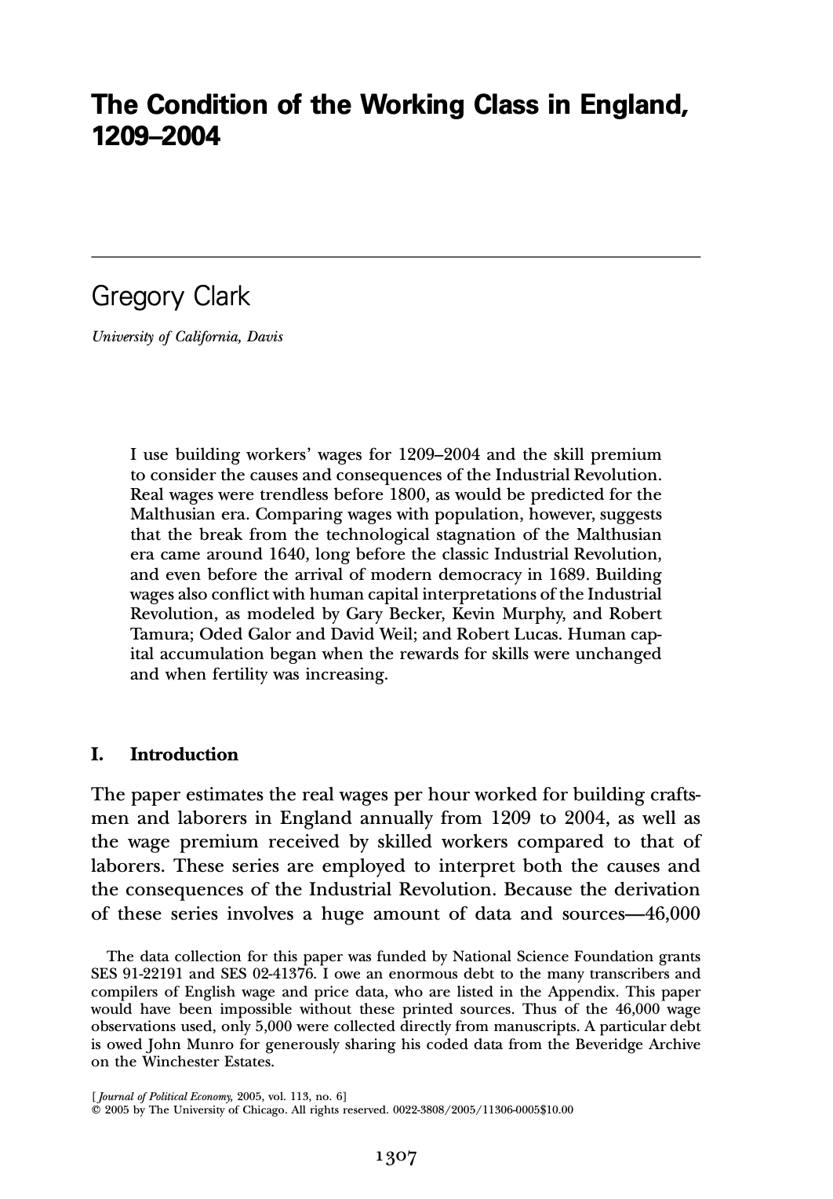
Reading Clark
Gregory Clark (2005): The Condition of the Working Class in England, 1209-2003 <https://delong.typepad.com/files/clark-condition.pdf>
46000 observations on construction workers
Both laborers and craftsmen
110000 observations on prices and housing rents
The break from the Malthusian era of little advance in the efficiency of labor in England began circa 1640:
Long before the famous Industrial Revolution
Before even the emergence of the modern political regime in England in 1689
J. Bradford DeLong brad.delong@gmail.com 2020-01-08 https://www.icloud.com/keynote/0h4DbG-5t5sfY_ky-UKRBj56A

Slide 3
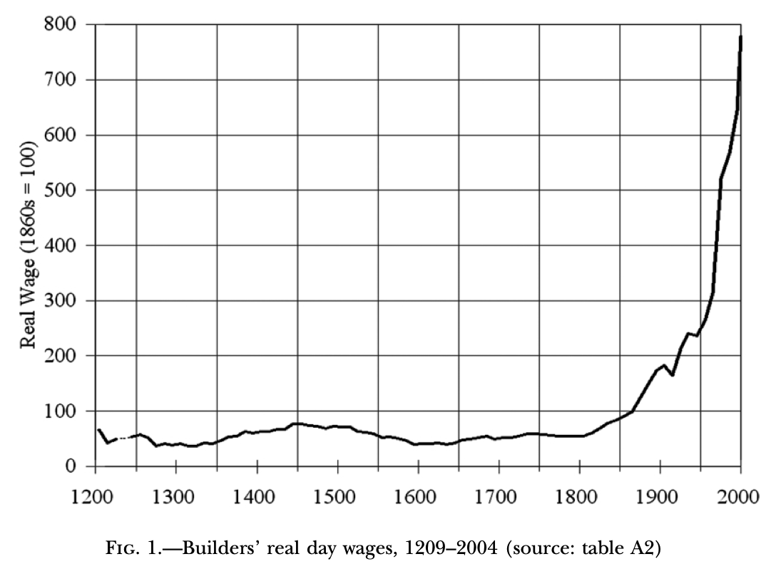
No Trend Until After 180
Before 1800, no clear trend
Real wages in late 1400s twice what they were between 1250 and 1350.
Wages 1250-1350 33% below 1200?
Wages in 1600 back to 1250-1350 low point
1850 75% above 1800
1950 350% above 1800
2000 1300% above 1800
J. Bradford DeLong brad.delong@gmail.com 2020-01-08

Slide 4
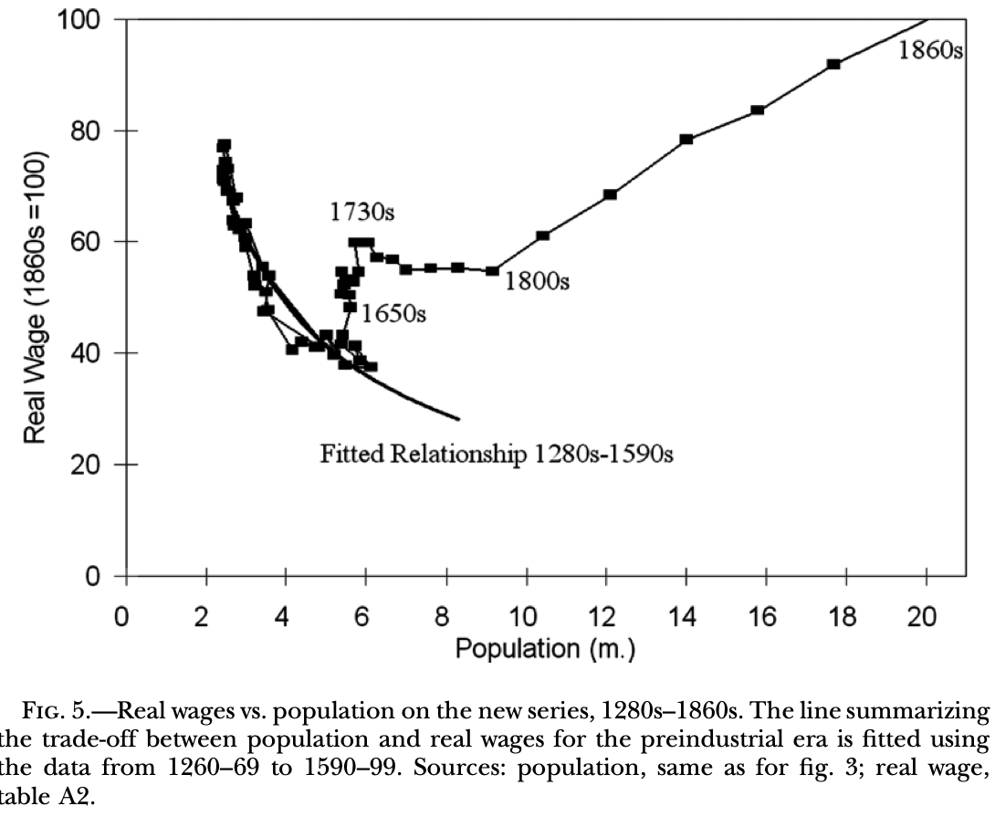
A Pre-1650 Malthusian Relationship
A Malthusian inverse wage-population relationship holds until 1650:
With no, zero, nada improvements in effective technology and organization
In 1625 both the population and the real wage level in England were what they were in 1300
Thereafter England move up and to the right on the graph
First slowly, then rapidly
J. Bradford DeLong brad.delong@gmail.com 2020-01-08

Slide 5
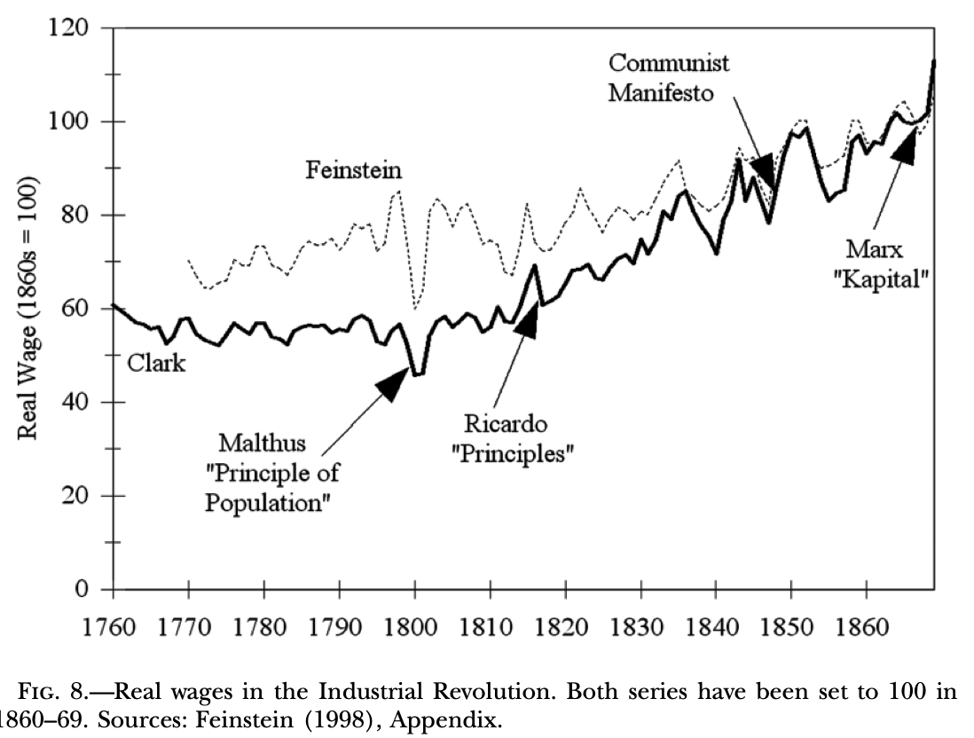
Did Workers Gain in the Early Stages of Industrialization?
Yes: real wages start increasing after 1810
By the writing of the Communist Manifesto, they are 50 above their value as of 1810
But: “When Thomas Malthus published his famous Essay on the Principle of Population in 1798, real wages had been flat or declining for several generations, ever since the first half of the eighteenth century…”
“At the time Malthus was writing, the dramatic technical innovations that transformed cotton spinning—the spinning jenny and water frame in 1769 and the mule in 1776—were almost a generation old. But these gains were expended mainly in allowing significant population growth rather than in raising real wages…”
J. Bradford DeLong brad.delong@gmail.com 2020-01-08

Slide 6
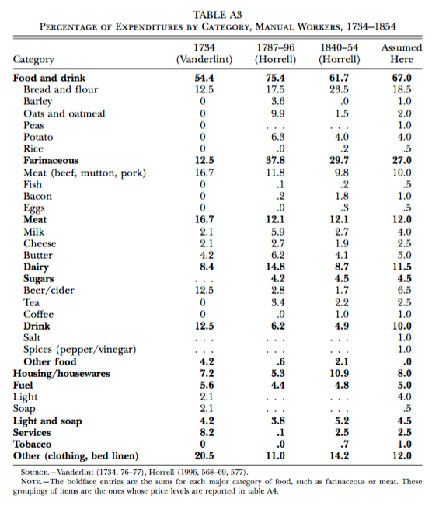
What Did the Working Class Spend Its Money on?
What did the working-class spend its money on in the past?
Even in the 1880s, the U.S. working class—the richest in the world—was spending something like 40% of marginal income dollars on simply getting more calories.
A still-remarkable degree of nutritional stress

Slide 7
Further Reading
Partha Dasgupta (2007): Economics: A Very Short Introduction <https://delong.typepad.com/files/dasgupta-economics.pdf>
Andy Matuschak (2019): Why Books Don’t Work <https://andymatuschak.org/books/>
Betsey Stevenson & Justin Wolfers (2019): Principles of Economics
J. Bradford DeLong brad.delong@gmail.com 2020-01-08

Slide 8
Catch Our Breath…
Ask a couple of questions?
Make a couple of comments?
Any more readings to recommend?

