Slide 1
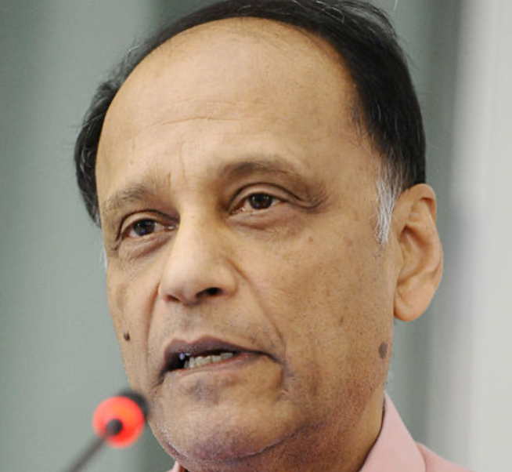
Reading Dasgupta
Partha Dasgupta: Economics: A Very Short Introduction <https://www.google.com/books/edition/Economics/9nsRDAAAQBAJ>
In your econ courses so far you have been taught to “think like an economist”: the marginal… the cost-benefit… the opportunity cost. the interdependence principle.
But why would you want to think like an economist?
Because it is useful in analyzing the economy.
Sir Partha Sarathi Dasgupta, FRS, FBA (born 17 November 1942) is Frank Ramsey Professor Emeritus of Economics at the University of Cambridge, Fellow of St John's College, Cambridge, and Visiting Professor at the New College of the Humanities, London. He was born in Dhaka, present-day Bangladesh.
J. Bradford DeLong brad.delong@gmail.com 2020-01-06 https://tinyurl.com/dl-2020-01-06c https://tinyurl.com/dl-2020-01-06d

Slide 2
What Is the economy?
And why is thinking like an economist the best way to analyze it?
Partha Dasgupta provides the best short answer to those two linked questions, and in the process of doing so provides the best introduction to economics, that I have seen.
A game theorist's short introduction to economics.
You won't get practice figuring out how price and quantity change in response to demand shocks or calculating multipliers.
You will find logic and rationale for why figuring out how price and quantity change in response to demand shocks or calculating multipliers is a worthwhile thing to do.
This is worth getting into your frontal brain lobes because we are going to spend the semester studying the growth of the human economy. And we are going to do so by thinking like economists.
J. Bradford DeLong brad.delong@gmail.com 2020-01-06

Slide 3
Read with Intent
If you just skim it, you will then forget it—and you will have wasted an hour and a half
The problem is that our brains are very good at forgetting irrelevant information
And information we do not use and reuse is irrelevant
I want you to do what I do.
I am rarely just reading.
I am generally also analyzing, compressing, synthesizing, and summarizing.
I am taking notes—but very brief, synthesizing and summarizing notes.
And I am generally asking myself questions—and then answering them.
J. Bradford DeLong brad.delong@gmail.com 2020-01-06

Slide 4
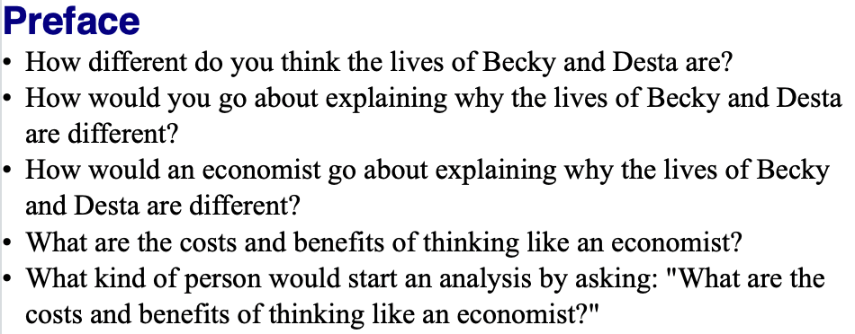
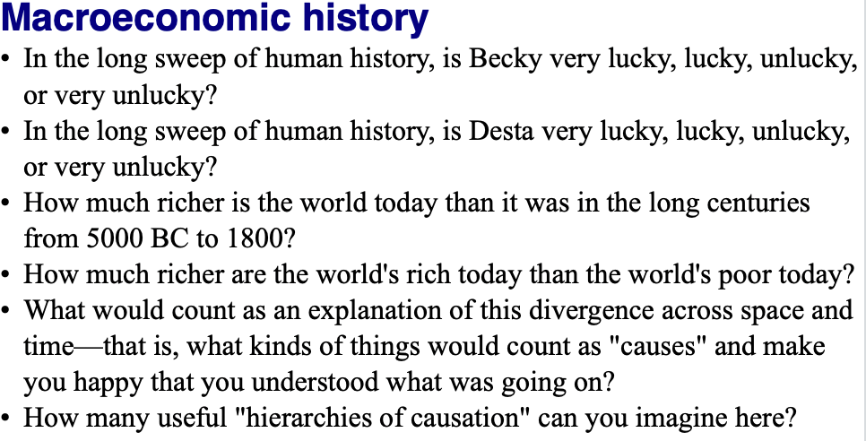
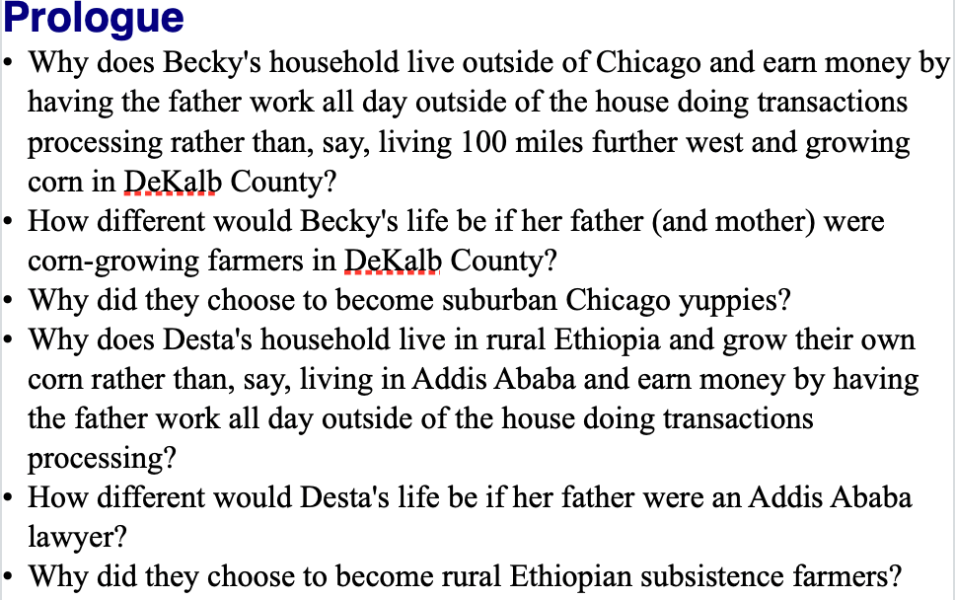
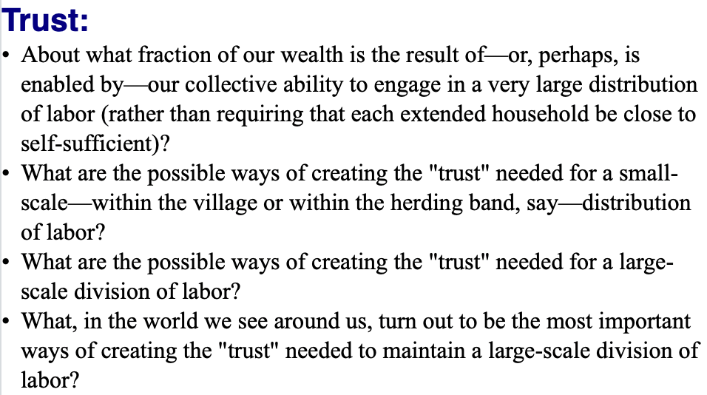
Questions
J. Bradford DeLong brad.delong@gmail.com 2020-01-06

Slide 5
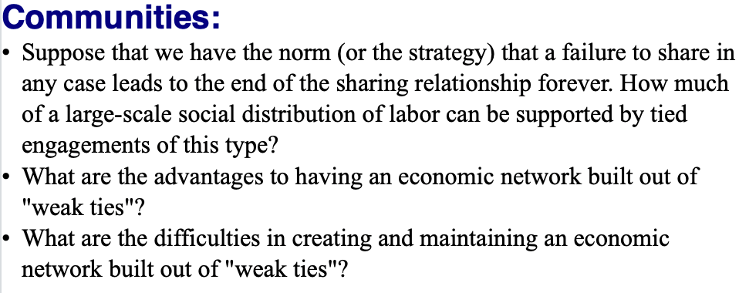
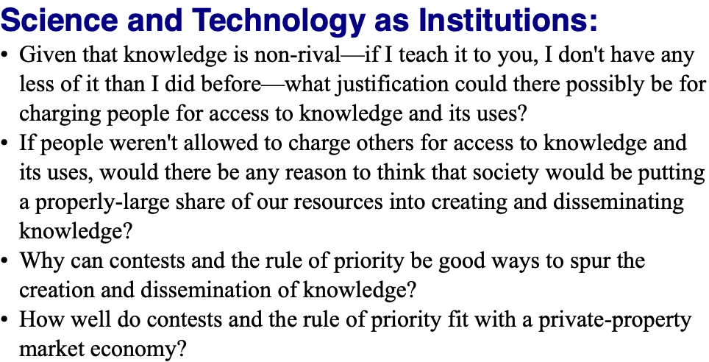
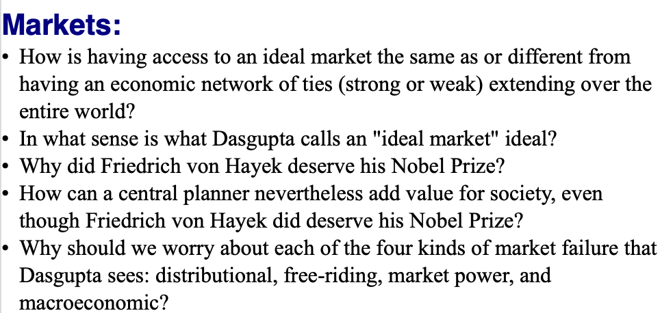
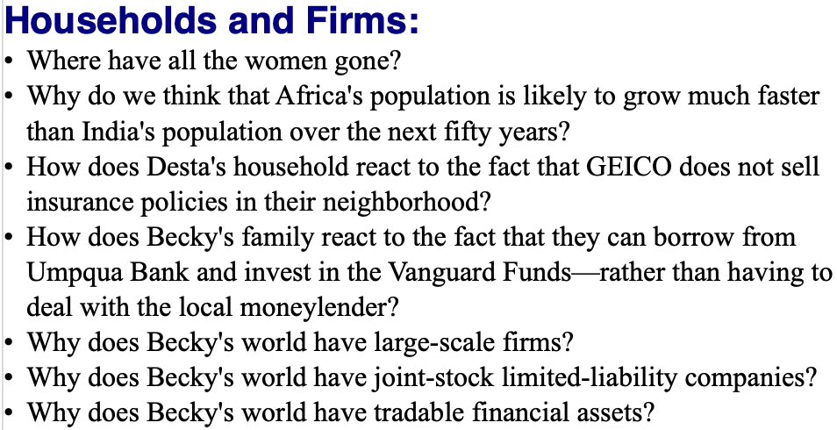
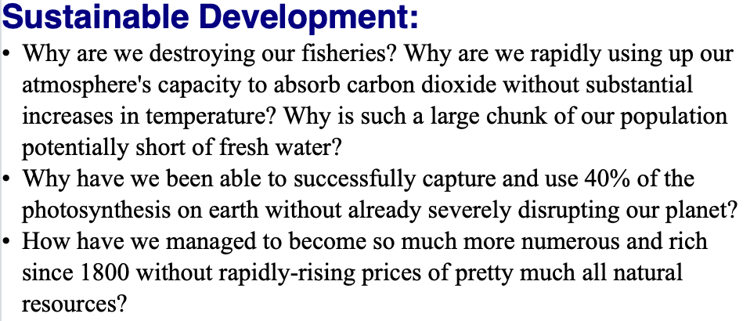
Questions II
J. Bradford DeLong brad.delong@gmail.com 2020-01-06

Slide 6

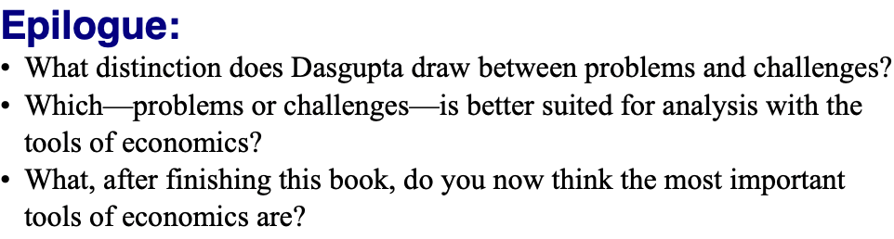
Questions III
J. Bradford DeLong brad.delong@gmail.com 2020-01-06

Slide 7
Further Reading
Partha Dasgupta (2007): Economics: A Very Short Introduction <https://delong.typepad.com/files/dasgupta-economics.pdf>
Andy Matuschak (2019): Why Books Don’t Work <https://andymatuschak.org/books/>
Betsey Stevenson & Justin Wolfers (2019): Principles of Economics
J. Bradford DeLong brad.delong@gmail.com 2020-01-06

