Slide 1
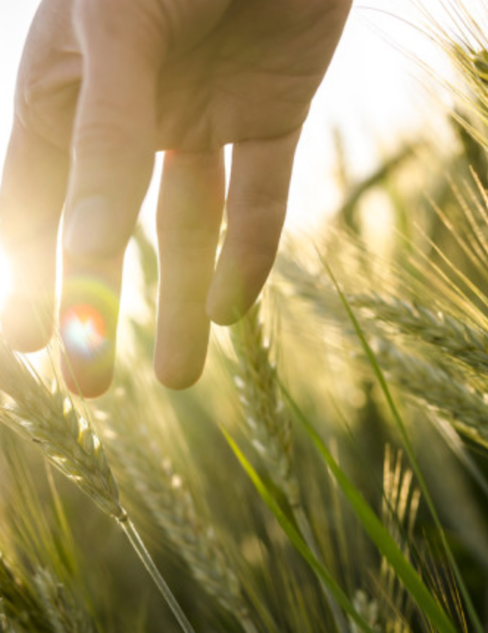
Reading Diamond
Jared Diamond (1999): The Worst Mistake in the History of the Human Race <https://tinyurl.com/dl-2020-01-14a>
“The mix of wild plants and animals in the diets of surviving hunter-gatherers provides more protein and a better balance of other nutrients…”
“Bushmen’s average daily food intake (during a month when food was plentiful) was 2,140 calories and 93 grams of protein, considerably greater than the recommended daily allowance for people of their size…”
J. Bradford DeLong brad.delong@gmail.com 2020-01-14

Slide 2
Jared Diamond: The Worst Mistake in the History of the Human Race
“It’s almost inconceivable that Bushmen, who eat 75 or so wild plants, could die of starvation the way hundreds of thousands of Irish farmers and their families did during the potato famine of the 1840s…”
“Skeletons from Greece and Turkey show that the average height of hunger-gatherers toward the end of the ice ages was a generous 5' 9'' for men, 5' 5'' for women. With the adoption of agriculture, height crashed, and by 3000 B. C. had reached a low of only 5' 3'' for men, 5' for women…”
“Besides malnutrition, starvation, and epidemic diseases, farming helped bring another curse upon humanity: deep class divisions…”:
“Skeletons from Greek tombs at Mycenae c. 1500 B. C. suggest that royals enjoyed a better diet than commoners, since the royal skeletons were two or three inches taller and had better teeth (on the average, one instead of six cavities or missing teeth)”
J. Bradford DeLong brad.delong@gmail.com 2020-01-14

Slide 3
Jared Diamond: The Worst Mistake in the History of the Human Race: Discussion
Accident—not design…
Large groups of people getting together…
Population up —> LR Q of Life not…
General Equilibrium
Outcome
Jared Diamond
Inequality!
Storage…
Can’t really run away…
Malnutrition!
Osteoarcheology…
Akhilleus’s choice…
General bio-medical upset!
Critiques
Assume little inequality before…
End of Ice Age…
Social Peace…
J. Bradford DeLong brad.delong@gmail.com 2020-01-14

Slide 4
Questions
How tall were gatherer-hunters compared to modern people?
How tall were agrarians compared to modern people?
Who ate a better diet: gatherer-hunters or agrarians?
How much taller were the high-and-mighty than the commoners in the agrarian age?
J. Bradford DeLong brad.delong@gmail.com 2020-01-14

Slide 5
Further Reading
J. Bradford DeLong brad.delong@gmail.com 2020-01-08

Slide 6
Catch Our Breath…
Ask a couple of questions?
Make a couple of comments?
Any more readings to recommend?

