Slide 1
Questions
What is your reasonable lower bound as to what national income per capita could have been in any country in 1870 or before? How did you arrive at this lower bound?
What distinguishes the countries that have converged to relative (and absolute!) wealth since 1870?
What common factors do the “other” countries that have not converged to relative wealth since 1870 share?
What was the ratio of the national income of the richest to the poorest country in 1870?
What was the ratio of the national income of the richest to the poorest country in 1990?
What is the role of international price structures in relative income comparisons?
J. Bradford DeLong brad.delong@gmail.com 2020-01-08 https://www.icloud.com/keynote/0yFMTicGJcrl9g6XQ8wwtqmGg

Slide 2
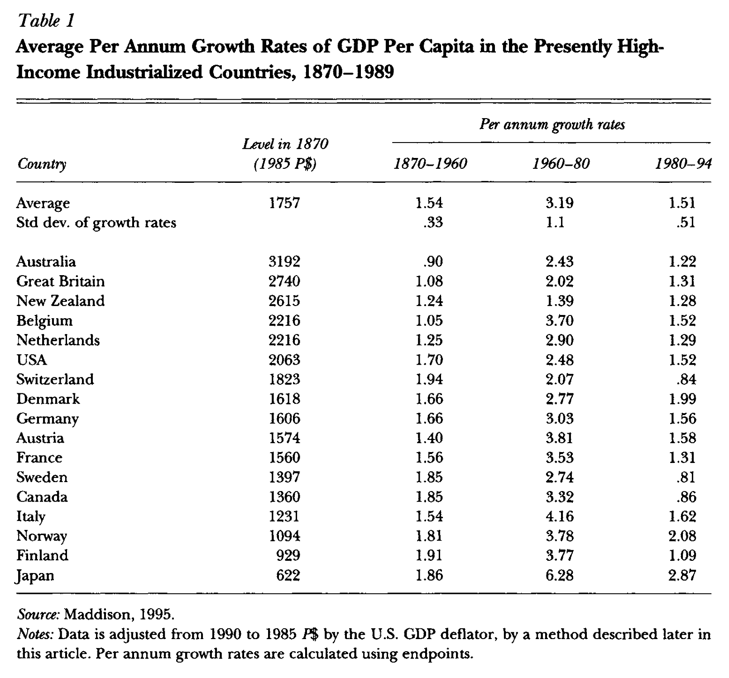
Reading Pritchett
Lant Pritchett (1997): Divergence, Bigtime <https://delong.typepad.com/files/pritchett-divergence.pdf>
Two sets of countries:
The "developed" or the "advanced capitalist”… or the "high income OECD" … European countries and their offshoots plus Japan. Since 1870, the long-run growth rates of these countries have been rapid (by previous historical standards), their growth rates have been remarkably similar, and the poorer members of the group grew sufficiently faster to produce considerable convergence in absolute income levels…
The other… awkwardly, defined only as "the other set of countries," as they have nothing else in common… have been strikingly different… with some converging rapidly on the leaders while others stagnate; and over time, with a mixed record of takeoffs, stalls and nose dives…
From 1870 to 1990 the ratio of per capita incomes between the richest and the poorest countries increased by roughly a factor of five
J. Bradford DeLong brad.delong@gmail.com 2020-01-08 https://www.icloud.com/keynote/0yFMTicGJcrl9g6XQ8wwtqmGg

Slide 3
The “Developed” Economies
There is strong convergence in per capita incomes within this set of countries…
The narrow range of the growth rates over the 1870-1960 period is striking. The United States, the richest country in 1960, had grown at 1.7 percent per annum since 1870, while the overall average was 1.54. Only one country, Australia, grew either a half a percentage point higher or lower than the average, and the standard deviation of the growth rates was only 0.33…
At least since 1870 there has been no obvious acceleration of overall growth rates over time…
Jones (1995) uses this basic fact of the constancy of growth to good effect in creating a compelling argument that the steadiness of U.S. growth implies that endogenous growth models that make growth a function of nonstationary variables, such as the level of R&D spending or the level of education of the labor force, are likely incorrect as they imply an accelerating growth rate (unless several variables working in opposite directions just happen to offset each other)...
J. Bradford DeLong brad.delong@gmail.com 2020-01-08

Slide 4
The “Other” Economies
Poverty Traps, Takeoffs and Convergence:
Sixteen developing countries had negativegrowth over the 1960–1990 period, including Mozambique ( 2.2 percent per annum) and Guyana ( .7 percent per annum)…
As Ben-David and Papell (1995) emphasize, many developing countries have seen their economies go into not just a slowdown, but a “meltdown”…
If we calculate the growth rates in the Penn World Tables and allow the data to dictate one break in the growth rate over the whole 1960–1990 period, then of the 103 developing countries, 81 have seen a deceleration of growth over the period, and the average deceleration is over 3 percentage points…
From 1980–1994, growth in per capita GDP averaged 1.5 percent in the advanced countries and .34 percent in the less developed countries…
These facts about growth in less developed countries highlight its enormous vari- ability and volatility. The range of annual growth rates in per capita GDP across less developed economies from 1960 to 1990 is from 2.7 percent to positive 6.9 percent…
J. Bradford DeLong brad.delong@gmail.com 2020-01-08

Slide 5
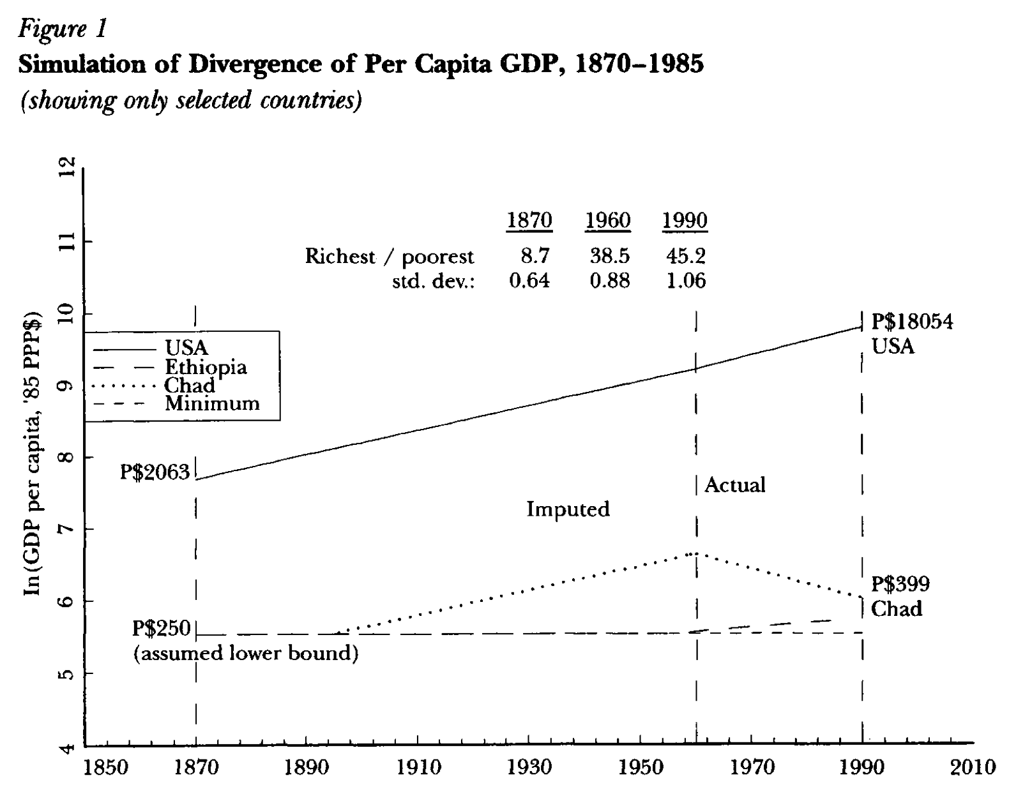
The Necessity of Divergence
Place a reasonable lower bound on what GDP per capita could have been in 1870 in any country:
Using the purchasing power adjustments for exchange rates has an especially important effect in poor countries…
Tradable goods will have generally the same prices across countries because of arbitrage…
Nontradable goods are typically much cheaper in poorer countries because of their lower income levels
A country with a per capita GDP level of $70 (1997) in U.S. dollars, measured in market exchange rates, will have a per capita GDP of P$250 (1997)…
The lowest five-year average level of per capita GDP reported for any country in the Penn World Tables (Mark 5) is P$275 (1997) for Ethiopia in 1961–65…
Maddison (1991) gives estimates of GDP per capita of some less developed countries as early as 1820: P$531 (1997) for India, P$523 (1997) for China and P$614 (1997) for Indonesia. His earliest estimates for Africa begin in 1913: P$508 (1997) for Egypt and P$648 (1997) for Ghana
If you accept: a) the current estimates of relative incomes across nations; b) the estimates of the historical growth rates of the now-rich nations; and c) that even in the poorest economies incomes were not below P$250 (1997) at any point—then you cannot escape the conclusion that the last 150 years have seen divergence, big time…
J. Bradford DeLong brad.delong@gmail.com 2020-01-08

Slide 6
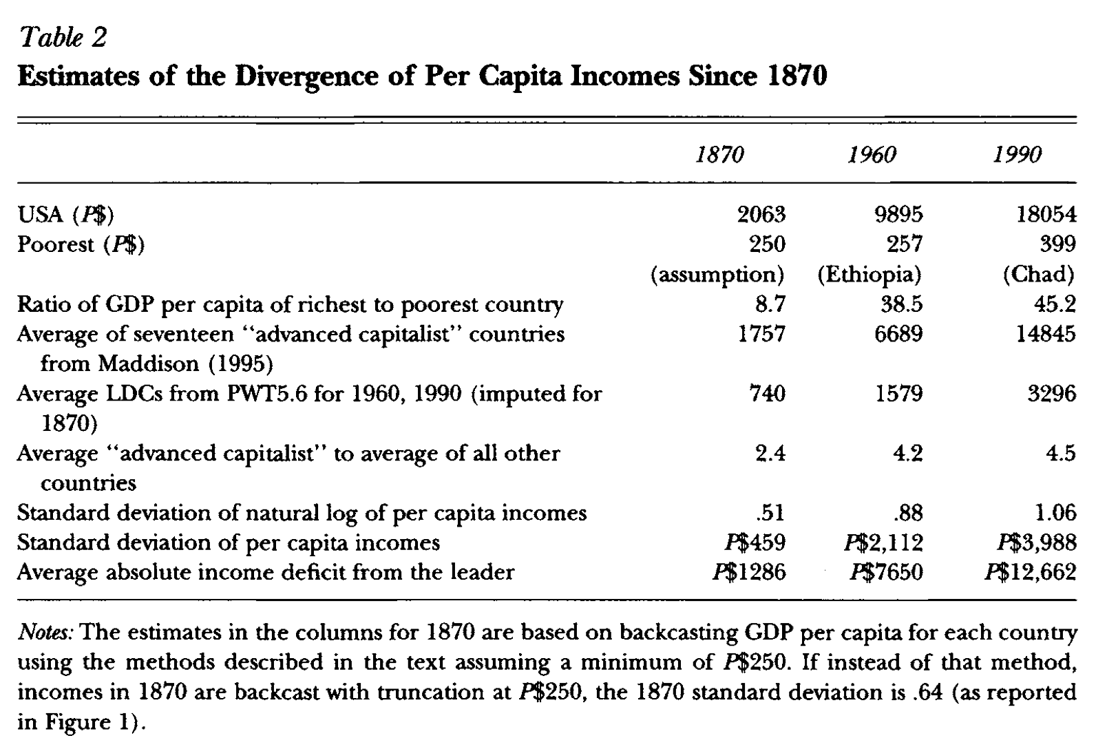
Estimates of Divergence
J. Bradford DeLong brad.delong@gmail.com 2020-01-08

Slide 7
Further Reading
Dan Ben-David and David Papell (1995): Slowdowns and Meltdowns: Post-War Growth Evidence from 74 Countries
Charles Jones (1995): R&D-Based Models of Economic Growth <https://delong.typepad.com/files/jones-r--d.pdf>
Fabio Canova and Albert Marcet (1995): The Poor Stay Poor: Non-Convergence Across Countries and Regions
J. Bradford DeLong (1988): Productivity Growth, Convergence, and Welfare: Comment
William Easterly, Michael Kremer, Lant Pritchett, and Lawrence Summers (1993): Good Policy or Good Luck? Country Growth Performance and Temporary Shocks
Alexander Gerschenkron (1962): Economic Backwardness in Historical Perspective, a Book of Essays
John R. Hanson (1988): Third World Incomes before World War I: Some Comparisons
John R. Hanson (1991): Third World Incomes before World War I: Further Evidence
Charles Jones (1995): R&D Based Models of Economic Growth
N. Gregory Mankiw, David Romer, and David Weil (1992): A Contribution to the Empirics of Economic Growth
J. Bradford DeLong brad.delong@gmail.com 2020-01-08

Slide 8
Catch Our Breath…
Ask a couple of questions?
Make a couple of comments?
Any more readings to recommend?

