Slide 1
Reading Temin
Peter Temin (2014): The Roman Market Economy, chapter 10 Growth in a Malthusian Empire https://delong.typepad.com/files/temin-roman-growth.pdf>
“here is growing evidence that ordinary Romans lived well in the early Roman Empire. The existence of many cities, and particularly the large size of Rome itself, provides indirect evidence of productivity advance. More detailed evidence is emerging of improving agricultural technology, building techniques, manufacturing plants, and land use. The widespread use of African Red Slipware pottery provides evidence that even ordinary people had access to the fruits of all this technology. And the literary evidence supports the idea of prosperity by providing insights into civilized urban lives in Roman cities. As explained in chapter 9, these are all proxies for economic growth. They are not measures, but they are suggestive. How could per capita income grow in a Malthusian economy? This chapter resolves the apparent paradox of economic growth in a Malthusian world…”
J. Bradford DeLong brad.delong@gmail.com 2020-01-14 https://tinyurl.com/dl-2020-01-14b

Slide 2
Room for Growth in a Malthusian Regime?
There are important delays in the Malthusian system. These dynamics are integral to the Malthusian model, and historical evidence from other periods indicate that the delays can be exceedingly long—on the order of centuries rather than decades:
These dynamics provide a way to acknowledge growing per capita income in the basically Malthusian world of the early Roman Empire.
It also provides a way to ask if the Romans could have escaped—in some alternate history—the Malthusian constraints.
The hypothesis of a one-time increase in productivity sees the productivity increase coming from the increase in Mediterranean trade promoted by the Romans: Scheidel (2009a) made a case for this hypothesis one in Roman times
The hypothesis of continuing productivity growth.
Economists create these oppositions for intellectual clarity, but history has a way of splitting the difference or revealing a more complex story than either extreme hypothesis.
“Soft” technologies of attitudes and markets described in previous chapters that also contributed to economic prosperity and growth.

Slide 3
Roman Technology
Finley was wrong—at least insofar as the spread of technology is concerned:
Terracing was common, extending the range of land on which crops, particularly grapes and olives, could be grown.
Wine and oil presses also used the screw, enabling grapes and olives grown on new land to be processed more efficiently.
The Archimedean screw was used widely in cereal agriculture to drain land, extending the range of land that could be used for this crop as well.
Everyone knows about the Roman use of arches and concrete to construct buildings, roads, and ports.
Aqueducts are well known, but the sophistication needed to construct them seldom is noticed
Water wheels also were more prevalent in Roman times than previously thought.
Mass-produced Roman products were prevalent: “Pottery, glassware, bricks, coins, plate, and humble metal objects such as nails were pro- duced in enormous quantities to standard shapes and sizes, and widely traded around the Roman Mediterranean and northern Europe” (Wilson 2008, 393).

Slide 4
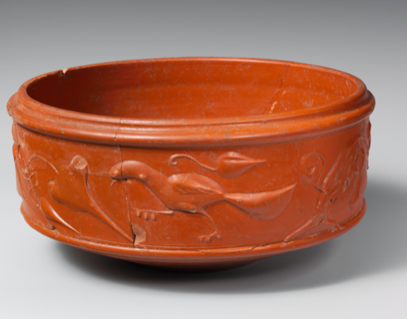
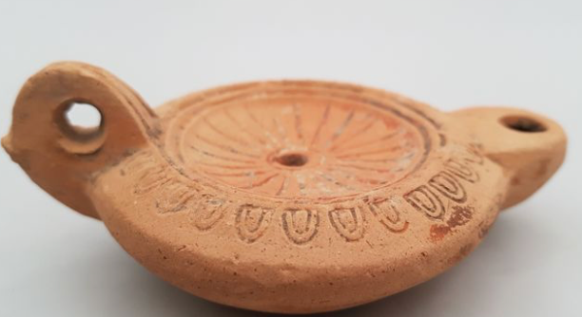
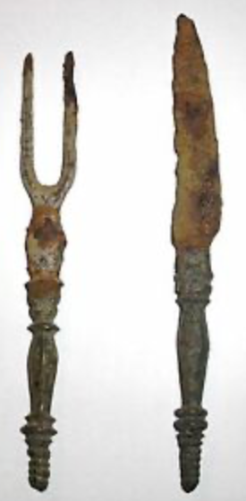
Roman Mass Consumption
Ordinary people also had consumer durables that were better than those before or after:
Industrial goods were made in centralized locations and shipped all over the Roman world
The most prevalent was African Red Slipware, ordinary pot- tery that is found everywhere in Roman settlements
Ordinary people had iron knives with which to cut their food
The omnipresent oil lamp was another consumer durable of Roman times.
Allen (2009a) used data from the Diocletian Price Edict of 301 to compare real wages in Rome with those in early-modern European and Asian cities. He found that the real wage calculated from the Price Edict was close to the real wage in Florence in the eighteenth century.

Slide 5
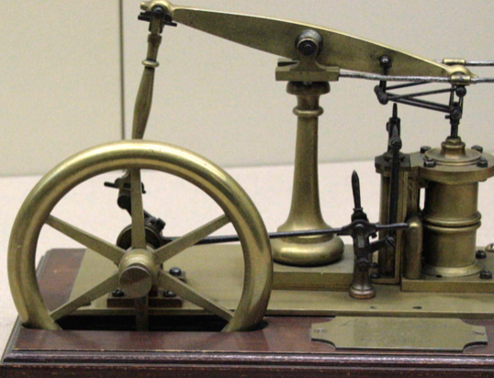
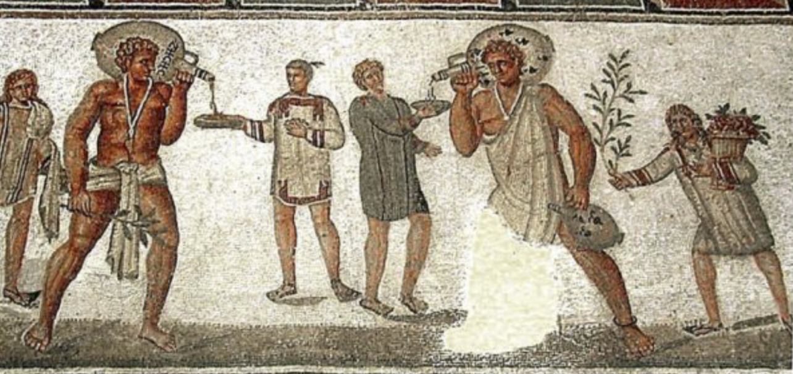
Why No Roman Industrialization?
industrialization began in England as a result of two forces: high wages and really cheap coal
The high ratio of wages to energy costs was not only absent in eighteenth- century continental Europe; it was absent as well in the Roman Empire.
More wealth to be gained by commanding slaves than by commanding nature.

Slide 6
Questions

Slide 7
Further Reading
J. Bradford DeLong brad.delong@gmail.com 2020-01-08

Slide 8
Catch Our Breath…
Ask a couple of questions?
Make a couple of comments?
Any more readings to recommend?

