Slide 1
Macroeconomics:
Background: Malthusian Economic Growth 70000 BC - 1500
J. Bradford DeLong
Economics and Blum Center of U.C. Berkeley, WCEG, and NBER
Delivered 2018-01-18
delong@econ.berkeley.edu http://bradford-delong.com @delong
<https://tinyurl.com/101bS2018>
<https://www.icloud.com/keynote/0Dy-Qg7Z__2fBvaECGbKVCvIg>
<https://github.com/braddelong/public-files/blob/master/module-malthusian-#MRE-d.pptx>
http://bradford-delong.com brad.delong@gmail.com

Slide 2
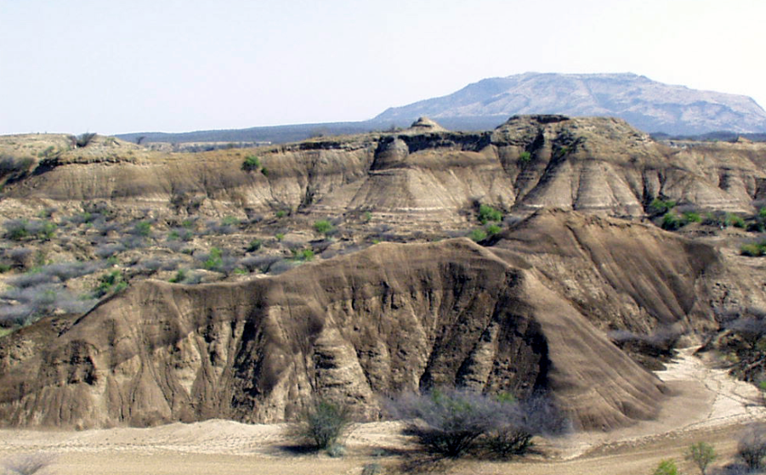
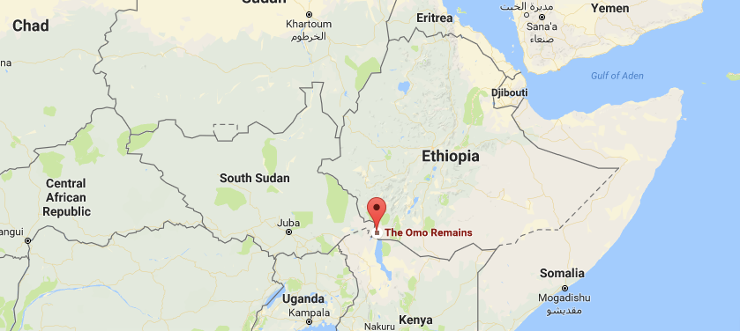
Anatomically Modern Humans
Anatomically modern humans—Home Sapiens Sapiens—evolved about 200,000 years ago:
In the Horn of Africa.
Omo Kibish remains in Ethiopia.
Behaviorally modern humans:
80KYrs ago? 50KYrs ago?
Gradual or sudden?

Slide 3
Behaviorally Modern Humans
Behaviorally modern humans:
80KYrs ago? 50KYrs ago?
Gradual or sudden?
Why?
Toba (Indonesia) supereruption of 75K BC…

Slide 4
Near Extinction?
Toba (Indonesia) volcanic supereruption of 75K BC:
Did it knock our breeding population down to 1K—did we almost go extinct?
Or did about 1K of us gain key advantageous traits of behavioral modernity, and then out compete the rest?

Slide 5
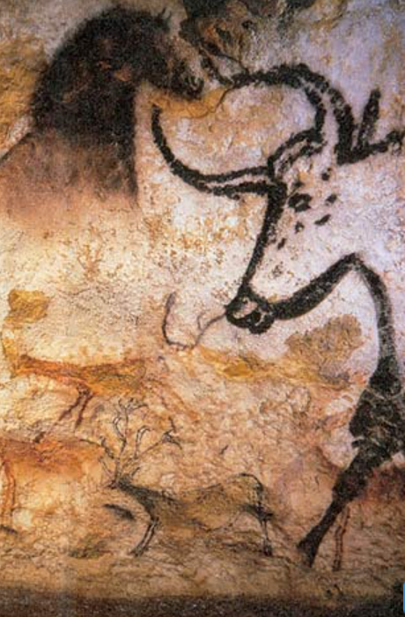
Behaviorally Modern Humans
By 50KYrs ago…
Archaeological evidence of behavioral modernity:
Art: cave paintings, petroglyphs, figurines
Pigment and jewelry for adornment
Bone tools
Long-distance transport
Blades
Hearths
Regional distinctions but standardization within regions
burial

Slide 6
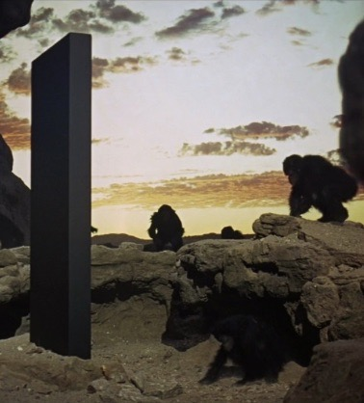
What Made Us Behaviorally Modern?
We use language:
Thus we become an anthology intelligence.
What one person learns, soon everybody knows.
We don’t just use language
We gossip
Constantly
Even when we know we shouldn’t…

Slide 7
In Addition…
NEW: We use language:
Thus we become an anthology intelligence.
What one person learns, soon everybody knows.
OLD: We make and use tools:
Complex, composite tools.
Making tools vs., say, building nests
OLD: We are sociable:
Much more sociable than our chimp, gorilla, orangutang cousins
Perhaps less than our bonobo cousins?

Slide 8

Civilized Sociable Language- and Tool-Using East African Plains Ape
What would an alien intelligence—vast, cool, and sympathetic or unsympathetic—say about us?
Form:
Mammals with opposable thumbs, upright posture, and big brains
Numbers: A lot of us: 7.4 billion now
Behavior
Sociable, linguistic, tool-using
Gossip (about food, threats, mating, etc.)
Alter our environment
Large-scale social division of labor—greater than seen in the social insects—mediated by markets and exchange
Gift-exchange

Slide 9
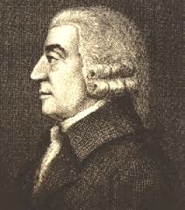
Adam Smith
Natural propensity to “truck, barter, and exchange”.
We form gift-exchange relationships with those we trust and to create trust—patterns of mutual obligation.
We have developed money to create trust between strangers.
On top of this natural propensity to develop gift-exchange relationships and the social institution of money-as-trust we have built our largely peaceful 7.4B-strong prosperous societal division of labor.

Slide 10
The Wealth of Nations and the System of Natural Liberty
Adam Smith's 1776 Wealth of Nations contains a genuinely game-changing insight:
The “system of natural liberty”—markets and exchange—
Has some remarkable advantages.
Just let people exchange things freely:
in an environment in which property is secure, and
in which there is an alternative deal almost as good just down the street, and
things will work out remarkably well…

Slide 11
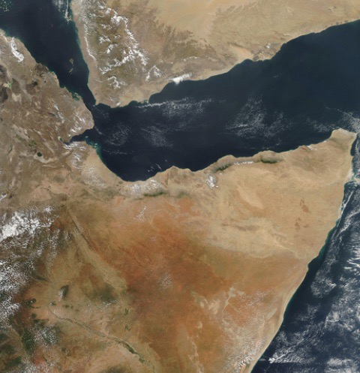
Radiation from the Horn to the Rest of and Out of Africa 50,000 Years Ago?
“Some 70,000 years ago, a part of the bearers of mitochondrial haplogroup L3 migrated from East Africa into the Near East…. From a population of 2,000 to 5,000 in Africa… possibly as few as 150 to 1,000 people, crossed the Red Sea…”

Slide 12
To the Rest of the World…
India as their first apparent stop…
Then radiation to Eurasia, Australasia—and then the Americas, Oceania…

Slide 13
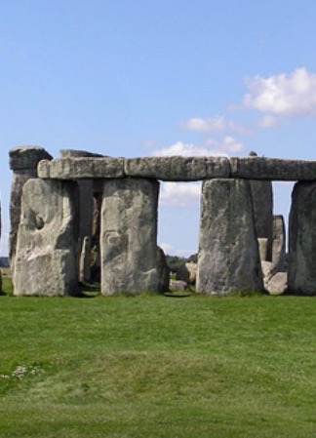
Neolithic Revolution 12-10KYrs Ago
Agriculture and herding:
Great things for the generations that discover and introduce them…
Can easily triple or quadruple how much food you can gather…
And that is without making big investments to further alter the environment.
Plus: infant mortality goes down:
No longer carrying babies as the band moves from place to place.

Slide 14
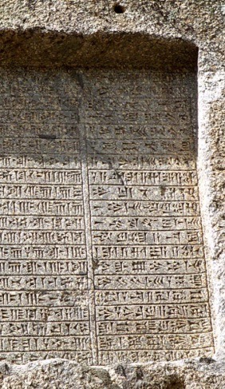
Literacy Revolution 7-4KYrs Ago
Agriculture, herding a great thing for the generations that discover and introduce it…
And agricultural regions fill up until population growth… stops…
Preventative check
Positive check
Malthusian Agrarianism—near-stagnation—as the default state of post-Neolithic humanity?
Thereafter the pace of technological improvement is slow…
But it is at least positive—and there is hope for something better after 3000 BC, for now it is the case that knowledge—or ideology and lies—can be reliably recorded and transmitted down the years

Slide 15
But Was Agriculture a Good Thing?
Agriculture, herding a great thing for the generations that discover and introduce it…
And agricultural regions fill up until population growth… stops…
Preventative check
Positive check
Malthusian Agrarianism—near-stagnation—as the default state of post-Neolithic humanity?
The shift to agriculture possibly the worst mistake in the history of the human race?

Slide 16
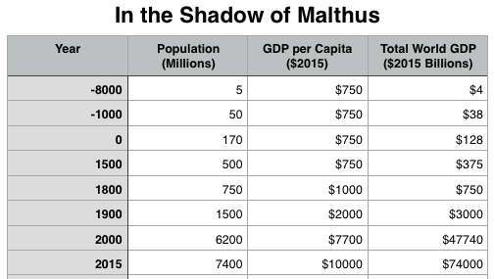
A Global Ten-Millennia Bird’s-Eye View of It All…
Linguistic quasi-speciation 100,000 years ago—or Less?
Radiation from the Horn of Africa 50,000 years ago?
Neolithic Revolution 10000 years ago.
Literacy Revolution 5000 years ago?
Growth rates?

Slide 17
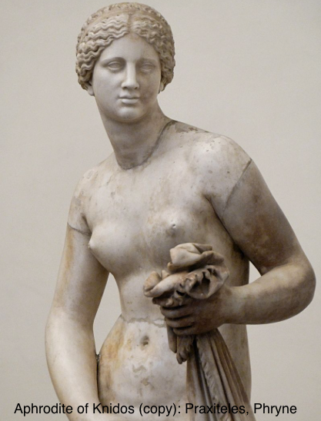
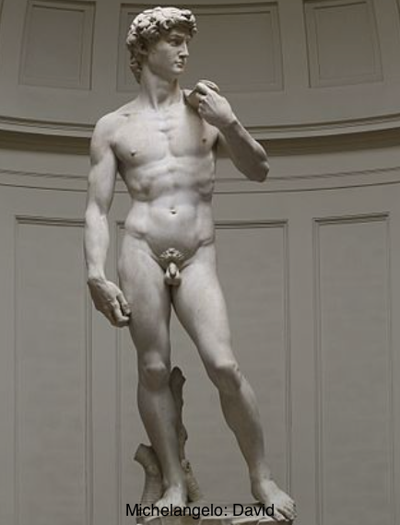
“Ancient” Ain’t “Primitive” or “Unsophisticated”
Could we teach:
Themistokles or Augustus much about politics?
Homer much about writing poetry?
Gaius Julius Caesar or Leonidas much about generalship?
Sophokles much about drama?
Phryne much about presentation-of-self-as-celebrity?
Michelangelo di Lodovico Buonarroti Simon much about painting ceilings?
Praxiteles much about sculpture?
Johann Sebastian Bach much about music?

Slide 18
A Global Ten-Millennia Bird’s-Eye View of It All… II
Malthusian Agrarianism—near-stagnation—as the default state of post-Neolithic humanity?
Industrial Revolution
Modern Economic Growth
Astronomy and the Fermi Paradox: The Great Filter

Slide 19
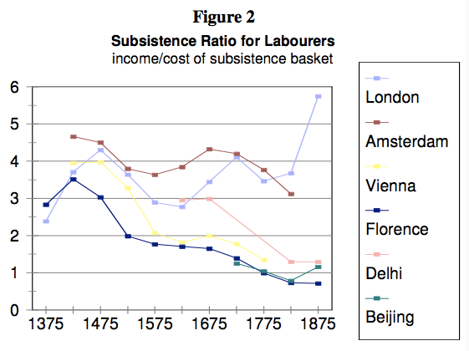
From Robert Allen: The British Industrial Revolution in Global Perspective
This is a “subsistence basket” for a family…
Unskilled urban laborers…
How would one go about thinking of how representative of the population in general such numbers are?

Slide 20
Let’s Calculate Some Growth Rates…
From 1000 BC to 0:
ln(170/50)/1000
http://google.com
= 0.12%/year
A nutritionally unstressed human population doubles every 30 years or so…
ln(2)/30 = 2.4%/year

Slide 21
How Much Pressure Is Human Life Under?
Preventative checks:
Late marriage patterns (nuclear, lineage); large scale female infanticide
Positive checks
Too skinny to ovulate?
Compromised immune systems?
Famine?

Slide 22
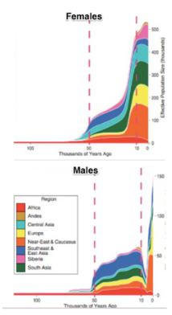
Low Patriarchy
Even when there do not appear to be durable polygynous lineages…
Agrarian life:
2 reproduce
4 reach puberty
7 live births
9 pregnancies
6 years pregnant; 15 years breastfeeding
biological load of eating for two
tied to the garden and the loom
Men take advantage…

Slide 23
High Patriarchy
During the early Agrarian Age…
A bigly greater proportion of men rather than women not leaving descendants…
Polygyny
Sustained polygony
“The sons of Heracles”
A sign of extraordinary social and economic inequality
Within the male gender
And, of course, between genders
Then the gender component goes away…
Polygyny becomes limited to the very very top…

Slide 24
There Are Exceptions
Exceptional elites
Exceptional regions
Exceptional eras
European marriage patterns
Asian lineage families
Large-scale female infanticide
Otherwise… Malthus rules

Slide 25
Very Slow Growth of Technology
And people—inventive people—aren’t that focused on rapid technological development
ln(128/38)/1000
= ?
ln(74000/47740)/15
= ?

Slide 26
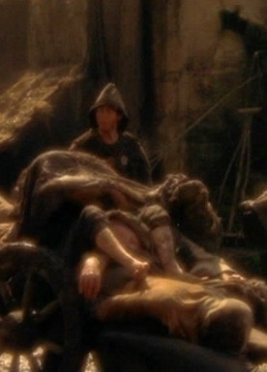
Malthusian Stagnation as the Default State?
Look at from 8000 BC to 1500 or 1800
Enormous increases in population
But spread out over enormous lengths of time
Static living standards for the most part
Exceptions:
Colonization
Biotechnology
European marriage pattern
Asian lineage family pattern
Large-scale female infanticide

Slide 27
And Yet, It Adds Up…
Growth of 0.1%/year = doubling time of 690 years
Growth of 0.1%/year = thousandfold time of 6900 years
We have 1.5 of those 0.1%/yr-thousandfold times since the Neolithic Revolution
Changes that are absolutely glacial over a year or a generation do add up

Slide 28
Are You Now Oriented?
Comments?
Questions?

