Slide 1
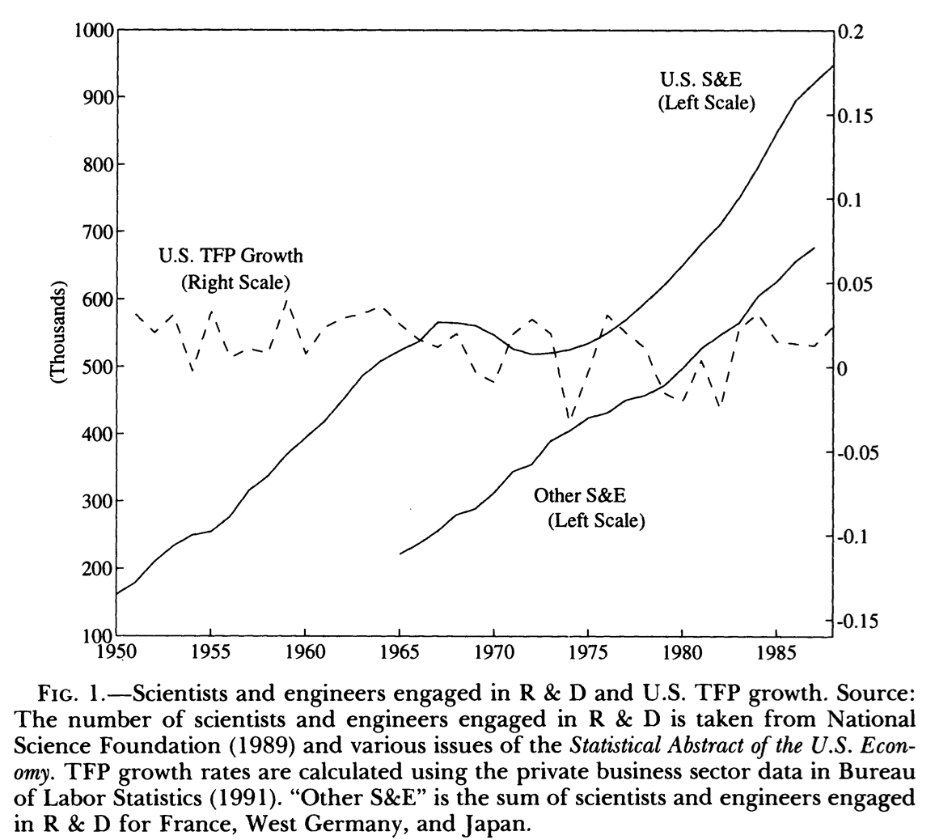
Reading Jones
Charles Jones (1995): R&D-Based Models of Economic Growth <https://delong.typepad.com/files/jones-r--d.pdf>
The 'scale effects' prediction of R&D-based models of growth is inconsistent with the time-series evidence from industrialized economies…
Eliminating the prediction of scale effects typically alters other implications of the R&D-based models induces a return to Solow-like implications for long-run growth...
Growth then becomes independent of policy changes such as subsidies to R&D or... capital accumulation...
J. Bradford DeLong brad.delong@gmail.com 2020-01-08

Slide 2
Making a “Semi-Endogenous” Model
Decreasing returns to R&D, and stepping-on-toes effects
The steady-state growth rate depends on the growth rate of inventions....
Welfare properties... are driven primarily by the monopolistic competition associated with innovation rather than by the externalities associated with R&D:
If there are diminishing returns to R&D... there may actually be too much R&D....
[Duplication and overlap] will [also] cause the decentralized economy to over invest....
Because of the monopoly markup over marginal cost in the sale of producer durables to the final sector... too little labor... [will be] devoid to R&D along the balanced-growth path....
[But] for nearly all these parameter values [tried], the decentralized economy underinvests in R&D.... The interaction between market structure and [intellectual property]... is possibly more important than the degree of externalitries in the R&D process itself...
J. Bradford DeLong brad.delong@gmail.com 2020-01-08

Slide 3

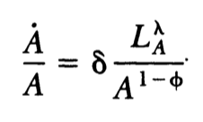
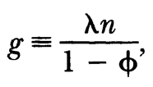
Jones’s Math
Steady-state growth rate is the effective rate of STEM labor force growth divided by the degree to which there are decreasing returns to investment in R&D:
Increased R&D effort from a larger STEM workforce has to be just offset by increasing difficulty of discovery as the low-hanging fruit has already been picked…
A: total factor productivity…
LA: labor employed in invention…
φ: value less than zero means that the invention pool gets “fished out”…
lA: external effects of crowding on net invention…
LA = lA in equilibrium…
λ-1: how much crowding into research reduces net invention…
Assuming φ < 1 eliminates the scale effects, which are replaced by a dependence of the steady-state growth rate on the growth rate of the (STEM) labor force rather than on its level…
Steady-state dynamics not terribly relevant: 1/e time for the model is on the order of 200 years…
Cf. 30 years for a typical 1/e time for the neoclassical growth model…
J. Bradford DeLong brad.delong@gmail.com 2020-01-08

Slide 4
Jones’s Math II
Steady-state growth rate is the effective rate of STEM labor force growth divided by the degree to which there are decreasing returns to investment in R&D:
Increased R&D effort from a larger STEM workforce has to be just offset by increasing difficulty of discovery as the low-hanging fruit has already been picked…
A: total factor productivity…
LA: labor employed in invention…
φ: value less than zero means that the invention pool gets “fished out”…
lA: external effects of crowding on net invention…
LA = lA in equilibrium…
λ-1: how much crowding into research reduces net invention…
Assuming φ < 1 eliminates the scale effects, which are replaced by a dependence of the steady-state growth rate on the growth rate of the (STEM) labor force rather than on its level…
Steady-state dynamics not terribly relevant: 1/e time for the model is on the order of 200 years…
Cf. 30 years for a typical 1/e time for the neoclassical growth model…
J. Bradford DeLong brad.delong@gmail.com 2020-01-08

Slide 5
Questions
Given that the STEM labor force has increased massively since 1870, what modeling strategy does Jones use to build a model in which the rate of TFP growth has not materially accelerated since 1870?
What is the steady-state growth rate in terms of the rate-of-increase n of the STEM labor force, the extent λ to which increases in the STEM labor force increase effective R&D effort, and the wedge 1-φ between actual and constant returns to scale ease of innovation due to the early picking of low-hanging fruit?
What is the intuition behind the formula for the steady-state growth rate that Jones comes up with?
How long is the 1/e time for convergence to the steady-state growth path for this model of Jones’s?
How relevant is the steady-state growth path?
J. Bradford DeLong brad.delong@gmail.com 2020-01-08

Slide 6
Further Reading
J. Bradford DeLong & Lawrence H. Summers (1991): Equipment Investment and Economic Growth <http://www.j-bradford-delong.net/pdf_files/QJE_Equipment.pdf>
Charles Jones (1994): Economic Growth and the Relative Price of Capital <https://web.stanford.edu/~chadj/JonesJME1994.pdf>
Michael Kremer (1993): Population Growth and Technological Change: One Million B.C. to 1990 <http://www.jstor.org/stable/2118405>
Lant Pritchett (1997): Divergence, Bigtime <https://delong.typepad.com/files/pritchett-divergence.pdf>
Robert Solow (1956): A Contribution to the Theory of Economic Growth <http://piketty.pse.ens.fr/files/Solow1956.pdf>
J. Bradford DeLong brad.delong@gmail.com 2020-01-08

