Slide 1
Questions
How much shorter were pre-industrial humans than modern humans?
Does it look like laborers were richer or poorer in classical Athens than in Britain in 1800?
Does it look like laborers were richer or poorer in ancient Babylonia than in Britain in 1800?
What were he implications of the western European marriage pattern?
What did the typical person before the Industrial Revolution spend their money on?
What is the pattern of long-run real wage trends in England?
When does it look like English technology began to improve?
When did English real wages begin to exceed their levels of 1450?
When did the population of England begin to exceed its level of 1310?
What were the long-run consequences of the Neolithic Revolution?
Why did the Neolithic Revolution take place?
In the Malthusian model, what are the consequences of a one-shot improvement in technology?
In the Malthusian model, what are the consequences of a downward shift in the birth rate schedule?
In the Malthusian model, what are the consequences of a downward shift in the death rate schedule?
J. Bradford DeLong brad.delong@gmail.com 2020-01-13 https://www.icloud.com/keynote/0528R1DULwv4FG3FC7l4LND6A

Slide 2
Reading Clark: A Farewell to Alms: Selections
Greg Clark (2007): A Farewell to Alms, selections <https://delong.typepad.com/files/clark-alms-selections.pdf>
The Malthusian model requires only three basic assumptions:
Each society has a birth rate, determined by customs regulating fertility, but increasing with material living standards.
The death rate in each society declines as living standards increase.
Material living standards decline as population increases.
As long as technology improved slowly, material conditions could not permanently improve, even while there was cumulatively significant gain in the technologies
The typical rate of technological advance before 1800 was well below 0.05 percent per year, about a thirtieth of the modern rate
J. Bradford DeLong brad.delong@gmail.com 2020-01-13 https://www.icloud.com/keynote/0528R1DULwv4FG3FC7l4LND6A

Slide 3
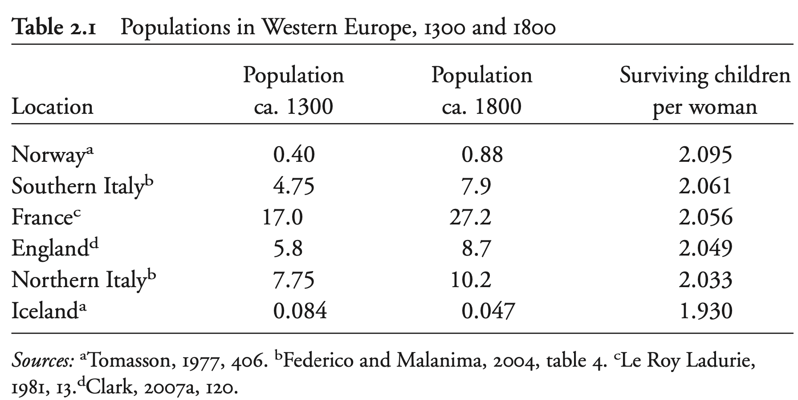
Average Surviving (and Reproducing) Children per Woman, 1300-1800
World population grew from perhaps 0.1 million in 130,000 BC to 770 million by 1800.
But this still represents an average of 2.005 surviving children per woman before 1800.
Even within successful preindustrial economies, such as those in western Europe, long-run rates of population growth were very small
In a stationary population life expectancy is the inverse of the death rate.
In a stationary population birth rates equal death rates.
Thus in preindustrial society the only way to achieve high life expectancies was by limiting births.
J. Bradford DeLong brad.delong@gmail.com 2020-01-13

Slide 4
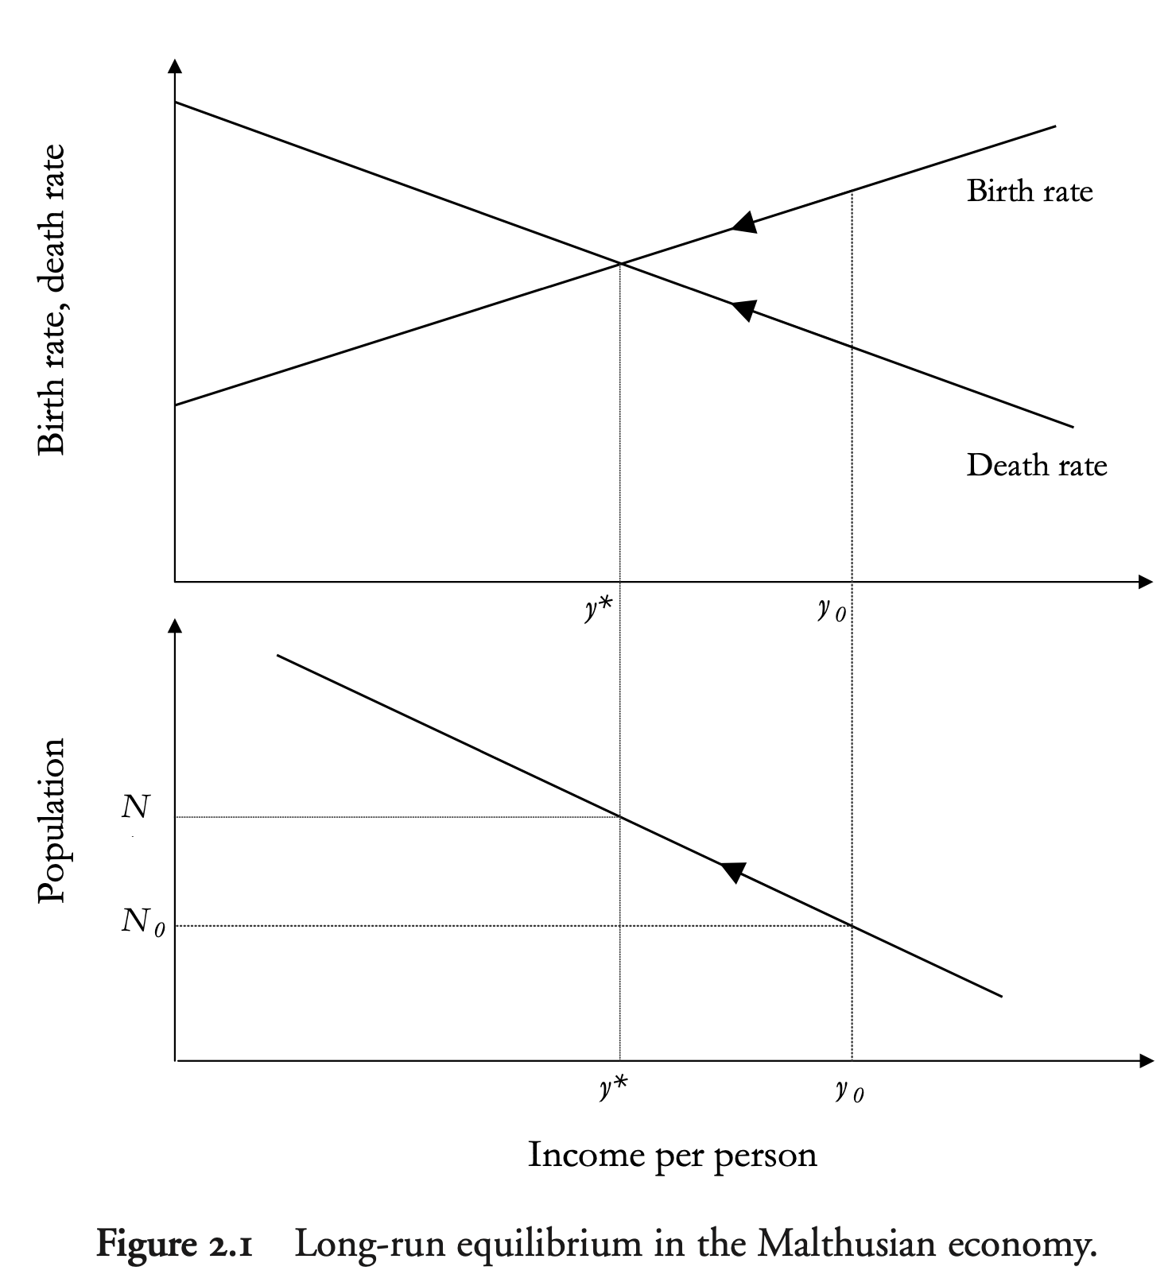
Material Living Standards in Malthusian Equilibrium
For all societies before 1800, the bulk of material consumption was food, shelter, and clothing
Material living standards will be so low as to make life expectancy the inverse of the birth rate
Children so malnourished their immune systems are compromised
Potential mothers so malnourished they fail to ovulate reliably
J. Bradford DeLong brad.delong@gmail.com 2020-01-13

Slide 5
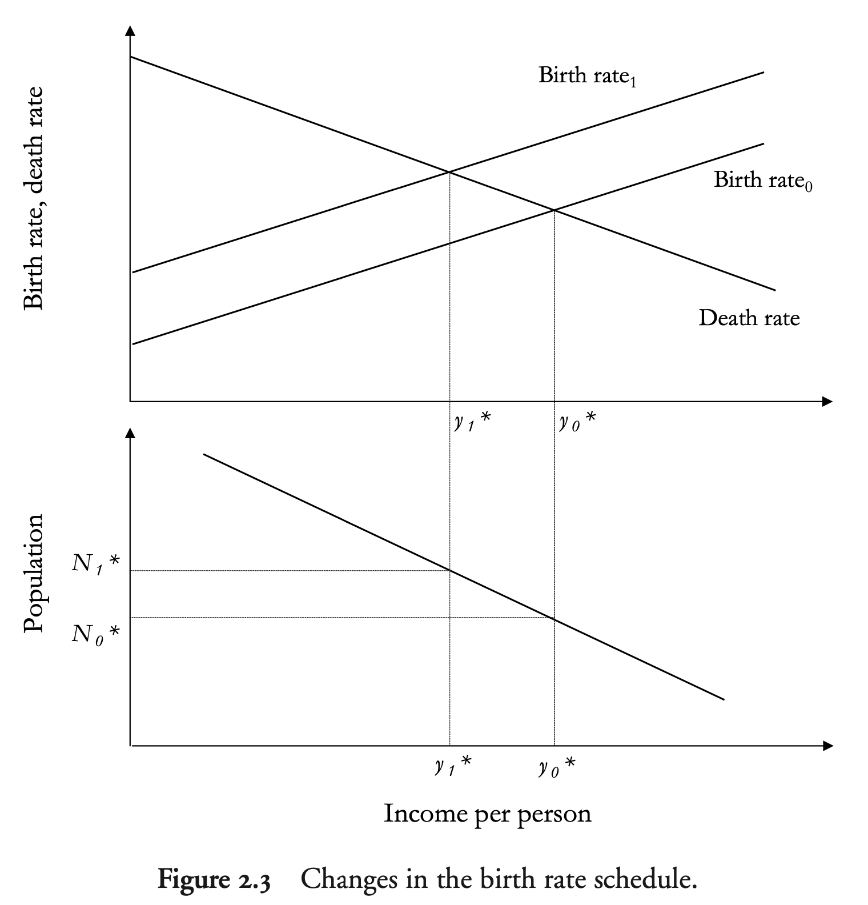
Shifts in Birth and Death Rate Schedules
An upward shift in the birth rate schedule leads, in equilibrium, to:
A larger population
Lower living standards
Shorter life expectancy
An upward shift in the death rate schedule leads, in equilibrium, to:
A smaller population
Higher living standarss
Longer life expectancy
J. Bradford DeLong brad.delong@gmail.com 2020-01-13

Slide 6
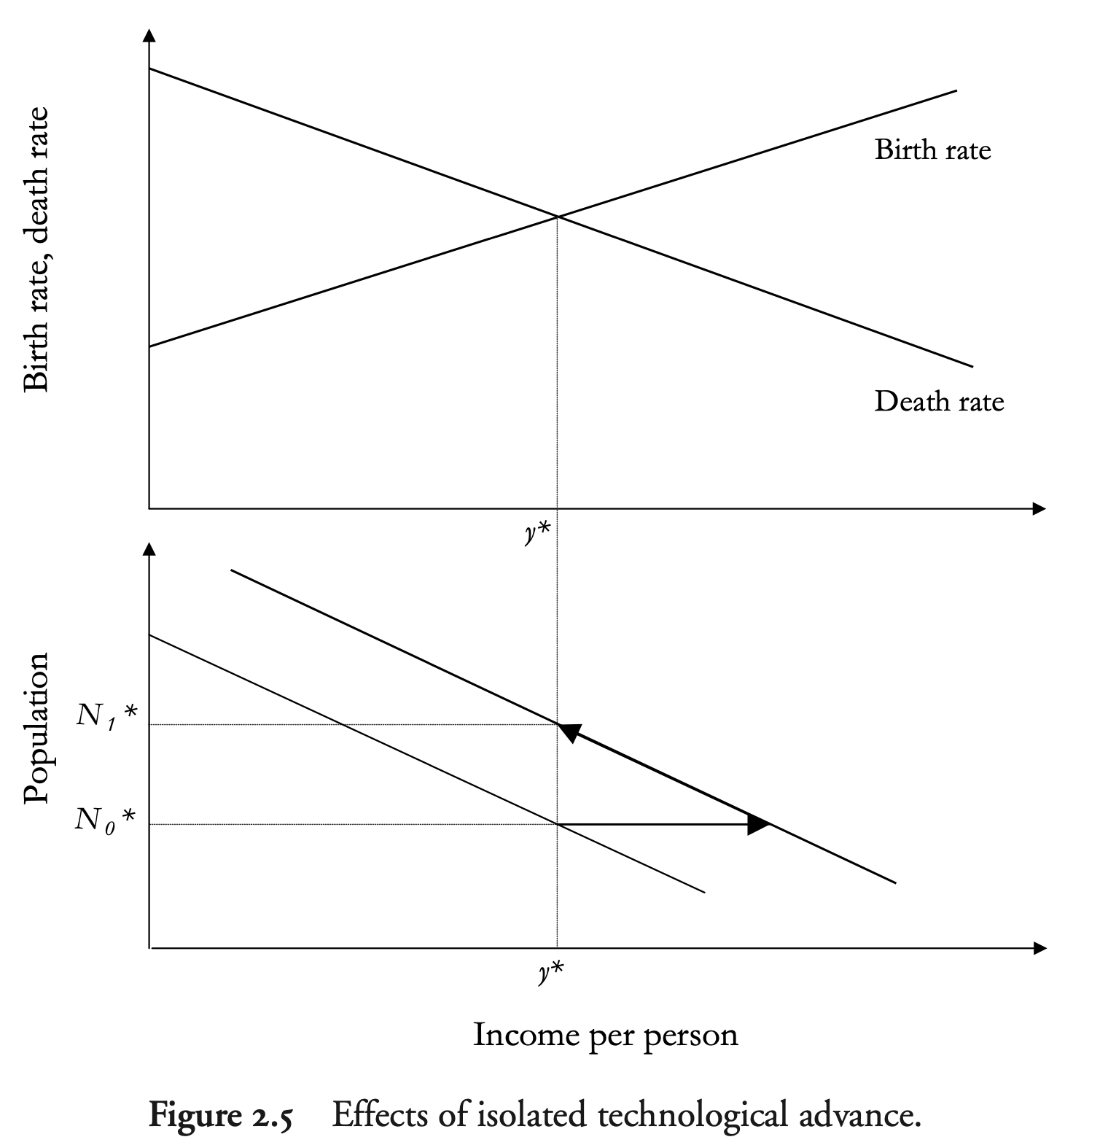
Isolated One-Shot Technological Advance
An isolated jump in technology leads to:
In equilibrium:
A larger population
The same living standards
The same life expectancy
Along the transition path:
A growing population
Higher but declining living standards
Higher but declining life expectancy
In the preindustrial world sporadic technological advance produced people, not wealth
J. Bradford DeLong brad.delong@gmail.com 2020-01-13

Slide 7
Why the Neolithic Revolution?
Settled agriculture failed to improve and probably reduced living conditions in the long run
Settlement reduced death rates
Disease increased mortality some, but increased morbidity more
People were certainly sicker, certainly more numerous, and perhaps poorer
Agriculture was adopted because it was initially a better technology, which generated higher incomes along the transition path
But the eventual new Malthusian equilibrium was probably less favorable to humans than that of the previous hunter- gatherer societies
J. Bradford DeLong brad.delong@gmail.com 2020-01-13

Slide 8
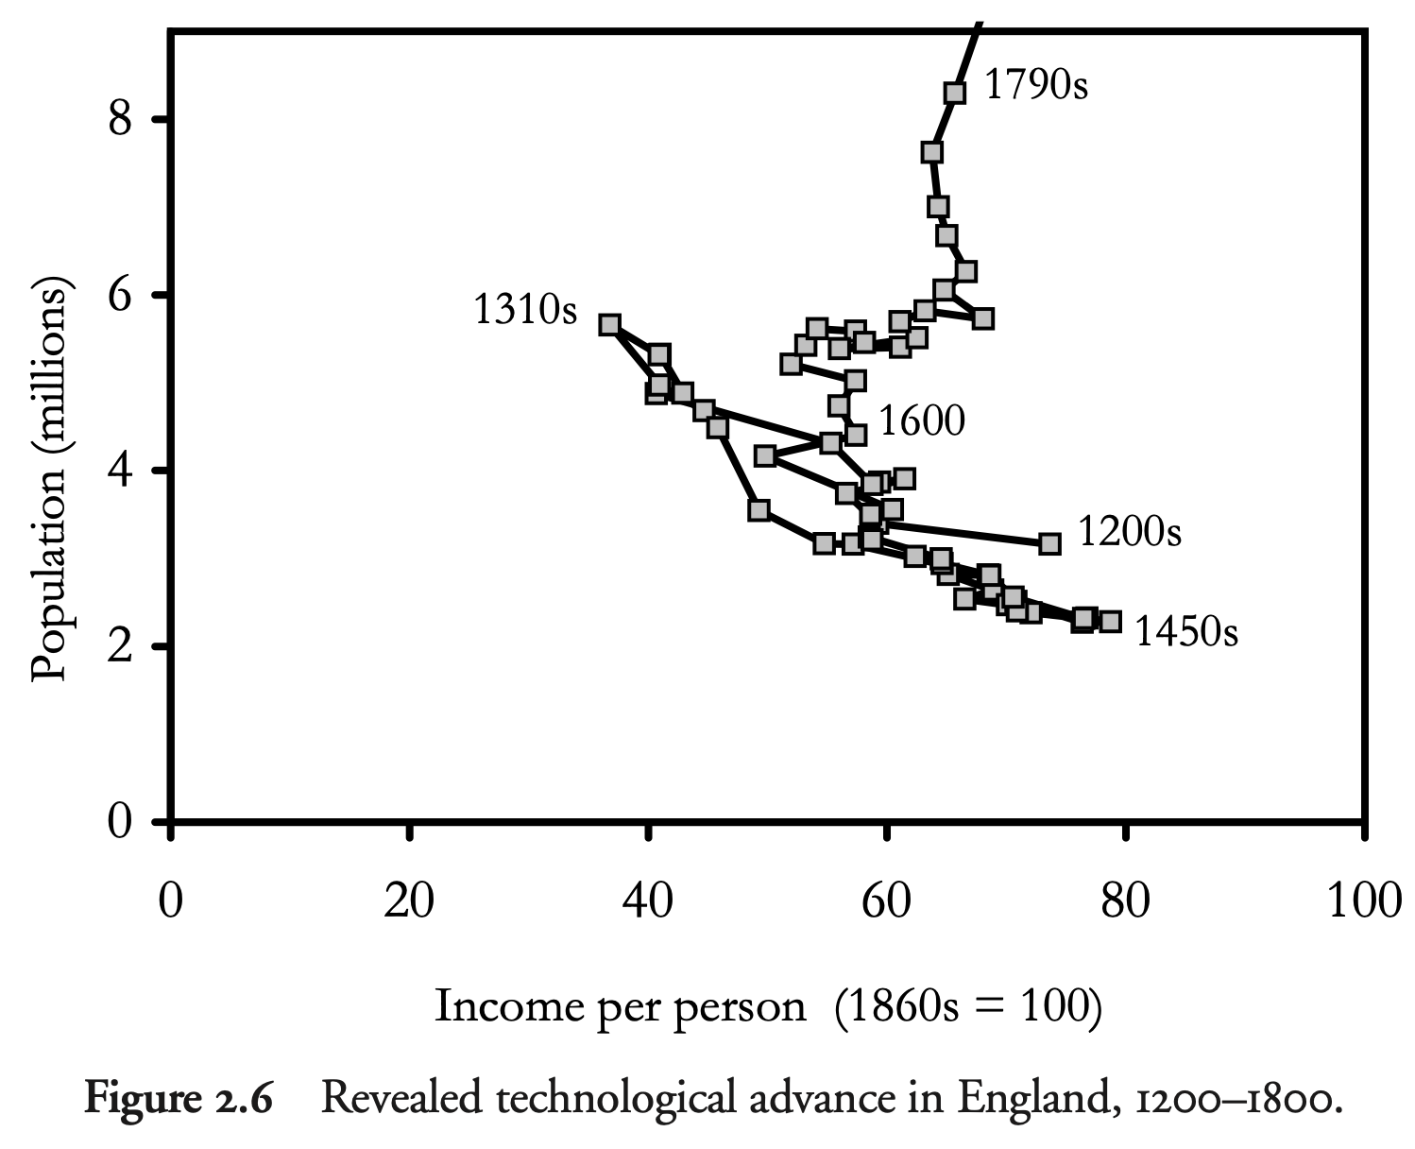
Revealed Technological Advance
There was growth in the medieval period from 1200 to 1316
At six million, the population in 1316 was as great as in the early eighteenth century.
But the arrival from Asia of the bubonic plague (the so-called Black Death) in 1348 caused a long period of population decline.
In the 1450s England had barely two million people.
From 1200 to 1650, as population changed under the influence of disease shocks, the income-population points lie along one downward-sloping line
After 1650, improvements in technology expand the income-population possibilities
J. Bradford DeLong brad.delong@gmail.com 2020-01-13

Slide 9
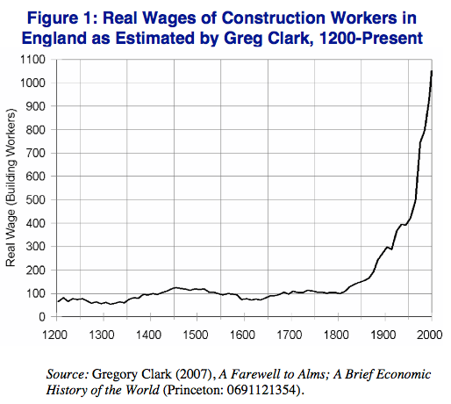
Direct Estimates of Long-Run Real Wage Trends
We know what monks paid their construction workers.
We know what bread and other staples cost.
Questions remain about whether and in what sense these workers are in representative of broader populations…
J. Bradford DeLong brad.delong@gmail.com 2020-01-13

Slide 10
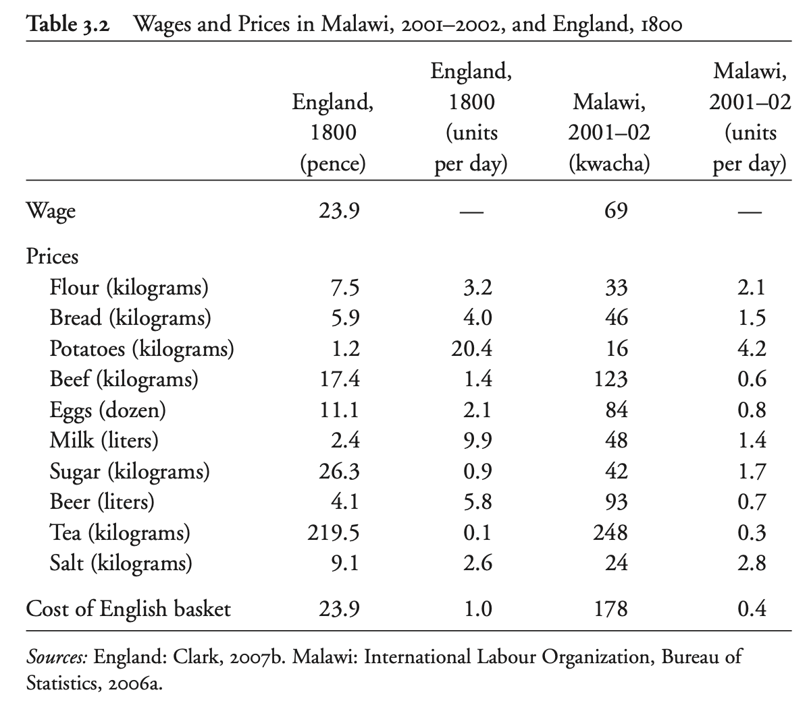
Material Living Standards in Malthusian Equilibrium
For all societies before 1800, the bulk of material consumption was food, shelter, and clothing
Material living standards will be so low as to make life expectancy the inverse of the birth rate
Children so malnourished their immune systems are compromised
Potential mothers so malnourished they fail to ovulate reliably
But England in 1800 was relatively rich—largely because of sociological forces that made for late marriage
J. Bradford DeLong brad.delong@gmail.com 2020-01-13

Slide 11
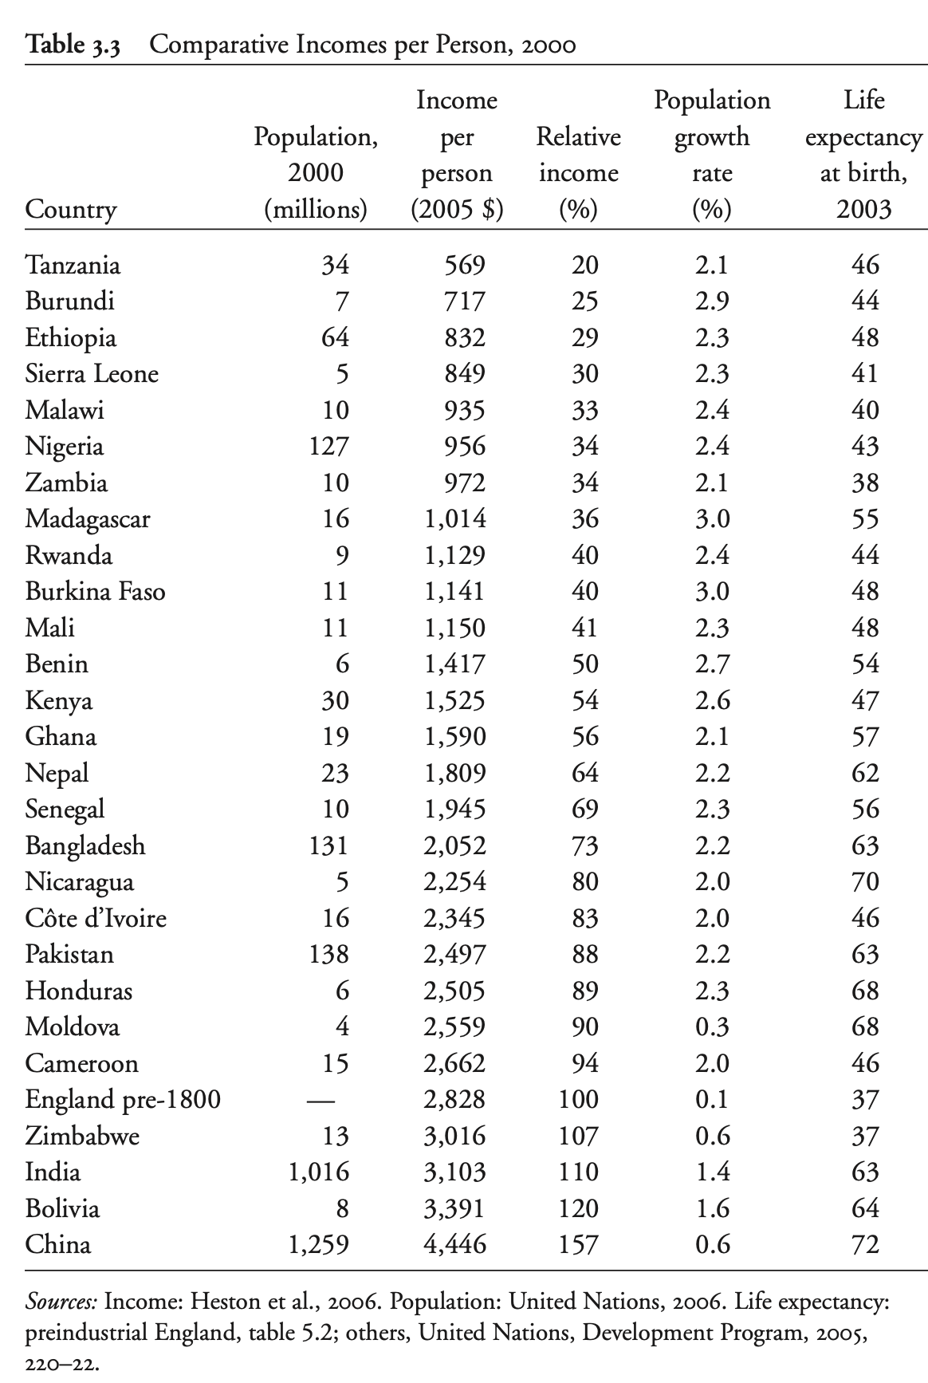
Implications of the Western European Marriage Pattern
Fathers would not let daughters marry until their prospective spouse had a stable farm of his own—or equivalent
Women would not be attractive on the marriage mart unless they came with a dowry—largely earned by their own work in their late teens and early twenties
These made England in 1800 richer than much of the world in 2000
J. Bradford DeLong brad.delong@gmail.com 2020-01-13

Slide 12
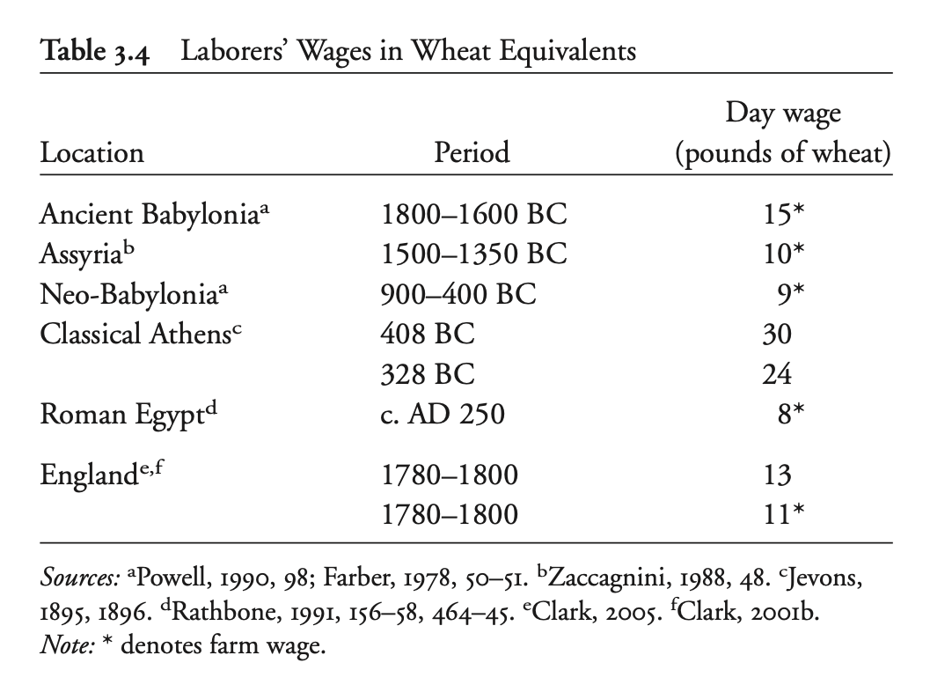
In Fact…
J. Bradford DeLong brad.delong@gmail.com 2020-01-13

Slide 13
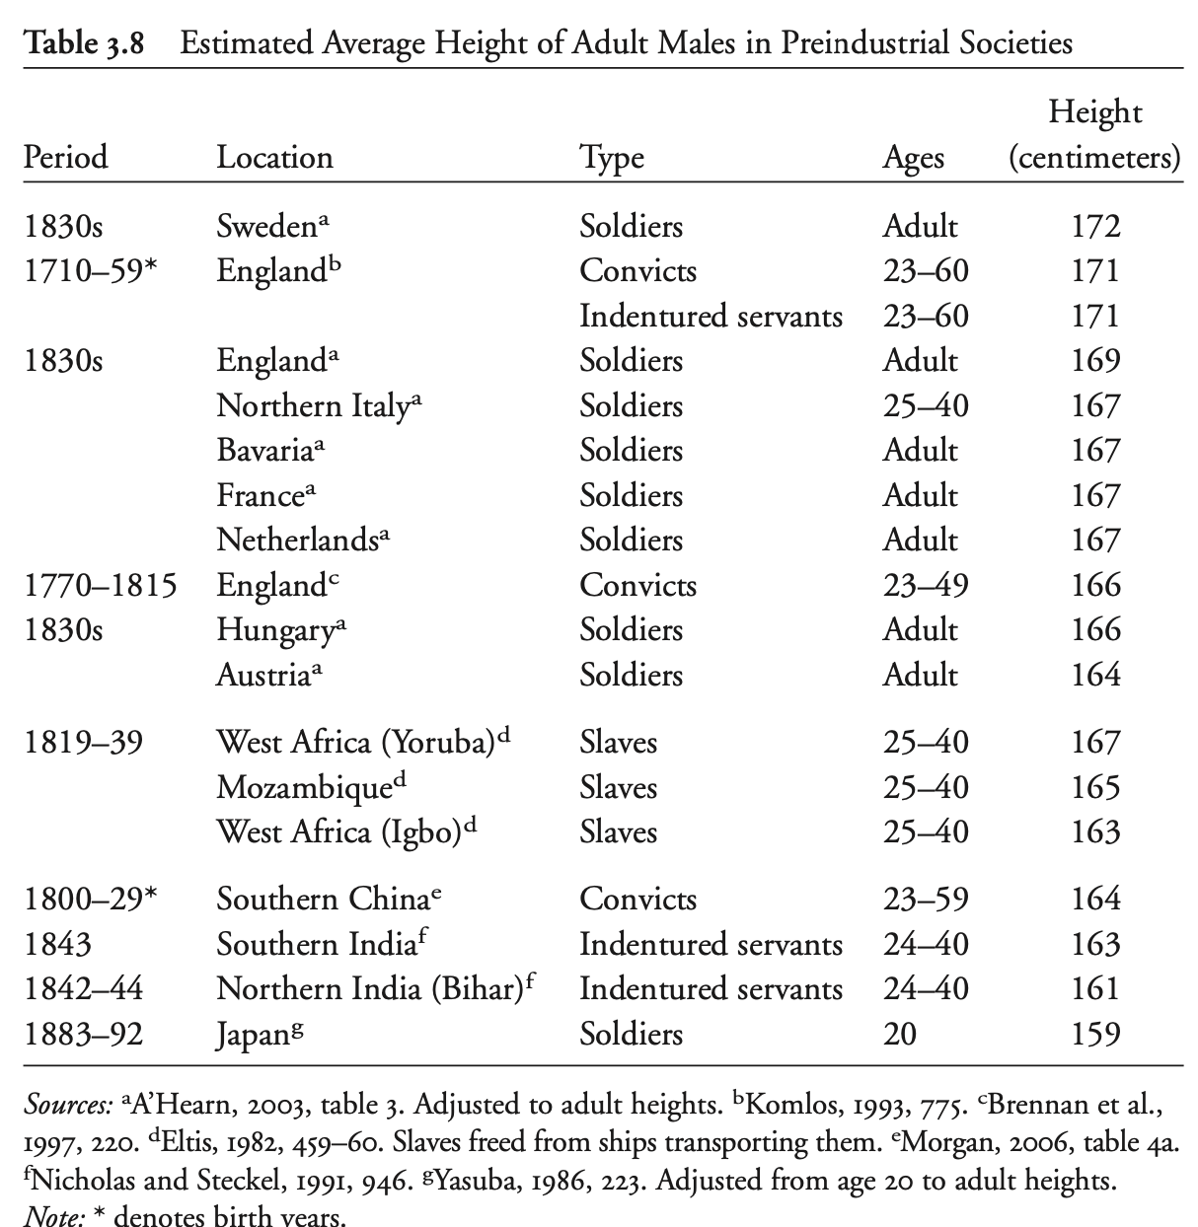
In Fact…
J. Bradford DeLong brad.delong@gmail.com 2020-01-13

Slide 14
Catch Our Breath…
Ask a couple of questions?
Make a couple of comments?
Any more readings to recommend?
J. Bradford DeLong brad.delong@gmail.com 2020-01-13

