Slide 1
About the Course
The long 20th century will in all likelihood be seen in the future as the watershed in human experience:
Nine aspects:
History was economic…
Explosion of wealth…
Cornucopia of technology…
Demographic transition…
Feminist revolution…
Empowered tyrannies…
Wealth gulfs…
Inclusion and hierarchy attenuation…
Mismanagement and insecurity…
Humanity is unlikely to see as transformative—for good and ill, but mostly for good, I think—a century again…

Slide 2
U.C. Berkeley: Economics 115: Spring 2020
20th Century Economic History: Lecture 5: After WWI: Restoring? Civilization?
Brad DeLong
Department of Economics and Blum Center, U.C. Berkeley; and WCEG
delong@econ.berkeley.edu
last revised: 2020-02-03
for delivery: W 2020-02-10 17:00 HMMB390
<https://bcourses.berkeley.edu/courses/1487684>
<https://github.com/braddelong/public-files/blob/master/econ-115-lecture-5.pptx>

Slide 3
Preview
Chapter 8: After World War I: Restoring? Civilization?
Exhaustion: The Belle Époque Broken
The End of Aristocracy
Social Democracy
The Birth of “Really Existing Socialism”
Government Promises:
Finances, Inflation, and “Reparations”
Keynes’s Protest
Post-WWI Economic Disorder
“The Deliberate Intensification of Unemployment”

Slide 4
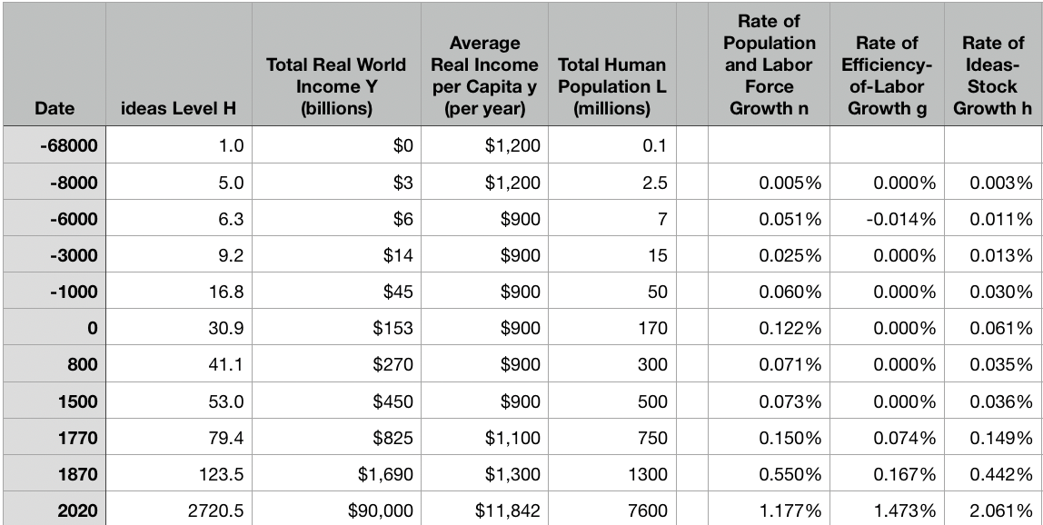
Review: The Broad Sweep
Post-1870 is the miracle:

Slide 5
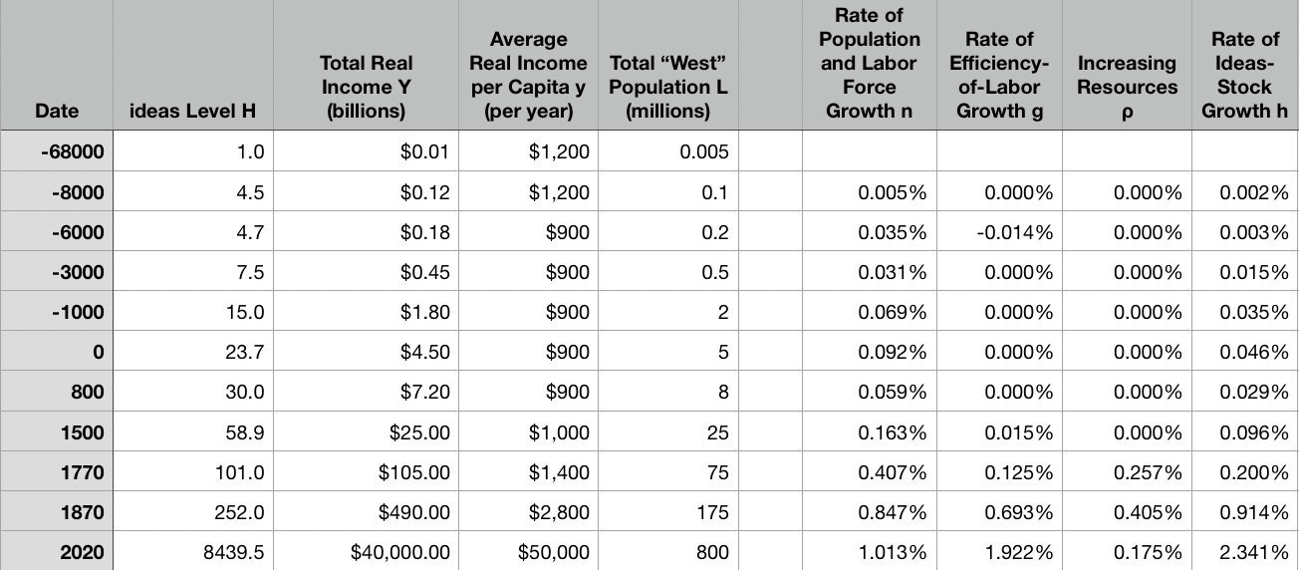
“The West”
800, 1500, 1770, or 1870?:

Slide 6
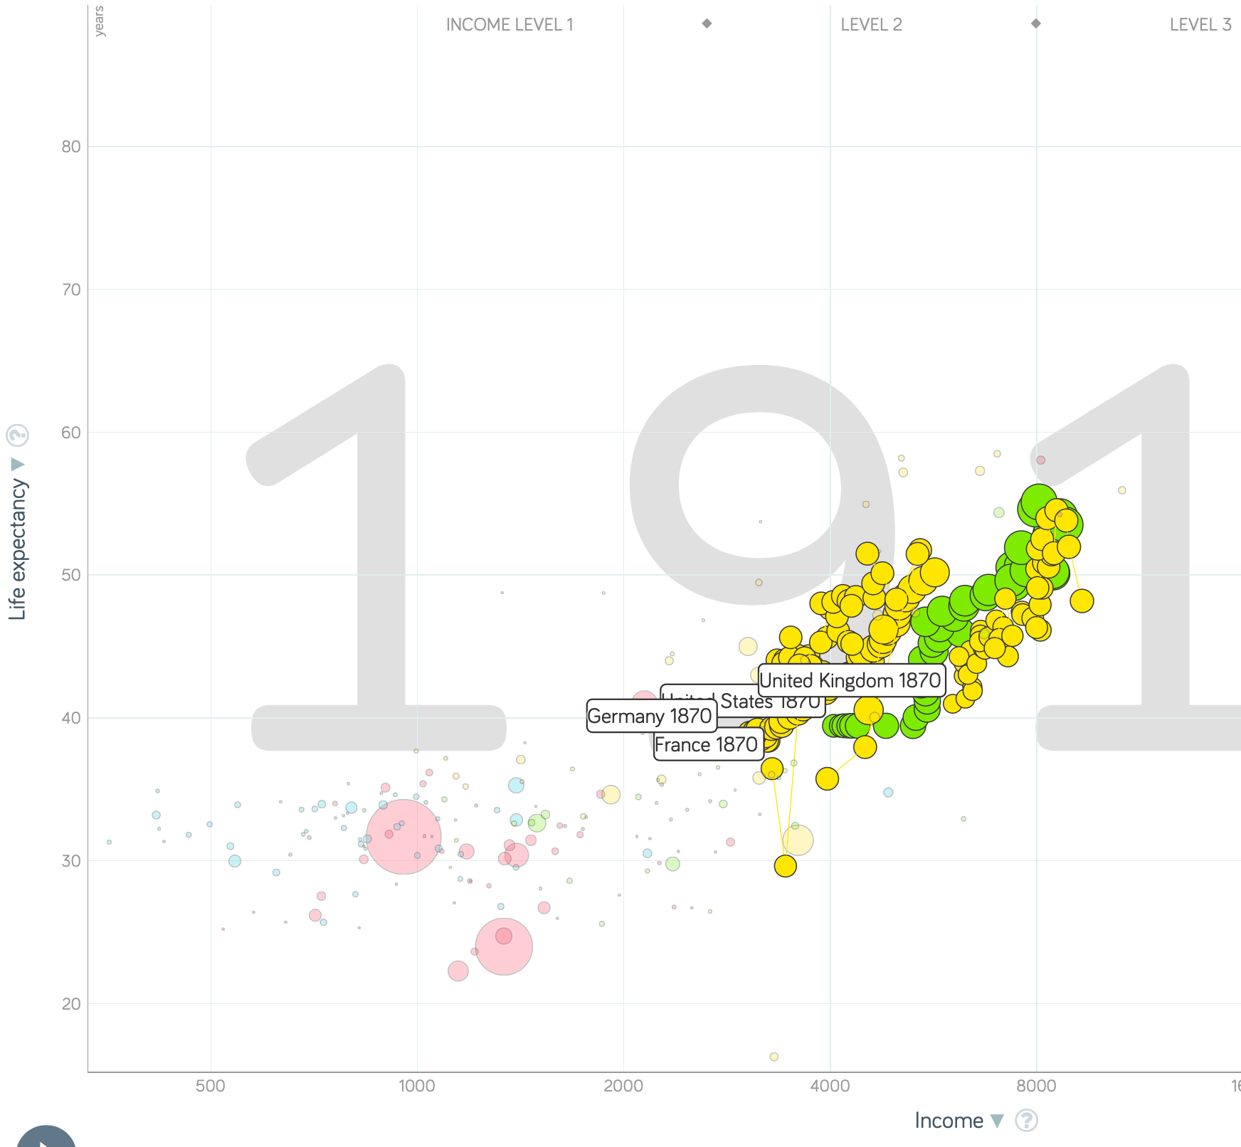
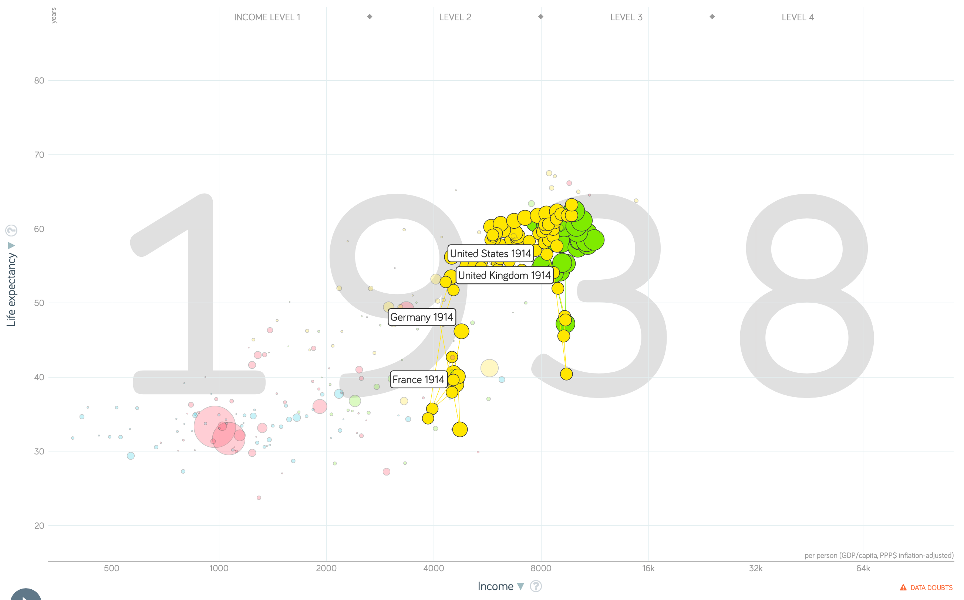
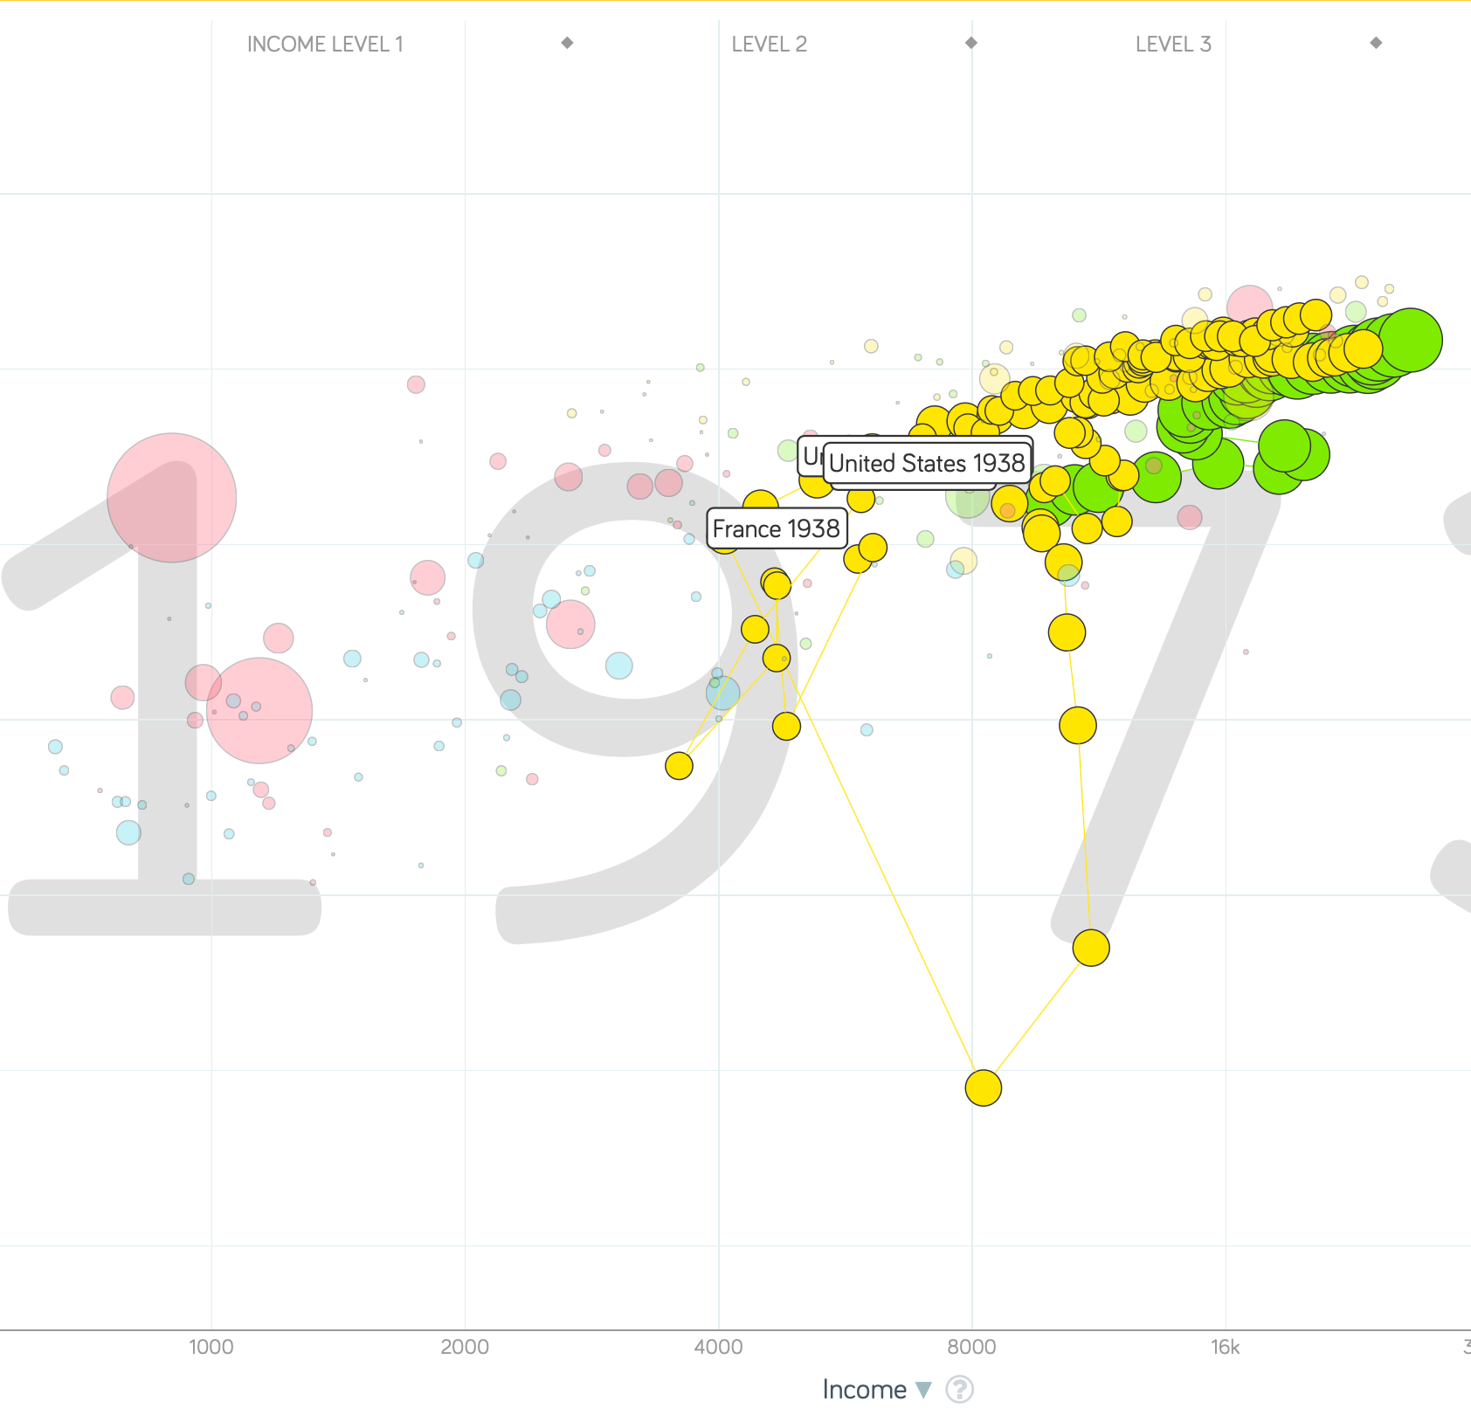
“The West”
1914-1938, 1870-1913, & 1938-1973
Rate of growth in the North Atlantic industrial core halves comparing 1870-1913 to 1914-1938; then triples afterwards over 1938-1973
Slows again after 1973

Slide 7
To Your iClickers
What was the growth rate of ideas in the industrial core of the world economy over 1870-2020?
About 2.3%/year
About 0.9%/year
About 0.23%/year
About 4%/year
None of the above

Slide 8
To Your iClickers
What was the growth rate of ideas in the industrial core of the world economy over 1770-1870?
About 2.3%/year
About 0.9%/year
About 0.23%/year
About 4%/year
None of the above

Slide 9
The Belle Époque Broken
John Maynard Keynes:
“Very few of us realise[d] with conviction the intensely unusual, unstable, complicated, unreliable, temporary nature of the economic organisation by which Western Europe has lived for the last half century. We assume some of the most peculiar and temporary of our late advantages as natural, permanent, and to be depended on, and we lay our plans accordingly.
“On this sandy and false foundation we scheme for social improvement and dress our political platforms, pursue our animosities and particular ambitions, and feel ourselves with enough margin in hand to foster, not assuage, civil conflict in the European family....
“France, Germany, Italy, Austria, and Holland, Russia and Roumania and Poland, throb together, and their structure and civilisation are essentially one. They flourished together, they have rocked together in a war which we, in spite of our enormous contributions and sacrifices (like though in a less degree than America), economically stood outside, and they may fall together…”

Slide 10
Aristocracy & Social Democracy
The aristocrats had rolled the dice:
Europe in 1914 was a Europe of national populations, of industrialists and socialists, of factory workers and technicians…
Europe’s governments in 1914—especially the defense and foreign affairs ministries—had been populated by aristocrats, ex-aristocrats, and would-be aristocrats.
Landed, aristocratic, military elites had control of many of the levers of propaganda and power…
Aristocrats had had help. Industrialists and entrepreneurs were eager to provide their political support in return for economic benefits, as in the 1879 German “marriage of iron and rye”: the imposition of tariffs on imports of British steel (to protect the positions of German manufacturers) and on imports of American grain (to protect the positions of German landlords)…
On the eve of World War I, these landed military service aristocrats, ex-aristocrats, and would-be aristocrats increasingly found themselves members of a social caste that had no societal function…
But power—in the form of office and of vast (if declining relative) wealth—and propaganda—in the form of pageantry and the press—were reinforced by ideologies: Social darwinism…
The aristocrats rolled the dice—and lost…
Social democrats picked up the chips:
Expanded suffrage…
Proportional representation…
“Lands fit for heroes…”
How to provide for the benefits politicians promised?

Slide 11
Reparations, Taxes, and Inflation
Reparations
A peace “without annexations and indemnities”…
But not without reparations…
Two years’ of Germany’s national income demanded:
Much of it “boob bait for the bubbas…” on the part of Allied politicians…
But a powerful shaper of post-WWI Germany
Taxes
High and progressive tax rates…
A powerful impact on inequality…
Class war…
Inflation
U.S.: price level x1.5
Britain: price level x2.0
France: price level x7.0
French government had encouraged investment in Russian bonds…
German: price level x1,000,000,000,000
Austria, Hungary, Czechoslovakia the same…

Slide 12
Keynes’s Protest
Jan Christian Smuts:
“Poor Keynes often sits with me at night after a good dinner and we rail against the world and the coming flood. And I tell him that this is the time for Grigua’s prayer (the Lord to come himself and not to send his Son, as this is not a time for children). And then we laugh, and behind the laughter is [Herbert] Hoover’s horrible picture of thirty million people who must die unless there is some great intervention. But then again we think that things are never really as bad as that; and something will turn up, and the worst will never be. And somehow all these phases of feeling are true and right in some sense…”

Slide 13
Keynes’s Protest II
John Maynard Keynes:
“If we aim deliberately at the impoverishment of Central Europe, vengeance, I dare predict, will not limp. Nothing can then delay for long that final civil war between the forces of reaction and the despairing convulsions of revolution, before which the horrors of the late German war will fade into nothing, and which will destroy... the civilization and progress of our generation…”

Slide 14
Digression: How to Study
Will I ask you about Jan Christian Smuts? About the prayer (and theology) of the Grigua?
No…
Themes and concepts…
But you need narratives and stories to hang onto them…
And our brains are very good at deep-sixing useless information
Andy Matuschak: Why Books Don’t Work <https://andymatuschak.org/books/>:
“Picture some serious non-fiction tomes. The Selfish Gene; Thinking, Fast and Slow; Guns, Germs, and Steel; etc.
“Have you ever had a book like this—one you’d read—come up in conversation, only to discover that you’d absorbed what amounts to a few sentences? I’ll be honest: it happens to me regularly. Often things go well at first. I’ll feel I can sketch the basic claims, paint the surface; but when someone asks a basic probing question, the edifice instantly collapses. Sometimes it’s a memory issue: I simply can’t recall the relevant details. But just as often, as I grasp about, I’ll realize I had never really understood the idea in question, though I’d certainly thought I understood when I read the book. Indeed, I’ll realize that I had barely noticed how little I’d absorbed until that very moment. I know I’m not alone here…

Slide 15
Revolutions
“Petty Officer Lemmgen… arrived at the Ministry [of War]… found… Lieutenant HambuRger.... Lemmgen produced a typed document with the following text: ‘Comrades and Workers! The Ebert-Scheidemann government have made themselves impossible.... The undersigned Revolutionary Council has provisionally assumed power.’
“Lieutenant Hamburger inspected the document and became properly indignant. ‘But where are the signatures? Before I can comply with this order, you’ll have to go back and get it properly signed. Otherwise any little shorthand typist could declare the government deposed.’ Petty Officer Lemmgen... saw the logic…. So he and his men saluted... and made their way back to the Revolutionary Council to obtain the necessary signatures....
“But by the time he had obtained the signatures, Lemmgen had learned that the People’s Naval Division had declared itself neutral. So he did not return to the Ministry of War…”

Slide 16
Marxist Economics
Everything measured in labor values
Proﬁt_Rate x Capital + Wages = 1
Wages < 1 - Proﬁt_Rate x Capital
Capital must increase…
Profit_Rate cannot fall below some floor…
Hence wages must fall—unless the system breaks down…
And it does, with each breakdown being bigger and bigger…

Slide 17
Marxist Economics II
“In proportion as capital accumulates, the lot of the laborer, be his payment high or low, must grow worse. The law that always equilibrates the relative surplus [unemployed] population to the extent and energy of accumulation, this law rivets the laborer to capital more ﬁrmly than the wedges of Vulcan did Prometheus to the rock. It establishes an accumulation of misery, corresponding with accumulation of capital. Accumulation of wealth at one pole is, therefore, at the same time accumulation of misery, agony of toil, slavery, ignorance, brutality, mental degradation, at the opposite pole, i.e., on the side of the [working] class…”

Slide 18
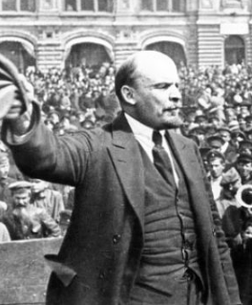
Lenin
A quick power grab…
Confidently expecting a German revolution, and then massive aid…
Brutal civil war
Kerenskyites
Reds
Whites
Nationalists
What was the revolutionary government to do?
Ludendorff’s German war economy…

Slide 19
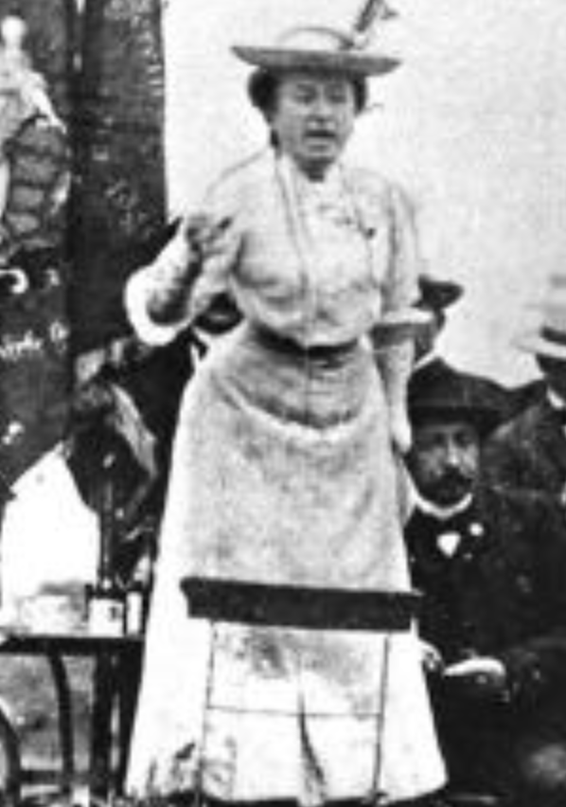
Red Rosa on Lenin
“Without general elections, without unrestricted freedom of press and assembly, without a free struggle of opinion, life dies out in every public institution…. Only the bureaucracy remains…. A few dozen party leaders of inexhaustible energy and boundless experience direct and rule….
“An elite of the working class is invited from time to time to meetings where they are to applaud the speeches of the leaders, and to approve proposed resolutions unanimously–at bottom, then, a clique affair…. Such conditions must inevitably cause a brutalization of public life: attempted assassinations, shooting of hostages, etc…
“Freedom only for the supporters of the government, only for the members of one party–however numerous they may be–is no freedom at all. Freedom is always and exclusively freedom for the one who thinks differently. Not because of any fanatical concept of “justice” but because all that is instructive, wholesome and purifying in political freedom depends on this essential characteristic, and its effectiveness vanishes when ‘freedom’ becomes a special privilege…

Slide 20
Wikipedia on Her Death
On New Year's Day, Luxemburg declared:
“Today we can seriously set about destroying capitalism once and for all. Nay, more; not merely are we today in a position to perform this task, nor merely is its performance a duty toward the proletariat, but our solution offers the only means of saving human society from destruction.”
Like Liebknecht, Luxemburg supported the violent putsch attempt. The Red Flag encouraged the rebels to occupy the editorial offices of the liberal press and later, all positions of power. On 8 January, Luxemburg's Red Flag printed a public statement by her, in which she called for revolutionary violence and no negotiations with the revolution's "mortal enemies", the Friedrich Ebert-Philipp Scheidemann government.
In response to the uprising, German Chancellor and SPD leader Friedrich Ebert ordered the Freikorps to destroy the left-wing revolution, which was crushed by 11 January 1919. Luxemburg's Red Flag falsely claimed that the rebellion was spreading across Germany. On 10 January, Luxemburg called for the murder of Scheidemann's supporters and said they had earned their fate. The uprising was small-scale, had limited support and consisted of the occupation of a few newspaper buildings and the construction of street barricades.
Luxemburg and Liebknecht were captured in Berlin on 15 January 1919 by the Rifle Division of the Cavalry Guards of the Freikorps (Garde-Kavallerie-Schützendivision). Its commander Captain Waldemar Pabst, with Lieutenant Horst von Pflugk-Harttung, questioned them under torture and then gave the order to summarily execute them. Luxemburg was knocked down with a rifle butt by the soldier Otto Runge, then shot in the head, either by Lieutenant Kurt Vogel or by Lieutenant Hermann Souchon. Her body was flung into Berlin's Landwehr Canal…

Slide 21
Econ 115: Administration: Office Hours &c.
DeLong: Office Hours
M 11:10-12:40, Blum Hall 200B
T 11:15-12:00, Blum Hall 200B
By appointment in Blum Hall 200B, Evans 691A, or elsewhere: email <delong@econ.berkeley.edu> Sign up at: <https://www.icloud.com/numbers/0leoOOlezWp6BYKSiPJhdXy7Q>
Paper due Feb 23: The Coming of Modern Economic Growth: Assignment 4
What do you think are the most important differences between the era of modern economic growth—in those economies and those periods which have been profoundly shaped by it—and earlier economies, or economies which have by-and-large not been profoundly shaped by the modern economic growth process?
Explain why you hold the views that you do. Justify your opinions with quotations from and citations to DeLong's book draft—and to other sources you believe apposite.
Write 400-500 words, and submit them on this webpage.: <https://bcourses.berkeley.edu/courses/1487684/assignments/8051997>
Dasgupta, Eichengreen, and Skidelsky will be on the exam!
Memo: bCourses website <https://bcourses.berkeley.edu/courses/1487684>

Slide 22
DeLong Office Hours
M 11:10-12:40, Blum Hall 200B
T 11:15-12:00, Blum Hall 200B
By appointment in Blum Hall 200B, Evans 691A, or elsewhere:
email <delong@econ.berkeley.edu>
Sign up at: <https://www.icloud.com/numbers/0leoOOlezWp6BYKSiPJhdXy7Q>

Slide 23
Midterm!
M 1700-18:30, HMMB 390
60% short answers about concepts so far
40% an essay
INSTRUCTOR REALITY CHECK…

Slide 24

The U.S.: The Roaring Twenties
The boom of the 1920s
Mass production—the flowering of the Second Industrial Revolution
“The business of America is business”
Structural changes in the 1920s

Slide 25
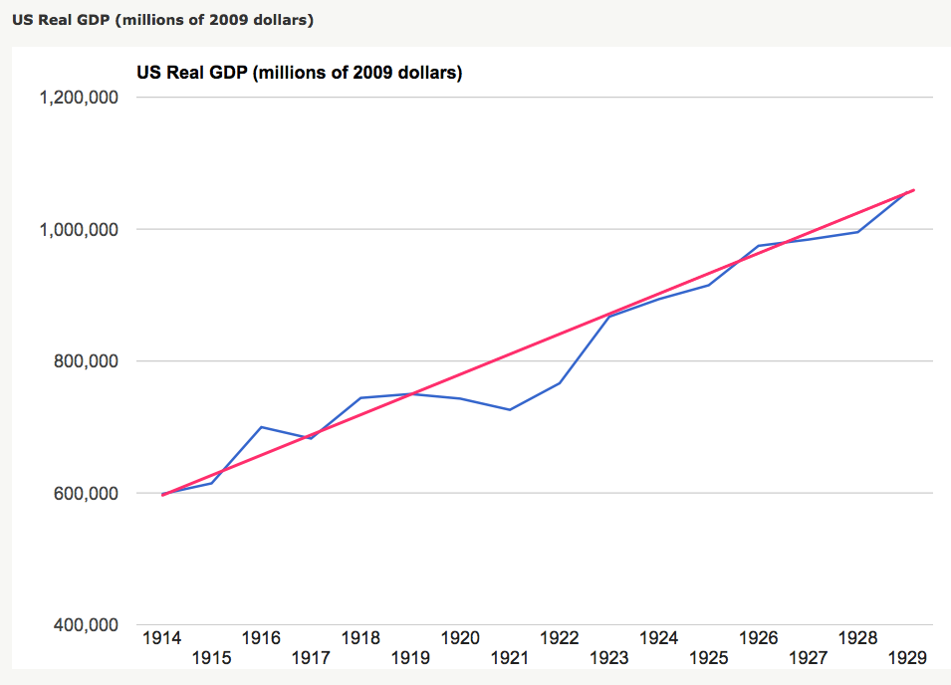
The Boom of the 1920s
The only big recession the post-WWI recession
Get rid of the inflation of WWI
Return the economy to sound finance
How big a deal was 1919-1921?
Rapid bounce-back, however

Slide 26
Structural Changes in the 1920s
Mass production—Henry Ford and the Model T
End of mass immigration—immigration restrictions of 1924
What do these do to the demand for construction, and construction workers?
The role of the stock market…
The role of the banking system…

Slide 27
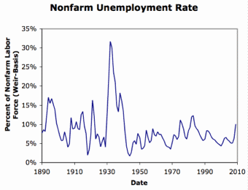
Setting the Stage for the Great Depression
What had ended previous downturns?:
1873—RR investment drops to zero
1884—RR investment drops to zero
1893—confidence that gold standard will be kept
1904—Theodore Roosevelt
1907—J.P. Morgan constitutes himself a pick-up central bank
1914—profits from European war demand WWI
1920—Federal Reserve reverses course

Slide 28
Takeaways
Chapter 8: Post-WWI
Exhaustion: The Belle Époque Broken
The End of Aristocracy
Social Democracy
The Birth of “Really Existing Socialism”
Government Finances, Inflation, and “Reparations”
Keynes’s Protest
Post-WWI Economic Disorder
“The Deliberate Intensification of Unemployment”

Slide 29
Preview: Next Time
On to Chapters 9 & 10: The Roaring Twenties & The Great Depression
Absence of a hegemon…
The coming of mass production…
Toward utopia?
Mass consumption
Mass distribution
Worldwide distribution
Feminism;
Left behind farmers & African-Americans
Frenzied finance & leading sectors: “radio”, autos, etc…
Things fall apart: The slide into the Great Depression…
Crash
“Liquidationism”
Debt & deflation

Slide 30
What Was Unconvincing Today?
Mistakes and unclarities: typos, wordos, and mindos…
In the DRAFT textbook?
In the lecture?

Slide 31
Catch Our Breath…
Ask a couple of questions?
Make a couple of comments?
Any more readings to recommend?

Slide 32
Notes

