Slide 1
Crafts: The Solow Productivity Paradox in Historical Perspective
Barry J. Eichengreen and J. Bradford DeLong
https://www.icloud.com/keynote/0tR_-udvdJau_fkmiItCzxmCQ

Slide 2
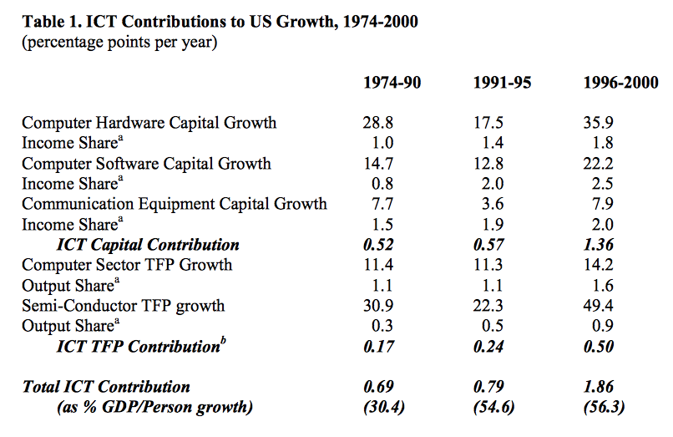
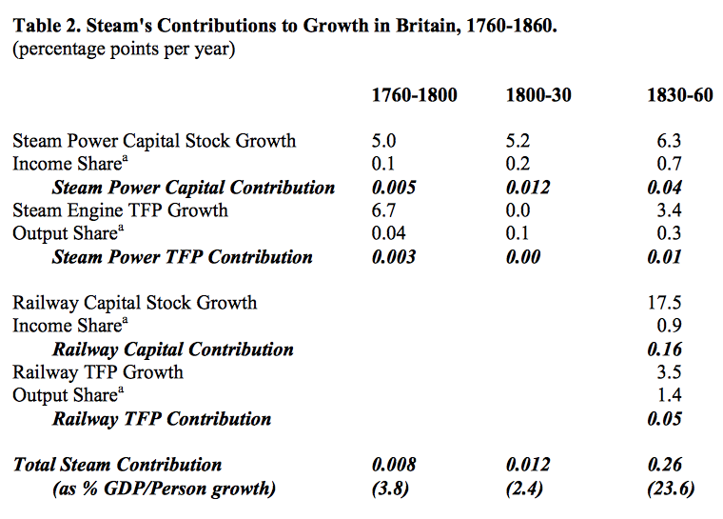
The Solow Productivity Paradox in Historical Perspective
Nicholas Crafts (2002), "The Solow Productivity Paradox in Historical Perspective," CEPR Discussion Paper no.3142 http://www.cepr.org/pubs/dps/DP3142.asp
Robert Solow: “You can see the computer age everywhere but in the productivity statistics…”

Slide 3
Crafts: The Solow Productivity Paradox in Historical Perspective: Catch Our Breath…
Ask a couple of questions?
Make a couple of comments?
Any more readings to recommend?
<https://www.icloud.com/keynote/0tR_-udvdJau_fkmiItCzxmCQ>

