Slide 1
Coronavirus!
With 420 deaths in the U.S. as of Mar 22, a 2% death rate, and 3 weeks between infection and death, that means that as of Mar 1 there were 21000 coronavirus cases in the United States.
If it is doubling every seven days, then now about 170,000 people have and in the next week about 170,000 more people in the U.S. will catch coronavirus—which means 1/2000, currently 3800 of the 7.6 million inhabitants of San Francisco Bay. Touch a hard surface that any of those 3800 has touched in the last 48 hours, and the virus has a chance to jump to you…
With 31 deaths in the U.S. as of March 11, a 1% death rate, and up to 4 weeks between infection and death, that means that as of Feb 12 there were 3100 coronavirus cases in the United States.
These numbers could be three times too big. These numbers are probably not five times too small unless the thing is a lot less deadly, and there are a lot of asymptomatic cases…
What is wrong with this analysis?

Slide 2
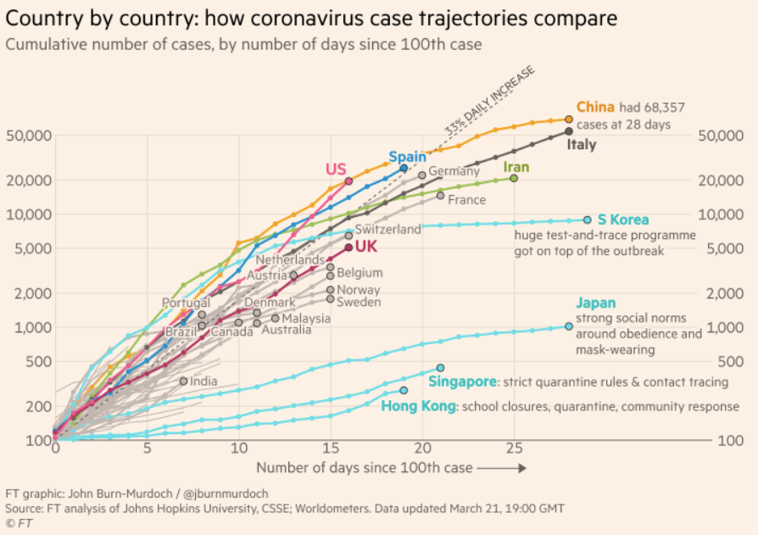
MOAR Coronavirus!
What I am watching:
Max Roser & Hannah Ritchie: Coronavirus Disease (COVID-19)_ <https://ourworldindata.org/coronavirus>…
Worldometer: Coronavirus Update (Live) <https://www.worldometers.info/coronavirus/>: ‘125,599 Cases and 4,605 Deaths from COVID-19 Virus Outbreak…
FT Coronavirus Tracker <https://www.ft.com/content/a26fbf7e-48f8-11ea-aeb3-955839e06441>
Josh Marshall’s COVID Twitter List <https://twitter.com/i/lists/1233998285779632128>

Slide 3
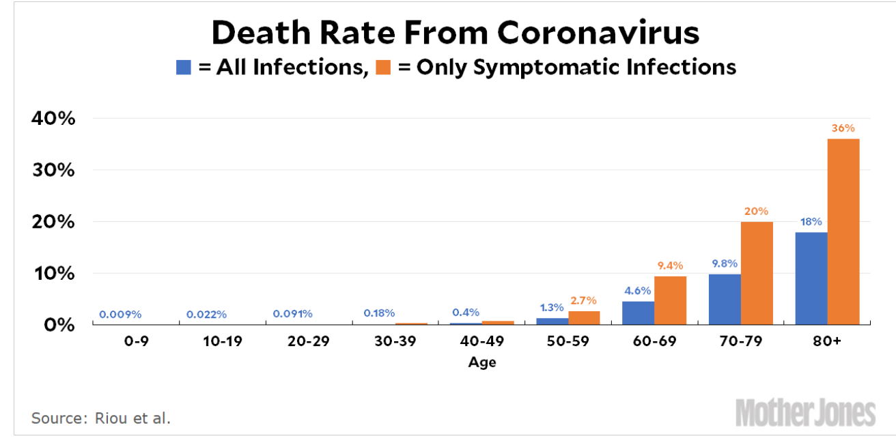
MOAR Coronavirus!
It’s a Thing for Geezers!
Mortality for the Youngs very low…
It’s the flu for them…

Slide 4
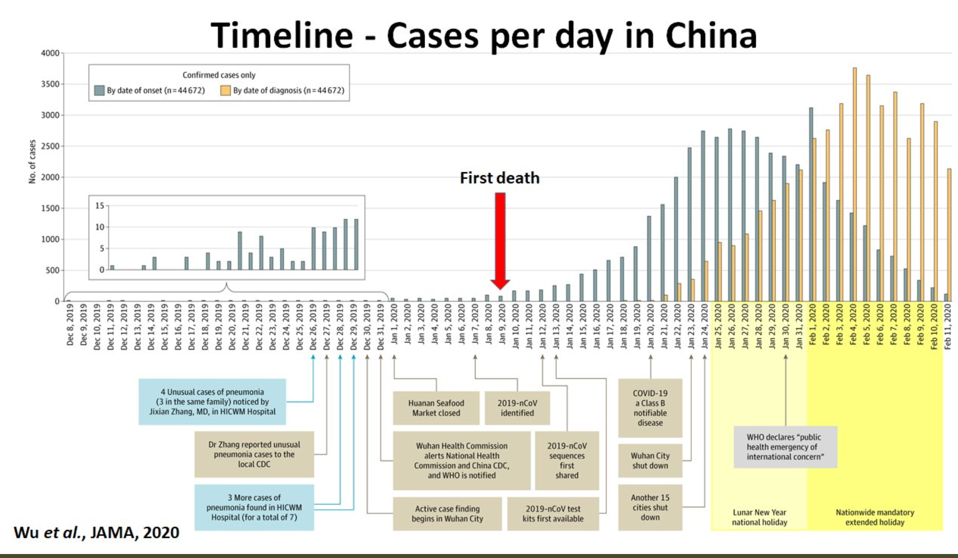
MOAR Coronavirus! II
China Beat It!
Shut down Wuhan when 200 cases per day
That seems to have been a good decision

Slide 5
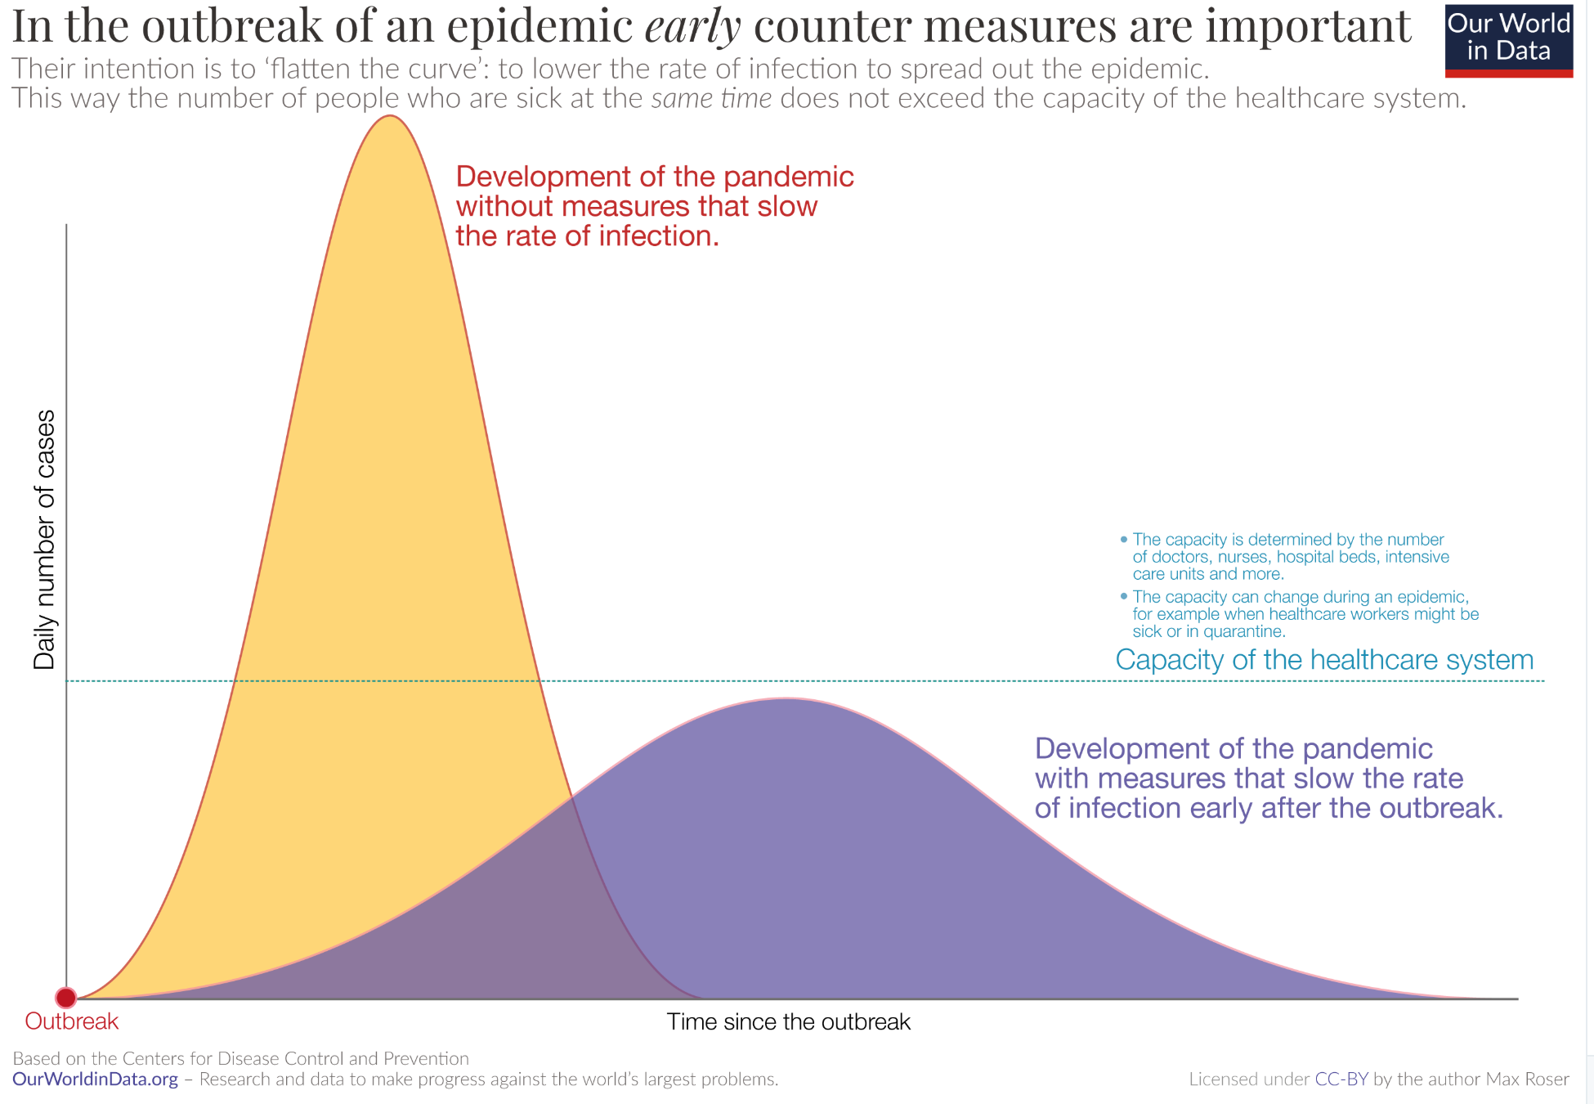
MOAR Coronavirus! III
When Is It Appropriate to Move on This?
Immediate social distancing…
Self-isolate if you have a cough and a fever…
Hope that warmer temperatures will do to this what they did to SARS…
Otherwise, when do you want to start spreading out transmission. It seems that early is as good as later…

Slide 6
Coronavirus! (March 16)
With 31 deaths in the U.S. as of March 11, a 1% death rate, and up to 4 weeks between infection and death, that means that as of Feb 12 there were 3100 coronavirus cases in the United States.
With 87 deaths in the U.S. as of Mar 16, a 1% death rate, and up to 4 weeks between infection and death, that means that as of Feb 17 there were 8700 coronavirus cases in the United States
If it is doubling every seven days, then now about 150,000 people have and in the next week about 150,000 more people in the U.S. will catch coronavirus—which means 1/2200, currently 3500 of the 7.6 million inhabitants of San Francisco Bay. Touch a hard surface that any of those 3500 has touched in the last 48 hours, and the virus has a chance to jump to you…
These numbers could be five times too big. These numbers are probably not five times too small unless the thing is a lot less deadly, and there are a lot of asymptomatic cases…
What is wrong with this analysis?

Slide 7
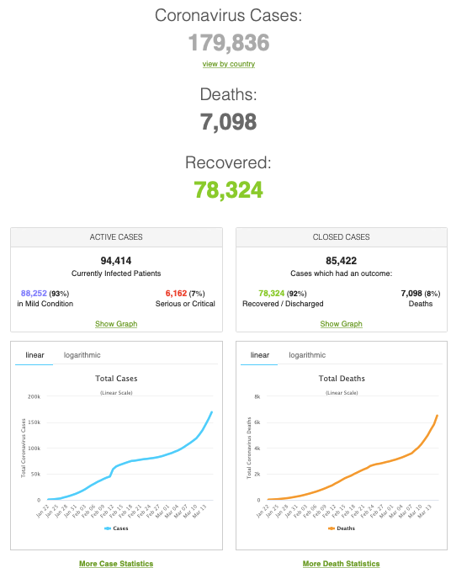
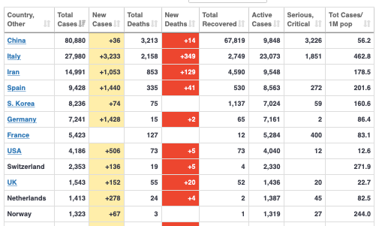
MOAR Coronavirus!
As of March 21: Things are not moving in the right direction:
What is the R0?
How can the R0 be changed?
How will the R0 change?
What is the asymptote share of the population?
What is the mortality rate?

Slide 8
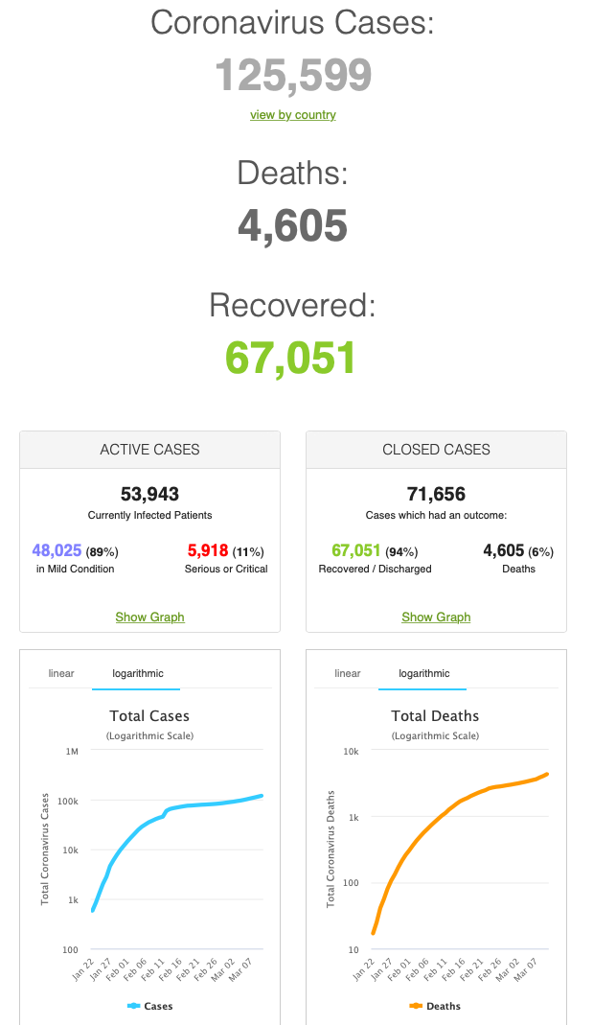
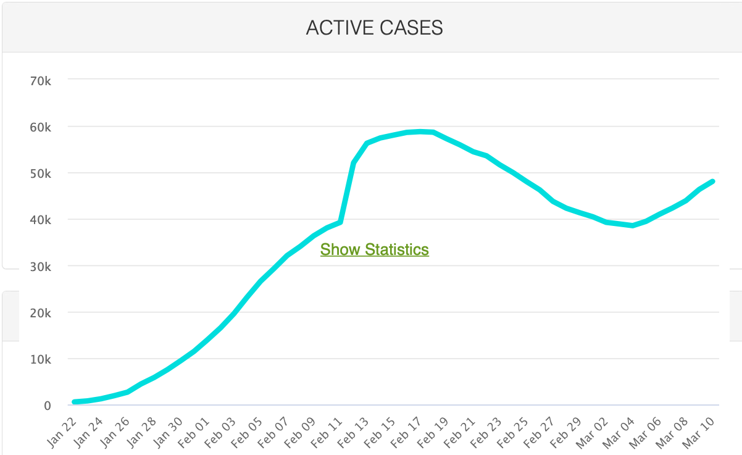
MOAR Coronavirus!
As of March 10: Things are not moving in the right direction:
What is the R0?
How can the R0 be changed?
How will the R0 change?
What is the asymptote share of the population?
What is the mortality rate?

Slide 9
Catch Our Breath…
Ask a couple of questions?
Make a couple of comments?
Any more readings to recommend?

Slide 10
Notes

