Slide 1
The Post-WWI Breakdown
Brad DeLong
U.C. Berkeley
Last Edited: 2020-03-31
<https://www.icloud.com/keynote/0Tyd74_PX2yDDrFeeka7b3zKg>
<https://github.com/braddelong/public-files/blob/master/econ-210a-lecture-10a.pptx>

Slide 2
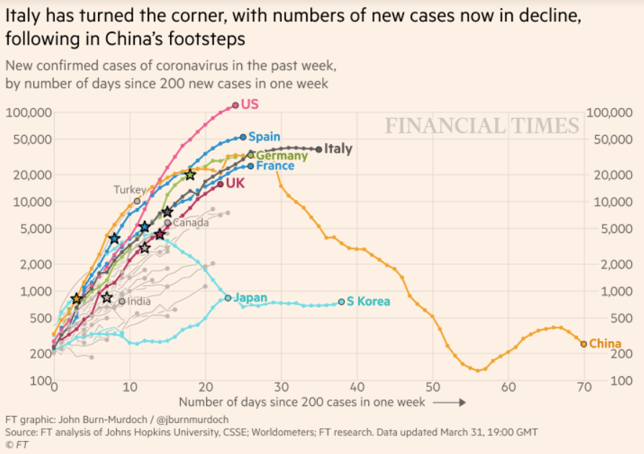
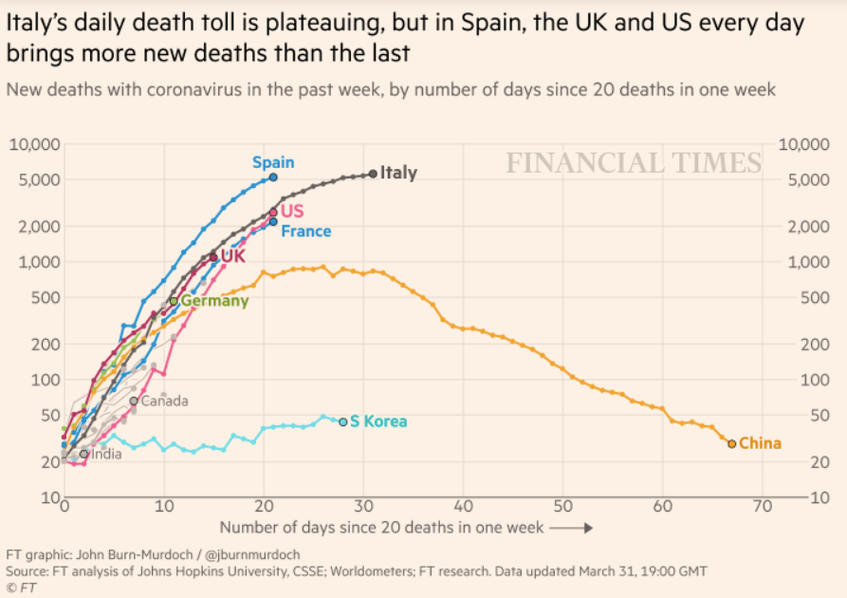
Coronavirus
Where we think we are:
We really do not know
No random samples…
Best thing I have read comes from Jim Stock <https://drive.google.com/file/d/12MV466ZZy5xHir4xdPhoTrL1oO8CbZU-/view>:
The basic SIR epidemiological model of contagion
The effect of social distancing and business shutdowns on epidemic dynamics enters the model through a single parameter: the case transmission rate β
Re-express the model in terms of β and the asymptomatic (or not very symptomatic) hence non-tested rate—the fraction of the infected who are not tested
The COVID-19 non-testing rate is unidentified in our model
Estimates in the epidemiological literature range from 0.18 to 0.86.
The asymptomatic rate could be estimated accurately and quickly by testing a random sample
The optimal policy response and its economic consequences hinge critically on the asymptomatic rate

Slide 3
Financial Times Graphs Blown Up…

Slide 6
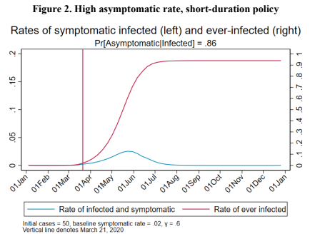
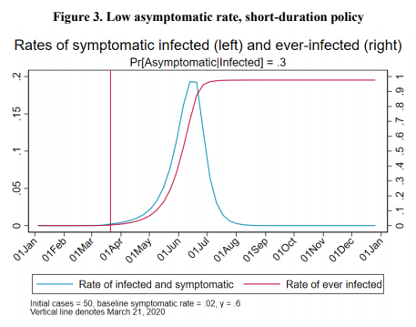
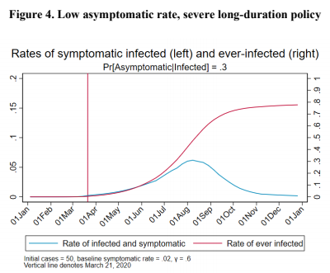
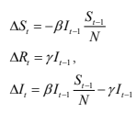
James Stock (2020)
<https://drive.google.com/file/d/12MV466ZZy5xHir4xdPhoTrL1oO8CbZU-/view>:
Susceptible, Infected, Recovered (& immune), transmission rate β, recovery rate γ, reproduction number R0, asymptomatic hence non-tested rate π0
Calibration: half-life of infection one week: γ = 0.5, s0 = 0.02, 50 cases on Jan 24
For March 21, 2020, the positive test rate in the United States is approximately 10%…

Slide 11
Bringing the Economy Back Up from Anæsthesia
Major issues:
Certificates of immunity:
Which requires test, test, test:
And not just disease virus tests
Presence-of-antibodies tests
How quickly can we match the immune with public-contact jobs?
What jobs can be done with minimal infection risk?
What minimal-infection substitutes can we find for previous jobs?
How quickly can restrictions be relaxed without the virus coming roaring back?
How do we avoid having the market give a “shutdown” signal to enterprises we in fact want restarted?
Which is pretty much all of them
How much of the potential caseload do we want to push out beyond the vaccine-arrival date?
ALL THESE QUESTIONS ARE ANSWERABLE IF WE LEARN THE ASYMPTOMATIC HENCE NON-TESTED RATE!!

Slide 12
Keeping the Economy from Crashing During the Lockdown
Nick Rowe <https://worthwhile.typepad.com/worthwhile_canadian_initi/2020/03/relative-supply-shocks-unobtainium-walras-law-and-the-coronavirus.html>:
We need a good RBC economist…
A temporary 100% output cut in 50% of the sectors (what the Coronavirus does) is very different from a 50% output cut in 100% of the sectors
Nick’s thought experiment:
In three months we are going to invent unobtanium:
Substantial intertemporal substitutibility
Plus lower cross-good contemporaneous substitutitbility
Hence high desired savings rate now
Flex-price market thus produces a nominal rate at the zero lower bound and a high inflation rate over the next three to six months
Can we get there? Should we get there? What should we do instead?

Slide 13
Keeping the Economy from Crashing During the Lockdown II
Nick Rowe <https://worthwhile.typepad.com/worthwhile_canadian_initi/2020/03/relative-supply-shocks-unobtainium-walras-law-and-the-coronavirus.html>:
Plus: to extend the thought experiment:
We just lost the ability to make “unobtainium”
So we should be substituting leisure for work, and moving workers into relatively unproductive labor, making the commodities we can still produce right now
How should relative prices move as a result? How should we make them move?
Plus: distributional issues
Plus: bankruptcy and credit chain issues

Slide 14
References
Financial Times (2020): Coronavirus Tracked: The Latest Figures as the Pandemic Spreads <https://www.ft.com/coronavirus-latest>
Nick Rowe (2020): Relative Supply Shocks, Unobtainium, Walras' Law, and the Coronavirus <https://worthwhile.typepad.com/worthwhile_canadian_initi/2020/03/relative-supply-shocks-unobtainium-walras-law-and-the-coronavirus.html>
Jim Stock (2020): Coronavirus Data Gaps and the Policy Response <https://drive.google.com/file/d/12MV466ZZy5xHir4xdPhoTrL1oO8CbZU-/view>

Slide 15
Paper Check-in…
How many people have what they need to complete their papers?:
What do you think the best thing to do with the assignment is?
Learn as much as you can…
Not stress you out…
Normally, stress is a tool we use to motivate you…
That does not seem to be a terribly good idea right now…

Slide 16
Readings
The Post-1914 Breakdown
John Maynard Keynes (1919): The Economic Consequences of the Peace, selections chs. 1-4 <https://delong.typepad.com/files/keynes-peace.pdf>
John Maynard Keynes (1925): The Economic Consequences of Mr. Churchill <https://gutenberg.ca/ebooks/keynes-essaysinpersuasion/keynes-essaysinpersuasion-00-h.html#Economic_Consequences>
American Exceptionalism
Kenneth Sokoloff (1984): Was the Transition from the Artisanal Shop to the Non-Mechanized Factory Associated with Gains in Efficiency? <http://www.nber.org/papers/w1386>
Daniel Gross (2017): Scale versus Scope in the Diffusion of New Technology: Evidence from the Tractor <https://www.nber.org/papers/w24125>
Dave Donaldson and Richard Hornbeck (2016): Railroads and American Economic Growth: A ‘Market Access’ Approach <https://academic.oup.com/qje/article/131/2/799/2606976>

Slide 17
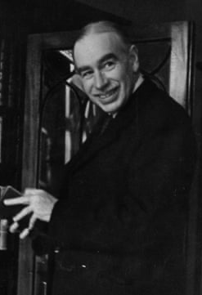
The Post-WWI Breakdown
Two from John Maynard Keynes:
John Maynard Keynes (1919): The Economic Consequences of the Peace, selections chs. 1-4 <https://delong.typepad.com/files/keynes-peace.pdf>
John Maynard Keynes (1925): The Economic Consequences of Mr. Churchill <https://gutenberg.ca/ebooks/keynes-essaysinpersuasion/keynes-essaysinpersuasion-00-h.html#Economic_Consequences>
Keynes’s thought process:
Peer through the web of finance at the real decisions being made underneath
Rearrange the web of finance and claims so that it was, well, sensible
A viewpoint very hostile to ideas of “austerity” and “confidence”
1:00
Notes:
Normally in a market economy it is quite clear that voluntary exchanges are win-win, and very clear why they are win-win. One party is exchanging generalized purchasing power in the form of money for a commodity that has a substantial use value, a use value larger then what they could believe they could get at the margin from holding onto their money or spending it in alternative ways. The other party has a commodity that has a very low use value for them, and would rather have generalized purchasing power. When I buy coffee from Peets both of us are happy: I get caffeinated, and that is worth much more to me than the money I have to pay; they get money, and that is worth much more to them than the marginal cup of coffee they have made. If the Peets employees drank all the coffee they made in the day, they were die: coffee is poisonous in large doses.
Capital markets are different. In capital markets people are trading money—generalized puchasing power—for money. Where, then, is the win-win here? How do these markets fit into this standard template of supply-and-demand and of producer and consumer surplus that we use to understand markets and their benefits?

Slide 18
Keynes on What an Economist Is
Obituary for his teacher Alfred Marshall:
“The study of economics does not seem to require any specialised gifts of an unusually high order. Is it not, intellectually regarded, a very easy subject compared with the higher branches of philosophy and pure science? Yet good, or even competent, economists are the rarest of birds.
“An easy subject, at which very few excel! The paradox finds its explanation, perhaps, in that the master-economist must possess a rare combination of gifts. He must reach a high standard in several different directions and must combine talents not often found together. He must be mathematician, historian, statesman, philosopher—in some degree. He must understand symbols and speak in words. He must contemplate the particular in terms of the general, and touch abstract and concrete in the same flight of thought. He must study the present in the light of the past for the purposes of the future.
“No part of man's nature or his institutions must lie entirely outside his regard. He must be purposeful and disinterested in a simultaneous mood; as aloof and incorruptible as an artist, yet sometimes as near the earth as a politician...”
1:00
Notes:
Normally in a market economy it is quite clear that voluntary exchanges are win-win, and very clear why they are win-win. One party is exchanging generalized purchasing power in the form of money for a commodity that has a substantial use value, a use value larger then what they could believe they could get at the margin from holding onto their money or spending it in alternative ways. The other party has a commodity that has a very low use value for them, and would rather have generalized purchasing power. When I buy coffee from Peets both of us are happy: I get caffeinated, and that is worth much more to me than the money I have to pay; they get money, and that is worth much more to them than the marginal cup of coffee they have made. If the Peets employees drank all the coffee they made in the day, they were die: coffee is poisonous in large doses.
Capital markets are different. In capital markets people are trading money—generalized puchasing power—for money. Where, then, is the win-win here? How do these markets fit into this standard template of supply-and-demand and of producer and consumer surplus that we use to understand markets and their benefits?

Slide 19
Trying to—Don’t Laugh—Restore Civilization
A profound sense that the mechanism of human progress was breaking:
Reaction to WWI & the peace treaty
Pre-WWI “El Dorado” fragile
Peace treaty an absolute disaster
Viewing newly-democratic Germany as an enemy from which resources were to be abstracted a mistake
Reaction to post-WWI attempts at normalization:
Austerity a huge mistake
Not the case that: “The market giveth, the market taketh away, blessed be the name of the market”
Rather: “The market was made for man; not man for the market”
1:00
Notes:
Normally in a market economy it is quite clear that voluntary exchanges are win-win, and very clear why they are win-win. One party is exchanging generalized purchasing power in the form of money for a commodity that has a substantial use value, a use value larger then what they could believe they could get at the margin from holding onto their money or spending it in alternative ways. The other party has a commodity that has a very low use value for them, and would rather have generalized purchasing power. When I buy coffee from Peets both of us are happy: I get caffeinated, and that is worth much more to me than the money I have to pay; they get money, and that is worth much more to them than the marginal cup of coffee they have made. If the Peets employees drank all the coffee they made in the day, they were die: coffee is poisonous in large doses.
Capital markets are different. In capital markets people are trading money—generalized puchasing power—for money. Where, then, is the win-win here? How do these markets fit into this standard template of supply-and-demand and of producer and consumer surplus that we use to understand markets and their benefits?

Slide 20
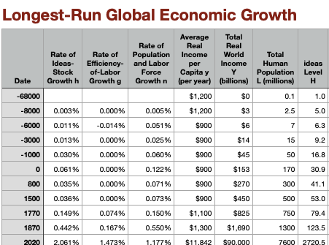
The Economic Consequences of the Peace
Once again, the 1870 Watershed:
Nearly five-fold amplification of rate of growth of human h relative to the 1770-1870 Industrial Revolution era
& that was three times Commercial Revolution 1500-1770 pace…
& that was four times Agrarian era pace…
“What an extraordinary episode in the economic progress of man that age was which came to an end in August, 1914!…”
“The projects and politics of militarism and imperialism, of racial and cultural rivalries, of monopolies, restrictions, and exclusion, which were to play the serpent to this paradise, were little more than the amusements of his daily newspaper, and appeared to exercise almost no influence at all on the ordinary course of social and economic life, the internationalization of which was nearly complete in practice…”
<https://www.icloud.com/numbers/0Y0FpX-xky2r4_BwNZ-iJPbew>
1:00
Notes:
The answer to the question of "where is the win-win here?" is rather complex. There are four ways in which capital market transactions can be win-win.
First, the counterparties can be exchanging generalized purchasing power, but generalized purchasing power to be spent at different dates. One counterparty can be borrowing in order to fund immediate consumption in excess of its current resources. Thus they are happy because what they lack is generalized purchasing power now. The other counterparty, by contrast, places is a low value on the possession of generalized purchasing power now relative to the future. The win-win here is this the creation of liquidity for those who have or rather suffer from urgency and would like to scratch some particular itch right now.
Second, the counterparties can be trading generalized purchasing power in different states of the world. In some states of the world, I will be desperately anxious to have more generalized purchasing power. And in others, I will be flush and my marginal utility of wealth will be low. Capital market trades that move my wealth from states of the world in which I have a low to stay till the world in which I have a high marginal utility of wealth are enormously beneficial to me. And if I can find a counterparty whose marginal the utility of wealth gradient across different potential states of the world is different, the exchanges can be win-win. Risk management, diversification, insurance—the win-win nature of these transactions is obvious.
Third, capital market transactions can move wealth so as to place it under different peoples control. This has the powerful potential of aligning incentives: by giving one's agents a stake in the action, one can be much more sure that they will be reliable agents. Moreover, capital market transactions can serve as signals as to when principal-agent relationships are going awry: rollover requirements and relationship banking are very important ways of managing wealth, and aligning agents incentives even outside the narrow corporate governance context.
Fourth, capital market transactions can achieve some sort of scale. They can mobilize the savings of lots of individuals in order to make possible a large and highly efficient enterprise. And economies of scale can create great convenience. That's the point of means of payment and intermediation transactions–those who have an expertise in doing them cheaply should do them, and take the load off of others, in return for a fee.
Thus we have four margins along which capital market transactions can be genuinely win-win for both parties and so fit into our standard market template of supply and demand and producer and consumer surplus. But, usually, these margins are small—and this makes capital markets and their transactions fraught in the way that normal consumer markets are not.

Slide 21
Notes:
The answer to the question of "where is the win-win here?" is rather complex. There are four ways in which capital market transactions can be win-win.
First, the counterparties can be exchanging generalized purchasing power, but generalized purchasing power to be spent at different dates. One counterparty can be borrowing in order to fund immediate consumption in excess of its current resources. Thus they are happy because what they lack is generalized purchasing power now. The other counterparty, by contrast, places is a low value on the possession of generalized purchasing power now relative to the future. The win-win here is this the creation of liquidity for those who have or rather suffer from urgency and would like to scratch some particular itch right now.
Second, the counterparties can be trading generalized purchasing power in different states of the world. In some states of the world, I will be desperately anxious to have more generalized purchasing power. And in others, I will be flush and my marginal utility of wealth will be low. Capital market trades that move my wealth from states of the world in which I have a low to stay till the world in which I have a high marginal utility of wealth are enormously beneficial to me. And if I can find a counterparty whose marginal the utility of wealth gradient across different potential states of the world is different, the exchanges can be win-win. Risk management, diversification, insurance—the win-win nature of these transactions is obvious.
Third, capital market transactions can move wealth so as to place it under different peoples control. This has the powerful potential of aligning incentives: by giving one's agents a stake in the action, one can be much more sure that they will be reliable agents. Moreover, capital market transactions can serve as signals as to when principal-agent relationships are going awry: rollover requirements and relationship banking are very important ways of managing wealth, and aligning agents incentives even outside the narrow corporate governance context.
Fourth, capital market transactions can achieve some sort of scale. They can mobilize the savings of lots of individuals in order to make possible a large and highly efficient enterprise. And economies of scale can create great convenience. That's the point of means of payment and intermediation transactions–those who have an expertise in doing them cheaply should do them, and take the load off of others, in return for a fee.
Thus we have four margins along which capital market transactions can be genuinely win-win for both parties and so fit into our standard market template of supply and demand and producer and consumer surplus. But, usually, these margins are small—and this makes capital markets and their transactions fraught in the way that normal consumer markets are not.

Slide 22
The Fragility of the Pre-1914 Order
Globalization: order, security, and uniformity:
“interference of frontiers and of tariffs was reduced to a minimum…”
“almost absolute security of property and of person…”
“currencies… maintained on a stable basis… facilitated the easy flow of capital and of trade to an extent the full value of which we only realize now, when we are deprived of its advantages…”
Psychology & economy:
“Europe… organized socially… to secure the maximum accumulation of capital…”
“Society… so framed as to throw… the increased income into the control of the class least likely to consume it…”
“If the rich had spent their new wealth on their own enjoyments, the world would long ago have found such a régime intolerable…”
“But like bees they saved and accumulated, not less to the advantage of the whole community because they themselves held narrower ends in prospect…”
John Maynard Keynes (1919): The Economic Consequences of the Peace <https://delong.typepad.com/files/keynes-peace.pdf>
1:00
Notes:
The answer to the question of "where is the win-win here?" is rather complex. There are four ways in which capital market transactions can be win-win.
First, the counterparties can be exchanging generalized purchasing power, but generalized purchasing power to be spent at different dates. One counterparty can be borrowing in order to fund immediate consumption in excess of its current resources. Thus they are happy because what they lack is generalized purchasing power now. The other counterparty, by contrast, places is a low value on the possession of generalized purchasing power now relative to the future. The win-win here is this the creation of liquidity for those who have or rather suffer from urgency and would like to scratch some particular itch right now.
Second, the counterparties can be trading generalized purchasing power in different states of the world. In some states of the world, I will be desperately anxious to have more generalized purchasing power. And in others, I will be flush and my marginal utility of wealth will be low. Capital market trades that move my wealth from states of the world in which I have a low to stay till the world in which I have a high marginal utility of wealth are enormously beneficial to me. And if I can find a counterparty whose marginal the utility of wealth gradient across different potential states of the world is different, the exchanges can be win-win. Risk management, diversification, insurance—the win-win nature of these transactions is obvious.
Third, capital market transactions can move wealth so as to place it under different peoples control. This has the powerful potential of aligning incentives: by giving one's agents a stake in the action, one can be much more sure that they will be reliable agents. Moreover, capital market transactions can serve as signals as to when principal-agent relationships are going awry: rollover requirements and relationship banking are very important ways of managing wealth, and aligning agents incentives even outside the narrow corporate governance context.
Fourth, capital market transactions can achieve some sort of scale. They can mobilize the savings of lots of individuals in order to make possible a large and highly efficient enterprise. And economies of scale can create great convenience. That's the point of means of payment and intermediation transactions–those who have an expertise in doing them cheaply should do them, and take the load off of others, in return for a fee.
Thus we have four margins along which capital market transactions can be genuinely win-win for both parties and so fit into our standard market template of supply and demand and producer and consumer surplus. But, usually, these margins are small—and this makes capital markets and their transactions fraught in the way that normal consumer markets are not.

Slide 23
The Prospect of Utopia
A double bluff, or deception:
“The laboring classes accepted… [that] they could call their own very little of the cake that they and Nature and the capitalists were co-operating to produce…”
“The capitalist classes were allowed to call the best part of the cake theirs and were theoretically free to consume it, on the tacit underlying condition that they consumed very little of it in practice…”
“Society knew what it was about…”
“If only the cake were… allowed to grow in the geometrical proportion…”
“A day might come when there would at last be enough to go round… overwork, overcrowding, and underfeeding…come to an end, and men, secure of the comforts and necessities of the body, could proceed to the nobler exercises of their faculties….”
“The great events of history are often due to secular changes in the growth of population and other fundamental economic causes, which, escaping by their gradual character the notice of contemporary observers, are attributed to the follies of statesmen or the fanaticism of atheists…”
John Maynard Keynes (1919): The Economic Consequences of the Peace <https://delong.typepad.com/files/keynes-peace.pdf>
1:00
Notes:
The answer to the question of "where is the win-win here?" is rather complex. There are four ways in which capital market transactions can be win-win.
First, the counterparties can be exchanging generalized purchasing power, but generalized purchasing power to be spent at different dates. One counterparty can be borrowing in order to fund immediate consumption in excess of its current resources. Thus they are happy because what they lack is generalized purchasing power now. The other counterparty, by contrast, places is a low value on the possession of generalized purchasing power now relative to the future. The win-win here is this the creation of liquidity for those who have or rather suffer from urgency and would like to scratch some particular itch right now.
Second, the counterparties can be trading generalized purchasing power in different states of the world. In some states of the world, I will be desperately anxious to have more generalized purchasing power. And in others, I will be flush and my marginal utility of wealth will be low. Capital market trades that move my wealth from states of the world in which I have a low to stay till the world in which I have a high marginal utility of wealth are enormously beneficial to me. And if I can find a counterparty whose marginal the utility of wealth gradient across different potential states of the world is different, the exchanges can be win-win. Risk management, diversification, insurance—the win-win nature of these transactions is obvious.
Third, capital market transactions can move wealth so as to place it under different peoples control. This has the powerful potential of aligning incentives: by giving one's agents a stake in the action, one can be much more sure that they will be reliable agents. Moreover, capital market transactions can serve as signals as to when principal-agent relationships are going awry: rollover requirements and relationship banking are very important ways of managing wealth, and aligning agents incentives even outside the narrow corporate governance context.
Fourth, capital market transactions can achieve some sort of scale. They can mobilize the savings of lots of individuals in order to make possible a large and highly efficient enterprise. And economies of scale can create great convenience. That's the point of means of payment and intermediation transactions–those who have an expertise in doing them cheaply should do them, and take the load off of others, in return for a fee.
Thus we have four margins along which capital market transactions can be genuinely win-win for both parties and so fit into our standard market template of supply and demand and producer and consumer surplus. But, usually, these margins are small—and this makes capital markets and their transactions fraught in the way that normal consumer markets are not.

Slide 24
The Dangers Raised by World War I
Upsetting the belief that the system was what it was, & upsetting accumulative psychology:
“The pre-war order of Society and of progress… depended on unstable psycholog[y]…”
“It may be impossible to recreate…”
“It was not natural for a population, of whom so few enjoyed the comforts of life, to accumulate so hugely…”
“The war has disclosed the possibility of consumption to all and the vanity of abstinence to many…”
John Maynard Keynes (1919): The Economic Consequences of the Peace <https://delong.typepad.com/files/keynes-peace.pdf>
1:00
Notes:
The answer to the question of "where is the win-win here?" is rather complex. There are four ways in which capital market transactions can be win-win.
First, the counterparties can be exchanging generalized purchasing power, but generalized purchasing power to be spent at different dates. One counterparty can be borrowing in order to fund immediate consumption in excess of its current resources. Thus they are happy because what they lack is generalized purchasing power now. The other counterparty, by contrast, places is a low value on the possession of generalized purchasing power now relative to the future. The win-win here is this the creation of liquidity for those who have or rather suffer from urgency and would like to scratch some particular itch right now.
Second, the counterparties can be trading generalized purchasing power in different states of the world. In some states of the world, I will be desperately anxious to have more generalized purchasing power. And in others, I will be flush and my marginal utility of wealth will be low. Capital market trades that move my wealth from states of the world in which I have a low to stay till the world in which I have a high marginal utility of wealth are enormously beneficial to me. And if I can find a counterparty whose marginal the utility of wealth gradient across different potential states of the world is different, the exchanges can be win-win. Risk management, diversification, insurance—the win-win nature of these transactions is obvious.
Third, capital market transactions can move wealth so as to place it under different peoples control. This has the powerful potential of aligning incentives: by giving one's agents a stake in the action, one can be much more sure that they will be reliable agents. Moreover, capital market transactions can serve as signals as to when principal-agent relationships are going awry: rollover requirements and relationship banking are very important ways of managing wealth, and aligning agents incentives even outside the narrow corporate governance context.
Fourth, capital market transactions can achieve some sort of scale. They can mobilize the savings of lots of individuals in order to make possible a large and highly efficient enterprise. And economies of scale can create great convenience. That's the point of means of payment and intermediation transactions–those who have an expertise in doing them cheaply should do them, and take the load off of others, in return for a fee.
Thus we have four margins along which capital market transactions can be genuinely win-win for both parties and so fit into our standard market template of supply and demand and producer and consumer surplus. But, usually, these margins are small—and this makes capital markets and their transactions fraught in the way that normal consumer markets are not.

Slide 25
French Premier Clemenceau as Villain
Justified villainy given his goals, but villainy:
The fundamentals:
“By 1914 the population of Germany was nearly seventy per cent in excess of that of France…”
“She had become one of the first manufacturing and trading nations of the world…”
“Her technical skill and her means for the production of future wealth were unequaled…”
“France… a stationary or declining population… fallen seriously behind in wealth and in the power to produce it…”
Clemenceau’s choice: transform Germany, or cripple it:
Clemenceau’s view:
“European civil war is to be regarded as a normal, or at least a recurrent, state of affairs…”
“A Peace of magnanimity or of fair and equal treatment… could only have the effect of shortening the interval of Germany's recovery and hastening the day when she will once again hurl at France her greater numbers and her superior resources and technical skill…”
“Each guarantee that was taken… increasing irritation and thus the probability of a subsequent Revanche by Germany, made necessary yet further provisions to crush…”
“Thus, as soon as this view of the world is adopted and the other discarded, a demand for a Carthaginian Peace is inevitable, to the full extent of the momentary power to impose it…”
John Maynard Keynes (1919): The Economic Consequences of the Peace <https://delong.typepad.com/files/keynes-peace.pdf>
1:00
Notes:
The answer to the question of "where is the win-win here?" is rather complex. There are four ways in which capital market transactions can be win-win.
First, the counterparties can be exchanging generalized purchasing power, but generalized purchasing power to be spent at different dates. One counterparty can be borrowing in order to fund immediate consumption in excess of its current resources. Thus they are happy because what they lack is generalized purchasing power now. The other counterparty, by contrast, places is a low value on the possession of generalized purchasing power now relative to the future. The win-win here is this the creation of liquidity for those who have or rather suffer from urgency and would like to scratch some particular itch right now.
Second, the counterparties can be trading generalized purchasing power in different states of the world. In some states of the world, I will be desperately anxious to have more generalized purchasing power. And in others, I will be flush and my marginal utility of wealth will be low. Capital market trades that move my wealth from states of the world in which I have a low to stay till the world in which I have a high marginal utility of wealth are enormously beneficial to me. And if I can find a counterparty whose marginal the utility of wealth gradient across different potential states of the world is different, the exchanges can be win-win. Risk management, diversification, insurance—the win-win nature of these transactions is obvious.
Third, capital market transactions can move wealth so as to place it under different peoples control. This has the powerful potential of aligning incentives: by giving one's agents a stake in the action, one can be much more sure that they will be reliable agents. Moreover, capital market transactions can serve as signals as to when principal-agent relationships are going awry: rollover requirements and relationship banking are very important ways of managing wealth, and aligning agents incentives even outside the narrow corporate governance context.
Fourth, capital market transactions can achieve some sort of scale. They can mobilize the savings of lots of individuals in order to make possible a large and highly efficient enterprise. And economies of scale can create great convenience. That's the point of means of payment and intermediation transactions–those who have an expertise in doing them cheaply should do them, and take the load off of others, in return for a fee.
Thus we have four margins along which capital market transactions can be genuinely win-win for both parties and so fit into our standard market template of supply and demand and producer and consumer surplus. But, usually, these margins are small—and this makes capital markets and their transactions fraught in the way that normal consumer markets are not.

Slide 26
American President Woodrow Wilson’s Dreams
The revolutionary German government asked for an armistice & peace negotiations on the basis of Woodrow Wilson’s “14 Points”:
Public diplomacy
Freedom of navigation
Free and equal trade
Disarmament and arms control.
Impartial adjustment of colonial claims in which the interests of the populations concerned have equal weight with the government awarded title
The evacuation of all Russian territory and such a settlement of all questions affecting Russia as will secure the best and freest cooperation of the other nations of the world in obtaining for her an unhampered and unembarrassed opportunity for the independent determination of her own political development and national policy under institutions of her own choosing
Belgium evacuated and restored
All French territory freed and restored, including Alsace-Lorraine
Italy’s frontiers to follow national lines
Peoples of Austria-Hungary accorded the freest opportunity to autonomous development.
Romania, Serbia, and Montenegro evacuated and Serbia accorded free and secure access to the sea.
The present Ottoman Empire dissolved, with nationalities assured security and an absolutely unmolested opportunity of autonomous development, the Dardanelles opened under international guarantees
Independent Polish including territories inhabited by indisputably Polish populations, with free and secure access to the sea, with political and economic independence and territorial integrity guaranteed
A general association of nations
Woodrow Wilson (1918): Fourteen Points <https://wwi.lib.byu.edu/index.php/President_Wilson%27s_Fourteen_Points>
1:00
Notes:
The answer to the question of "where is the win-win here?" is rather complex. There are four ways in which capital market transactions can be win-win.
First, the counterparties can be exchanging generalized purchasing power, but generalized purchasing power to be spent at different dates. One counterparty can be borrowing in order to fund immediate consumption in excess of its current resources. Thus they are happy because what they lack is generalized purchasing power now. The other counterparty, by contrast, places is a low value on the possession of generalized purchasing power now relative to the future. The win-win here is this the creation of liquidity for those who have or rather suffer from urgency and would like to scratch some particular itch right now.
Second, the counterparties can be trading generalized purchasing power in different states of the world. In some states of the world, I will be desperately anxious to have more generalized purchasing power. And in others, I will be flush and my marginal utility of wealth will be low. Capital market trades that move my wealth from states of the world in which I have a low to stay till the world in which I have a high marginal utility of wealth are enormously beneficial to me. And if I can find a counterparty whose marginal the utility of wealth gradient across different potential states of the world is different, the exchanges can be win-win. Risk management, diversification, insurance—the win-win nature of these transactions is obvious.
Third, capital market transactions can move wealth so as to place it under different peoples control. This has the powerful potential of aligning incentives: by giving one's agents a stake in the action, one can be much more sure that they will be reliable agents. Moreover, capital market transactions can serve as signals as to when principal-agent relationships are going awry: rollover requirements and relationship banking are very important ways of managing wealth, and aligning agents incentives even outside the narrow corporate governance context.
Fourth, capital market transactions can achieve some sort of scale. They can mobilize the savings of lots of individuals in order to make possible a large and highly efficient enterprise. And economies of scale can create great convenience. That's the point of means of payment and intermediation transactions–those who have an expertise in doing them cheaply should do them, and take the load off of others, in return for a fee.
Thus we have four margins along which capital market transactions can be genuinely win-win for both parties and so fit into our standard market template of supply and demand and producer and consumer surplus. But, usually, these margins are small—and this makes capital markets and their transactions fraught in the way that normal consumer markets are not.

Slide 27
The Big Four
Wilson’s commitments: “no annexations, no contributions, no punitive damages…” “justice meted out must involve no discrimination between those to whom we wish to be just and those to whom we do not wish to be just…”:
“Mr. Lloyd George's election pledge to the effect that the Allies were entitled to demand from Germany the entire costs of the war…”
David Lloyd-George said: Not contributions, not punitive damages, only reparations
“The President's slowness… was noteworthy… liable, therefore, to defeat by the mere swiftness, apprehension, and agility of a Lloyd George. There can seldom have been a statesman of the first rank more incompetent than the President in the agilities of the council chamber…”
A diktat: “Clemenceau brought to success, what had seemed to be, a few months before, the extraordinary and impossible proposal that the Germans should not be heard…”
“The President had thought nothing out, [so] the Council was generally working on the basis of a French or British draft…”
“The more extravagant expectations as to Reparation receipts, by which Finance Ministers have deceived their publics, will be heard of no more when they have served their immediate purpose of postponing the hour of taxation and retrenchment…”
“To his horror, Mr. Lloyd George, desiring at the last moment all the moderation he dared, discovered that he could not in five days persuade the President of error in what it had taken five months to prove to him to be just and right. After all, it was harder to de-bamboozle this old Presbyterian than it had been to bamboozle him…”
John Maynard Keynes (1919): The Economic Consequences of the Peace <https://delong.typepad.com/files/keynes-peace.pdf>
1:00
Notes:
The answer to the question of "where is the win-win here?" is rather complex. There are four ways in which capital market transactions can be win-win.
First, the counterparties can be exchanging generalized purchasing power, but generalized purchasing power to be spent at different dates. One counterparty can be borrowing in order to fund immediate consumption in excess of its current resources. Thus they are happy because what they lack is generalized purchasing power now. The other counterparty, by contrast, places is a low value on the possession of generalized purchasing power now relative to the future. The win-win here is this the creation of liquidity for those who have or rather suffer from urgency and would like to scratch some particular itch right now.
Second, the counterparties can be trading generalized purchasing power in different states of the world. In some states of the world, I will be desperately anxious to have more generalized purchasing power. And in others, I will be flush and my marginal utility of wealth will be low. Capital market trades that move my wealth from states of the world in which I have a low to stay till the world in which I have a high marginal utility of wealth are enormously beneficial to me. And if I can find a counterparty whose marginal the utility of wealth gradient across different potential states of the world is different, the exchanges can be win-win. Risk management, diversification, insurance—the win-win nature of these transactions is obvious.
Third, capital market transactions can move wealth so as to place it under different peoples control. This has the powerful potential of aligning incentives: by giving one's agents a stake in the action, one can be much more sure that they will be reliable agents. Moreover, capital market transactions can serve as signals as to when principal-agent relationships are going awry: rollover requirements and relationship banking are very important ways of managing wealth, and aligning agents incentives even outside the narrow corporate governance context.
Fourth, capital market transactions can achieve some sort of scale. They can mobilize the savings of lots of individuals in order to make possible a large and highly efficient enterprise. And economies of scale can create great convenience. That's the point of means of payment and intermediation transactions–those who have an expertise in doing them cheaply should do them, and take the load off of others, in return for a fee.
Thus we have four margins along which capital market transactions can be genuinely win-win for both parties and so fit into our standard market template of supply and demand and producer and consumer surplus. But, usually, these margins are small—and this makes capital markets and their transactions fraught in the way that normal consumer markets are not.

Slide 28
The Diktat
A domestic political and an international document:
“The Treaty includes no provisions for the economic rehabilitation of Europe,—nothing to make the defeated Central Empires into good neighbors, nothing to stabilize the new States of Europe, nothing to reclaim Russia; nor does it promote in any way a compact of economic solidarity amongst the Allies themselves; no arrangement was reached at Paris for restoring the disordered finances of France and Italy, or to adjust the systems of the Old World and the New…”
“The Council of Four paid no attention to these issues, being preoccupied with others,—Clemenceau to crush the economic life of his enemy, Lloyd George to do a deal and bring home something which would pass muster for a week, the President to do nothing that was not just and right. It is an extraordinary fact that the fundamental economic problems of a Europe starving and disintegrating before their eyes, was the one question in which it was impossible to arouse the interest of the Four…”
“Article 231 reads:
“The Allied and Associated Governments affirm and Germany accepts the responsibility of Germany and her allies for causing all the loss and damage to which the Allied and Associated Governments and their nationals have been subjected as a consequence of the war imposed upon them by the aggression of Germany and her allies.”
“This is a well and carefully drafted Article; for the President could read it as statement of admission on Germany's part of moral responsibility for bringing about the war, while the Prime Minister could explain it as an admission of financial liability for the general costs of the war…”
John Maynard Keynes (1919): The Economic Consequences of the Peace <https://delong.typepad.com/files/keynes-peace.pdf>
1:00
Notes:
The answer to the question of "where is the win-win here?" is rather complex. There are four ways in which capital market transactions can be win-win.
First, the counterparties can be exchanging generalized purchasing power, but generalized purchasing power to be spent at different dates. One counterparty can be borrowing in order to fund immediate consumption in excess of its current resources. Thus they are happy because what they lack is generalized purchasing power now. The other counterparty, by contrast, places is a low value on the possession of generalized purchasing power now relative to the future. The win-win here is this the creation of liquidity for those who have or rather suffer from urgency and would like to scratch some particular itch right now.
Second, the counterparties can be trading generalized purchasing power in different states of the world. In some states of the world, I will be desperately anxious to have more generalized purchasing power. And in others, I will be flush and my marginal utility of wealth will be low. Capital market trades that move my wealth from states of the world in which I have a low to stay till the world in which I have a high marginal utility of wealth are enormously beneficial to me. And if I can find a counterparty whose marginal the utility of wealth gradient across different potential states of the world is different, the exchanges can be win-win. Risk management, diversification, insurance—the win-win nature of these transactions is obvious.
Third, capital market transactions can move wealth so as to place it under different peoples control. This has the powerful potential of aligning incentives: by giving one's agents a stake in the action, one can be much more sure that they will be reliable agents. Moreover, capital market transactions can serve as signals as to when principal-agent relationships are going awry: rollover requirements and relationship banking are very important ways of managing wealth, and aligning agents incentives even outside the narrow corporate governance context.
Fourth, capital market transactions can achieve some sort of scale. They can mobilize the savings of lots of individuals in order to make possible a large and highly efficient enterprise. And economies of scale can create great convenience. That's the point of means of payment and intermediation transactions–those who have an expertise in doing them cheaply should do them, and take the load off of others, in return for a fee.
Thus we have four margins along which capital market transactions can be genuinely win-win for both parties and so fit into our standard market template of supply and demand and producer and consumer surplus. But, usually, these margins are small—and this makes capital markets and their transactions fraught in the way that normal consumer markets are not.

Slide 29
The Diktat II
The rubber meets the road here:
“Article 232 continues:
“The Allied and Associated Governments recognize that the resources of Germany are not adequate, after taking into account permanent diminutions of such resources which will result from other provisions of the present Treaty, to make complete reparation for all such loss and damage.”
“The President could comfort himself that this was no more than a statement of undoubted fact, and that to recognize that Germany cannot pay a certain claim does not imply that she is liable to pay the claim; but the Prime Minister could point out that in the context it emphasizes to the reader the assumption of Germany's theoretic liability asserted in the preceding Article. Article 232 proceeds:
"The Allied and Associated Governments, however, require, and Germany undertakes, that she will make compensation for all damage done to the civilian population of the Allied and Associated Powers and to their property during the period of the belligerency of each as an Allied or Associated Power against Germany by such aggression by land, by sea, and from the air, and in general all damage as defined in Annex I. hereto.”
“The words italicized being practically a quotation from the pre-Armistice conditions, satisfied the scruples of the President, while the addition of the words "and in general all damage as defined in Annex I. hereto" gave the Prime Minister a chance in Annex I…”
“the Treaty…t fixes no definite sum as representing Germany's liability…. Two different kinds of false statements had been widely promulgated, one as to Germany's capacity to pay, the other as to the amount of the Allies' just claims in respect of the devastated areas. The fixing of either of these figures presented a dilemma. A figure for Germany's prospective capacity to pay, not too much in excess of the estimates of most candid and well-informed authorities, would have fallen hopelessly far short of popular expectations both in England and in France…”
John Maynard Keynes (1919): The Economic Consequences of the Peace <https://delong.typepad.com/files/keynes-peace.pdf>
1:00
Notes:
The answer to the question of "where is the win-win here?" is rather complex. There are four ways in which capital market transactions can be win-win.
First, the counterparties can be exchanging generalized purchasing power, but generalized purchasing power to be spent at different dates. One counterparty can be borrowing in order to fund immediate consumption in excess of its current resources. Thus they are happy because what they lack is generalized purchasing power now. The other counterparty, by contrast, places is a low value on the possession of generalized purchasing power now relative to the future. The win-win here is this the creation of liquidity for those who have or rather suffer from urgency and would like to scratch some particular itch right now.
Second, the counterparties can be trading generalized purchasing power in different states of the world. In some states of the world, I will be desperately anxious to have more generalized purchasing power. And in others, I will be flush and my marginal utility of wealth will be low. Capital market trades that move my wealth from states of the world in which I have a low to stay till the world in which I have a high marginal utility of wealth are enormously beneficial to me. And if I can find a counterparty whose marginal the utility of wealth gradient across different potential states of the world is different, the exchanges can be win-win. Risk management, diversification, insurance—the win-win nature of these transactions is obvious.
Third, capital market transactions can move wealth so as to place it under different peoples control. This has the powerful potential of aligning incentives: by giving one's agents a stake in the action, one can be much more sure that they will be reliable agents. Moreover, capital market transactions can serve as signals as to when principal-agent relationships are going awry: rollover requirements and relationship banking are very important ways of managing wealth, and aligning agents incentives even outside the narrow corporate governance context.
Fourth, capital market transactions can achieve some sort of scale. They can mobilize the savings of lots of individuals in order to make possible a large and highly efficient enterprise. And economies of scale can create great convenience. That's the point of means of payment and intermediation transactions–those who have an expertise in doing them cheaply should do them, and take the load off of others, in return for a fee.
Thus we have four margins along which capital market transactions can be genuinely win-win for both parties and so fit into our standard market template of supply and demand and producer and consumer surplus. But, usually, these margins are small—and this makes capital markets and their transactions fraught in the way that normal consumer markets are not.

Slide 30
Was There a “Transfer Problem”?
Many have argued that Keynes was wrong here…
Thought experiment: impose a large wealth tax on Germany:
Then give the proceeds to the allies
In the form of ownership of German capital
How can there be a “transfer problem”?
Now the allies own Germany’s capital…
If they want to turn that ownership into consumption, they simply sell the shares and buy exports…
John Maynard Keynes (1919): The Economic Consequences of the Peace <https://delong.typepad.com/files/keynes-peace.pdf>
1:00
Notes:
The answer to the question of "where is the win-win here?" is rather complex. There are four ways in which capital market transactions can be win-win.
First, the counterparties can be exchanging generalized purchasing power, but generalized purchasing power to be spent at different dates. One counterparty can be borrowing in order to fund immediate consumption in excess of its current resources. Thus they are happy because what they lack is generalized purchasing power now. The other counterparty, by contrast, places is a low value on the possession of generalized purchasing power now relative to the future. The win-win here is this the creation of liquidity for those who have or rather suffer from urgency and would like to scratch some particular itch right now.
Second, the counterparties can be trading generalized purchasing power in different states of the world. In some states of the world, I will be desperately anxious to have more generalized purchasing power. And in others, I will be flush and my marginal utility of wealth will be low. Capital market trades that move my wealth from states of the world in which I have a low to stay till the world in which I have a high marginal utility of wealth are enormously beneficial to me. And if I can find a counterparty whose marginal the utility of wealth gradient across different potential states of the world is different, the exchanges can be win-win. Risk management, diversification, insurance—the win-win nature of these transactions is obvious.
Third, capital market transactions can move wealth so as to place it under different peoples control. This has the powerful potential of aligning incentives: by giving one's agents a stake in the action, one can be much more sure that they will be reliable agents. Moreover, capital market transactions can serve as signals as to when principal-agent relationships are going awry: rollover requirements and relationship banking are very important ways of managing wealth, and aligning agents incentives even outside the narrow corporate governance context.
Fourth, capital market transactions can achieve some sort of scale. They can mobilize the savings of lots of individuals in order to make possible a large and highly efficient enterprise. And economies of scale can create great convenience. That's the point of means of payment and intermediation transactions–those who have an expertise in doing them cheaply should do them, and take the load off of others, in return for a fee.
Thus we have four margins along which capital market transactions can be genuinely win-win for both parties and so fit into our standard market template of supply and demand and producer and consumer surplus. But, usually, these margins are small—and this makes capital markets and their transactions fraught in the way that normal consumer markets are not.

Slide 31
The Economic Consequences of Mr. Churchill
The British 1924 decision to return to the gold standard in 1925:
At the pre-WWI parity of $4.86 = £1
At a time when the “fundamental” value was something like $3.40
Market settled at $4.30 because of a belief that there was a 70% chance of return
What happens when you try to peg your real exchange rate above its fundamental level?
The risk that the real peg is going to collapse
Higher short-term real interest rates than the world level until…
<https://gutenberg.ca/ebooks/keynes-essaysinpersuasion/keynes-essaysinpersuasion-00-h.html#Economic_Consequences>
1:00
Notes:
The answer to the question of "where is the win-win here?" is rather complex. There are four ways in which capital market transactions can be win-win.
First, the counterparties can be exchanging generalized purchasing power, but generalized purchasing power to be spent at different dates. One counterparty can be borrowing in order to fund immediate consumption in excess of its current resources. Thus they are happy because what they lack is generalized purchasing power now. The other counterparty, by contrast, places is a low value on the possession of generalized purchasing power now relative to the future. The win-win here is this the creation of liquidity for those who have or rather suffer from urgency and would like to scratch some particular itch right now.
Second, the counterparties can be trading generalized purchasing power in different states of the world. In some states of the world, I will be desperately anxious to have more generalized purchasing power. And in others, I will be flush and my marginal utility of wealth will be low. Capital market trades that move my wealth from states of the world in which I have a low to stay till the world in which I have a high marginal utility of wealth are enormously beneficial to me. And if I can find a counterparty whose marginal the utility of wealth gradient across different potential states of the world is different, the exchanges can be win-win. Risk management, diversification, insurance—the win-win nature of these transactions is obvious.
Third, capital market transactions can move wealth so as to place it under different peoples control. This has the powerful potential of aligning incentives: by giving one's agents a stake in the action, one can be much more sure that they will be reliable agents. Moreover, capital market transactions can serve as signals as to when principal-agent relationships are going awry: rollover requirements and relationship banking are very important ways of managing wealth, and aligning agents incentives even outside the narrow corporate governance context.
Fourth, capital market transactions can achieve some sort of scale. They can mobilize the savings of lots of individuals in order to make possible a large and highly efficient enterprise. And economies of scale can create great convenience. That's the point of means of payment and intermediation transactions–those who have an expertise in doing them cheaply should do them, and take the load off of others, in return for a fee.
Thus we have four margins along which capital market transactions can be genuinely win-win for both parties and so fit into our standard market template of supply and demand and producer and consumer surplus. But, usually, these margins are small—and this makes capital markets and their transactions fraught in the way that normal consumer markets are not.

Slide 32
The British Government’s Reaction
Let’s try to prevent the wage adjustment, to the extent we can:
Boosting UI so that people can stay in their jobs and their communities
So the signal that you have to accept lower nominal wages in the export industries are not sent
And the general excess supply of labor nationwide putting downward pressure on nominal wages is not registered elsewhere in the economy
An indicative-planning attempt to reduce lending abroad
With consequences for London’s role as a financial center
And, of course, when the peg does break, it does so at the worst possible time…
<https://gutenberg.ca/ebooks/keynes-essaysinpersuasion/keynes-essaysinpersuasion-00-h.html#Economic_Consequences>
1:00
Notes:
The answer to the question of "where is the win-win here?" is rather complex. There are four ways in which capital market transactions can be win-win.
First, the counterparties can be exchanging generalized purchasing power, but generalized purchasing power to be spent at different dates. One counterparty can be borrowing in order to fund immediate consumption in excess of its current resources. Thus they are happy because what they lack is generalized purchasing power now. The other counterparty, by contrast, places is a low value on the possession of generalized purchasing power now relative to the future. The win-win here is this the creation of liquidity for those who have or rather suffer from urgency and would like to scratch some particular itch right now.
Second, the counterparties can be trading generalized purchasing power in different states of the world. In some states of the world, I will be desperately anxious to have more generalized purchasing power. And in others, I will be flush and my marginal utility of wealth will be low. Capital market trades that move my wealth from states of the world in which I have a low to stay till the world in which I have a high marginal utility of wealth are enormously beneficial to me. And if I can find a counterparty whose marginal the utility of wealth gradient across different potential states of the world is different, the exchanges can be win-win. Risk management, diversification, insurance—the win-win nature of these transactions is obvious.
Third, capital market transactions can move wealth so as to place it under different peoples control. This has the powerful potential of aligning incentives: by giving one's agents a stake in the action, one can be much more sure that they will be reliable agents. Moreover, capital market transactions can serve as signals as to when principal-agent relationships are going awry: rollover requirements and relationship banking are very important ways of managing wealth, and aligning agents incentives even outside the narrow corporate governance context.
Fourth, capital market transactions can achieve some sort of scale. They can mobilize the savings of lots of individuals in order to make possible a large and highly efficient enterprise. And economies of scale can create great convenience. That's the point of means of payment and intermediation transactions–those who have an expertise in doing them cheaply should do them, and take the load off of others, in return for a fee.
Thus we have four margins along which capital market transactions can be genuinely win-win for both parties and so fit into our standard market template of supply and demand and producer and consumer surplus. But, usually, these margins are small—and this makes capital markets and their transactions fraught in the way that normal consumer markets are not.

Slide 33
American Exceptionalism
Two from John Maynard Keynes:
Reaction to WWI & the peace treaty
Pre-WWI “El Dorado” fragile
Peace treaty an absolute disaster
Viewing newly-democratic Germany as an enemy from which resources were to be abstracted a mistake
Reaction to post-WWI attempts at normalization:
Austerity a huge mistake
Not the case that: “The market giveth, the market taketh away, blessed be the name of the market”
Rather: “The market was made for man; not man for the market”
Peer through the web of finance at the real decisions being made underneath
Rearrange the web of finance and claims so that it was, well, sensible
A viewpoint very hostile to ideas of “austerity” and “confidence”
1:00
Notes:
Normally in a market economy it is quite clear that voluntary exchanges are win-win, and very clear why they are win-win. One party is exchanging generalized purchasing power in the form of money for a commodity that has a substantial use value, a use value larger then what they could believe they could get at the margin from holding onto their money or spending it in alternative ways. The other party has a commodity that has a very low use value for them, and would rather have generalized purchasing power. When I buy coffee from Peets both of us are happy: I get caffeinated, and that is worth much more to me than the money I have to pay; they get money, and that is worth much more to them than the marginal cup of coffee they have made. If the Peets employees drank all the coffee they made in the day, they were die: coffee is poisonous in large doses.
Capital markets are different. In capital markets people are trading money—generalized puchasing power—for money. Where, then, is the win-win here? How do these markets fit into this standard template of supply-and-demand and of producer and consumer surplus that we use to understand markets and their benefits?

Slide 34
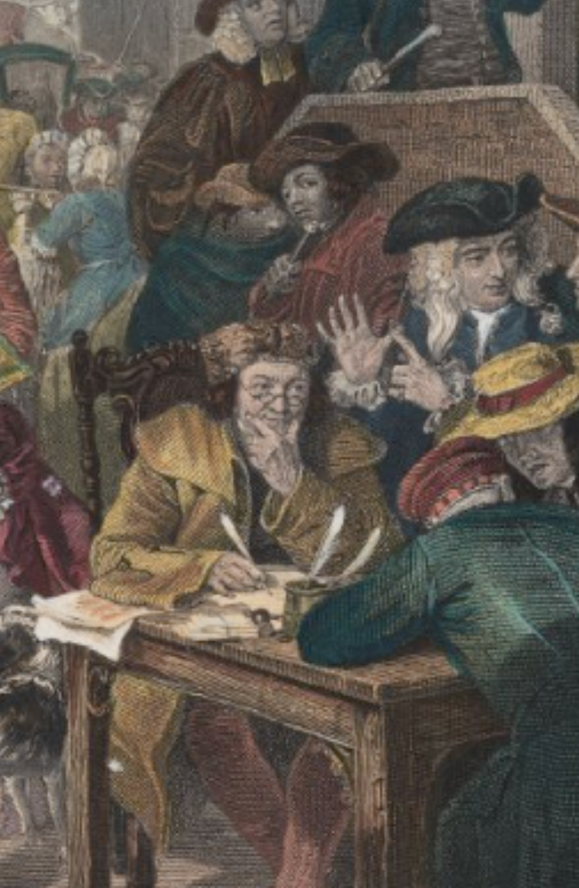
The Economic Consequences of Mr. Churchill
Where, then, is the win-win here?:
At different times (liquidity)
To fund immediate consumption
To fund productive investment
In different states of the world (risk, diversification, insurance)
Under different people’s control (align incentives)
Corporate governance
Monitoring borrowers (rollover and relationship)
To achieve scale:
Savings mobilization to realize increasing returns, at least over a range
Convenience (means of payment; intermediation)
3:30
Notes:
The answer to the question of "where is the win-win here?" is rather complex. There are four ways in which capital market transactions can be win-win.
First, the counterparties can be exchanging generalized purchasing power, but generalized purchasing power to be spent at different dates. One counterparty can be borrowing in order to fund immediate consumption in excess of its current resources. Thus they are happy because what they lack is generalized purchasing power now. The other counterparty, by contrast, places is a low value on the possession of generalized purchasing power now relative to the future. The win-win here is this the creation of liquidity for those who have or rather suffer from urgency and would like to scratch some particular itch right now.
Second, the counterparties can be trading generalized purchasing power in different states of the world. In some states of the world, I will be desperately anxious to have more generalized purchasing power. And in others, I will be flush and my marginal utility of wealth will be low. Capital market trades that move my wealth from states of the world in which I have a low to stay till the world in which I have a high marginal utility of wealth are enormously beneficial to me. And if I can find a counterparty whose marginal the utility of wealth gradient across different potential states of the world is different, the exchanges can be win-win. Risk management, diversification, insurance—the win-win nature of these transactions is obvious.
Third, capital market transactions can move wealth so as to place it under different peoples control. This has the powerful potential of aligning incentives: by giving one's agents a stake in the action, one can be much more sure that they will be reliable agents. Moreover, capital market transactions can serve as signals as to when principal-agent relationships are going awry: rollover requirements and relationship banking are very important ways of managing wealth, and aligning agents incentives even outside the narrow corporate governance context.
Fourth, capital market transactions can achieve some sort of scale. They can mobilize the savings of lots of individuals in order to make possible a large and highly efficient enterprise. And economies of scale can create great convenience. That's the point of means of payment and intermediation transactions–those who have an expertise in doing them cheaply should do them, and take the load off of others, in return for a fee.
Thus we have four margins along which capital market transactions can be genuinely win-win for both parties and so fit into our standard market template of supply and demand and producer and consumer surplus. But, usually, these margins are small—and this makes capital markets and their transactions fraught in the way that normal consumer markets are not.

Slide 35
Catch Our Breath…
Ask a couple of questions?
Make a couple of comments?
Any more readings to recommend?

