Slide 1
Coronavirus!
With 31 deaths in the U.S. as of March 11, a 1% death rate, and up to 4 weeks between infection and death, that means that as of Feb 12 there were 3100 coronavirus cases in the United States. If it is doubling every seven days, then now about 45,000 people have and in the next week about 45,000 more people in the U.S. will catch coronavirus—which means 1/6000, currently 10 members of the extended Berkeley community.
These numbers could be five times too big. These numbers are probably not five times too small unless the thing is a lot less deadly, and there are a lot of asymptomatic cases…
What is wrong with this analysis?

Slide 2
Coronavirus!
Calls are Carol Christ’s…
She has made the call: classes are now moved online: I am busy adding audio to slide files
That said:
If you are coughing and sneezing, stay home! Email me and we will give you extra-credit points…
Otherwise, there are powerful herd-animal benefits to coming to lecture
(& to talking about course material with your friends: you need to convince your brain that these concepts are useful, & it should keep them)
Washington State has been doing an intensive flu screening, so they know stuff:
They guess: 1 in 1000 people in WA has coronavirus as of a week ago (March 1)…
Half of them have no symptoms
Asymptomatic transmission means that we cannot contain this without shutting society down
Cases doubling every 5 days
Means that by the end of March 1 in 45 people in WA will have it…
April will be epidemic month—unless something substantially reduces R0
In the end, 30%-70% of us will test positive
&, worldwide, 20 million people are likely to be dead
Our hope is to stretch out this process as long as possible, so that health providers are not totally overwhelmed
When will “the end” be?
How fast will we get there?
Will we be rescued by warmer weather?

Slide 3
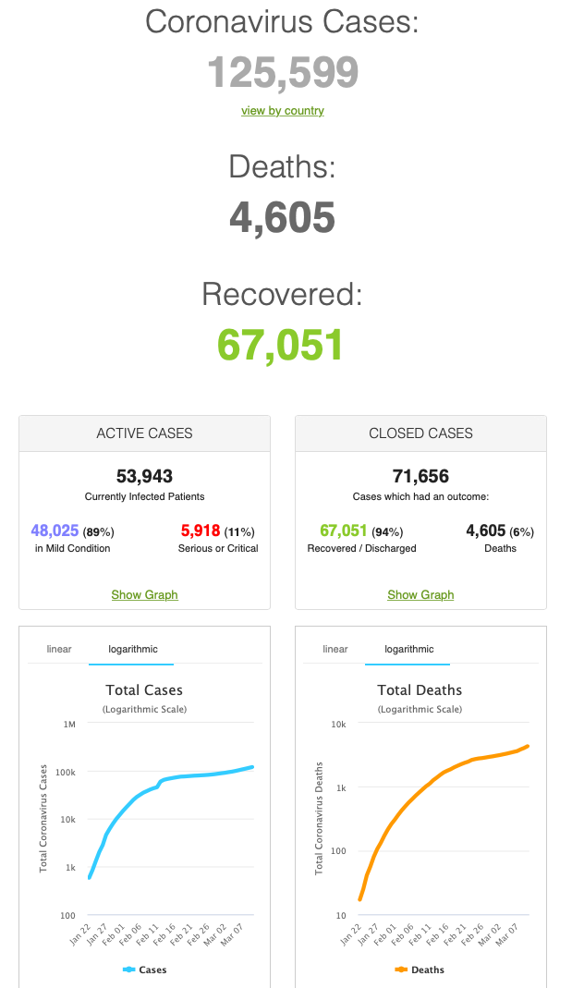
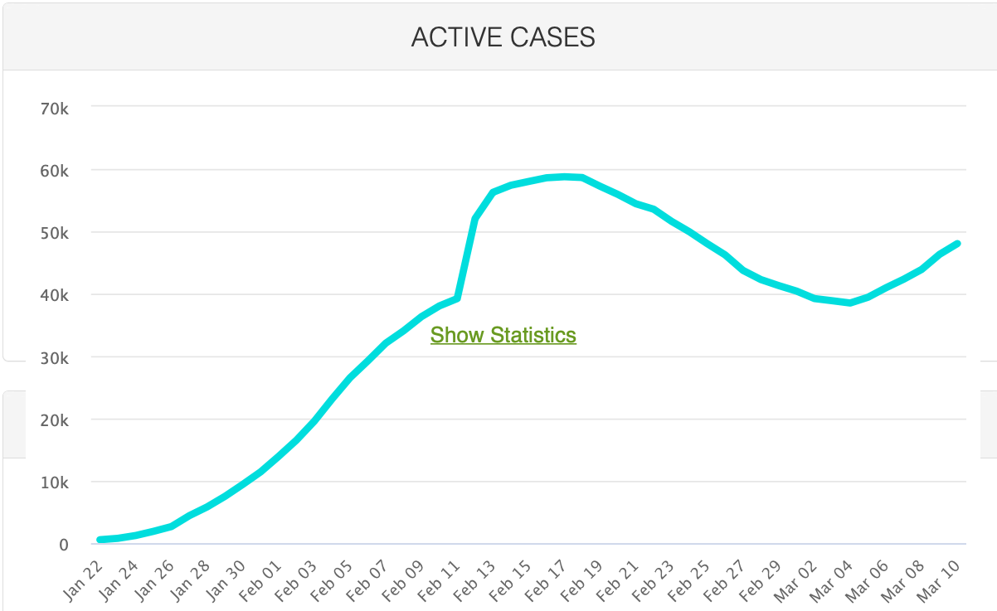
MOAR Coronavirus!
Things are not moving in the right direction:
What is the R0?
How can the R0 be changed?
How will the R0 change?
What is the asymptote share of the population?
What is the mortality rate?

Slide 4
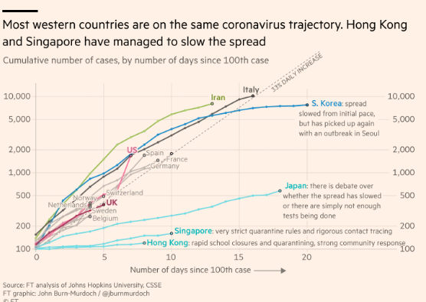
MOAR Coronavirus!
What I am watching:
Max Roser & Hannah Ritchie: Coronavirus Disease (COVID-19)_ <https://ourworldindata.org/coronavirus>…
Worldometer: Coronavirus Update (Live) <https://www.worldometers.info/coronavirus/>: ‘125,599 Cases and 4,605 Deaths from COVID-19 Virus Outbreak…
FT Coronavirus Tracker <https://www.ft.com/content/a26fbf7e-48f8-11ea-aeb3-955839e06441>
<https://www.nytimes.com/interactive/2020/us/coronavirus-us-cases.html>

Slide 5
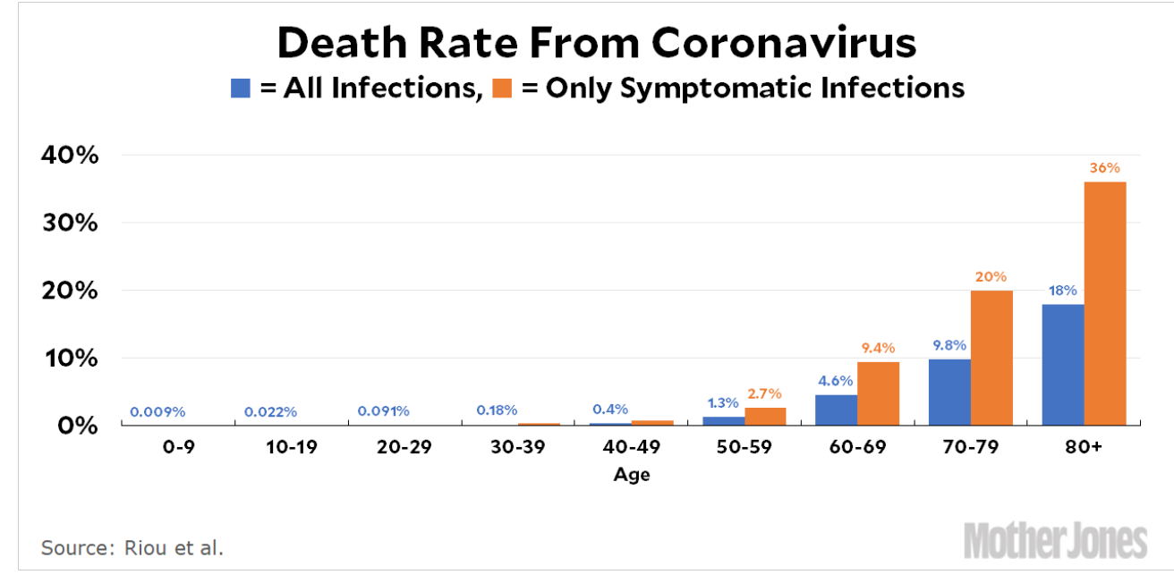
MOAR Coronavirus!
It’s a Thing for Geezers!
Mortality for the Youngs very low…
It’s the flu for them…

Slide 6
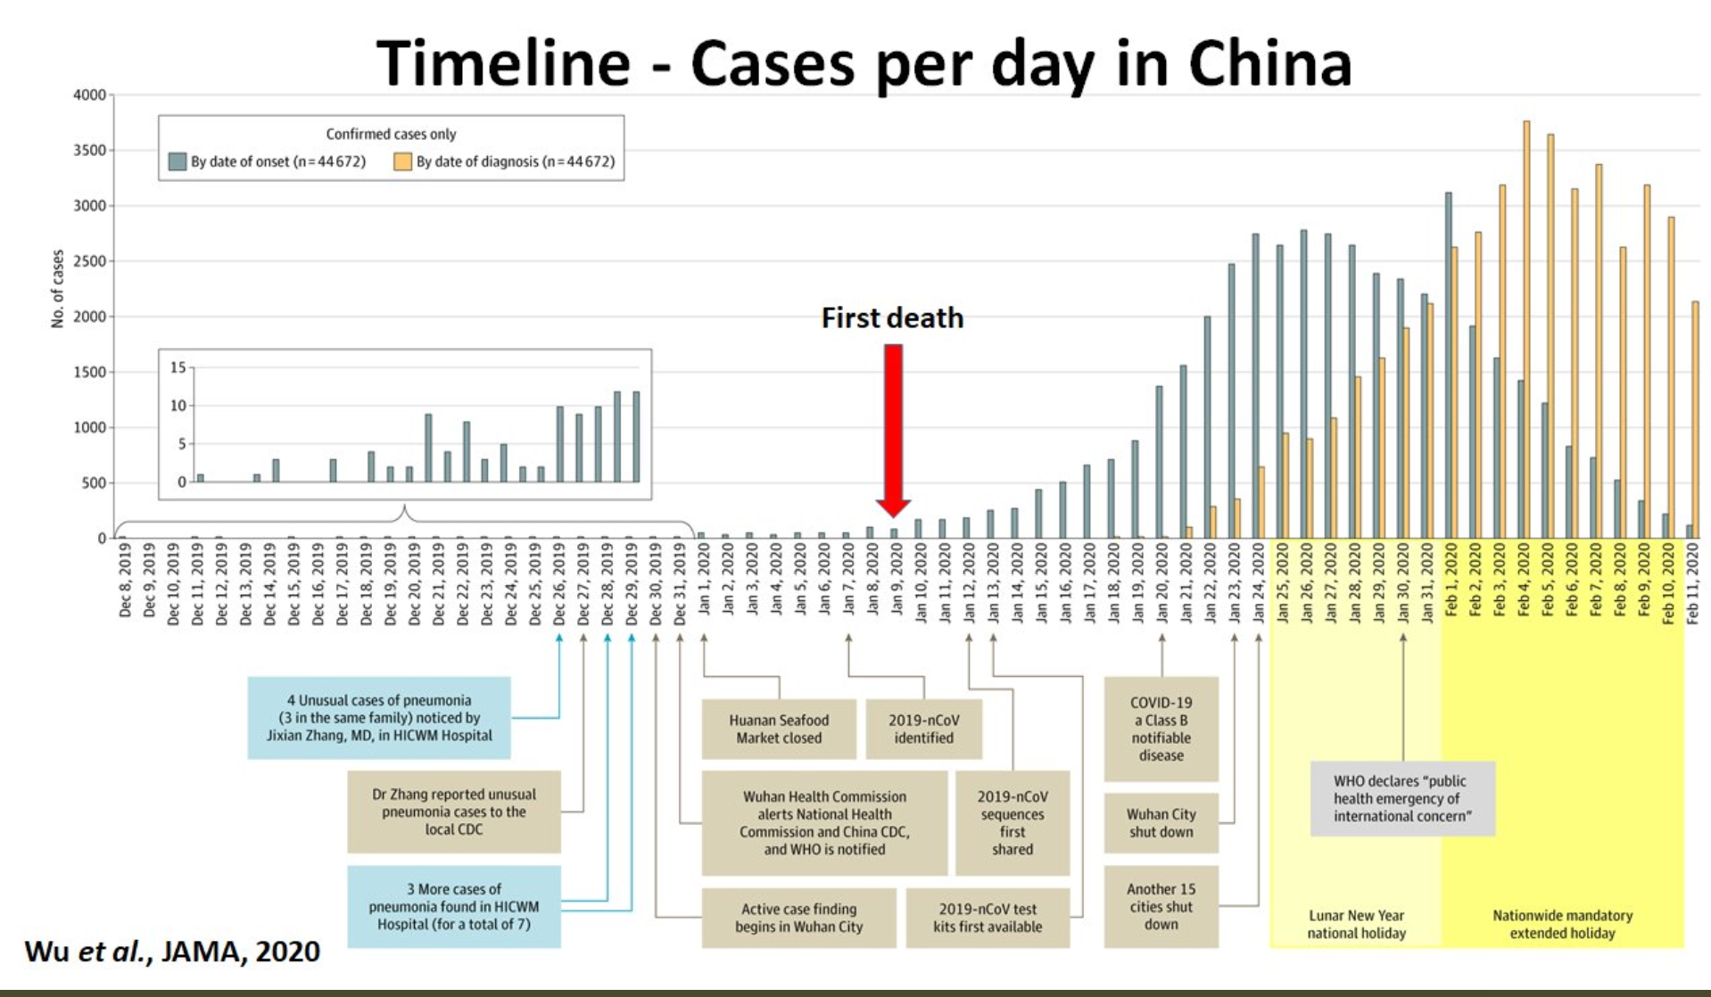
MOAR Coronavirus! II
China Beat It!
Shut down Wuhan when 200 cases per day
That seems to have been a good decision

Slide 7
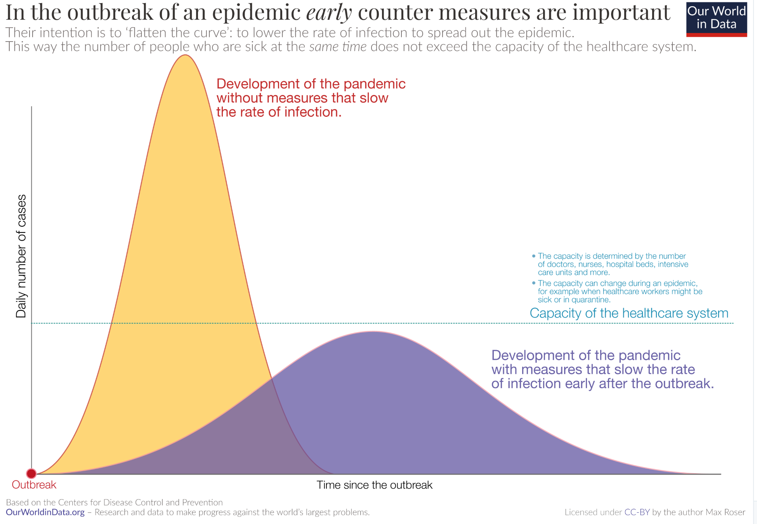
MOAR Coronavirus! III
When Is It Appropriate to Move on This?
Immediate social distancing…
Self-isolate if you have a cough and a fever…
Hope that warmer temperatures will do to this what they did to SARS…
Otherwise, when do you want to start spreading out transmission. It seems that early is as good as later…

Slide 8
Catch Our Breath…
Ask a couple of questions?
Make a couple of comments?
Any more readings to recommend?

Slide 9
Notes

