Slide 1
Econ 210a: Industrial Revolutions (February 5, 2020b)
J. Bradford DeLong
Spring 2019
Evans 648
W 1:10-3:00 pm
<https://bcourses.berkeley.edu/courses/1487686/>
<https://github.com/braddelong/public-files/blob/master/econ-210a-lecture-3b.pptx>

Slide 2
Industrial Revolutions: Readings for February 5…
Robert C. Allen (2011): Why the Industrial Revolution Was British: Commerce, Induced Invention and the Scientific Revolution <http://onlinelibrary.wiley.com/doi/10.1111/j.1468-0289.2010.00532.x/pdf>
Peter Temin (1997): Two Views of the British Industrial Revolution <http://www.jstor.org/stable/pdfplus/2951107.pdf>
Stephen Nicholas and Richard H. Steckel (1991): Heights and Living Standards of English Workers during the Early Years of Industrialization, 1770–1815 <http://www.jstor.org/stable/pdfplus/2123399.pdf>

Slide 3
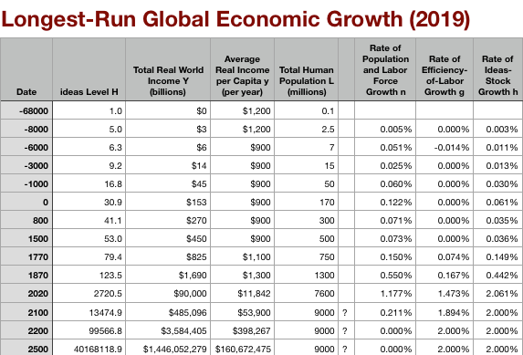
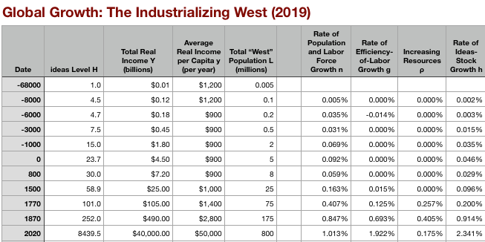
Global and “Western” Numbers
Is ‘the west’ special between 800 and 1500?
Or is it just recovery from a Dark Age depression?
The Commercial Revolution acceleration appears everywhere
Due to globalization
And especially to the “Columbian Exchange”

Slide 4
Reading Allen
Robert C. Allen (2011): Why the Industrial Revolution Was British: Commerce, Induced Invention and the Scientific Revolution <http://onlinelibrary.wiley.com/doi/10.1111/j.1468-0289.2010.00532.x/pdf>:
Information economics visits the 1500s…
How much of a difference can a small sector—1% of GDP—actually make?
What are the economic benefits of books, anyway?
What does this tell us about the market system as optimal societal structure?

Slide 5
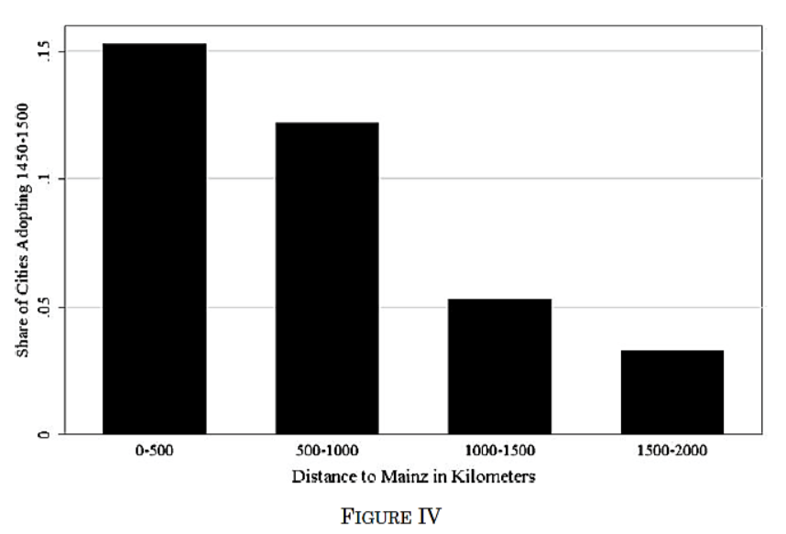
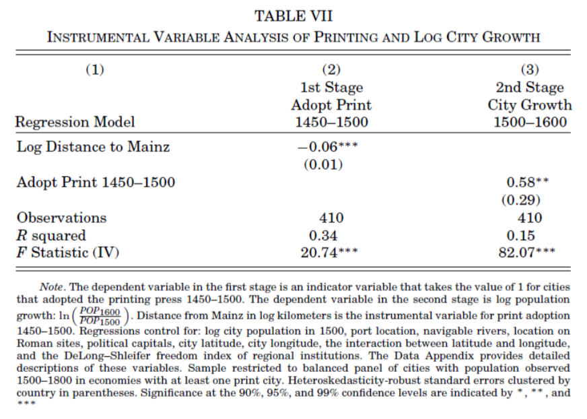
What Should We Think When IV Estimates Are so Much Bigger than OLS Ones?
Dittmar’s Test: Compare (especially over the period 1500– 1600) population growth of cities that did and did not adopt the printing press before 1500.
Why are DIttmar’s IV estimates so big? 0.6 per century—a near doubling—as opposed to 0.2?

Slide 6

Questions for Allen

Slide 7
Reading Temin
Peter Temin (1997): Two Views of the British Industrial Revolution <http://www.jstor.org/stable/pdfplus/2951107.pdf>:
Information economics visits the 1500s…
How much of a difference can a small sector—1% of GDP—actually make?
What are the economic benefits of books, anyway?
What does this tell us about the market system as optimal societal structure?

Slide 8
What Should We Think When IV Estimates Are so Much Bigger than OLS Ones?
Dittmar’s Test: Compare (especially over the period 1500– 1600) population growth of cities that did and did not adopt the printing press before 1500.
Why are DIttmar’s IV estimates so big? 0.6 per century—a near doubling—as opposed to 0.2?

Slide 9
Questions for Temin

Slide 10
Reading Nicholas and Steckel
Stephen Nicholas and Richard H. Steckel (1991): Heights and Living Standards of English Workers during the Early Years of Industrialization, 1770–1815 <http://www.jstor.org/stable/pdfplus/2123399.pdf>:
Information economics visits the 1500s…
How much of a difference can a small sector—1% of GDP—actually make?
What are the economic benefits of books, anyway?
What does this tell us about the market system as optimal societal structure?

Slide 11
What Should We Think When IV Estimates Are so Much Bigger than OLS Ones?
Dittmar’s Test: Compare (especially over the period 1500– 1600) population growth of cities that did and did not adopt the printing press before 1500.
Why are DIttmar’s IV estimates so big? 0.6 per century—a near doubling—as opposed to 0.2?

Slide 12
Questions for Nicholas and Steckel

Slide 13
Questions for AJR
We are talking an extra 10% of the population in cities here. Is this reasonable to attribute to the effects of good government?
But does “Atlantic trade" automatically produce good government?

Slide 14
Catch Our Breath…
Ask a couple of questions?
Make a couple of comments?
Any more readings to recommend?

Slide 15
Notes…

