Slide 1
Lecture 3: Malthusian Theory: Outline
Read Beforehand: J. Bradford DeLong: Lecture Notes: Malthusian Economies <https://tinyurl.com/dl-2020-01-18g>
Read Beforehand: Greg Clark: A Farewell to Alms, selections <https://delong.typepad.com/files/clark-alms-selections.pdf>
Slides: <https://github.com/braddelong/public-files/blob/master/econ-135-lecture-3.pptx>
Review: Long-run shape of global economic growth
Lecture: Solow-Malthus model basics
Review: Solow model essentials
Lecture: Applying the Solow-Malthus model
<https://datahub.berkeley.edu/user/delong@econ.berkeley.edu/notebooks/LS2019/2019-10-14-Ancient_Economies.ipynb>
<https://nbviewer.jupyter.org/github/braddelong/LS2019/blob/master/2019-10-14-Ancient_Economies.ipynb>
Assignment: What is economics? paper <https://bcourses.berkeley.edu/courses/1487685/assignments/8065184>
Big Ideas: Principal takeaways from this class
MOAR references:
C.I. Jones: The Facts of Economic Growth <https://web.stanford.edu/~chadj/facts.pdf>...
Gregory Clark (2005): The Condition of the Working Class in England, 1209-2003 <https://delong.typepad.com/files/clark-condition.pdf>...
Ian Morris (2010): Why the West Rules–For Now, chapter 3: Taking the Measure of the Past <https://delong.typepad.com/files/morris-rules-3.pdf>...
Patricia Crone: Pre-Industrial Societies, selections <https://delong.typepad.com/files/crone-pre-selections.pdf>...

Slide 2
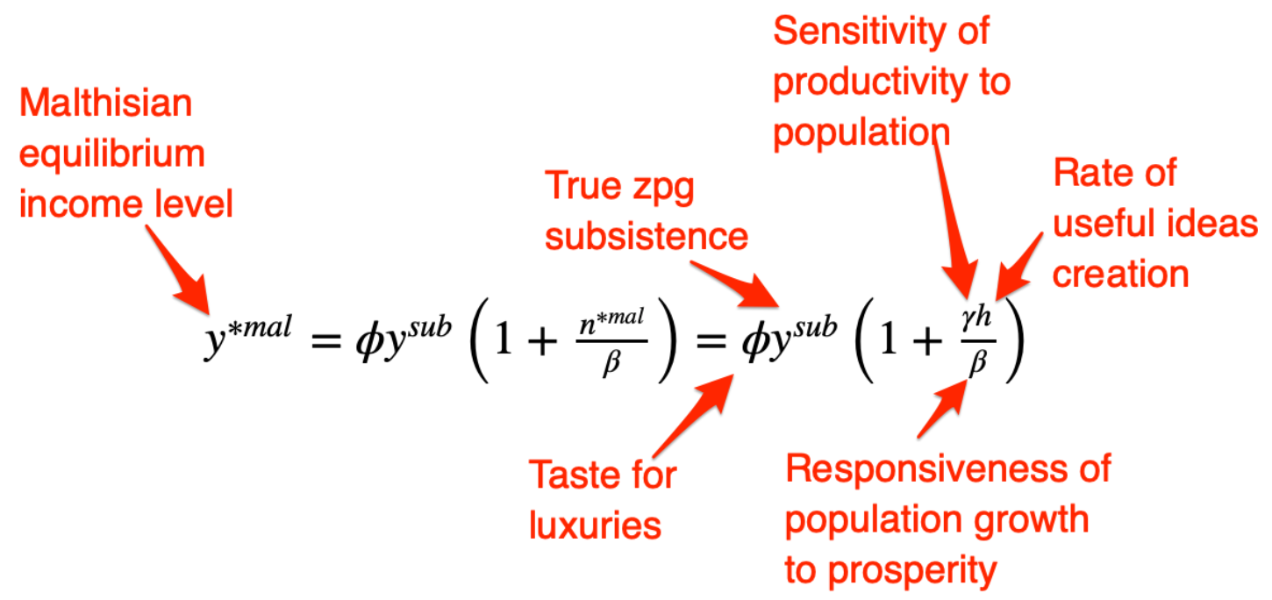
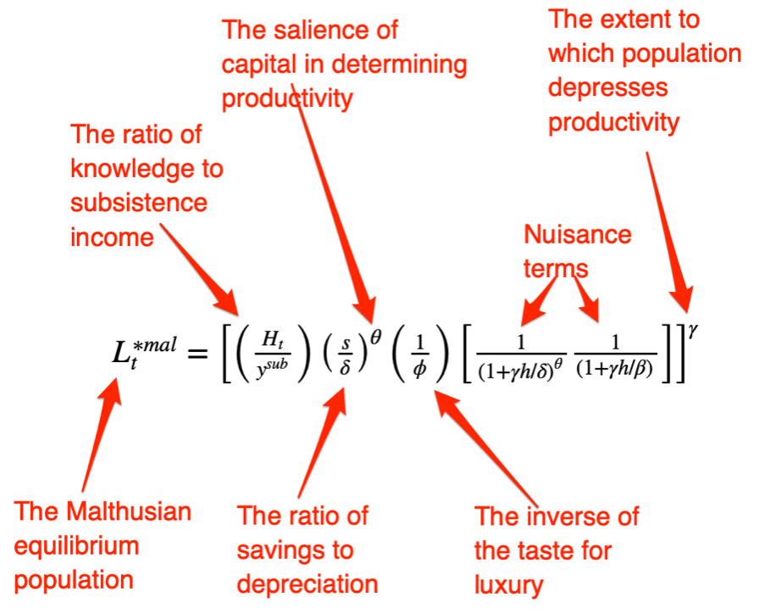
Big Ideas: Lecture 3: Malthusian Theory
Takeaways from this lecture:
People were ingenious and inventive back before 1500, yet standards of living did not increase
Populations, however, did
Slowly
We explain this via:
Natural resource scarcity: more heads means smaller farms which offset the productive benefit of better ideas: efficiency of labor growth g = h - n/γ, where h is ideas growth, n is population and labor force growth, and γ is the resource scarcity-pressure parameter.
Population pressure: before the demographic transition, higher standards of living mean faster population growth: n = β(y/(Φy^{sub}) - 1), where Φ is taste for luxuries (inequality! urbanization!), y^{sub} is the income level at which we have zpg on average, and β is the population-responsiveness parameter
Malthusian equilibrium, with efflorescences and declines:

