Slide 1
Lecture 2:
1.1. Theory: Robert Solow’s Economic Growth Model
Brad DeLong
Department of Economics and Blum Center, U.C. Berkeley; WCEG; and NBER
last revised: 2019-10-15
Original course by Melissa Dell (Harvard Econ 1342), revised by Brad DeLong, research assistance by Anish Biligiri
<https://github.com/braddelong/public-files/blob/master/econ-135-lecture-2.pptx>

Slide 2
Lecture 2: Solow Theory: Outline
Slides: <https://github.com/braddelong/public-files/blob/master/econ-135-lecture-2.pptx>
Read After: J. Bradford DeLong: Lecture Notes: The Solow Growth Model <https://tinyurl.com/dl-2020-01-18f>
Read After: Partha Dasgupta (2007): Economics: A Very Short Introduction, chapters 5-8 & Epilogue <https://delong.typepad.com/files/dasgupta-economics.pdf>
Do: Assignment 2 (3 pts): Letter to GSI, due Sa Jan 25 9:00 am <https://tinyurl.com/dl-2020-01-12g>
Administration: Office hours poll
Lecture: Solow basics
<https://www.bradford-delong.com/2020/01/lecture-notes-the-solow-growth-model-the-history-of-economic-growth-econ-135.html> <http://datahub.berkeley.edu/user-redirect/interact?account=braddelong&repo=long-form-drafts&branch=master&path=solow-model-3-growing.ipynb> <http://datahub.berkeley.edu/user-redirect/interact?account=braddelong&repo=long-form-drafts&branch=master&path=solow-model-4-using.ipynb>
Review: Growth patterns
Lecture: Solving the Solow model
<https://nbviewer.jupyter.org/github/braddelong/lecture-support-2020/blob/master/lecture-support-solow-2020-01-23.ipynb>
Big Ideas: Principal takeaways from this class
MOAR references:
Robert Solow (1956): A Contribution to the Theory of Economic Growth <http://piketty.pse.ens.fr/files/Solow1956.pdf>
Moses Abramovitz (1956): Resource and Output Trends in the United States Since 1870 <https://www.nber.org/chapters/c5650.pdf>
Robert Solow (1957): Technical Change and the Aggregate Production Function <http://www.piketty.pse.ens.fr/files/Solow1957.pdf>
Moses Abramovitz (1986): Catching Up, Forging Ahead, and Falling Behind <http://www.j-bradford-delong.net/teaching_Folder/Econ_210c_spring_2002/Readings/Abramovitz.pdf>
Robert Solow (1987): Growth Theory and After <https://www.nobelprize.org/prizes/economic-sciences/1987/solow/lecture/>

Slide 3
Office Hours
Office Hours:
M 11:15-12:30,
T 11:15-12:00
By appointment: email <delong@econ.berkeley.edu>

Slide 4
Solow Model Basics
Lecture Notes: <https://www.bradford-delong.com/2020/01/lecture-notes-the-solow-growth-model-the-history-of-economic-growth-econ-135.html>
Let's assume three things about the relationship between an economy's resources and the total output it produces and income it generates:
Production
Other parts of the model
Balanced-growth equilibrium
Convergence to equilibrium

Slide 5
Solow Model Basics: Production
Let's assume three things about the relationship between an economy's resources and the total output it produces and income it generates:
A proportional increase in the economy's capital intensity κ, measured by the capital stock divided by total production κ = K/Y, will carry with it the same (smaller) proportional increase in income and production Y no matter how rich and productive the economy is. A 1% increase in capital intensity will always increase income and production by the same proportional amount θ.
If two economies have the same capital intensity, defined as the same capital-output ratio κ, and have the same level of technology- and organization-driven efficiency-of-labor E, then the ratio of their levels of income and output will be equal to the ratio of their labor forces L.
If two economies have the same capital intensity, defined as the same capital-output ratio κ, and have the same labor forces L, then the ratio of their levels of income and output will be equal to the ratio of their technology- and organization-driven efficiencies-of-labor E

Slide 6
Basics: Production Notation
Y: total income and production
E: technological and organizational efficiency-of-labor
L: labor force
y: per-worker income and production
κ: the capital-intensity of the economy, as measured by the capital-output ratio K/Y (Greek lower kappa)
θ: the relative salience in economic growth of capital-intensity vis-a-vis technological and organizational progress (Greek lower theta)
if α is the share of income received by capital under the marginal productivity theory of distribution, then α=θ/(1+θ), 1-α=1/(1+θ), θ = α/(1-α)

Slide 7
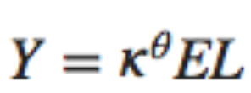
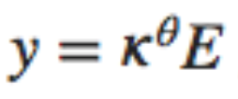
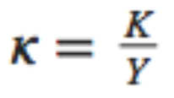
Basics: Production Algebra
Then there is one and only one equation that satisfies those three rules of thumb:
And it is also worth writing down
a version of this equation in per-worker form, where y = Y/L
the definition of capital intensity κ: κ= K/Y
We have just done what economists typically do: take a complex situation, strip things down to some salient piece of it, and then formalize and algebraize that piece in the hope of gaining insight…

Slide 8
Solow Model Basics: Notes
The code in the nbViewer documents is static. But you should also look at:
<http://datahub.berkeley.edu/user-redirect/interact?account=braddelong&repo=long-form-drafts&branch=master&path=solow-model-2-basics.ipynb>
<http://datahub.berkeley.edu/user-redirect/interact?account=braddelong&repo=long-form-drafts&branch=master&path=solow-model-3-growing.ipynb>
<http://datahub.berkeley.edu/user-redirect/interact?account=braddelong&repo=long-form-drafts&branch=master&path=solow-model-4-using.ipynb>

Slide 9



The Rest of the Model: Growth Rates
Variables change over time:
growth of labor gL: proportional at a constant n (for now)
growth of labor efficiency gE: proportional at a constant g (for now)
rate of change of capital: savings minus depreciation
growth of capital gK = s/κ-δ
What do these mean?
Now let’s look at the rate of change of capital-intensity κ as a function of the level of capital-intensity κ, for constant n, g, s, δ, and θ…

Slide 10
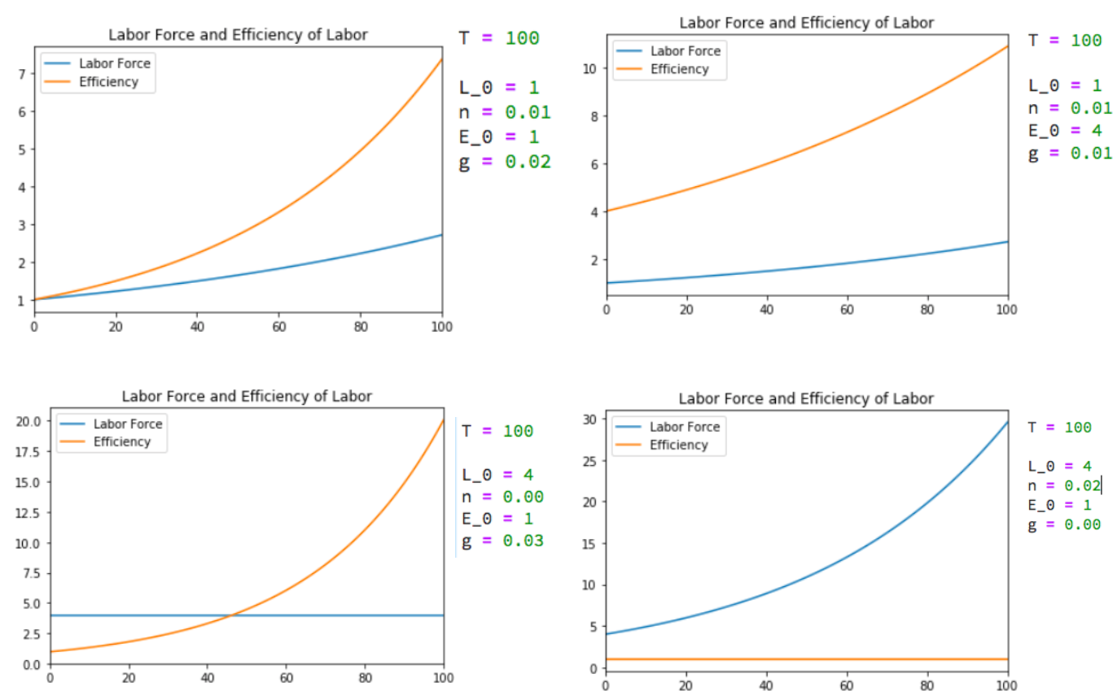
Growth Rates: L & E

Slide 11
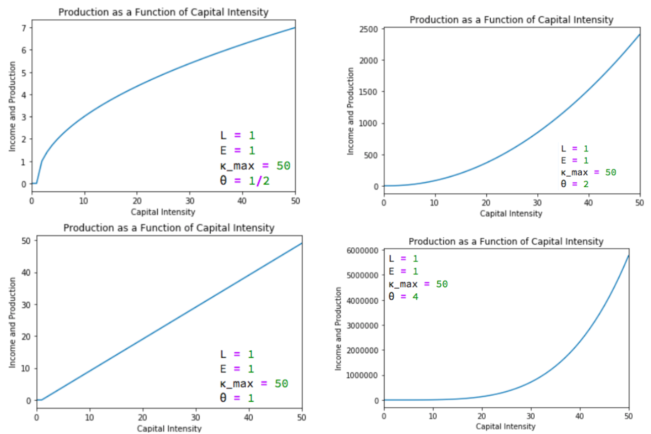
Salience of Capital: θ

Slide 12
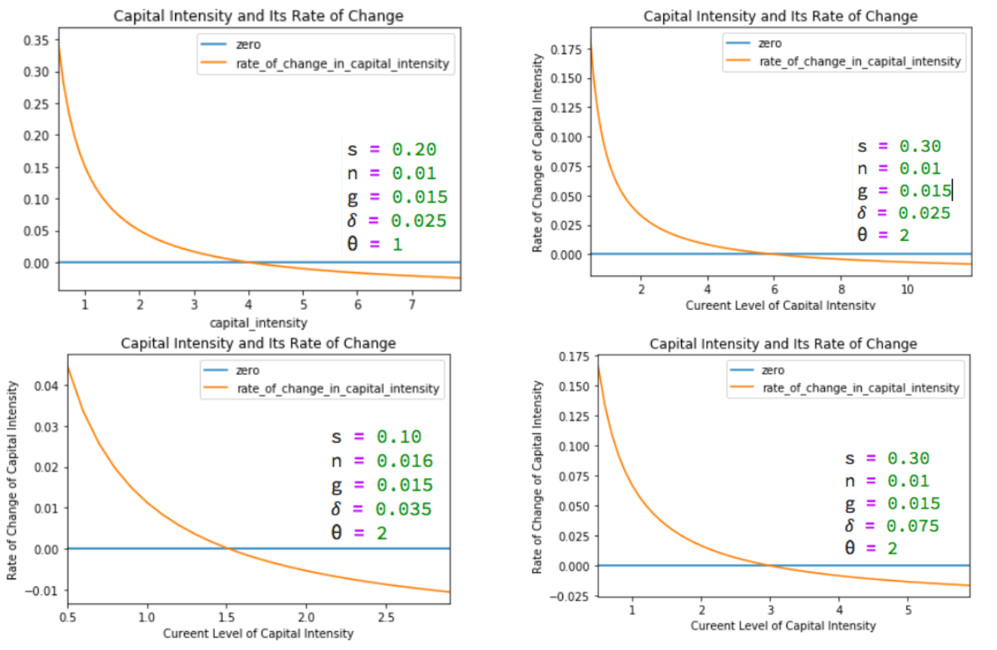
Change in Capital-Intensity κ as a Function of Its Level

Slide 13

Catch Our Breath…
Ask a couple of questions?
Make a couple of comments?
Any more readings to recommend?

Slide 14
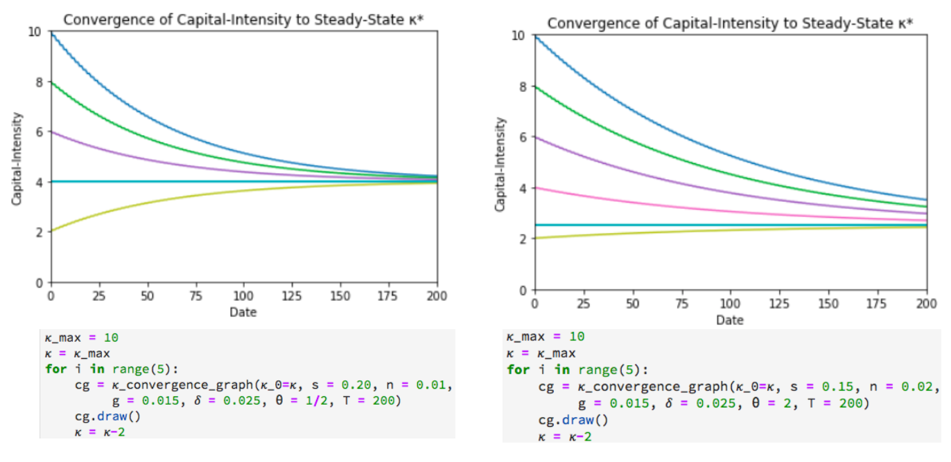
Solving the Model

Slide 15
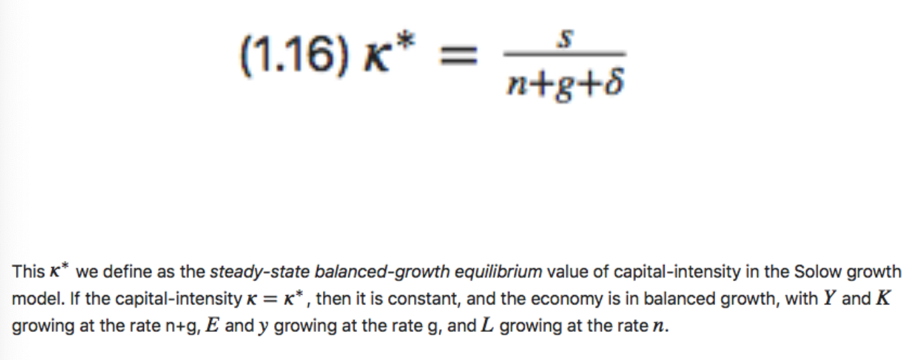
Balanced-Growth Equilibrium: Steady-State Capital-Intensity κ*

Slide 16
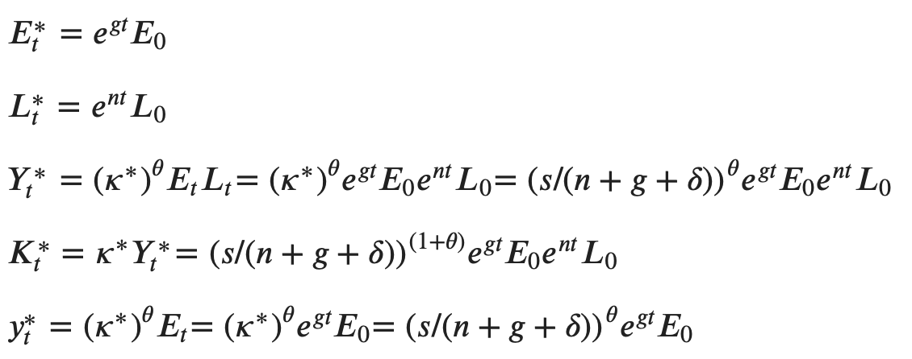
Along the Balanced-Growth Path
Everything except κ—which is constant—grows at a constant proportional rate: either n, or g, or n+g;
Labor force L grows at n
Income per worker y and the efficiency of labor E grow at g
Total income Y and the capital stock K grow at n+g

Slide 17
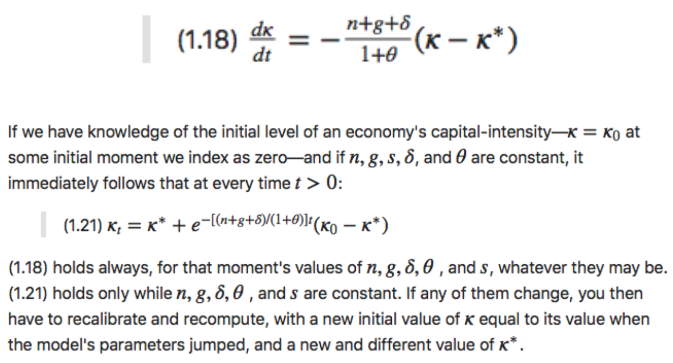
Convergence to Steady-State Capital-Intensity

Slide 18
Convergence to κ*

Slide 19
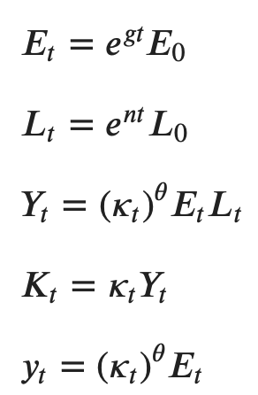
Other Variables in the Model

Slide 20
Catch Our Breath…
Ask a couple of questions?
Make a couple of comments?
Any more readings to recommend?

Slide 21
Big Ideas: Lecture 2: Solow Theory
Takeaways from this lecture:
Math is a language!
Three assumptions about the production function immediately get us to:
Y = κ^{θ}EL
Plus:
constant: dln(L)/dt = n; dln(E)/dt = g; dln(K)/dt = s/κ - δ
Results in:
κ* = s/(n+g+δ); dκ/dt = -(n+g+δ)/(1+θ)
y = κ^{θ}E; K = κY
convergence to and then growth along a steady-state balanced-growth path associated with κ*.

Slide 22
Basic References
Robert Solow (1956): A Contribution to the Theory of Economic Growth <http://piketty.pse.ens.fr/files/Solow1956.pdf>
Moses Abramovitz (1956): Resource and Output Trends in the United States Since 1870 <https://www.nber.org/chapters/c5650.pdf>
Robert Solow (1957): Technical Change and the Aggregate Production Function <http://www.piketty.pse.ens.fr/files/Solow1957.pdf>
Moses Abramovitz (1986): Catching Up, Forging Ahead, and Falling Behind <http://www.j-bradford-delong.net/teaching_Folder/Econ_210c_spring_2002/Readings/Abramovitz.pdf>
Robert Solow (1987): Growth Theory and After <https://www.nobelprize.org/prizes/economic-sciences/1987/solow/lecture/>

Slide 23
Catch Our Breath…
Ask a couple of questions?
Make a couple of comments?
Any more readings to recommend?

Slide 24
Notes

