Slide 1
Econ 210a: Comparative Development and Underdevelopment (February 19, 2020a)
J. Bradford DeLong
Spring 2019
Evans 648
W 1:10-3:00 pm
<https://bcourses.berkeley.edu/courses/1487686/>
<https://github.com/braddelong/public-files/blob/master/econ-210a-lecture-5a.pptx>

Slide 2
Comparative Development and Underdevelopment: Readings for February 12…
Karl Marx (1853): The Future Results of British Rule in India <http://tinyurl.com/dl20090112l>
W. Arthur Lewis (1978): Evolution of the International Economic Order <https://delong.typepad.com/files/lewis-evolution-a.pdf> <https://delong.typepad.com/files/lewis-evolution-b.pdf>
Daron Acemoglu, Simon Johnson, and James A. Robinson (2001): The Colonial Origins of Comparative Development: An Empirical Investigation <https://economics.mit.edu/files/4123>

Slide 3
Memo 3: Comparative Development and Underdevelopment
The economies settled from northwestern Europe—the United States, Canada, Australia, New Zealand—were all very resource rich. So why did they industrialize early? Why didn't they simply become gigantic Denmarks, shipping agricultural and other resource-based products to the European industrial powers in return for manufactures?

Slide 4
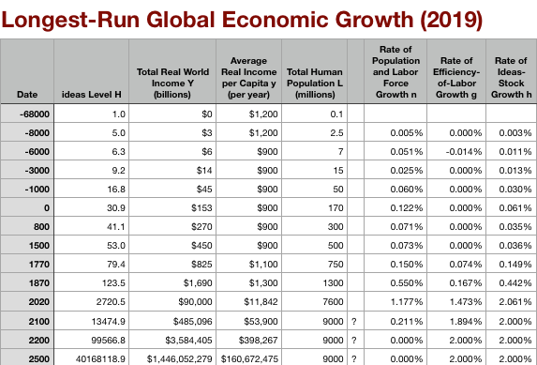
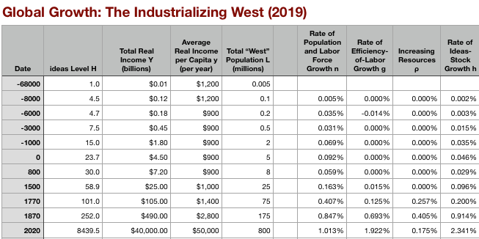
Global and “Western” Numbers
Is ‘the west’ special between 800 and 1500?
Or is it just recovery from a Dark Age depression?
The Commercial Revolution acceleration appears everywhere
Due to globalization
And especially to the “Columbian Exchange”

Slide 5
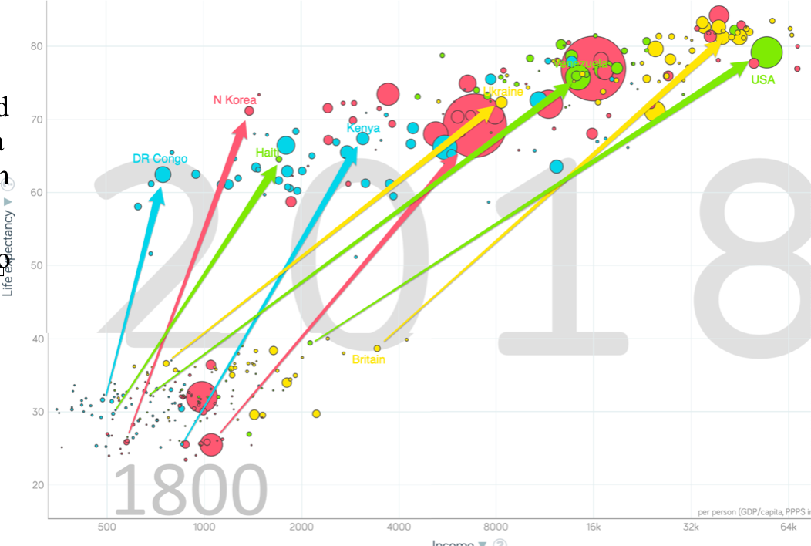
Freaky Patterns Over the Past Two Centuries
The enormous spreading-out
In spite of the world getting “smaller” on every dimension

Slide 6
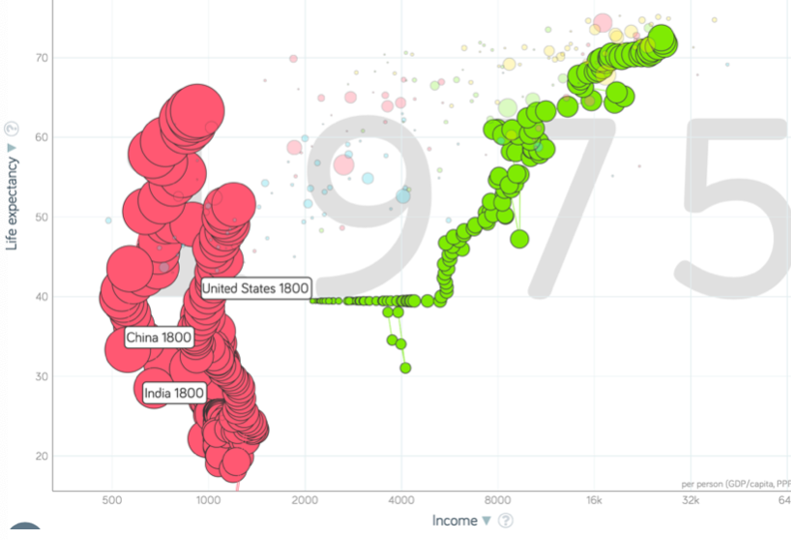
Has This Reversed since 1975?
Since 1975, convergence in people…
Since 1975, no convergence in nation states…
But not much divergence since 1975 in nation states either…

Slide 7
Reading Lewis
W. Arthur Lewis (1978): Evolution of the International Economic Order <https://delong.typepad.com/files/lewis-evolution-a.pdf> <https://delong.typepad.com/files/lewis-evolution-b.pdf>:
100 million people change continents between 1870 and 1914
Essentially all non-perishable non-fragile goods become internationally transportable for pennies
What were the implications of this?
How is it related to the great divergence that has occurred since 1800?
What is Lewis’s bottom line?
Is he right?

Slide 8
The International Economic Order
I will discuss certain aspects of the relationship between the developing and the developed countries that the first find particularly irksome:
The division of the world into exporters of primary products and exporters of manufactured goods
The adverse factoral terms of trade for the products of the developing countries
The dependence of the developing countries on the developed for finance
The dependence of the developing countries on the developed for their engine of growth…
Even as late as 1883… total imports into the United States and Western Europe from Asia, Africa, and tropical Latin America came only to about a dollar per head of the population of the exporting countries…. Leading industrial countries… were… nearly self-sufficient [in] the raw materials of the Industrial Revolution… coal, iron ore, cotton, and wool… except for wool…
“Not until… the end of the nineteenth century… did a big demand for rubber, copper, oil, bauxite, and such materials occur…

Slide 9
Why Slow Adoption of Industrial Technologies in Emerging Markets?
“The smallness of the market was one constraint on industrialization…”
“The absence of an investment climate was another…”
“And so the world divided: countries that industrialized and exported manufactures, and countries that exported agricultural products. The speed of this adjustment… created an illusion… an article of faith in Western Europe that the tropical countries had a comparative advantage in agriculture…”
“In fact, as Indian textile production soon began to show, between the tropical and temperate countries, the differences in food production per head were much greater than the differences in industrial production per head…”

Slide 10
The Factoral Terms of Trade
“In the second half of the nineteenth century… fifty million people left Europe temperate settlements… and about the same number left India and China to work mainly as laborers in the tropics on plantations, in mines, or in construction projects…”
“The availability of these two streams set the terms of trade for tropical and temperate agricultural commodities…”
“For temperate commodities, the market forces set prices that could attract European immigrants…"
“For tropical commodities they set prices that would sustain indentured Indians…”
“In Britain, which was the largest single source of European migration, the yield of wheat by 1900 was 1,600 lbs. per acre, compared to the tropical yield of 700 lbs. of grain per acre…. The yield per man must have been six or seven times larger…”
“New temperate settlements could attract European immigrants… only by offering income levels higher than prevailed in Northwest Europe…”
“In the tropical situation… any prices for tea or rubber or peanuts that would offer a standard of living in excess of the 700 lbs. of grain per acre level were an improvement…. There was an unlimited supply of Indians and Chinese willing to travel anywhere to work on plantations for a shilling a day. This stream of migrants… set the tropical prices…”

Slide 11
The Productivity Trap
“Tropical countries cannot escape from these unfavorable terms of trade by increasing productivity in the commodities they export, since this will reduce reduce the prices of such commodities. We have seen this quite clearly in the two commodities in which productivity has risen most, sugar and rubber…”
“A farmer in Nigeria might tend his peanuts with as much diligence and skill as a farmer in Australia tended his sheep, but the return would be very different…. The market price gave the Nigerian for his peanuts a 700-lbs.-of-grain-per-acre acre level of living, and the Australian for his wool a 1600-lbs.-per-acre level of living…”

Slide 12
But No Industrialization
“To a large extent the import and export trades of these countries were controlled by foreign hands…. Had trading profits accumulated in domestic hands, there would have been more domestic reinvestment, and almost certainly more interest in domestic manufacturing. Foreigners participated heavily in the trade trade of these countries for a variety of economic, cultural, and political reasons…”
“Participation in trade itself whets the appetite for foreign goods.… The consumer learns to prefer wheat to yams and cement to local building materials…”
“The industrial forces… [had not] conquered the government.… The fact is that the very success of the country in exporting created a vested interest of those who lived by primary production—small farmers no less than big capitalists—and who opposed measures for industrialization, whether because they might deflect resources from agriculture and raise factor prices, or because they might result in raising the prices of manufactured goods…”

Slide 13
Australia vs. Argentina
“The contrast between Argentina and Australia is particularly instructive. These two began to grow rapidly at the same time… sold the same commodities…. In 1913 their incomes per head were both in the world's top ten. But Australia industrialized rapidly, and Argentina did not…. Argentinian politics was dominated by an old, landed aristocracy. Australia had no landed aristocracy. Its politics was dominated by its urban communities, who used their power to protect industrial profits and wages…. Internal social and political structure… [rather than] the impact of external forces…”

Slide 14
More Questions About Lewis

Slide 15
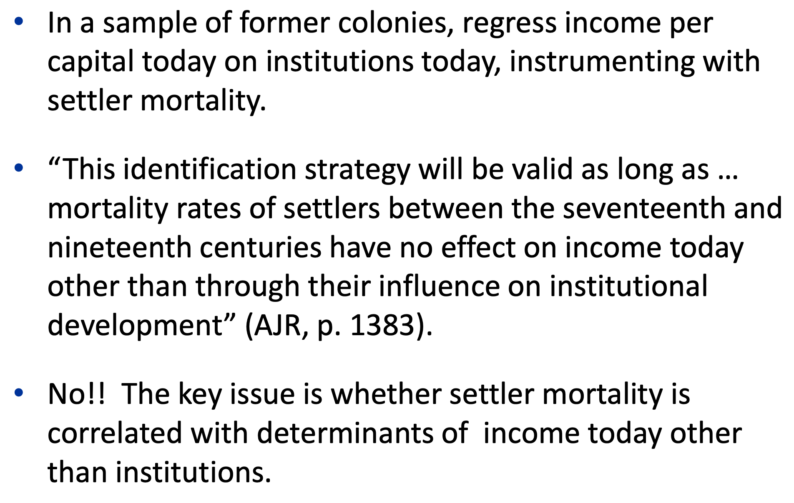
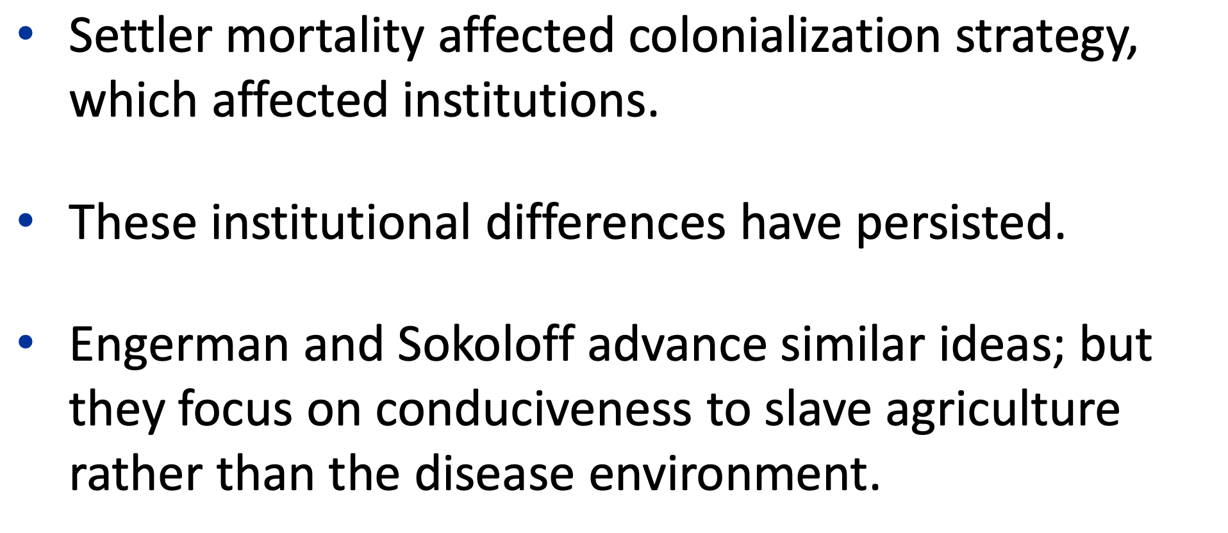
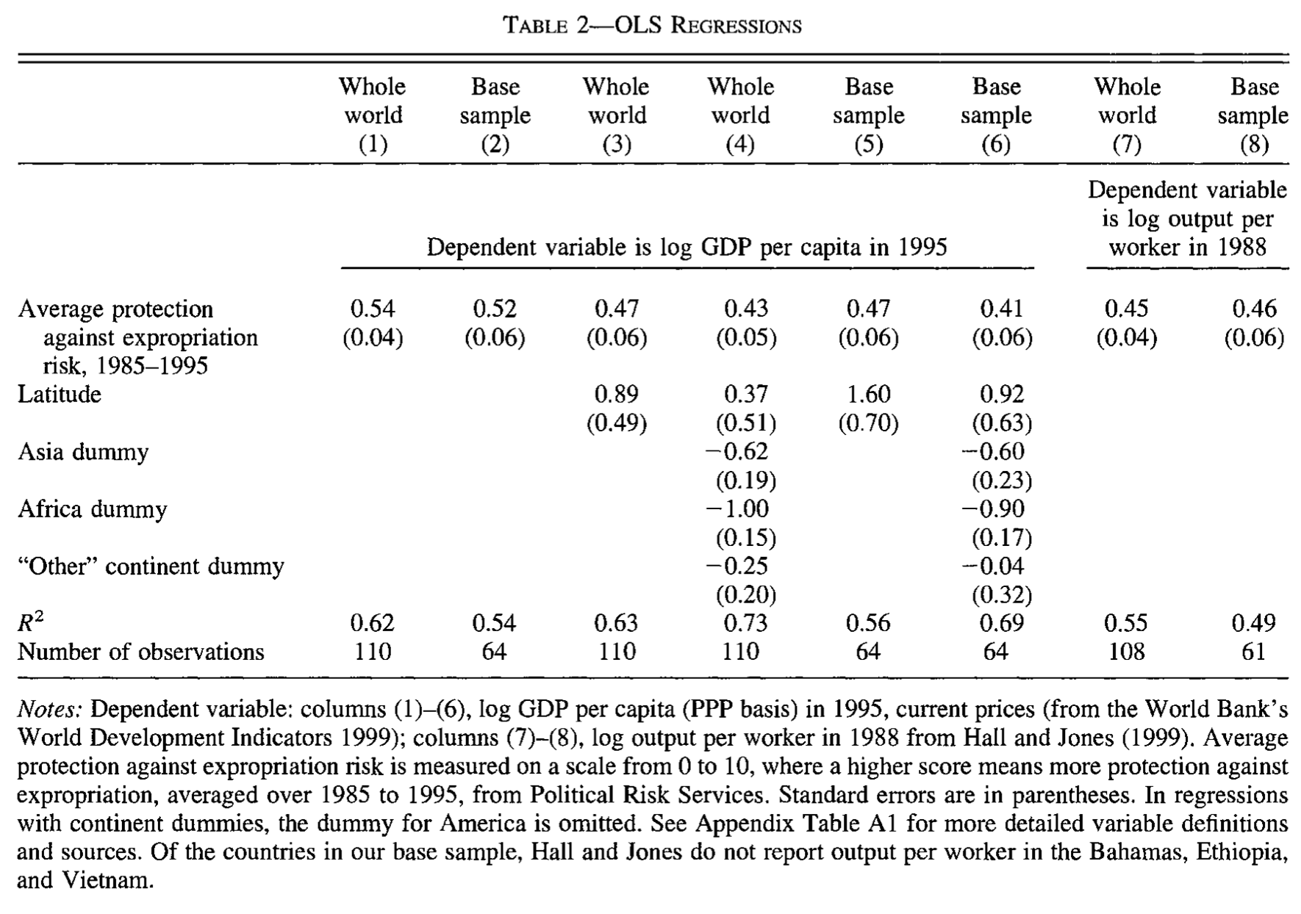
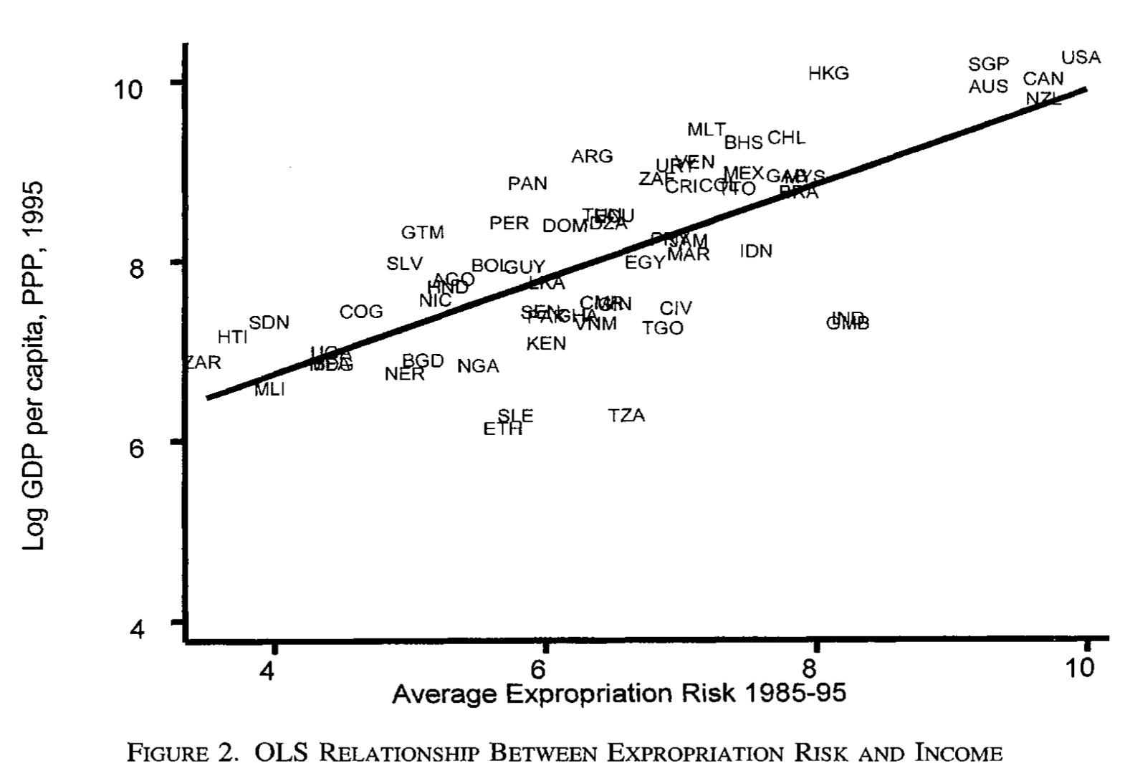
Reading AJR
Daron Acemoglu, Simon Johnson, and James A. Robinson (2001): The Colonial Origins of Comparative Development: An Empirical Investigation <https://economics.mit.edu/files/4123>:

Slide 16
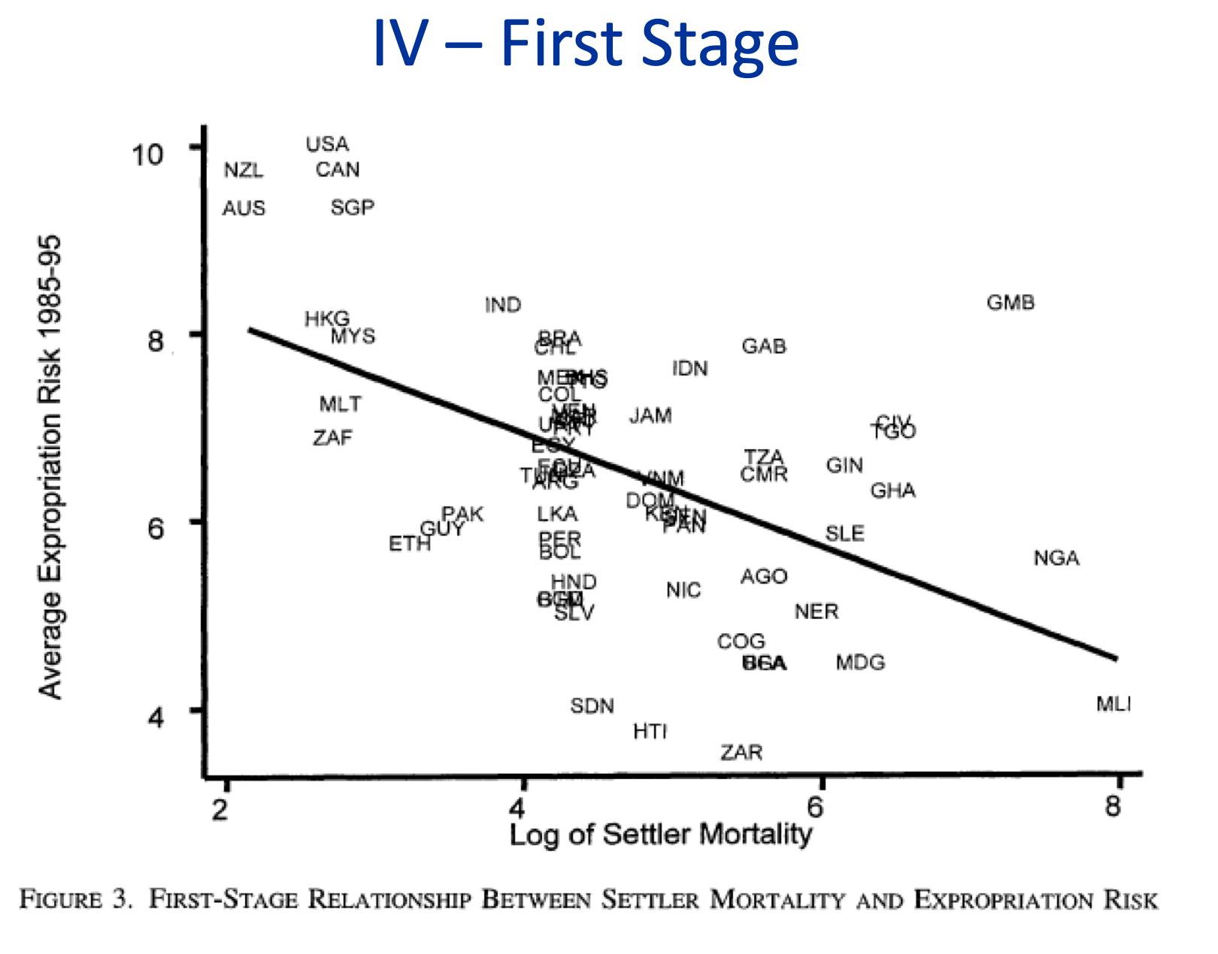
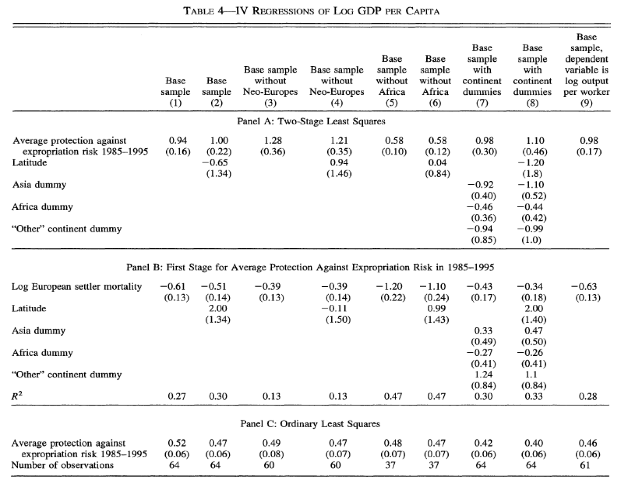
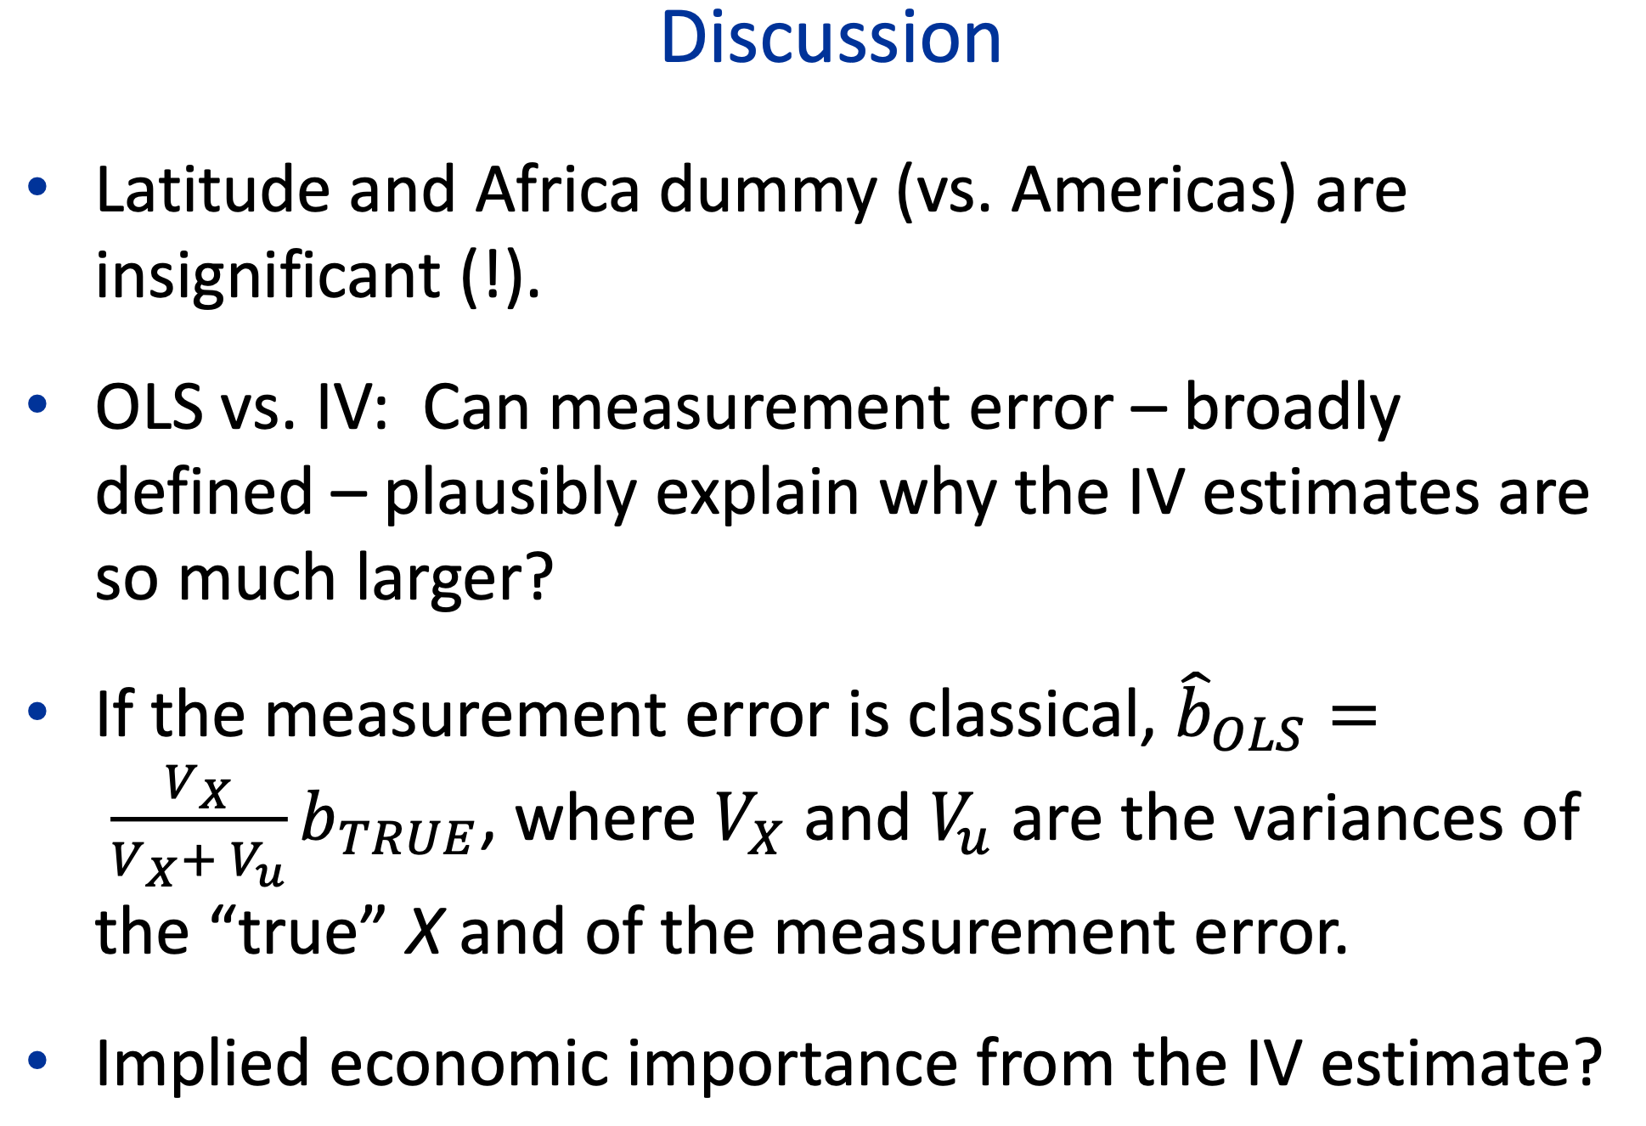
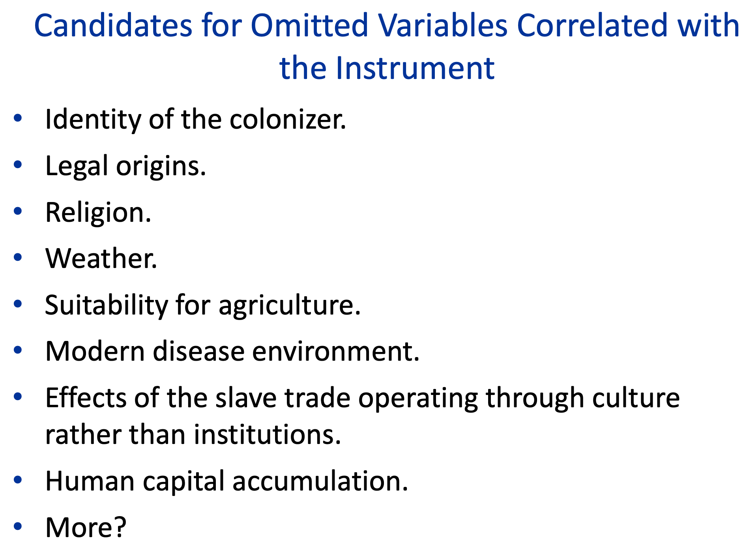
Instrumental Variables

Slide 17
Conclusions?

Slide 18
Reading Marx
Karl Marx (1853): The Future Results of British Rule in India <http://tinyurl.com/dl20090112l>:
The English millocracy intend to endow India with railways with the exclusive view of extracting at diminished expenses the cotton and other raw materials for their manufactures.
But when you have once introduced machinery into the locomotion of a country, which possesses iron and coals, you are unable to withhold it from its fabrication. You cannot maintain a net of railways over an immense country without introducing all those industrial processes necessary to meet the immediate and current wants of railway locomotion, and out of which there must grow the application of machinery to those branches of industry not immediately connected with railways.
The railway-system will therefore become, in India, truly the forerunner of modern industry.
This is the more certain as the Hindoos are allowed by British authorities themselves to possess particular aptitude. for accommodating themselves to entirely new labor, and acquiring the requisite knowledge of machinery….

Slide 19
Reading Marx II
Modern industry, resulting from the railway system, will dissolve the hereditary divisions of labor, upon which rest the Indian castes, those decisive impediments to Indian progress and Indian power.
All the English bourgeoisie may be forced to do will neither emancipate nor materially mend the social condition of the mass of the people, depending not only on the development of the productive powers, but on their appropriation by the people. But what they will not fail to do is to lay down the material premises for both. Has the bourgeoisie ever done more? Has it ever effected a progress without dragging individuals and people through blood and dirt, through misery and degradation?...
The devastating effects of English industry, when contemplated with regard to India, a country as vast as Europe, and containing 150 millions of acres, are palpable and confounding.

Slide 20
Reading Marx III
But we must not forget… bourgeois industry and commerce create these material conditions of a new world in the same way as geological revolutions have created the surface of the earth.
When a great social revolution shall have mastered the results of the bourgeois epoch, the market of the world and the modern powers of production, and subjected them to the common control of the most advanced peoples, then only will human progress cease to resemble that hideous, pagan idol, who would not drink the nectar but from the skulls of the slain.

Slide 21
Lecture Next Time: Modern Economic Growth
The three key numbers in this course are: 0.15, 0.44, 2.06—the annual percentage growth rates h of the useful-ideas stock in the Commercial Revolution, Industrial Revolution, and Modern Economic Growth periods. (Or perhaps 0.2, 0.9, 2.3—the numbers for “the West”.) But is it really best thought of as 2.06 (or 2.3)? And why is it so much bigger than 0.44 (or 0.9)?:
Readings:
William D. Nordhaus (1997): Do Real-Output and Real-Wage Measures Capture Reality? The History of Lighting Suggests Not <http://www.nber.org/chapters/c6064>
Robert Gordon (2000): Interpreting the “One Big Wave” in Long-Term Productivity Growth <https://www.nber.org/papers/w7752.pdf>
Peter Thompson (2001): How Much Did the Liberty Shipbuilders Learn? New Evidence for an Old Case Study <http://www.jstor.org/stable/pdfplus/10.1086/318605.pdf>

Slide 22
Assignment Next Time:Unfreedom
What relevance and use does a work like Karl Marx and Friedrich Engels (1848), "Manifesto of the Communist Party" have to twenty-first century economists today?
Readings:
Karl Marx and Friedrich Engels (1848): Manifesto of the Communist Party <http://www.marxists.org/archive/marx/works/1848/communist-manifesto/>
Stanley Engerman and Kenneth Sokoloff (1994): Factor Endowments, Institutions and Differential Paths of Development among New World Economies <http://papers.nber.org/papers/h0066>
Nathan Nunn (2008): The Long-Term Effects of Africa’s Slave Trades <http://www.jstor.org/stable/pdfplus/25098896.pdf>

Slide 23
Catch Our Breath…
Ask a couple of questions?
Make a couple of comments?
Any more readings to recommend?

Slide 24
Notes…

