Slide 1
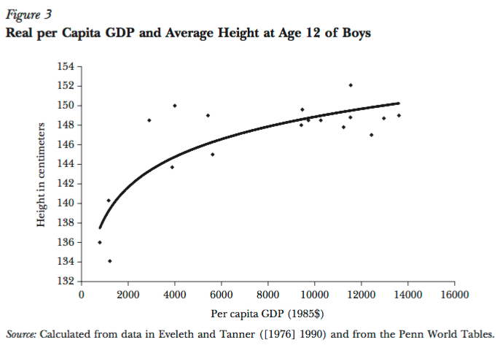
Rick Steckel: Height and Income in the Late 20th Century
Height as a proxy for living standards…
Nutrition…
Get more than so poor, and nutrition is compromised…
The relationship is strong for levels of income $(1985) 6000 or so…
The relationship very weak if richer: nutritional sufficiency…

Slide 2
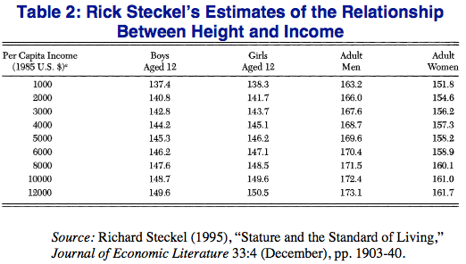
Nasty, Brutish, and Short
The phrase is Thomas Hobbes’s
Modern standard of living is worth 10 cm.
Practically every non-aristo skeleton from our agrarian past is really short
Exceptions: fish eaters
Exceptions: Souix
Exceptions: Hunter-gatherers
What does being 10 cm. shorter do to brain development?

Slide 3

From Rick Steckel: Income Indicators Throughout the 20th Century
We can check whether the cross-sectional relationship between prosperity and biomedical indicators holds across time roughly back to the start of the twentieth century…
It looks like it does…
Then we can guess and leap further into the past with biomedical information, checked with shaky—very shaky—historical documents…

Slide 4

From Rick Steckel: The New World Back to the Early 18th Century
Even New World populations in the eighteenth century are 2” short…
And there is a remarkable mid- and late-nineteenth century decline as urbanization and industrialization take hold…
Nadir for those born in 1900…

Slide 5
From Rick Steckel: The Old World
“In nineteenth century Sweden, for example, average height was three to eight centimeters greater in rural areas compared with Stockholm, depending upon the time period and rural area (Sandberg and Steckel, 1988)….
“In late eighteenth-century England, for example, the average heights at age 14 of poor boys admitted to the Marine Society were 20 centimeters below those of upper-class boys who attended the elite academy at Sandhurst (Floud, Wachter, and Gregory, 1990). During the same era, the difference in average height between the rich and the poor in the United States was roughly 3 centimeters (Margo and Steckel, 1982).”
<https://www.icloud.com/keynote/0bb0qK4PFlXfY2xlQmUZl1rjQ>

Slide 6
Catch Our Breath…
Ask a couple of questions?
Make a couple of comments?
Any more readings to recommend?

