Slide 1
Econ 135:
Changeup: Review
Brad DeLong
Department of Economics and Blum Center, U.C. Berkeley; and WCEG
last revised: 2020-01-06
delong@econ.berkeley.edu
U.C. Berkeley Econ 135 Spring 2020
Original course by Melissa Dell (Harvard Econ 1342 <https://canvas.harvard.edu/courses/8254/assignments/syllabus>), revised by Brad DeLong
<https://bcourses.berkeley.edu/courses/1487685>

Slide 2
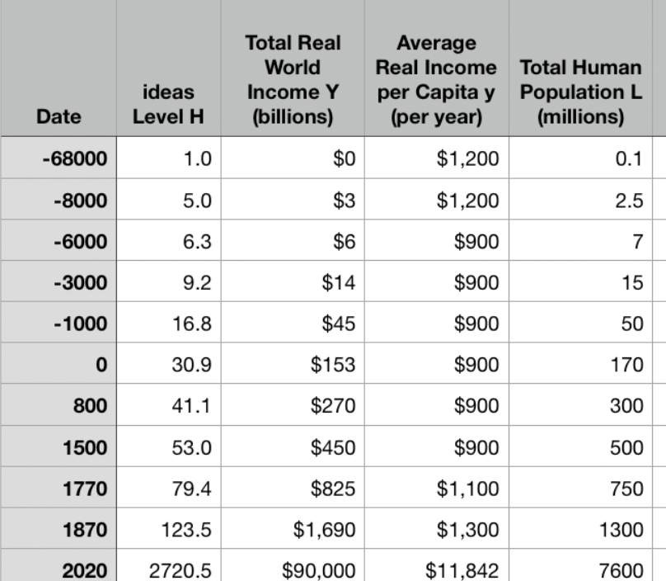
Changeup Review: One Table: Average Global Numbers
J. Bradford DeLong brad.delong@gmail.com 2020-01-18

Slide 3
You’ve Seen This Before…
Approximately what was the growth rate of the human useful-ideas stock between the year 0 and 1500?
About 0.036%/year
About 3.6%/year
About 2.06%/year
About 0.206%/year
None of the above are close

Slide 4
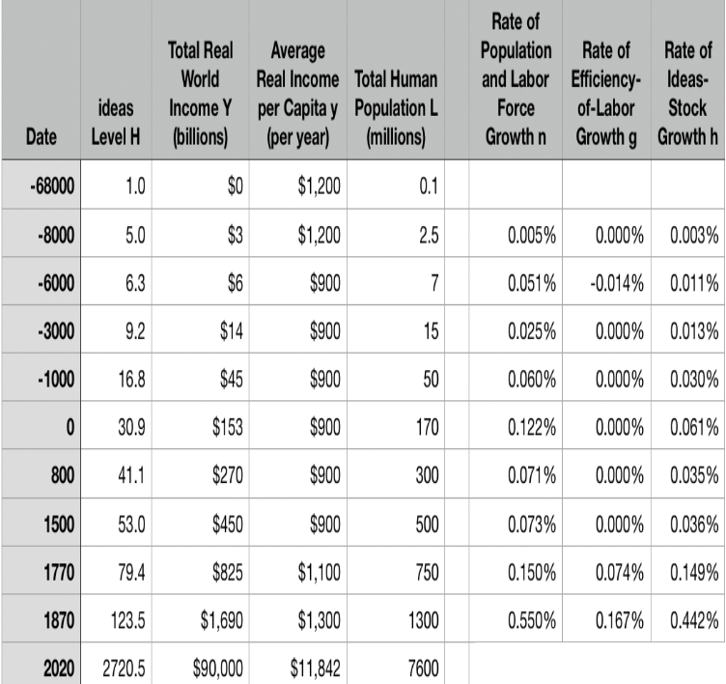
One Table: Average Global Numbers
Approximately what has been the growth rate of the human useful-ideas stock between the year 1870 and today?
About 0.036%/year
About 3.6%/year
About 2.06%/year
About 0.206%/year
None of the above are close

Slide 5

Why Is This Interesting?
2.06/.0036 is about 60, no?
What else do you find interesting about this table to the left?

Slide 6
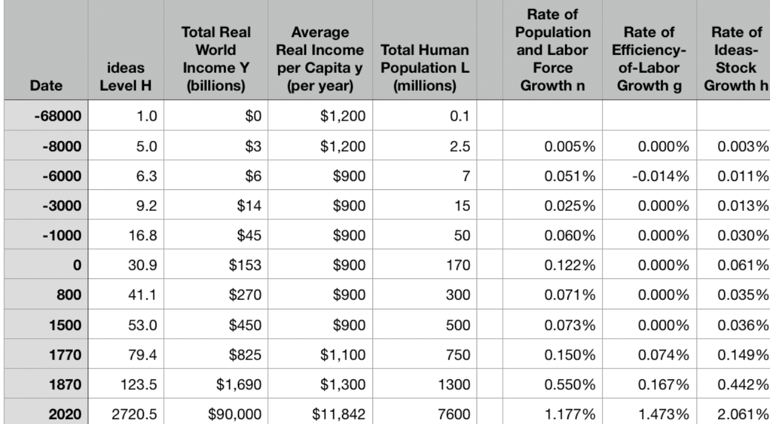
One Table: Average Global Numbers
10:00

Slide 7
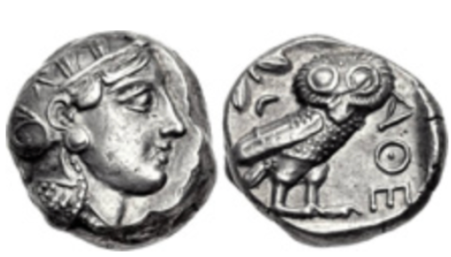
Questions
What assumption that Aristotle made—perhaps (probably?) without thinking about it, because it seemed most obvious to him—struck you as the most wrong or repugnant or weird?
What role do the “statues of Daedalus, [and] the tripods [robotic catering vessels] of Hephaestus” play in Aristotle’s argument about how the economy of his age is, must be, and should be structured?
What role does Aristotle’s claim that “Of the art of acquisition [ktêtike] then there is one kind which by nature is a part of the management of a household…. There is another… commonly and rightly called an art of wealth-getting [chrêmatistikê]… [with] the notion that riches and property have no limit…” play in his argument?
Did you find any advice—even indirect and oblique advice—from Aristotle in this passage about what the economic policy of a city-state should be? If so, what was it? If not, why do you think he fails to offer advice here (he offers lots of advice as to the organization and policies of city-states later on in the book)?
What does Aristotle say are the four tasks of the Greek man in managing his household? Why these four?
What are these four in rank order of importance
Classical Athenian 4-drachma silver coin
The “owl”, with the head of the goddess Athene on the front and her familiar bird of wisdom on the back, of the type that Aristotle (or his slaves) would have carried on their person. Weighs 3/5 of an ounce. The Athenian navy paid its oarsmen one drachma a day.
J. Bradford DeLong brad.delong@gmail.com 2020-01-06

Slide 8
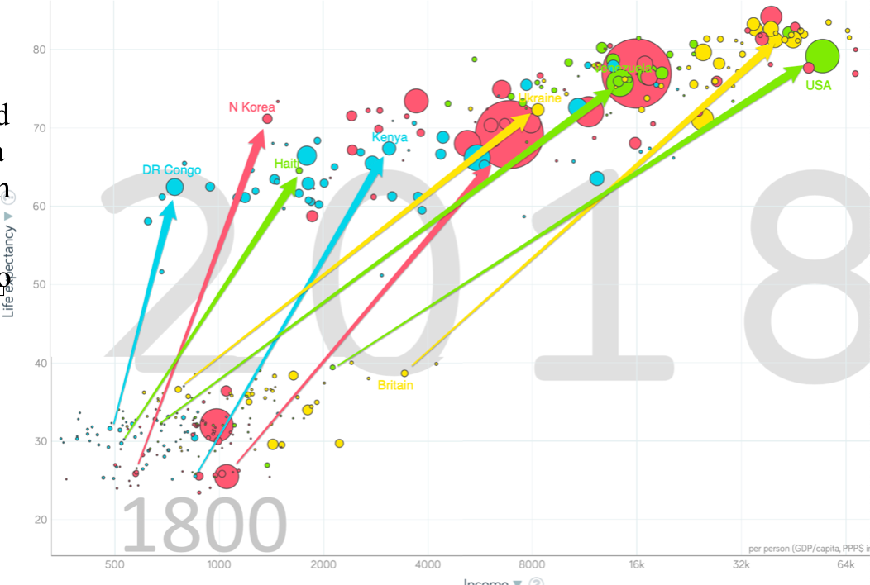
One Figure: A Great Divergence
10:20
From 1800 to 2018:
The dots start with a 3-1 spread in incomes and a 10-year spread in life expectancy.
All the arrows go up.
Some arrows—mostly those already to the right—go right fast.
Other arrows go right slowly.

Slide 9
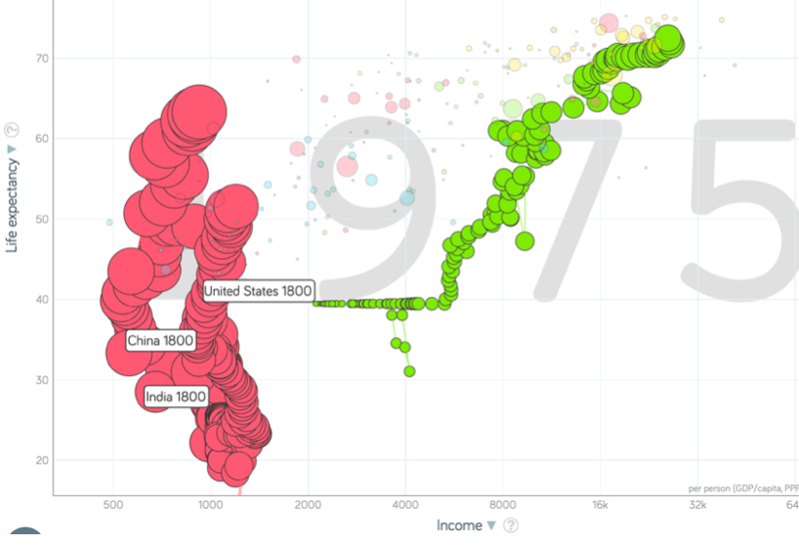
China and India and America, 1800-1975
From 1800 to 1975:
Measured living standards and productivity levels improve fourteen-fold in the United States…
…& less than 30% in China & India…
…in spite of economic, transport, and cultural globalization…
This is crazy!
A “great divergence”
Not only were China & India relatively poor in 1800, they fell further behind thereafter

Slide 10
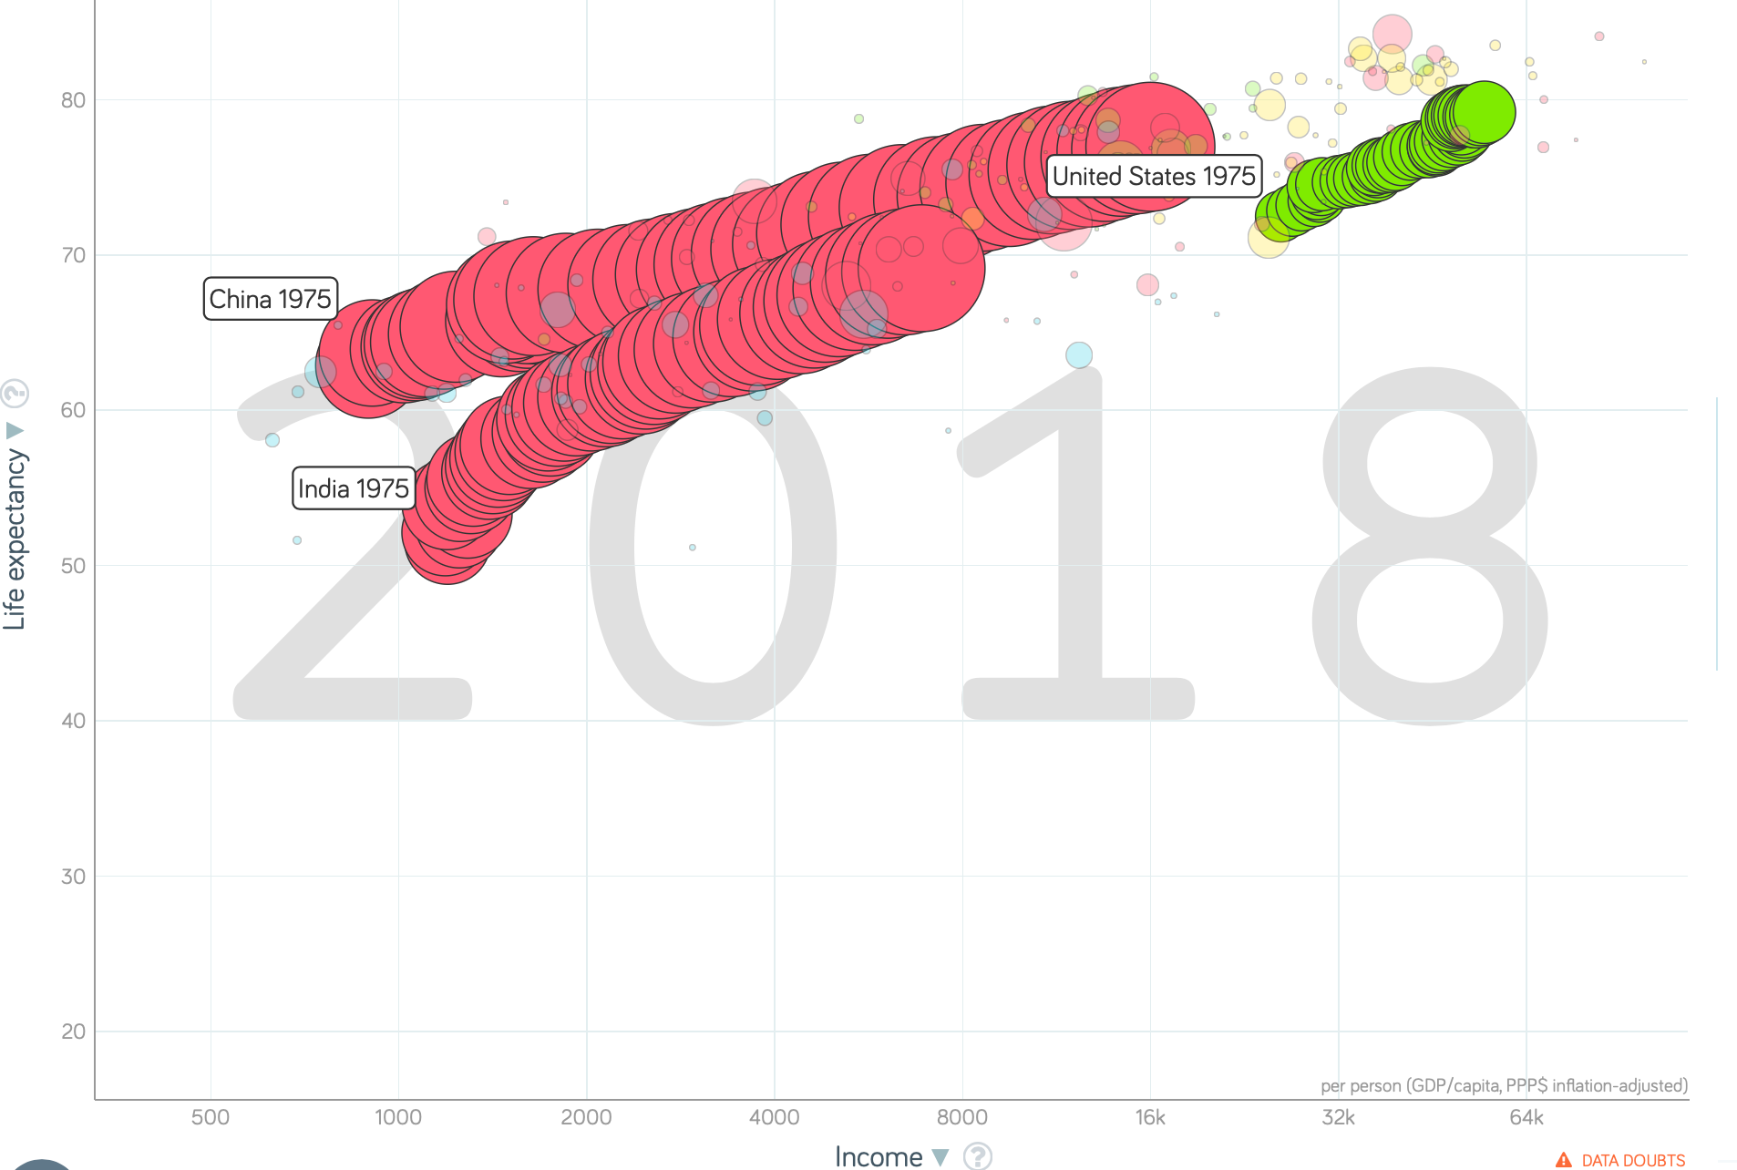
China and India and America, 1975–2018
From 1975-2018:
Measured living standards and productivity levels…
…54.9/25.9 = 2.12 in America…
…16.0/0.9 = 17.8 in China…
…6.9/1.2 = 5.8 in India…

Slide 11
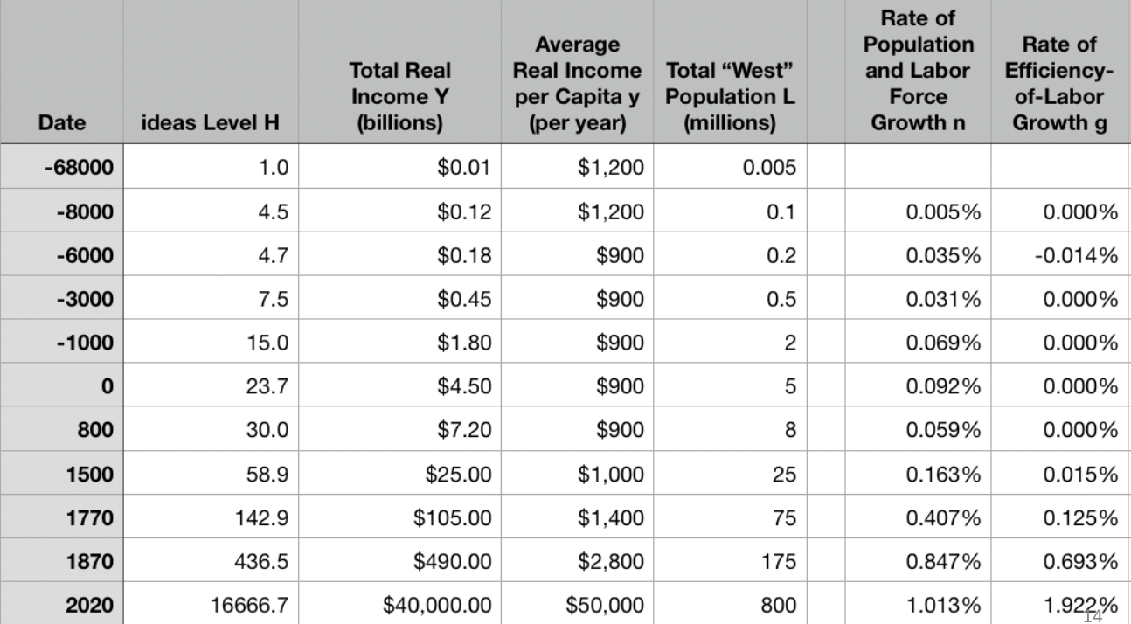
A Second Table: “The West”
10:45

Slide 12
Four Major Features
10:55
The history of economic growth has four major features:
Poverty, in the pre-industrial ages, with population growth on average but with average population growth very slow
n = 0.07%/yr; h = 0.035%/yr
Growing prosperity, in the Industrial Revolution and the Modern Economic Growth ages
In the MEG era: h = 2.06%/yr
The great divergence
Globalization
American twentieth-century economic ascendancy
Pre-industrial efflorescences and declines

Slide 13

Catch Our Breath…
Ask a couple of questions?
Make a couple of comments?
Any more readings to recommend?

