Slide 1
Econ 210a: Introduction to Economic History: Introduction (January 22, 2020a)
J. Bradford DeLong
Spring 2019
Evans 648
W 1:10-3:00 pm
<https://bcourses.berkeley.edu/courses/1487686/>
<https://github.com/braddelong/public-files/blob/master/econ-210a-lecture-1a.pptx>

Slide 2
Outline…
Econ 210a: Logistics
A Word on Lecture vs. Discussion…
Why Economic History
Insights History Provides to the Practicing Economist?
Readings: Opinions on the Point of Economic History <https://www.icloud.com/keynote/0qxY-UGeEjom7SGGpw2qDMM2Q>

Slide 3
Logistics
Brad DeLong Office Hours TBA Evans 691A & by appointment—email delong@econ.berkeley.edu…
Weekly memos due Tu @ 5 pm: bcourses assignment page 200-300
Paper!
Discuss topic in first month
Prospectus due 5 pm Friday before spring vacation
Presentation (short) in class
Final paper
We do have to give grades—timeliness a welcome source of identifying variance here…

Slide 4
Important Questions I
When are your midterms?
When are your finals?

Slide 5
Important Questions II
How many of you have read how many of the papers for this week?:

Slide 6
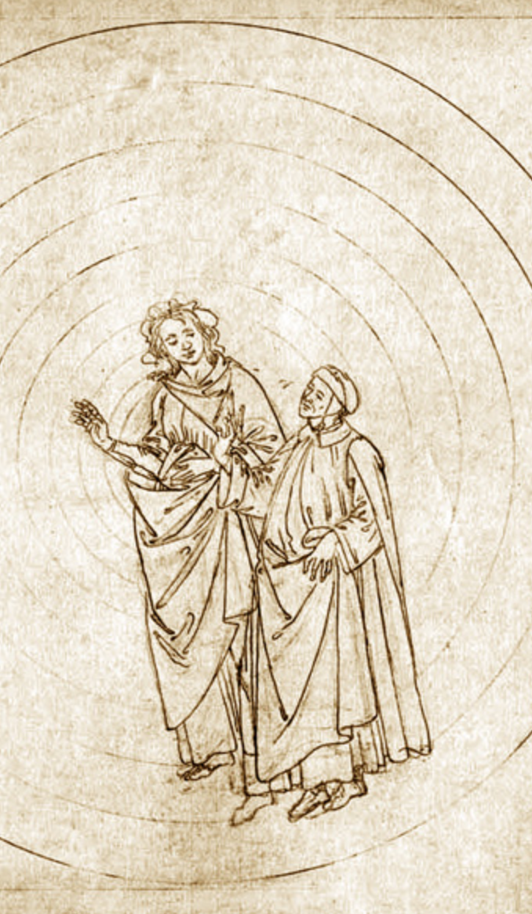
A Word on Lecture vs. Discussion…
This is going to be mostly lecture today…
I very much hope to change that next week…
The Divine Comedy of classroom experiences
Primum Mobile & Empyrean: six students debate with about 3/4 of the rest chiming in (if one of you says something, about a 75% chance it will stick—if Barry or I say something, 25% chance)…
Outer Paradise: two or three students debate with the instructor; most of the rest listen—and follow… (50%)
Purgatory: Lecture… (25%)
Limbo: An airhog… (10%)
Inferno: Like pulling teeth: nobody has done the reading, or those who have don’t see the point of the reading…
Do note that Plato couldn’t sustain #1, even in his imagination…
<https://www.icloud.com/keynote/0vJOK4LT-gQ54Dd5S5RQRn1FQ>

Slide 7
Why Gather Us All Here W 1-3?
Self study/distance learning/MOOCs—why aren’t we doing that?
The 10% (reading)-25% (lecturing)-75% (discussing) rule…
That means you gotta talk—or this course is going to be much less useful than it could and should be…
The instant-correction-of-misapprehensions principle…

Slide 8
Why Assign Readings?
Why not just dump a bunch of data on you, and ask you to make sense of it?
Why assign these readings? How should readings be chosen?
Why ask you to write about the readings—briefly, briefly—before class?
Why a big paper rather than a midterm and a final exam?

Slide 9
Why Ask You to Write?
Why ask you to write about the readings—briefly, briefly—before class?
Why a big paper rather than a midterm and a final exam?

Slide 10
What Is Econ 210a?
Economics 210a required of Econ Ph.D. students
Must pass with a B or better, or else…
A selection of hopefully-useful themes from the contemporary economic history literature
Emphasis on insights history can provide to the practicing economist
More about this anon…
Class meetings consist of a mixture of lecture and discussion.
Because discussion will focus on issues raised by the assigned readings, readings should be completed before class.
To that end, we ask for a one-page memo (200-300 words) submitted via bCourses before 4 PM on the Tuesday before each lecture…

Slide 11
How Is Econ 210a Graded?
Your grade will be based:
50 percent on one-page memos due at 4 pm the Tuesday before each class—submitted via bCourses via the “Assignments” tab…
50 percent on the research paper
Partly on the synopsis you submit prior to spring break
Mostly on the paper you submit at the end of instruction.
Substantial extra credit will be given for informed classroom discussion

Slide 12
What Are the Weekly Memos?
A short memo on each week’s readings is due the afternoon before the beginning of the class in which those readings are discussed.
Typically the week’s question will be posted on the Thursday six days before the class when your memo is due.
Your memos should be one page (200-300 words): bCourses for submissions
Memos cannot be exhaustive or provide definitive answers.
But they can explain why a question is important, and they can draw on assigned readings to answer it.
Not surveys: question-answering…

Slide 13
What Is the Paper?
Papers are due at the end of the semester:
Send an electronic copy via bCourses
The paper should not exceed 25 pages.
The writing and submission process involves benchmarks:
Discuss your paper topic during office hours with one of your instructors during the first month of the semester
Sign up for this appointment before the end of January 31
Submit a brief paper prospectus before spring break)
Give a brief April presentation of paper-in-progress
Submit final paper…

Slide 14
What Should the Paper Do?
Provide new evidence and analysis of a topic in economic history—not just summarize a literature.
Use the tools of economics to pose and answer as best you can a historical question.
Do not merely relabeling the variables in theoretical models taught elsewhere, or simply apply new statistical techniques to old data.
The topic must genuinely involve the past. (What is the economic past? One answer is a period when the economic environment was significantly different from today. You as author and researcher must make the case.)
Comparisons of past and current events are fine, but excessive focus on developments in recent decades is likely to be problematic.

Slide 15
Successful Papers…
Your graduate career (indeed your entire career) will center on identifying interesting questions.
Here we mention, by way of illustration, some kinds of topics that have been successful:
A comment on an existing paper.
Historical roots or counterparts to a modern development you are interested in.
Data serendipity.
A new way of testing a hypothesis in the historical literature
Just as one should be on the lookout for interesting sources, one should also be thinking about interesting events.

Slide 16
Model Papers…
Marc Dordal i Carreras (2015): U.S. Banking Panics and the Credit Channel: Evidence from 1870-1904 <http://delong.typepad.com/econ_history_marc_dordal.pdf>
Daniel Gross (2016): Scale versus Scope in the Diffusion of New Technology: Evidence from the Farm Tractor <https://delong.typepad.com/gross-scale.pdf>
Petra Moser (2005): How Do Patent Laws Influence Innovation?: Evidence from Nineteenth-Century World Fairs <https://delong.typepad.com/w9909.pdf>
Jacob P. Weber (2018): Patterns in British Height: 1770-1845 <https://delong.typepad.com/jacob-p.-weber-heightpaperfinal-x.pdf>
Sreeraahul Kancherla (2018): The Effect of Monetary Transportation Costs on Immigration: Evidence from Transatlantic Migration <https://delong.typepad.com/files/kancherla-210a-paper.pdf>

Slide 17
Why Economic History?
What is our theory—what are the parameters that we are going to estimate?
How are we going to identify our estimation—how do we achieve internal validity?
What have we estimated the wrong model?
Are our properly-identified RCT estimations worth anything—do we have external validity?
What have we missed—for not everything is market exchange and production functions, and even things that are market exchange and production functions have political, sociological, and psychological penumbras around them?

Slide 18
Why Economic History? II
Bob Solow in 1985:
All narrowly economic activity is embedded in a web of social institutions, customs, beliefs, and attitudes. Concrete outcomes are indubitably affected by these background factors, some of which change slowly and gradually, others erratically.... If economists set themselves the task of modeling particular contingent social circumstances, with some sensitivity to context, it seems to me that they would provide exactly the interpretive help an economic historian needs....
[But] the best and brightest in the [economics] profession proceed as if economics is the physics of society. There is a single universally valid model of the world. It only needs to be applied.... Hard sciences dealing with complex systems... like the hydrogen atom or the optic nerve seem to succeed because they can... experiment, and... make repeated observations under controlled conditions. Other sciences, like astronomy, succeed because they can make long series of observations under natural but essentially stationary conditions.... Neither of these roads to success is open to economists…,

Slide 19
Why Economic History? II
The validity of an economic model may depend on the social context. What is here today may be gone tomorrow.... The economist is concerned with making and testing models of the economic world as it now is, or as we think it is. The economic historian can ask whether this or that story rings true when applied in earlier times or other places, and, if not, why not... imagine how things might have been before they became as they now are....
Economic history can offer the economist a sense of the variety and flexibility of social arrangements and thus, in particular, a shot at understanding a little better the interaction of economic behavior and other social institutions...

Slide 20
Why Economic History? III
And:
Unfortunately, however, economics is a social science. It is subject to Damon Runyon's Law that nothing between human beings is more than three to one…. Much of what we observe cannot be treated as the realization of a stationary stochastic process without straining credulity…. My impression is that the best and brightest in the profession proceed as if economics is the physics of society. There is a single universally valid model of the world. It only needs to be applied.
You could drop a modern economist from a time machine- a helicopter, maybe, like the one that drops the money-at any time, in any place, along with his or her personal computer; he or she could set up in business without even bothering to ask what time and which place. In a little while, the up-to-date economist will have maximized a familiar-looking present-value integral, made a few familiar log-linear approximations, and run the obligatory familiar regression. The familiar coefficients will be poorly determined, but about one-twentieth of them will be significant at the 5 percent level…. The other nineteen do not have to be published. With a little judicious selection here and there, it will turn out that the data are just barely consistent with your thesis adviser's hypothesis... everywhere and always, modulo an information asymmetry, any old informa- tion asymmetry, don't worry, you'll think of one.... If the project of turning economics into a hard science could succeed, it would surely be worth doing. No doubt some of us should keep trying...

Slide 21
Why Economic History? IV
The other nineteen do not have to be published.
With a little judicious selection here and there, it will turn out that the data are just barely consistent with your thesis adviser's hypothesis... everywhere and always, modulo an information asymmetry, any old information asymmetry, don't worry, you'll think of one....
If the project of turning economics into a hard science could succeed, it would surely be worth doing. No doubt some of us should keep trying...

Slide 22
Why Economic History? V
We are now:
Too good at making theories…
For every ε>0, there exists a δ such that a theorist can build a model Mδ within δ of complete theoretical rigor so that the conclusions C(Mδ) are within ε of what the economist desires to prove…
Too good at doing econometrics…
Results we do not like can be dismissed as not properly identified…
Results we want to attain can be attained by some sufficiently clever choice of instrument…

Slide 23
Why Economic History? VI
We are now:
Too good at making theories…
For every ε>0, there exists an N index of theoretical complexity such that a theorist can build a model MN so that the model’s conclusions C(MN) are within ε of what the economist desires to prove…
Too good at doing econometrics…
Results we do not like can be dismissed as not properly identified…
Results we want to attain can be attained by some sufficiently clever choice of instrument…

Slide 24
Why Economic History? VII
Is a theoretical result an interesting constraint on reality, or a demonstration of the ingenuity of the researcher?
Is an econometric-empirical result a robust finding about the world out there, or a demonstration that research assistants desperate to please jet-setting tenured bosses can do amazing things?
This is not to say that things were not worse in the old days, before the identification revolution
But we still have a replication problem…
IN THE END, GOOD THEORY IS AND CAN BE NOTHING BUT DISTILLED AND CRYSTALLIZED ECONOMIC HISTORY!!!!

Slide 25
Readings: Why Economic History?
Robert M. Solow (1985): Economic History and Economics <http://www.jstor.org/stable/1805620>
Kenneth J. Arrow (1985): Maine and Texas <http://www.jstor.org/stable/1805618>
Paul Krugman (2011): Mr. Keynes and the Moderns <https://voxeu.org/article/mr-keynes-and-moderns>
Carl Shapiro and Hal Varian (1999): Information Rules: A Strategic Guide to the Network Economy, selections <https://delong.typepad.com/files/shapiro-variation-rules-selections.pdf>

Slide 26
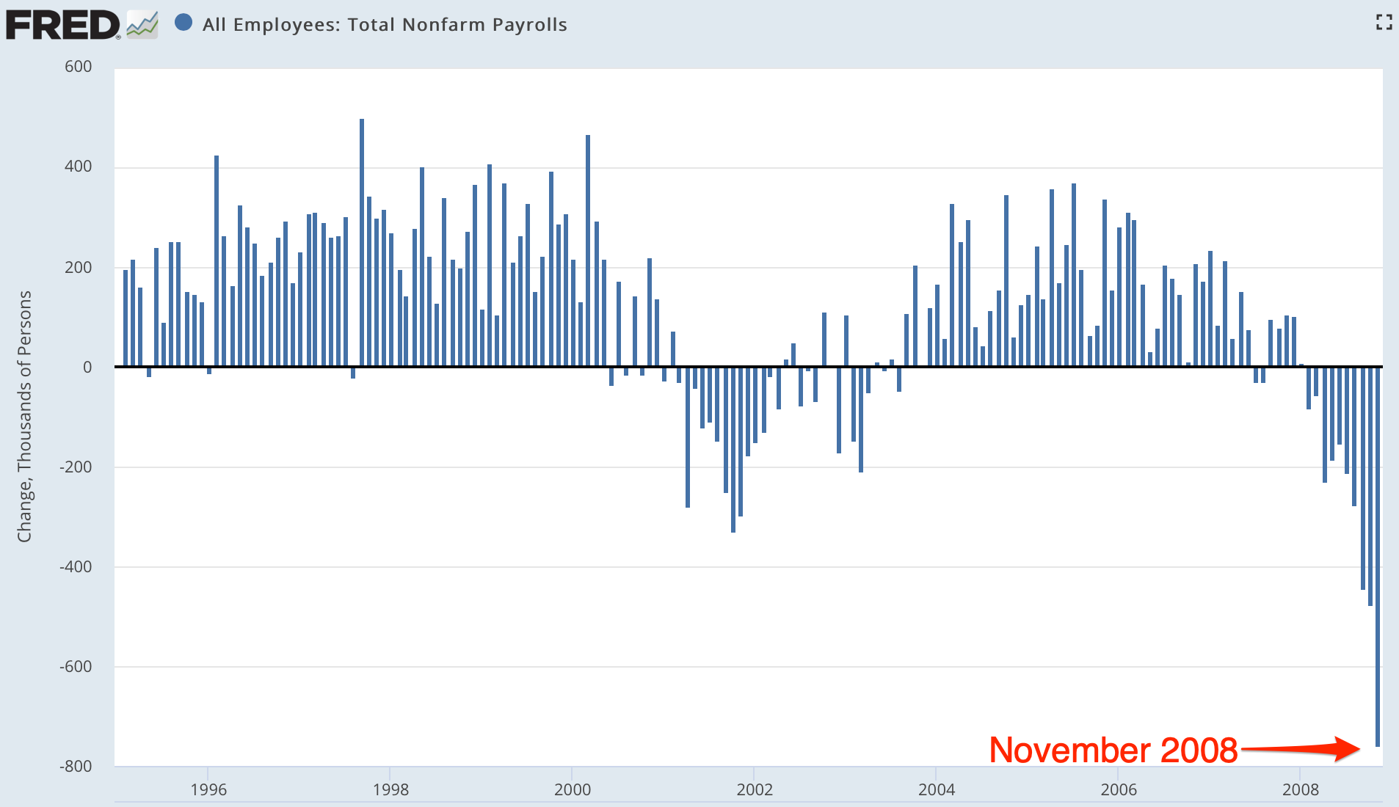
What Are the Insights?
Scene: The Presidential Transition Offices, 8:30 am EST Friday December 5, 2008:
Questions:
Just what is going on?
What is the government supposed to be doing to stop it from doing that?
What can our economists tell us about the best policy response?

Slide 27
Scene: The Bretton Woods Hotel, in Bretton Woods, NH, in April 2011
Martin Wolf: How far do you feel that what we have experienced in the last few years suggests that economists just did not understand what was going on?
Larry Summers: There are things economists did not know. There are things economists were wrong about. And there are things where some economists were right…. When I was in the government, I got a lot of papers…. I attempted to read all of the ones that used the words "leverage," "liquidity," "deflation," or “depression”… I attempted to read none of the ones that used the words "neoclassical," "choice-theoretic," "real business cycle," or "optimizing model of”. There were more in the second…

Slide 28
Summers at the Bretton Woods Hotel II
But there were a reasonable number in the first. And they told you a lot. There is a lot in [Walter] Bagehot['s 1873 Lombard Street] about the crisis we just went through. There is more in [Hyman] Minsky. And there is still more in [Charles] Kindleberger['s 1978 Manias, Panics, and Crashes]….
There are enormous amounts that are essentially distracting, confusing, and problem-denying in the stuff that is the substance of the first year course in Ph.D. programs. I think economics knows a fair amount. I think economics has forgotten a fair amount that is relevant. And it has been distracted by an enormous amount…

Slide 29
Summers at the Bretton Woods Hotel III
People who were practical understood… liquidity finding its way into… asset price inflation and being problematic… but those concepts were at the very edge—or in many cases not even at the very edge—of contemporary macroeconomics, to the great detriment of contemporary macroeconomics.
The wisdom that is in the Bagehot-Minsky-Kindleberger-Eichengreen-Akerlof-Shiller… runs way ahead of those who bring negative attitudes to economics.… We make a serious mistake when we throw the baby out with the bathwater….
But… the vast edifice in both its new Keynesian variety and its new classical variety of attempting to place microfoundations under macroeconomics was not something that informed the policy-making process in any important way…

Slide 30
Insights: Solow
Robert Solow: Complicated system... cannot conduct controlled experiments... a social science... subject to Damon Runyon's Law that nothing between human beings is more than three to one... narrowly economic activity is embedded in a web of social institutions, customs, beliefs, and attitudes….
As soon as time-series get long enough to offer hope of discriminating among complex hypotheses, the likelihood that they remain stationary dwindles away, and the noise level gets correspondingly high. Under these circumstances, a little cleverness and persistence can get you almost any result you want….
If the project of turning economics into a hard science could succeed, it would surely be worth doing. No doubt some of us should keep trying….
The economic historian can ask whether this or that [model-]story rings true when applied in earlier times or other places, and, if not, why not... offer… a sense of the variety and flexibility of social arrangements... the interaction of economic behavior and other social institutions…

Slide 31
Insights: Arrow
Kenneth Arrow: The use of economic history as a source of empirical evidence for testing theories and estimating relations....
A second use… historical conditioning… national or cultural conditioning…. Cultural differences between nations, with all their implications for polity and economy, are precipitates of past events.... It will always be true that practical understanding of the present will require knowledge of the past...

Slide 32
Insights: Krugman
Paul Krugman: There’s no way for me to make this point without citing specific examples, which means naming names. So, on the first point, here’s Chicago’s John Cochrane (2009):
“First, if money is not going to be printed, it has to come from somewhere. If the government borrows a dollar from you, that is a dollar that you do not spend, or that you do not lend to a company to spend on new investment. Every dollar of increased government spending must correspond to one less dollar of private spending. Jobs created by stimulus spending are offset by jobs lost from the decline in private spending. We can build roads instead of factories, but fiscal stimulus can’t help us to build more of both. This is just accounting, and does not need a complex argument about ‘crowding out’…”
Did Cochrane know that he was assuming that the U.S. in 2009 was well-modeled as an economy with a fixed stock of inside money and a rigid cash-in-advance constraint?

Slide 33
Insights: Krugman II
If much of our public debate over fiscal policy has involved reinventing the same fallacies Keynes refuted in 1936, the same can be said of debates over international financial policy. Consider the claim, made by almost everyone, that given its large budget deficits the US desperately needs continuing inflows of capital from China and other emerging markets. Even very good economists fall into this trap.
Just last week Ken Rogoff declared that:
“loans from emerging economies are keeping the debt-challenged US economy on life support.” US economy on life support.”
Um, no: inflows of capital from other nations simply add to the already excessive supply of U.S. savings relative to investment demand.
These inflows of capital have as their counterpart a trade deficit that makes America worse off, not better off.
If the Chinese, in a huff, stopped buying Treasuries they would be doing us a favour.
And the fact that top officials and highly regarded economists don’t get this, 75 years after the General Theory, represents a sad case of intellectual regression…

Slide 34
Insights: Warsh on Shapiro and Varian’s Information Rules
David Warsh: As they increasingly were drawn into the policy battles of the information age, Shapiro and Varian heard the constant refrain… the old rules had been broken; a new set of principles was required to guide business strategy and public policy…. But, they said, ou don't need a brand-new economics. You just need to see the really cool stuff. Incompatible standards… Edison and Westinghouse in electricity…. Neither positive feedback and network externalities… is… recent…. Railroads, highways, electricity grids, television, e-mail: all obey the same basic principles…

Slide 35
Catch Our Breath…
Ask a couple of questions?
Make a couple of comments?
Any more readings to recommend?

