Slide 1
Prefatory Note for Required Reading: Matuschak
The university got its start when books were expensive: really expensive. In the year 301, in the time of the Roman Emperor Diocletian, a scribe’s copying cost of 25 𐆖 for 100 lines meant that a relatively short book by our standards cost as much as 100 days’ work of an unskilled laborer. That’s the same multiple of the pay of a minimum wage worker in California today as $120,000.
Back then, gathering students in the same place along with a library was the only even faintly cost-effective way for them to read lots of books themselves, and listen to lots of books being read aloud (and commented on) by the lecturer.
But with Johann Gutenberg’s movable type printing press in the 1400s books became really cheap. By the 1800s books cost 1/100 times as much on the minimum-wage scale as in 300: the equivalent of not $120,000 but $1,200. And today? My oh my! Especially if we count virtual books on our devices.
Yet the university, even though its fundamental reason for being was gone—you could now curl up with lots of good books anywhere, cheaply—not only survived: it flourished.
Why?
Andy Matuschak’s Why Books Don’t Work proposes an answer: Most people are bad at reading. Hence you have to gather them into a university and force them into its social networks and practices in order to make people do the things necessary for them to even do a half-assed job of learning from the books they might read.
Now some people are excellent readers on their own.
Consider Niccolo Machiavelli, living in the Italian city of Florence in the late 1400s, living in the very first generation when books were cheap enough that some people had personal libraries. When he entered his library, he wrote:
I take off my workday clothes, covered with mud and dirt, and put on the garments of court and palace. Fitted out appropriately, I step inside the venerable courts of the ancients, where, solicitously received by them, I nourish myself on that food that alone is mine and for which I was born; where I am unashamed to converse with them and to question them about the motives for their actions, and they, out of their human kindness, answer me. And for four hours at a time I feel no boredom, I forget all my troubles, I do not dread poverty, and I am not terrified by death…
For Machiavelli, reading a book was the same thing as having an active conversation. Just the thoughts and ideas that went through his mind as he read were linked into his memory and became part of his intellectual human capital.
But if you do not read actively, it simply does not work. Your brain is very good at dumping information that it concludes is trivial and useless.
And how does it assess what is trivial and useless? It decides anything that flashes before your eyes once, or twice, or three times, but that never in pills you to say or do anything and never gets hooked into your broader mental network of associations and ideas—that is what needs to be dumped.
The in-person university does a half assed job of turning its students into active readers, into active learners. It does only a half-assed job, however. It could be vastly improved (that is mostly what Matuschak’s article is about). But that is a discussion for another day, as we no longer have the in-person university.
We have a mostly-online university. We need to make it do a better than quarter-assed job at assisting students to be active readers and active learners.
If it doesn’t, then all you will be left with are books. And as Sokrates warned, for most people a book by itself is very inadequate as a teaching device:
[Written words,] said Theuth, “will make the Egyptians wiser and give them better memories… [and] wit”.
Thamus replied: “O most ingenious Theuth… this discovery of yours will create forgetfulness in the learners' souls, because they will not use their memories; they will trust to the external written characters…. You give your disciples not truth, but only the semblance of truth; they will be hearers of many things and will have learned nothing; they will appear to be omniscient and will generally know nothing; they will be tiresome company, having the show of wisdom without the reality…”
Your task as you read Matuschak is to come up with a plan to make your educational experience this semester at least half-assed.
——
Greg Clark (2001): Secret History of the Industrial Revolution <https://github.com/braddelong/public-files/blob/master/readings/article-clark-secret-history.pdf>
Diocletian (301): Edict on Maximum Prices <https://github.com/braddelong/public-files/blob/master/readings/article-diocletian-price-edict-kropff.pdf>
Niccolo Machiavelli (1513): Letter to Francesco Vettori <https://github.com/braddelong/public-files/blob/master/readings/letter-machiavelli-vettori.pdf>
Andy Matuschak (2019): Why Books Don’t Work <https://github.com/braddelong/public-files/blob/master/readings/article-matuschak-books.pdf>
Plato (-370): Phaedrus <https://github.com/braddelong/public-files/blob/master/readings/book-plato-phaedrus.pdf>
831 words

Slide 2
Prefatory Note for Required Reading: Dasgupta
In your lives so far you have certainly taken at least one course in economics—probably three or four. That probably means that you have been taught, as Betsey Stevenson and Justin Wolfers put it in their textbook, to use:
four core principles… The marginal principle: Ask ‘one more?’ instead of ‘how many?’ The cost-benefit principle: Compare the relevant costs and benefits. The opportunity cost principle…. The interdependence principle…
Betsey and Justin promise us that “these four core principles form a simple but powerful framework for making even the most mundane decisions…” and claim that their book will show “the unity and power of the economic approach’, and by “learning to apply these core ideas to any new economic question they face… [students] will naturally come to ‘think like an economist’…”
But why would one want to think like an economist? What is thinking like an economist—rather than like a sociologist (looking for the webs of human connections and common belief), a political scientist (looking at power and at authority both given and taken), or a historian (looking at origins and development)? One wants to think like an economist because it is an especially useful way of thinking about the economy. What, then, is the economy? And why is “thinking like an economist”—marginal, interdependence, benefit-cost, and opportunity cost calculations—a good way of understanding it?
Partha Dasgupta provides the best short answer to those two linked questions, and in the process of doing so provides the best introduction to economics, that I have seen. His book is a game theorist's short introduction to economics. It focus on: individual goals, individual opportunities and constraints, individual incentives, strategies, exchange, trust, and equilibrium outcomes.
It is, of course, greatly concerned with wealth and poverty—that is, after all, the point of the discipline of economics: it is an inquiry into nature and causes of the wealth of nations. You won't find in Dasgupta’s book lots of practice figuring out how price and quantity change in response to demand shocks or calculating multipliers. What you will find is the logic and rationale for why figuring out how price and quantity change in response to demand shocks or calculating multipliers is a worthwhile thing to do.
It is worth getting into your frontal brain lobes what an economy is and what thinking like an economist is because of what we are going to do this semester. We are going to study the growth of the human economy. And we are going to do so by thinking like economists.
So I want you, before class begins, to read Partha Dasgupta’s book: Economics: A Very Short Introduction
And I don’t want you to just skim it. If you do, you will then forget it—and you will have wasted an hour and a half. The problem is that our brains are very good at forgetting irrelevant information. And our brains take information that we do not find ourselves using and reusing to be irrelevant—to be thrown out so that we can focus on information relevant to the continued life and reproductive success of the East African Plains Ape. The things that we remember are things that we think about over and over again in our inner monologue. So as you read this book I want you to do what I do. I am rarely just reading: I am generally also analyzing, compressing, synthesizing, and summarizing. I am taking notes—but very brief, synthesizing and summarizing notes. And I am generally asking myself questions—and then answering them.
To get you started, let me outline the preface for you:
Dasgupta begins by stating that he will attempt in this book to provide:
An account of how economists reason
Examples of how that reasoning can be applied to (some of) the most urgent problems Humanity faces today
He is going to contrast two lives:
The life of "Becky"—the daughter of a Chicago lawyer
The life of "Desta"—the daughter of an Ethiopian farmer couple
One way to view economics is that it is an attempt to answer the question "what do humans need to do to be rich?"
Cf.: Adam Smith (1776): An Inquiry into the Nature and Causes of the Wealth of Nations
But some people are not rich—for example, Desta—and three centuries ago, back before Adam Smith's day, very, very few people were what we would call "not desperately poor"
So let me ask you: What answers does Partha Dasgupta propose to the questions of how humans can be wealthy—and why, in history and today, many humans have not grasped the opportunity? Are his answers right? How do "economists think"? And how does "how economists think" make you trust or distrust the answers that Dasgupta comes up with?
——
J. Bradford DeLong (2020): Reading Notes <https://github.com/braddelong/public-files/blob/master/book-dasgupta-reading-note-text.pdf> <https://github.com/braddelong/public-files/blob/master/book-dasgupta-reading-note.pdf> <https://github.com/braddelong/public-files/blob/master/book-dasgupta-reading-note.pptx>
Partha Dasgupta (2007): Economics: A Very Short Introduction <https://github.com/braddelong/public-files/blob/master/readings/book-dasgupta-economics.pdf>
Adam Smith (1776): An Inquiry into the Nature and Causes of the Wealth of Nations <https://github.com/braddelong/public-files/blob/master/readings/book-smith-wealth.pdf>
816 words

Slide 3
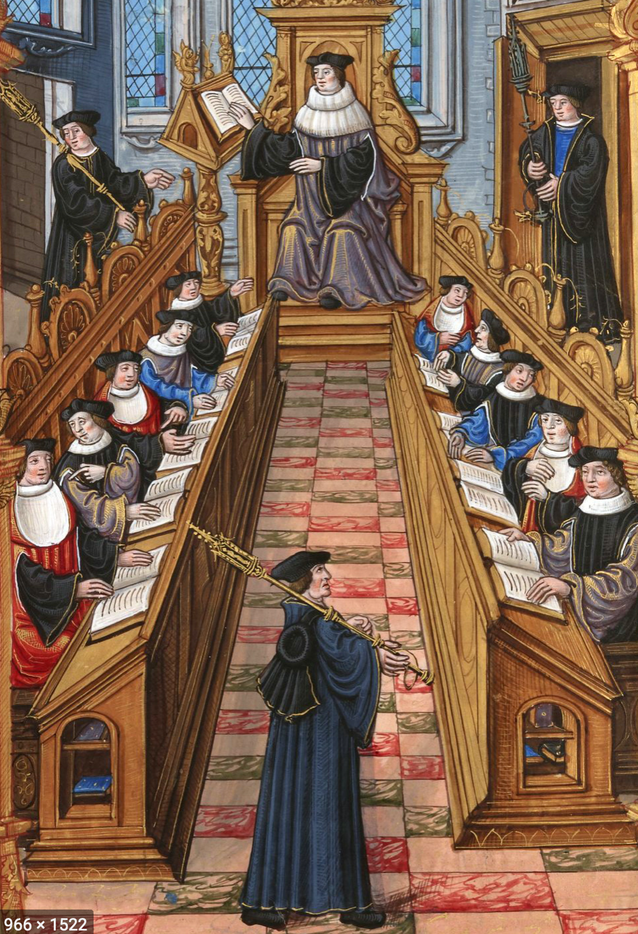
Quiz: Check Your Comprehension of the Required Readings
Questions to answer, & then think about more deeply:
Matuschak:
How does Matuschak think lectures are better than books?
How does Matuschak think lectures are worse than books?
What does Matuschak claim that good readers do when they read books?
Why don’t people buy textbooks in order to learn subjects when they are not concurrently taking a related course?
How does Matuschak believe that books should be redesigned—or replaced—in order to help people think more deeply?
Dasgupta:
Sustainability: Why have we been able to successfully capture and use 40% of the photosynthesis on earth without already severely disrupting our planet?
Political & Social Welfare: What are T.H. Marshall's “three revolutions”, & what importance do they have in Dasgupta’s argument?
Households: Why do we think that Africa's population is likely to grow much faster than India’s population over the next fifty years?
Mechanism Design: Why did Friedrich von Hayek deserve his Nobel Prize? How, notwithstanding von Hayek’s Nobel Prize, can central planning add to societal well-being?
Human Cooperation: What are the principal advantages of building your economic network on the basis of “weak ties”?
QUIZ URL: <https://bcourses.berkeley.edu/courses/1493152/quizzes/2309098/>
184 words

Slide 4
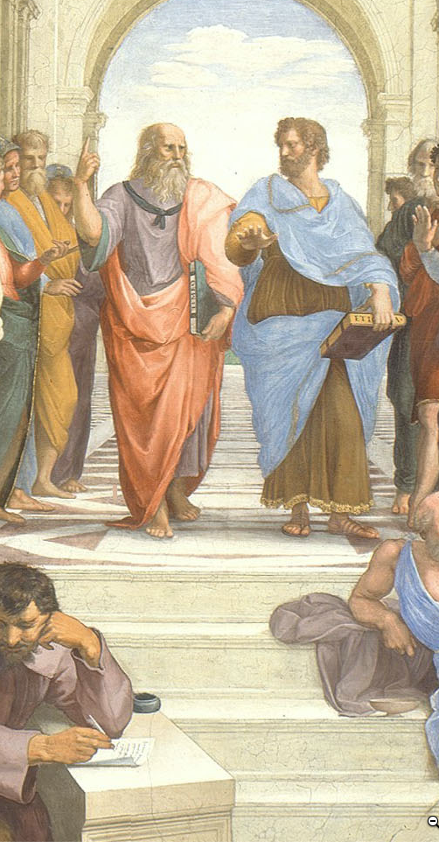
Discuss: Matuschak & Dasgupta
Let me start this discussion off by asking four questions:
Suppose we accept everything Andy Matuschak says: what does his argument tell us about how this course ought to be run?
What things that Andy Matuschak says should we reject?
What do you think is the most notable conclusion Partha Dasgupta reaches about the nature and causes of the wealth of nations?
Suppose we accept everything Partha Dasgupta says: what does his argument tell us about how this course ought to be run?
As before, for full credit for this discussion, provide at least two substantive contributions to the discussion, of which at most one should be a direct response to one of my questions. We want you to talk to & react to one another here…
THREADED DISCUSSION URL: <https://bcourses.berkeley.edu/courses/1493152/discussion_topics/5774300>
117 words

