Slide 1
Econ 210a: Malthusian Economies (January 22, 2020b)
J. Bradford DeLong
Spring 2019
Evans 648
W 1:10-3:00 pm
<https://bcourses.berkeley.edu/courses/1487686/>
<https://github.com/braddelong/public-files/blob/master/econ-210a-lecture-1b.pptx>

Slide 2
Malthusian Economies: Readings for January 22…
Gregory Clark (2005), “The Condition of the Working Class in England, 1209–2004,” Journal of Political Economy 113 (December), pp. 1307–1340 <www.jstor.org/stable/pdfplus/10.1086/.pdf> <https://www.icloud.com/keynote/0h4DbG-5t5sfY_ky-UKRBj56A>
Richard Steckel (2008), "Biological Measures of the Standard of Living," Journal of Economic Perspectives 22:1 Winter), pp. 129-52 <http://www.aeaweb.org/articles.php?doi=10.1257/jep.22.1.129> <https://www.icloud.com/keynote/0bb0qK4PFlXfY2xlQmUZl1rjQ>
Jared Diamond (1987), “The Worst Mistake in the History of the Human Race,” Discover <http://discovermagazine.com/1987/may/02-the-worst-mistake-in-the-history-of-the-human-race> <https://www.icloud.com/keynote/0zxW4kbYZdg4IxjhmsLaOJDhA>

Slide 3
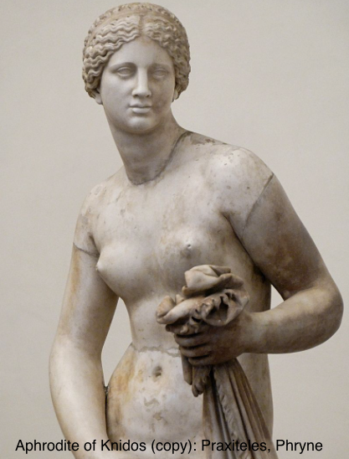

“Ancient” Ain’t “Primitive” or “Unsophisticated”, Is It?
Could we teach:
Themistokles or Augustus much about politics?
Homer much about writing poetry?
Gaius Julius Caesar or Leonidas much about generalship?
Sophokles much about drama?
Phryne much about presentation-of-self-as-celebrity?
Michelangelo di Lodovico Buonarroti Simon much about painting ceilings?
Praxiteles much about sculpture?
Johann Sebastian Bach much about music?

Slide 4
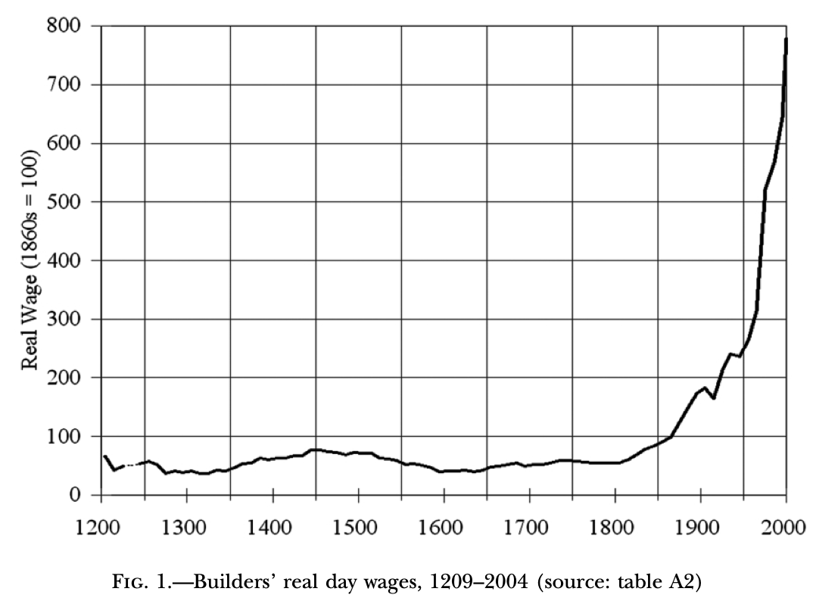
And Yet, If We Look at the Economy…

Slide 5
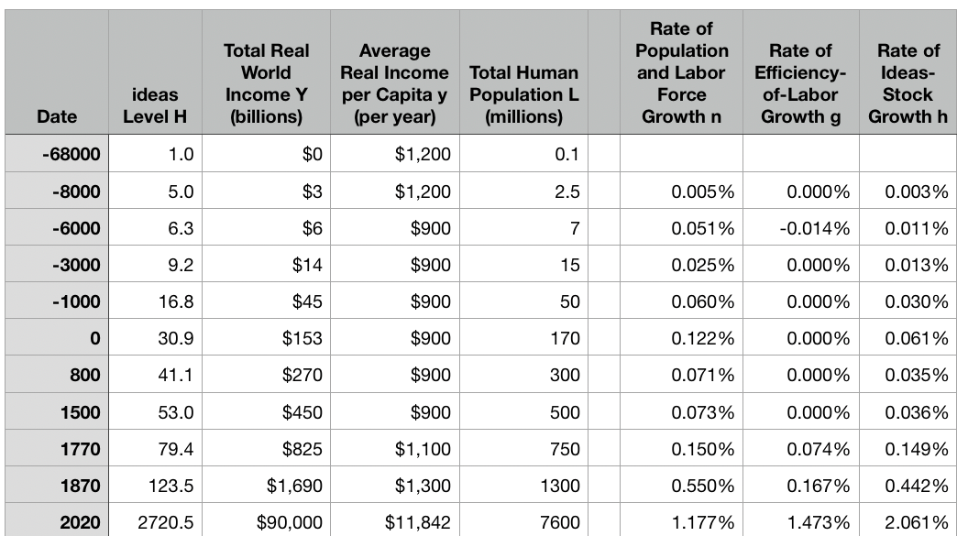
One Table: Average Global Numbers

Slide 6

The Default State? How Was It Exited?
Malthusian Agrarianism—near-stagnation—as the default state of post-Neolithic humanity?
Exit:
Industrial Revolution
Modern Economic Growth
Reentry?
Astronomy and the Fermi Paradox: The Great Filter
Notes?

Slide 7
Reading Clark: No Real Wage Trend Until After 1800
Before 1800, no clear trend
Real wages in late 1400s twice what they were between 1250 and 1350.
Wages 1250-1350 33% below 1200?
Wages in 1600 back to 1250-1350 low point
1850 75% above 1800
1950 350% above 1800
2000 1300% above 1800
J. Bradford DeLong brad.delong@gmail.com 2020-01-08

Slide 8
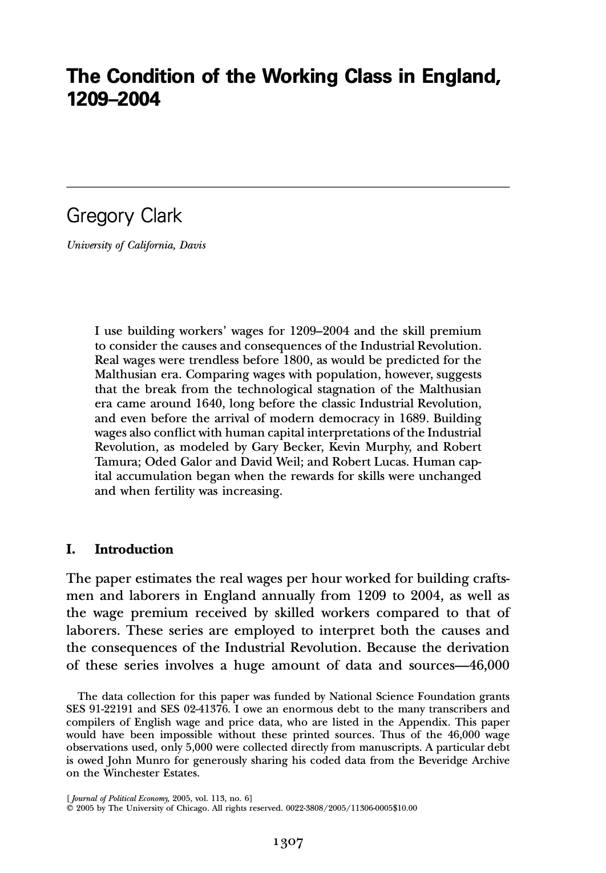
How Reliable?
Gregory Clark (2005): The Condition of the Working Class in England, 1209-2003 <https://delong.typepad.com/files/clark-condition.pdf>
46000 observations on construction workers
Both laborers and craftsmen
110000 observations on prices and housing rents
The break from the Malthusian era of little advance in the efficiency of labor in England began circa 1640:
Long before the famous Industrial Revolution
Before even the emergence of the modern political regime in England in 1689
J. Bradford DeLong brad.delong@gmail.com 2020-01-08 https://www.icloud.com/keynote/0h4DbG-5t5sfY_ky-UKRBj56A

Slide 9
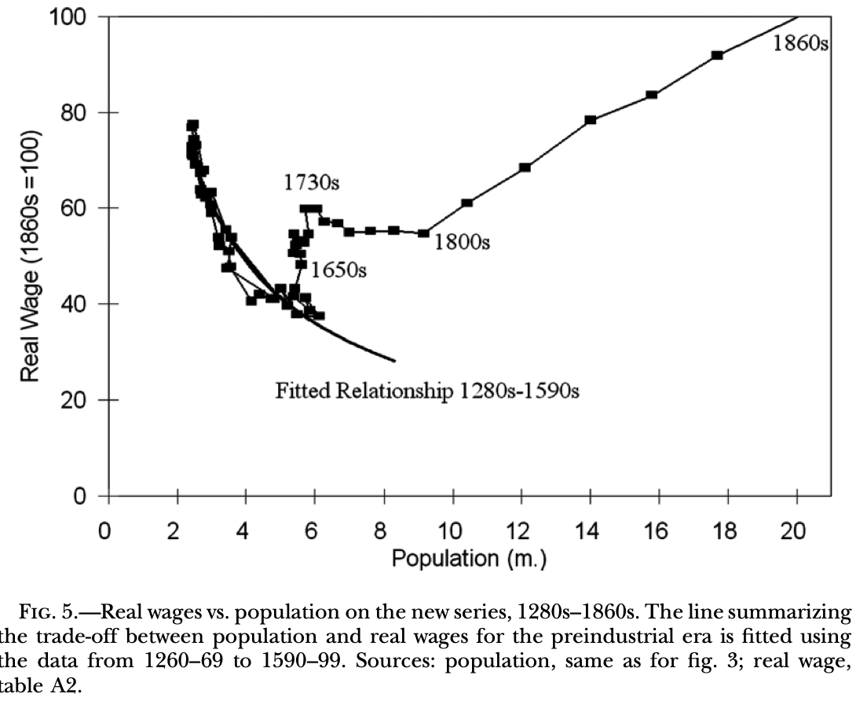
A Pre-1650 Malthusian Relationship
A Malthusian inverse wage-population relationship holds until 1650:
With no, zero, nada improvements in effective technology and organization
In 1625 both the population and the real wage level in England were what they were in 1300
Thereafter England move up and to the right on the graph
First slowly, then rapidly
J. Bradford DeLong brad.delong@gmail.com 2020-01-08

Slide 10
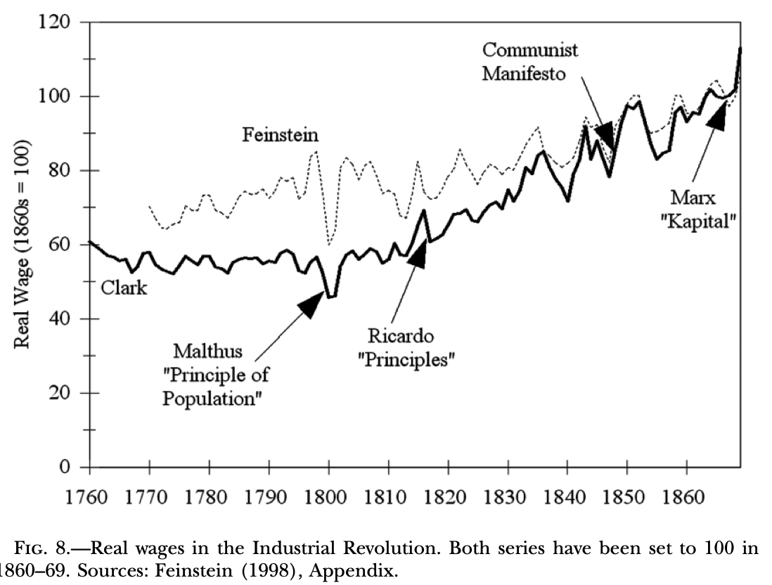
Did Workers Gain in the Early Stages of Industrialization?
Yes: real wages start increasing after 1810
By the writing of the Communist Manifesto, they are 50 above their value as of 1810
But: “When Thomas Malthus published his famous Essay on the Principle of Population in 1798, real wages had been flat or declining for several generations, ever since the first half of the eighteenth century…”
“At the time Malthus was writing, the dramatic technical innovations that transformed cotton spinning—the spinning jenny and water frame in 1769 and the mule in 1776—were almost a generation old. But these gains were expended mainly in allowing significant population growth rather than in raising real wages…”
J. Bradford DeLong brad.delong@gmail.com 2020-01-08

Slide 11
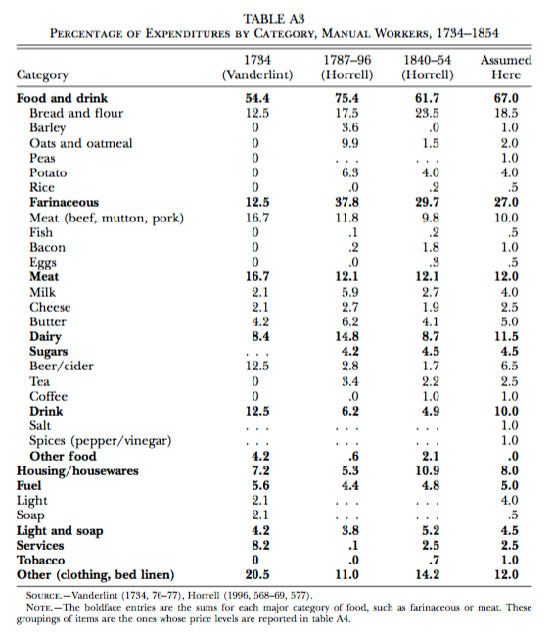
What Did the Working Class Spend Its Money on?
What did the working-class spend its money on in the past?
Even in the 1880s, the U.S. working class—the richest in the world—was spending something like 40% of marginal income dollars on simply getting more calories.
A still-remarkable degree of nutritional stress

Slide 12
Reading Clark: Questions
What can we say about the condition of the working class in England from 1209-1640?
What can we say about the condition of the working class in England from 1640-1870?
What can we say about the condition of the working class in England from 1870-today?
When does the break from Malthusian stagnation happen in England?
Why is this date particularly interesting?
How confident are we in Clark’s numbers?
What is the real wage today compared to the real wage in 1800?
What was the real wage in 1800 compared to the real wage in 1450?
What was the real wage in 1800 compared to the real wage in 1320?
When did the real wage in England exceed its 1450 value?
When did the population of England exceed its 1320 value?
J. Bradford DeLong brad.delong@gmail.com 2020-01-08 https://www.icloud.com/keynote/0h4DbG-5t5sfY_ky-UKRBj56A

Slide 13
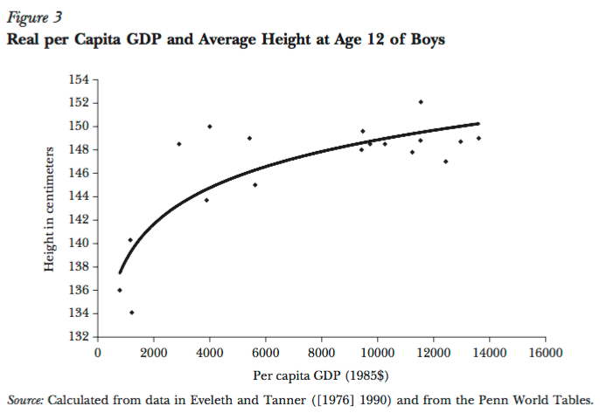
Rick Steckel: Height and Income in the Late 20th Century
Height as a proxy for living standards…
Nutrition…
Get more than so poor, and nutrition is compromised…
The relationship is strong for levels of income $(1985) 6000 or so…
The relationship very weak if richer: nutritional sufficiency…

Slide 14
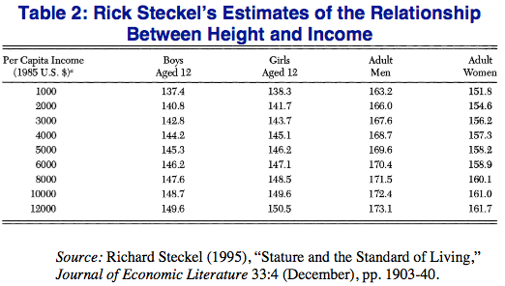
Nasty, Brutish, and Short
The phrase is Thomas Hobbes’s
Modern standard of living is worth 10 cm.
Practically every non-aristo skeleton from our agrarian past is really short
Exceptions: fish eaters
Exceptions: Souix
Exceptions: Hunter-gatherers
What does being 10 cm. shorter do to brain development?

Slide 15
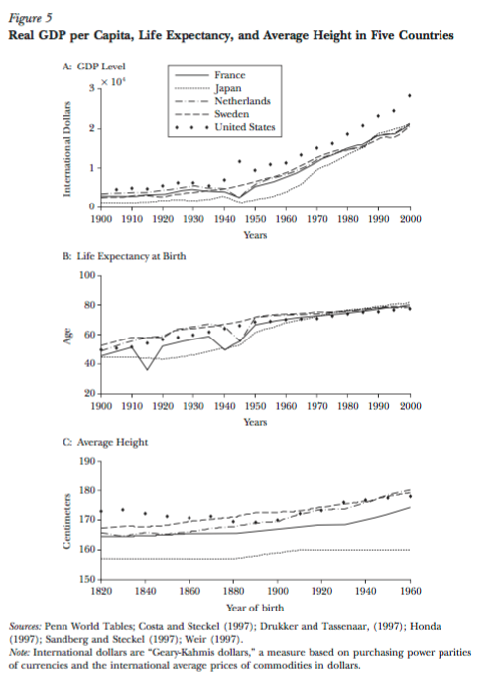
From Rick Steckel: Income Indicators Throughout the 20th Century
We can check whether the cross-sectional relationship between prosperity and biomedical indicators holds across time roughly back to the start of the twentieth century…
It looks like it does…
Then we can guess and leap further into the past with biomedical information, checked with shaky—very shaky—historical documents…

Slide 16
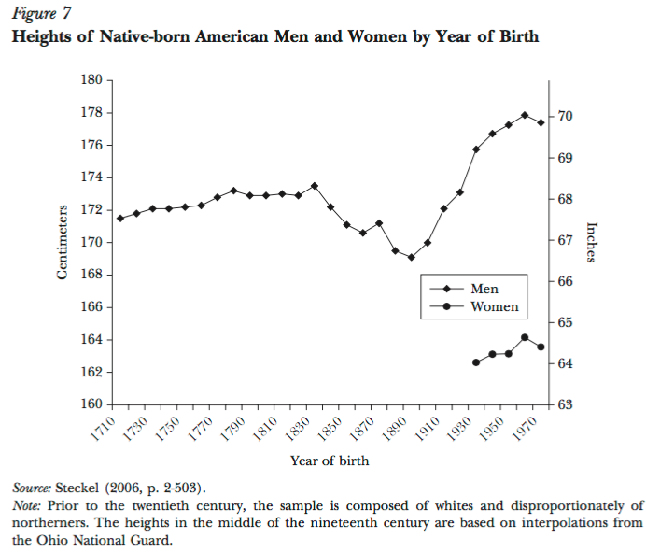
From Rick Steckel: The New World Back to the Early 18th Century
Even New World populations in the eighteenth century are 2” short…
And there is a remarkable mid- and late-nineteenth century decline as urbanization and industrialization take hold…
Nadir for those born in 1900…

Slide 17
From Rick Steckel: The Old World
“In nineteenth century Sweden, for example, average height was three to eight centimeters greater in rural areas compared with Stockholm, depending upon the time period and rural area (Sandberg and Steckel, 1988)….
“In late eighteenth-century England, for example, the average heights at age 14 of poor boys admitted to the Marine Society were 20 centimeters below those of upper-class boys who attended the elite academy at Sandhurst (Floud, Wachter, and Gregory, 1990). During the same era, the difference in average height between the rich and the poor in the United States was roughly 3 centimeters (Margo and Steckel, 1982).”
<https://www.icloud.com/keynote/0bb0qK4PFlXfY2xlQmUZl1rjQ>

Slide 18
Jared Diamond: The Worst Mistake in the History of the Human Race
“The mix of wild plants and animals in the diets of surviving hunter-gatherers provides more protein and a better balance of other nutrients…”
“Bushmen’s average daily food intake (during a month when food was plentiful) was 2,140 calories and 93 grams of protein, considerably greater than the recommended daily allowance for people of their size…”
“It’s almost inconceivable that Bushmen, who eat 75 or so wild plants, could die of starvation the way hundreds of thousands of Irish farmers and their families did during the potato famine of the 1840s…”
“Skeletons from Greece and Turkey show that the average height of hunger-gatherers toward the end of the ice ages was a generous 5' 9'' for men, 5' 5'' for women. With the adoption of agriculture, height crashed, and by 3000 B. C. had reached a low of only 5' 3'' for men, 5' for women…”
“Besides malnutrition, starvation, and epidemic diseases, farming helped bring another curse upon humanity: deep class divisions…”
<https://www.icloud.com/keynote/0zxW4kbYZdg4IxjhmsLaOJDhA>

Slide 19
Catch Our Breath…
Ask a couple of questions?
Make a couple of comments?
Any more readings to recommend?

Slide 20
Notes…
Hunters and Gatherers: Background <https://www.icloud.com/keynote/0gpMaqZkyvrfqgrfeFkSdZhrA>
Humans as an Anthology Intelligence <https://www.icloud.com/keynote/0mXqcK7TUGGJGZdud0ODZJjSg>
Historical Patriarchy <https://www.icloud.com/keynote/00hc0TFwhajEqn5JFBPhNbTog>
Malthusian Economic Growth <https://www.icloud.com/keynote/0Dy-Qg7Z__2fBvaECGbKVCvIg>
The Figure <https://www.icloud.com/keynote/0ysTdN41E5B7qCmwuB35WJtOQ>

