Slide 1
Econ 210a: Commercial Revolutions (January 29, 2020b)
J. Bradford DeLong
Spring 2019
Evans 648
W 1:10-3:00 pm
<https://bcourses.berkeley.edu/courses/1487686/>
<https://github.com/braddelong/public-files/blob/master/econ-210a-lecture-2b.pptx>

Slide 2
Commercial Revolutions: Readings for January 29…
Jeremiah E. Dittmar (2011): Information Technology and Economic Change: The Impact of the Printing Press <http://qje.oxfordjournals.org/content/126/3/1133.abstract >
J. Bradford DeLong and Andrei Shleifer (1993): Princes and Merchants: European City Growth before the Industrial Revolution <http://www.jstor.org/stable/725804 >
Daron Acemoglu, Simon Johnson, and James Robinson (2005): The Rise of Europe: Atlantic Trade, Institutional Change, and Economic Growth <http://www.jstor.org/stable/4132729>

Slide 3
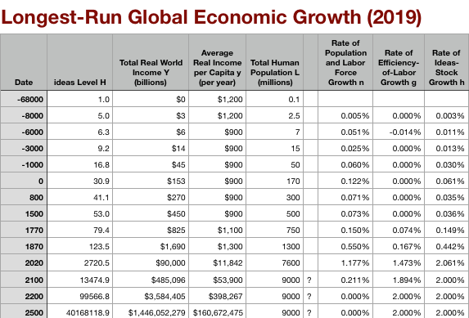
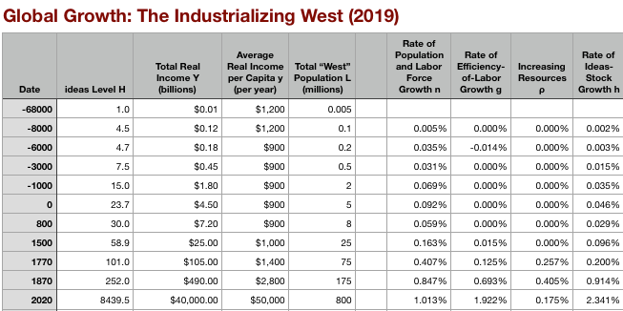
Global and “Western” Numbers
Is ‘the west’ special between 800 and 1500?
Or is it just recovery from a Dark Age depression?
The Commercial Revolution acceleration appears everywhere
Due to globalization
And especially to the “Columbian Exchange”

Slide 4
Reading Dittmar: Could One Innovation Make Such a Difference?
Jeremiah E. Dittmar (2011): Information Technology and Economic Change: The Impact of the Printing Press <http://qje.oxfordjournals.org/content/126/3/1133.abstract>:
Information economics visits the 1500s…
How much of a difference can a small sector—1% of GDP—actually make?
What are the economic benefits of books, anyway?
What does this tell us about the market system as optimal societal structure?

Slide 5
Jeremiah Dittmar (2011): The Printing Press as an Agent of Change…

Slide 6
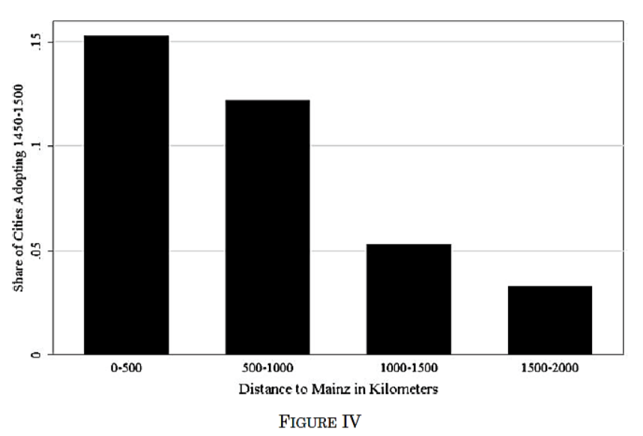
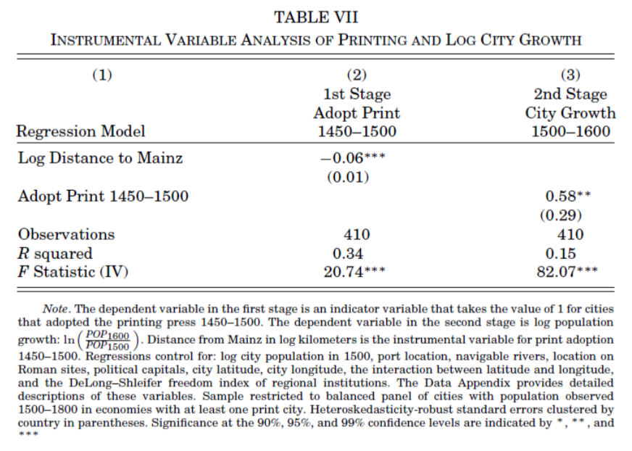
What Should We Think When IV Estimates Are so Much Bigger than OLS Ones?
Dittmar’s Test: Compare (especially over the period 1500– 1600) population growth of cities that did and did not adopt the printing press before 1500.
Why are DIttmar’s IV estimates so big? 0.6 per century—a near doubling—as opposed to 0.2?

Slide 7

Questions for Dittmar
What else might have been going on that is correlated with "distance from Mainz”?
How should we think about the possibility of finding a “good instrument”, anyway?
Jim Heckman likes to say that you need a structural model before you can figure out if you have a good instrument—and then you might as well do structural estimation. Is he right? Is he wrong?
What is the mechanism here? What do people who read printed books do, exactly, that generates so much in the way of population growth?
Once again: why the divergence—and in this particular direction—between OLS and IV estimates?

Slide 8
Reading DeLong and Shleifer: Are Cities a Net Plus, or Simply a Redistribution of Activity?
J. Bradford DeLong and Andrei Shleifer (1993): Princes and Merchants: European City Growth before the Industrial Revolution <http://www.jstor.org/stable/725804>
DeLong and Shleifer:
“The Greeks and Romans together added little to the world's store of technical knowledge and equipment…”
“The Greeks and Romans built a high civilization, full of power and intellect and beauty, but they transmitted to their successors few new inventions…”
“There was both more and less technical progress in the ancient world than the standard picture reveals. There was more, provided we avoid the mistake of hunting solely for great radical inventions and we also look at developments within the limits of the traditional techniques…”
“The gear and the screw, the rotary mill and the water-mill, the direct screw-press, glass-blowing and concrete, hollow bronze-casting, the dioptra for surveying, the torsion catapult, the water-clock and water organ, automata (mechanical toys) driven by water and wind and steam—this short list is fairly exhaustive, and it adds up to not very much for a great civilization over fifteen hundred years…”

Slide 9
Merchants Rule! OK?
In which genre is this paper?
The “freedom of the citizen” genre…
The “character of the elites” genre…
Particular institution of interest
Absolutist versus limited government.
(Not sure I would say “limited”—British government was very good at stealing stuff that did not belong to the gentry/merchant aristocracy—that’s what Marx is all about)
What is assumed direction of effect and mechanism?
Direction of causation?
Urbanization as indicator: Is this sensible?

Slide 10
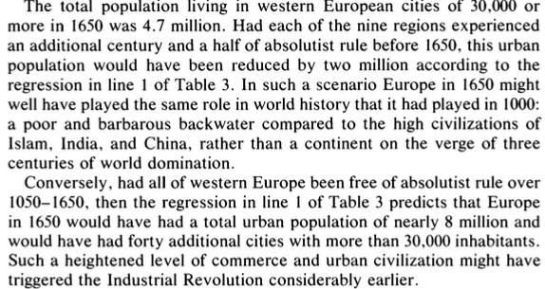
DeLong and Shleifer II
It’s a big deal…

Slide 11
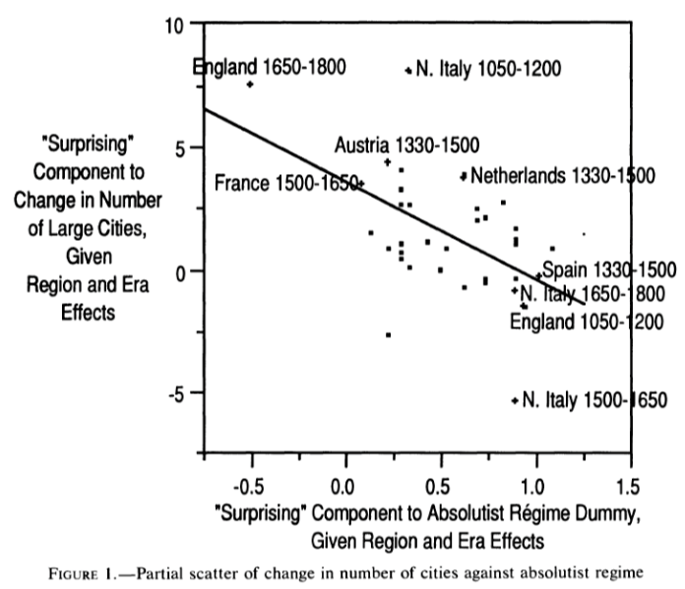
DeLong and Shleifer III
Northern Italy in 1500-1650 is “surprising” as absolutist then
England 1650-1800 is “surprising” as non-absolutist then
WTF?! with the Italian urban boom 1050-1200
Econometric problems
Normal distribution—we have only 45 observations, and 30 degrees of freedom…
The file-drawer problem…

Slide 12


Questions for DeLong and Shleifer

Slide 13
Reading Acemoglu: Wait a Minute! It Was Spain—and Portugal!
Daron Acemoglu, Simon Johnson, and James Robinson (2005): The Rise of Europe: Atlantic Trade, Institutional Change, and Economic Growth <http://www.jstor.org/stable/4132729>
But where does “limited government” come from?
Atlantic trade shock as an identifying instrument
What are the direct effects of “Atlantic trade”?
What do AJR claim are the indirect effects?
Why do they think the indirect effects are materially large?
What would convince you they were right (or wrong)?

Slide 14
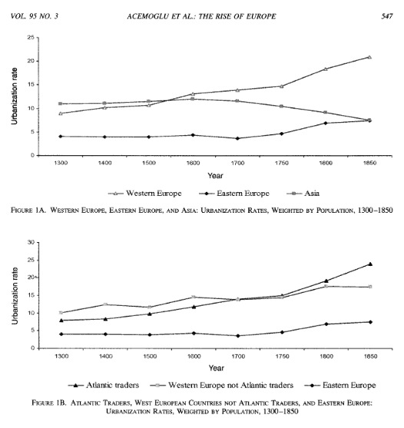
Acemoglu, Johnson, and Robinson: Urbanization and Atlantic Trade

Slide 15
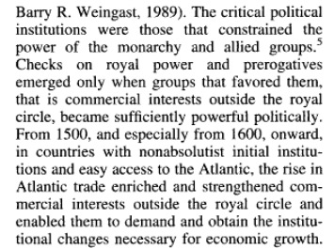
AJR

Slide 16
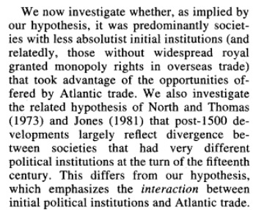
AJR

Slide 17
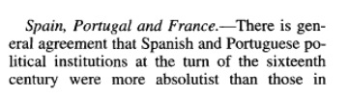
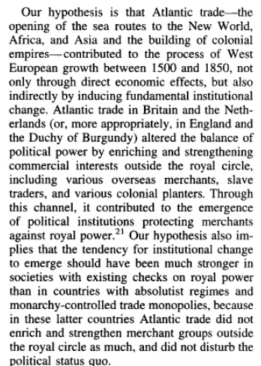
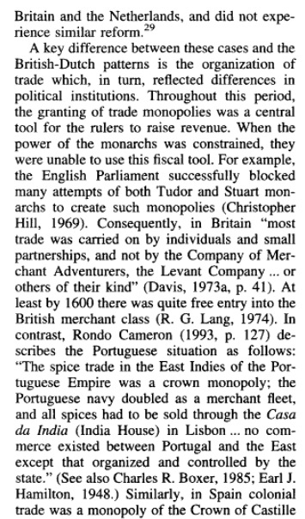
AJR

Slide 18
Questions for AJR
We are talking an extra 10% of the population in cities here. Is this reasonable to attribute to the effects of good government?
But does “Atlantic trade" automatically produce good government?

Slide 19
Catch Our Breath…
Ask a couple of questions?
Make a couple of comments?
Any more readings to recommend?

Slide 20
Notes…

