Slide 1
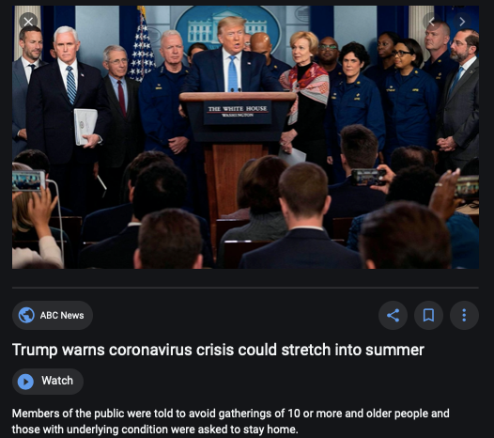
Coronavirus!

Slide 2
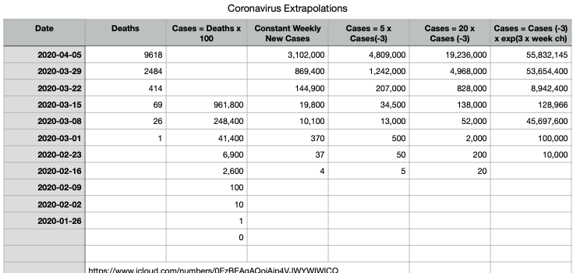
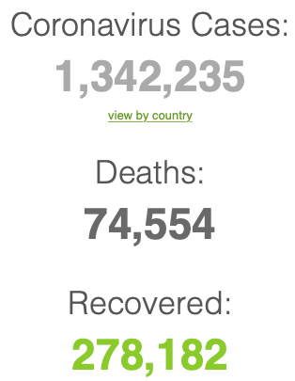
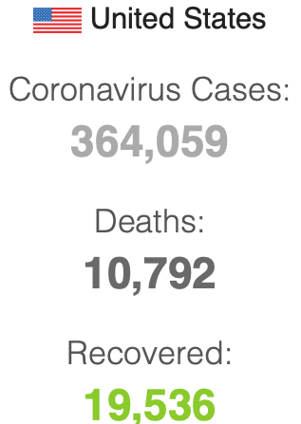
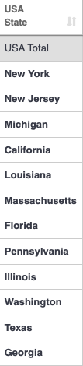
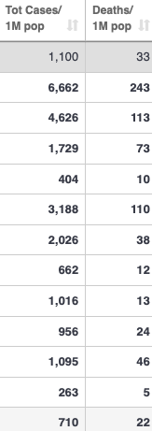
Coronavirus
Where we think we are, as of Mo Apr 6:
We really do not know
No random samples…
If we extrapolate out the past week straight-line log:
We will have 440,000 deaths in three weeks
But it is unlikely to be that bad
Best thing I have read comes from Jim Stock <https://drive.google.com/file/d/12MV466ZZy5xHir4xdPhoTrL1oO8CbZU-/view>:
The basic SIR epidemiological model of contagion
The effect of social distancing and business shutdowns on epidemic dynamics enters the model through a single parameter: the case transmission rate β
Re-express the model in terms of β and the asymptomatic (or not very symptomatic) hence non-tested rate—the fraction of the infected who are not tested
The COVID-19 non-testing rate is unidentified in our model
Estimates in the epidemiological literature range from 0.18 to 0.86.
The asymptomatic rate could be estimated accurately and quickly by testing a random sample
The optimal policy response and its economic consequences hinge critically on the asymptomatic rate

Slide 3
Coronavirus II
We do not really know where we are, as of Mo Apr 6:
Best thing I have read comes from Jim Stock <https://drive.google.com/file/d/12MV466ZZy5xHir4xdPhoTrL1oO8CbZU-/view>:
The basic SIR epidemiological model of contagion
The effect of social distancing and business shutdowns on epidemic dynamics enters the model through a single parameter: the case transmission rate β
Re-express the model in terms of β and the asymptomatic (or not very symptomatic) hence non-tested rate—the fraction of the infected who are not tested
The COVID-19 non-testing rate is unidentified in our model
Estimates in the epidemiological literature range from 0.18 to 0.86.
The asymptomatic rate could be estimated accurately and quickly by testing a random sample
The optimal policy response and its economic consequences hinge critically on the asymptomatic rate

Slide 7
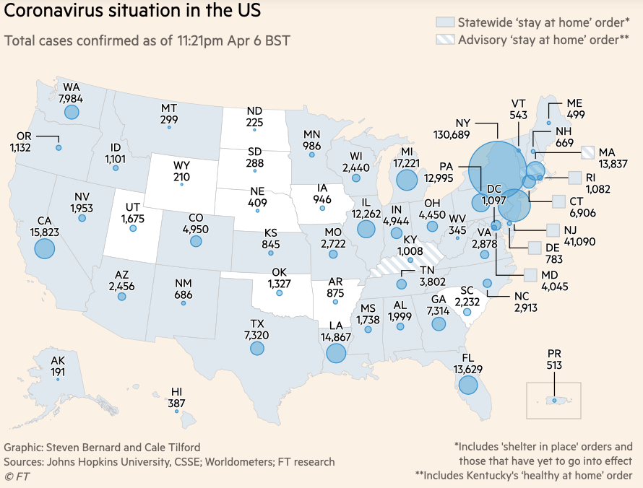
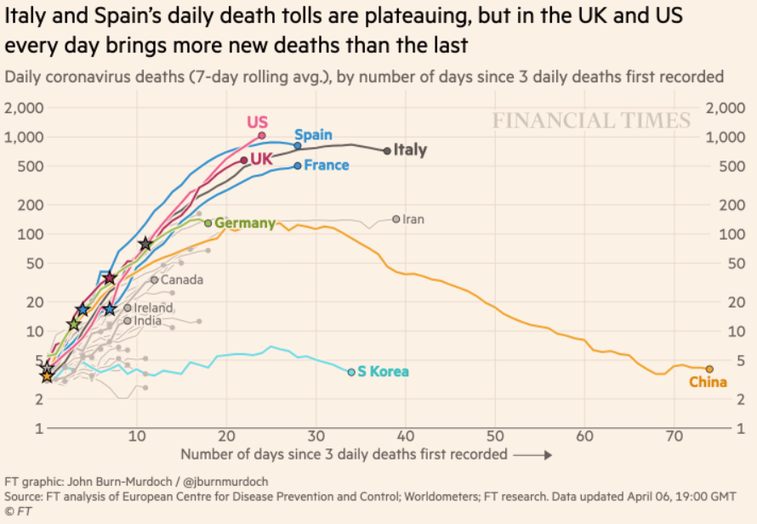
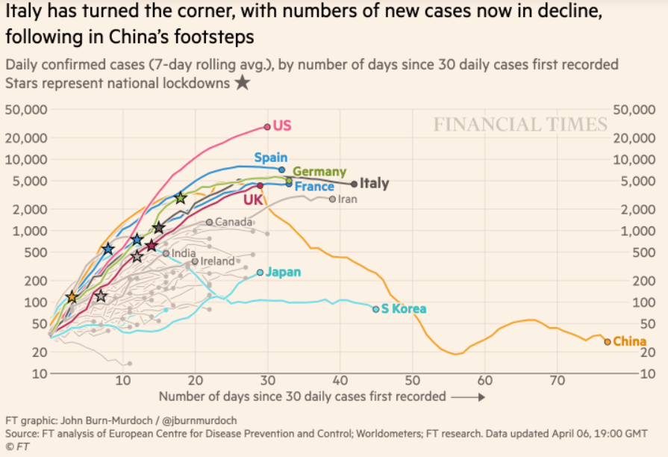
Financial Times Graphs Blown Up…

Slide 11
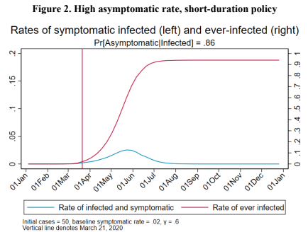
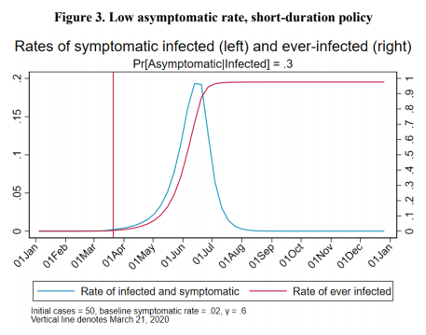
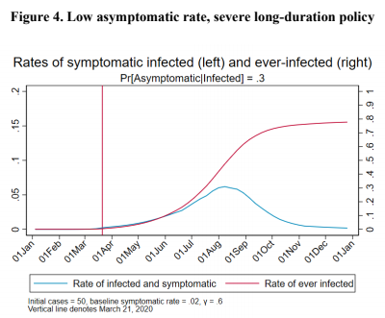
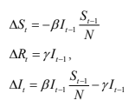
James Stock (2020)
Standard SIR model:<https://drive.google.com/file/d/12MV466ZZy5xHir4xdPhoTrL1oO8CbZU-/view>:
Susceptible, Infected, Recovered (& immune), transmission rate β, recovery rate γ, reproduction number R0, asymptomatic hence non-tested rate π0
Calibration: half-life of infection one week: γ = 0.5, s0 = 0.02, 50 cases on Jan 24
For March 21, 2020, the positive test rate in the United States is approximately 10%…
<https://drive.google.com/file/d/12MV466ZZy5xHir4xdPhoTrL1oO8CbZU-/view>

Slide 16
Bringing the Economy Back Up from Anæsthesia
Major issues:
Certificates of immunity:
Which requires test, test, test:
And not just disease virus tests
Presence-of-antibodies tests
How quickly can we match the immune with public-contact jobs?
What jobs can be done with minimal infection risk?
What minimal-infection substitutes can we find for previous jobs?
How quickly can restrictions be relaxed without the virus coming roaring back?
How do we avoid having the market give a “shutdown” signal to enterprises we in fact want restarted?
Which is pretty much all of them
How much of the potential caseload do we want to push out beyond the vaccine-arrival date?
ALL THESE QUESTIONS ARE ANSWERABLE IF WE LEARN THE ASYMPTOMATIC HENCE NON-TESTED RATE!!

Slide 17
Keeping the Economy from Crashing During the Lockdown
Nick Rowe: We have a 50% output cut in 100% of the sectors:
A temporary 100% output cut in 50% of the sectors (what the Coronavirus does) is very different from a 50% output cut in 100% of the sectors
Nick’s thought experiment:
In three months we are going to invent unobtanium:
Substantial intertemporal substitutibility
Plus lower cross-good contemporaneous substitutitbility
Hence high desired savings rate now
Flex-price market thus produces a nominal rate at the zero lower bound and a high inflation rate over the next three to six months
Plus liquidity-constrained workers in affected sectors see their demand go to zero immediately
Can we get there? Should we get there? What should we do instead?
We need a good RBC economist: are there any?…
<https://worthwhile.typepad.com/worthwhile_canadian_initi/2020/03/relative-supply-shocks-unobtainium-walras-law-and-the-coronavirus.html>

Slide 18
Keeping the Economy from Crashing During the Lockdown II
Nick Rowe:
<https://worthwhile.typepad.com/worthwhile_canadian_initi/2020/03/relative-supply-shocks-unobtainium-walras-law-and-the-coronavirus.html>
Plus: to extend the thought experiment:
We just lost the ability to make “unobtainium”
So we should be substituting leisure for work, and moving workers into relatively unproductive labor, making the commodities we can still produce right now
How should relative prices move as a result? How should we make them move?
Plus: distributional issues
Plus: bankruptcy and credit chain issues

Slide 19
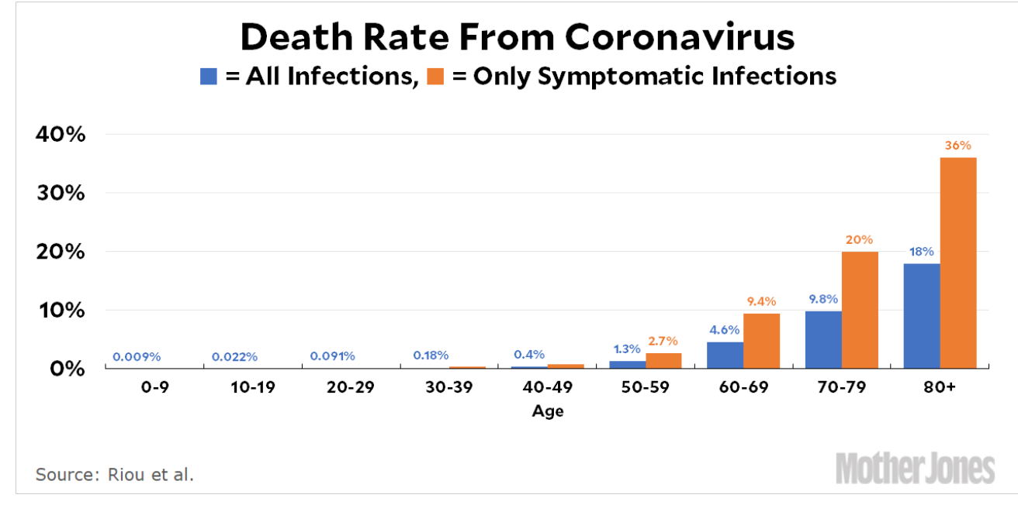
MOAR Coronavirus!
Death for Geezers!
Mortality for the Youngs very low…
It’s the flu for them—for you…
And an extra doubling—or is it 5%?—mortality for the asthmatic
And an extra doubling—or is it 5%?—mortality for the overweight

Slide 20
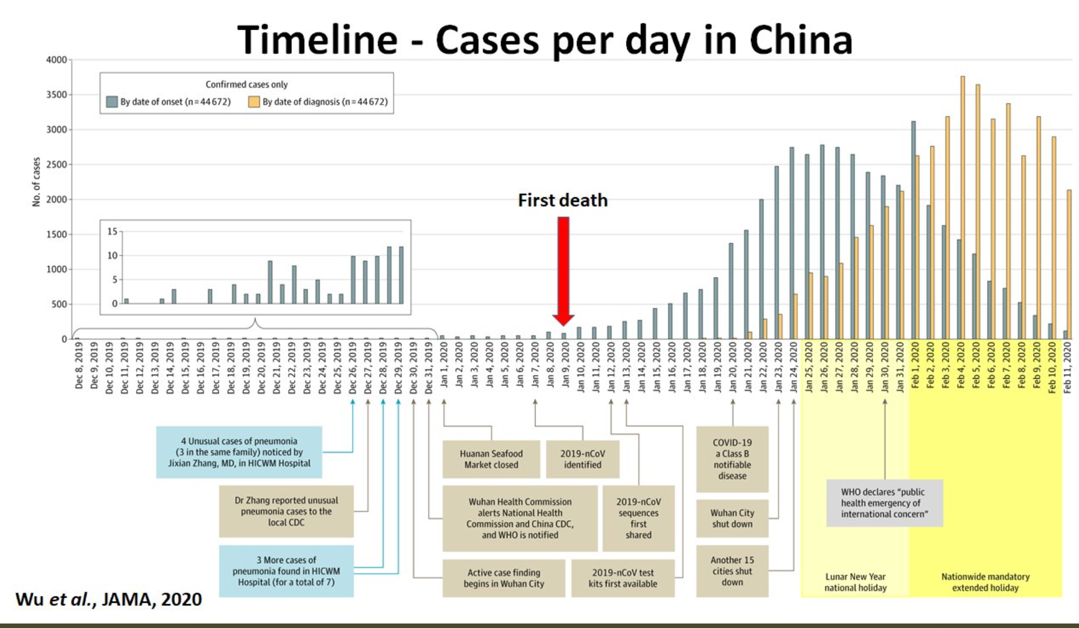
What We Think Happened in Wuhan
China beat it quickly & relatively easily!
We think
Shut down Wuhan when 200 cases per day
That seems to have been a good decision

Slide 21
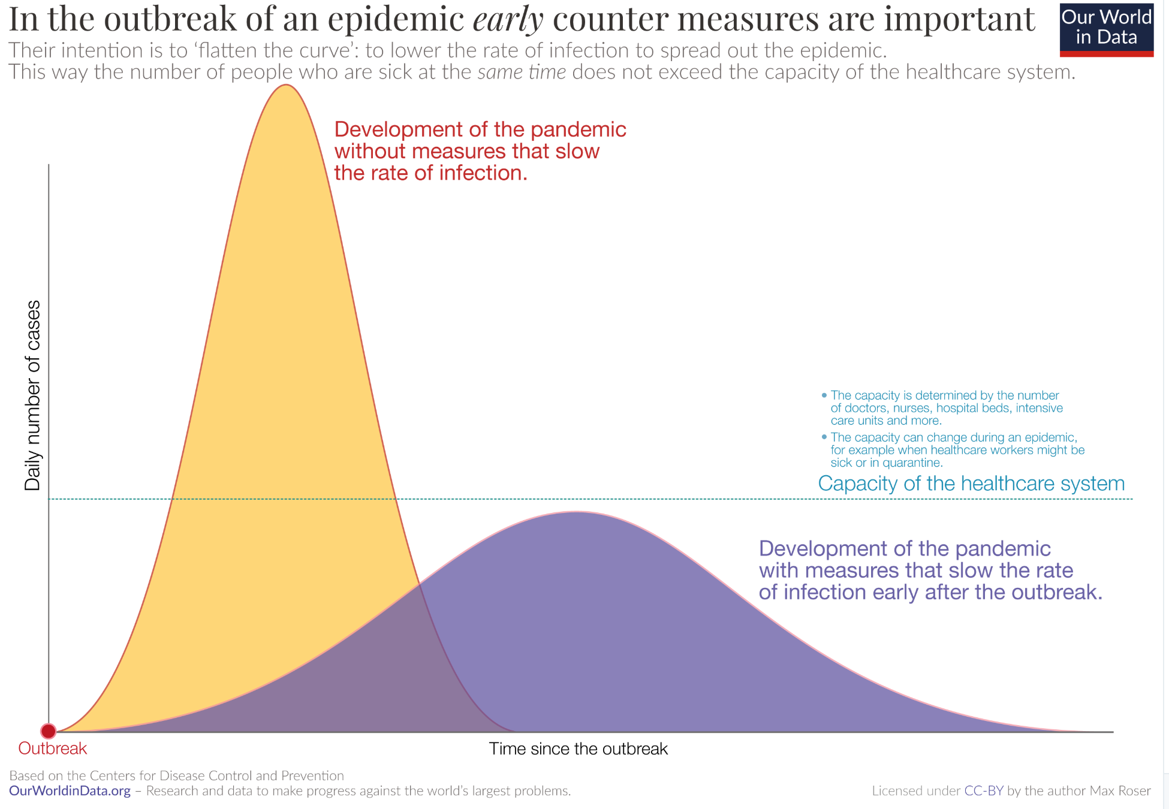
The Goal
When Is It Appropriate to Move on This?
Immediate social distancing…
Self-isolate if you have a cough and a fever…
Hope that warmer temperatures will do to this what they did to SARS…
Otherwise, when do you want to start spreading out transmission. It seems that early is as good as later, so do it early…
I have no good intuition on why you want to move early
Plus your moving early will be wasted if you get reinfected
Plus the sparks you throw off making others’ lives more difficult

Slide 22
References
Financial Times (2020): Coronavirus Tracked: The Latest Figures as the Pandemic Spreads <https://www.ft.com/coronavirus-latest>
Nick Rowe (2020): Relative Supply Shocks, Unobtainium, Walras' Law, and the Coronavirus <https://worthwhile.typepad.com/worthwhile_canadian_initi/2020/03/relative-supply-shocks-unobtainium-walras-law-and-the-coronavirus.html>
Jim Stock (2020): Coronavirus Data Gaps and the Policy Response <https://drive.google.com/file/d/12MV466ZZy5xHir4xdPhoTrL1oO8CbZU-/view>

Slide 23
MOAR Coronavirus!
What I am watching:
Max Roser & Hannah Ritchie: Coronavirus Disease (COVID-19) <https://ourworldindata.org/coronavirus>…
Worldometer: Coronavirus Update (Live) <https://www.worldometers.info/coronavirus/>: ‘125,599 Cases and 4,605 Deaths from COVID-19 Virus Outbreak…
FT Coronavirus Tracker <https://www.ft.com/content/a26fbf7e-48f8-11ea-aeb3-955839e06441>
Josh Marshall’s COVID Twitter List <https://twitter.com/i/lists/1233998285779632128>
NEJM Group: Updates on the Covid-19 Pandemic <http://m.n.nejm.org/nl/jsp/m.jsp?c=%40kxNtXckRDOq8oG0jJvAXsIzN4mPECIPhltxoTSdTU9k%3D&cid=DM89089_NEJM_COVID-19_Newsletter&bid=173498255>: 'From the New England Journal of Medicine, NEJM Journal Watch, NEJM Catalyst, and other trusted sources...

Slide 24
Catch Our Breath…
Ask a couple of questions?
Make a couple of comments?
Any more readings to recommend?
<https://www.icloud.com/keynote/0YKEi7HeOrVGvKYtt9FEqH7nA>
<https://www.bradford-delong.com/2020/04/coronavirus.html>
github:<https://github.com/braddelong/public-files/blob/master/coronavirus.pptx>
https://github.com/braddelong/public-files/blob/master/coronavirus.pdf>
html File: <https://www.bradford-delong.com/2020/04/coronavirus.html>
Edit This File: <https://www.typepad.com/site/blogs/6a00e551f08003883400e551f080068834/post/6a00e551f080038834025d9b3bd66a200c/edit>
<https://delong.typepad.com/files/2020-04-01-coronavirus.pdf>

Slide 25
Coronavirus! (March 16)
With 31 deaths in the U.S. as of March 11, a 1% death rate, and up to 4 weeks between infection and death, that means that as of Feb 12 there were 3100 coronavirus cases in the United States.
With 87 deaths in the U.S. as of Mar 16, a 1% death rate, and up to 4 weeks between infection and death, that means that as of Feb 17 there were 8700 coronavirus cases in the United States
If it is doubling every seven days, then now about 150,000 people have and in the next week about 150,000 more people in the U.S. will catch coronavirus—which means 1/2200, currently 3500 of the 7.6 million inhabitants of San Francisco Bay. Touch a hard surface that any of those 3500 has touched in the last 48 hours, and the virus has a chance to jump to you…
These numbers could be five times too big. These numbers are probably not five times too small unless the thing is a lot less deadly, and there are a lot of asymptomatic cases…
What is wrong with this analysis?

Slide 26
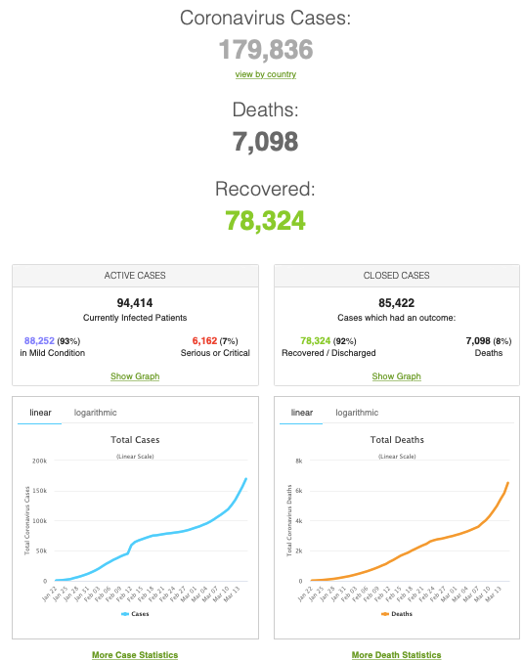
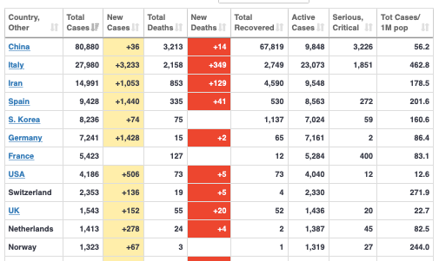
MOAR Coronavirus!
As of March 21: Things are not moving in the right direction:
What is the R0?
How can the R0 be changed?
How will the R0 change?
What is the asymptote share of the population?
What is the mortality rate?

Slide 27
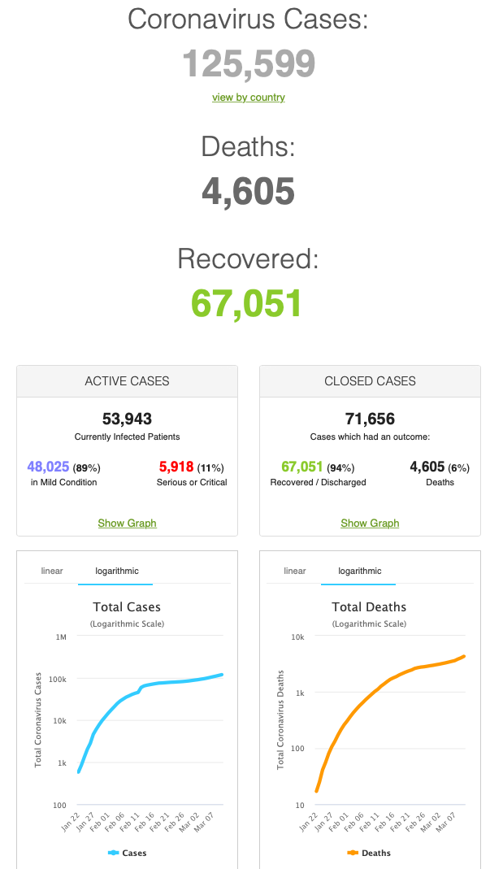
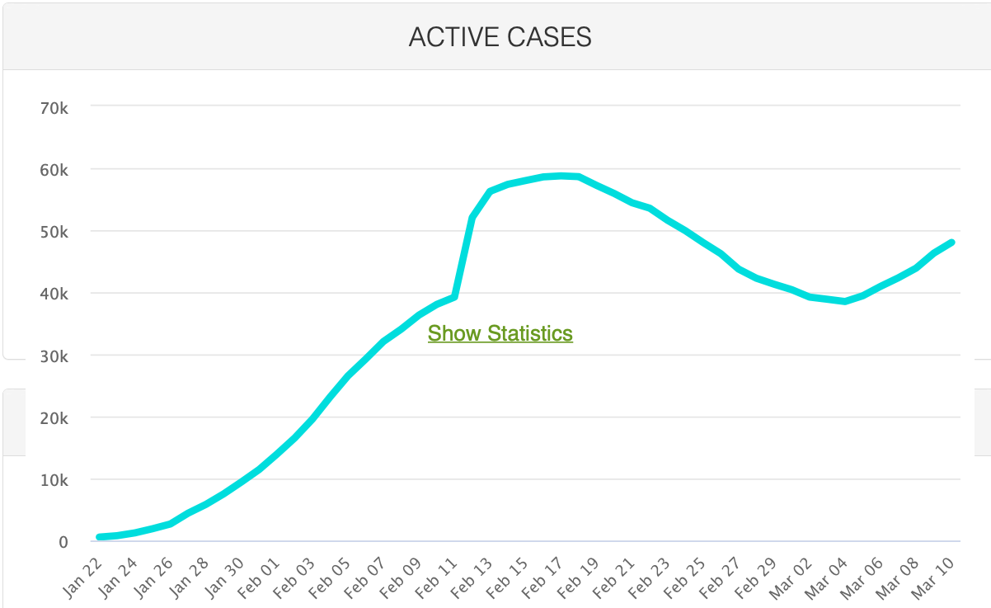
MOAR Coronavirus!
As of March 10: Things are not moving in the right direction:
What is the R0?
How can the R0 be changed?
How will the R0 change?
What is the asymptote share of the population?
What is the mortality rate?

Slide 28
Notes

