Slide 1
Econ 210a: Introduction to Economic History: Introduction/Malthusian Economies (January 22, 2020)
J. Bradford DeLong
Spring 2019
Evans 648
W 1:10-3:00 pm
<https://bcourses.berkeley.edu/courses/1487686/>

Slide 2
Outline…
Econ 210a: Logistics <https://www.icloud.com/keynote/0ERlxVwhRxr2D5cnMk0qowrJg>
Who we are…
Why Economic History <https://www.icloud.com/keynote/0zXitPzTmn_VjnTB0str8Jjhg>
A Word on Lecture vs. Discussion… <https://www.icloud.com/keynote/0vJOK4LT-gQ54Dd5S5RQRn1FQ>
Insights History Provides to the Practicing Economist? <https://www.icloud.com/keynote/0v-mm05tqOe0nkaU2TuOUzIAw>
Readings: Malthusian Economies <https://www.icloud.com/keynote/0HNRgTZRZRLikEXuKRARGgdBA>
Readings: Opinions on the Point of Economic History <https://www.icloud.com/keynote/0qxY-UGeEjom7SGGpw2qDMM2Q>
Looking forward to Commercial Revolutions <https://www.icloud.com/keynote/0vWsOF2kY_DRIbVaPsy6YqOLg>

Slide 3
Logistics
Brad DeLong Office Hours TBA Evans 691A & by appointment—email delong@econ.berkeley.edu…
Weekly memos due Tu @ 5 pm: bcourses assignment page 200-300
Paper!
Discuss topic in first month
Prospectus due 5 pm Friday before spring vacation
Presentation (short)
Final paper
We do have to give grades—timeliness a welcome source of identifying variance here…

Slide 4
What Is Econ 210a?
Economics 210a required of Econ Ph.D. students
Must pass with a B or better, or else…
A selection of hopefully-useful themes from the contemporary economic history literature
Emphasis on insights history can provide to the practicing economist
More about this anon…
Class meetings consist of a mixture of lecture and discussion.
Because discussion will focus on issues raised by the assigned readings, readings should be completed before class.
To that end, we ask for a one-page memo (200-300 words) submitted via bCourses before 4 PM on the Tuesday before each lecture…

Slide 5
How Is Econ 210a Graded?
Your grade will be based:
50 percent on one-page memos due at 4 pm the Tuesday before each class—submitted via bCourses via the “Assignments” tab…
50 percent on the research paper
Partly on the synopsis you submit prior to spring break
Mostly on the paper you submit at the end of instruction.
Substantial extra credit will be given for informed classroom discussion

Slide 6
What Are the Weekly Memos?
A short memo on each week’s readings is due the afternoon before the beginning of the class in which those readings are discussed.
Typically the week’s question will be posted on the Thursday six days before the class when your memo is due.
Your memos should be one page (200-300 words): bCourses for submissions
Memos cannot be exhaustive or provide definitive answers.
But they can explain why a question is important, and they can draw on assigned readings to answer it.
Not surveys: question-answering…

Slide 7
What Is the Paper?
Papers are due at the end of the semester:
Send an electronic copy via bCourses
The paper should not exceed 25 pages.
The writing and submission process involves benchmarks:
Discuss your paper topic during office hours with one of your instructors during the first month of the semester
Sign up for this appointment before the end of January 31
Submit a brief paper prospectus before spring break)
Give a brief April presentation of paper-in-progress
Submit final paper…

Slide 8
What Should the Paper Do?
Provide new evidence and analysis of a topic in economic history—not just summarize a literature.
Use the tools of economics to pose and answer as best you can a historical question.
Do not merely relabeling the variables in theoretical models taught elsewhere, or simply apply new statistical techniques to old data.
The topic must genuinely involve the past. (What is the economic past? One answer is a period when the economic environment was significantly different from today. You as author and researcher must make the case.)
Comparisons of past and current events are fine, but excessive focus on developments in recent decades is likely to be problematic.

Slide 9
Successful Papers…
Your graduate career (indeed your entire career) will center on identifying interesting questions.
Here we mention, by way of illustration, some kinds of topics that have been successful:
A comment on an existing paper.
Historical roots or counterparts to a modern development you are interested in.
Data serendipity.
A new way of testing a hypothesis in the historical literature
Just as one should be on the lookout for interesting sources, one should also be thinking about interesting events.
Model papers from the past:
Marc Dordal i Carreras (2015): U.S. Banking Panics and the Credit Channel: Evidence from 1870-1904 <http://delong.typepad.com/econ_history_marc_dordal.pdf>
Daniel Gross (2016): Scale versus Scope in the Diffusion of New Technology: Evidence from the Farm Tractor <https://delong.typepad.com/gross-scale.pdf>
Petra Moser (2005): How Do Patent Laws Influence Innovation?: Evidence from Nineteenth-Century World Fairs <https://delong.typepad.com/w9909.pdf>
Jacob P. Weber (2018): Patterns in British Height: 1770-1845 <https://delong.typepad.com/jacob-p.-weber-heightpaperfinal-x.pdf>
Sreeraahul Kancherla (2018): The Effect of Monetary Transportation Costs on Immigration: Evidence from Transatlantic Migration <https://delong.typepad.com/files/kancherla-210a-paper.pdf>

Slide 10
Why Economic History?
Too good at making theories…
Too good at doing econometrics…
Is a theoretical result an interesting constraint on reality or a demonstration of the ingenuity of the researcher? Is an econometric-empirical result a robust finding about the world out there or a demonstration that research assistants desperate to please jet-setting tenured bosses can do amazing things?
This is not to say that things were not worse in the old days
GOOD THEORY IS IN THE END NOTHING BUT DISTILLED AND CRYSTALLIZED ECONOMIC HISTORY!!!!
<https://www.icloud.com/keynote/0zXitPzTmn_VjnTB0str8Jjhg>
<https://www.bradford-delong.com/2019/01/why-economic-history.html>

Slide 11
Why Gather Us All Here W 1-3?
Self study/distance learning/MOOCs—why aren’t we doing that?
The 10% (reading)-25% (lecturing)-75% (discussing) rule…
That means you gotta talk—or this course is going to be much less useful than it could and should be…
The instant-correction-of-misapprehensions principle…

Slide 12
Why Assign Readings?
Why not just dump a bunch of data on you, and ask you to make sense of it?
Why assign these readings? How should readings be chosen?
Why ask you to write about the readings—briefly, briefly—before class?
Why a big paper rather than a midterm and a final exam?

Slide 13
Why Ask You to Write?
Why ask you to write about the readings—briefly, briefly—before class?
Why a big paper rather than a midterm and a final exam?

Slide 14
Important Questions I
When are your midterms?
When are your finals?

Slide 15
Important Questions II
How many of you have read how many of the papers for this week?:

Slide 16
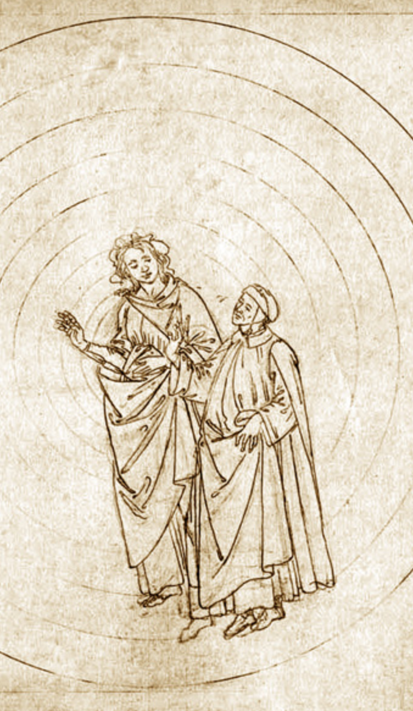
A Word on Lecture vs. Discussion…
This is going to be mostly lecture today…
I very much hope to change that next week…
The Divine Comedy of classroom experiences
Primum Mobile & Empyrean: six students debate with about 3/4 of the rest chiming in (if one of you says something, about a 75% chance it will stick—if Barry or I say something, 25% chance)…
Outer Paradise: two or three students debate with the instructor; most of the rest listen—and follow… (50%)
Purgatory: Lecture… (25%)
Limbo: An airhog… (10%)
Inferno: Like pulling teeth: nobody has done the reading, or those who have don’t see the point of the reading…
Do note that Plato couldn’t sustain #1, even in his imagination…
<https://www.icloud.com/keynote/0vJOK4LT-gQ54Dd5S5RQRn1FQ>

Slide 17
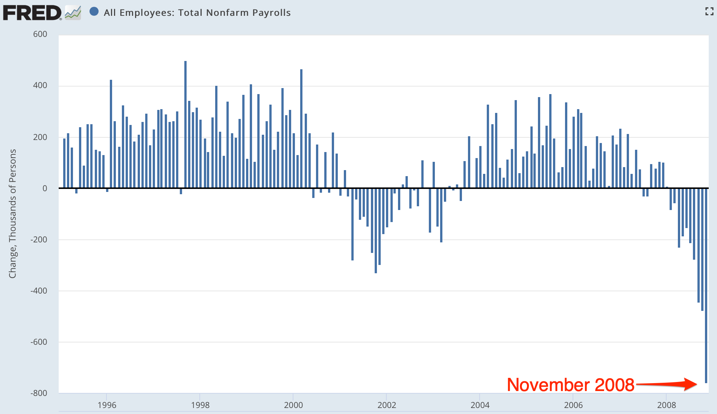
What Are the Insights?
Scene: The Presidential Transition Offices, 8:30 am EST Friday December 5, 2008:
Questions:
Just what is going on?
What is the government supposed to be doing to stop it from doing that?
What can our economists tell us about the best policy response?

Slide 18
Scene: The Bretton Woods Hotel, in Bretton Woods, NH, in April 2011
Martin Wolf: How far do you feel that what we have experienced in the last few years suggests that economists just did not understand what was going on?
Larry Summers: There are things economists did not know. There are things economists were wrong about. And there are things where some economists were right…
…When I was in the government, I got a lot of papers…. I attempted to read all of the ones that used the words "leverage," "liquidity," "deflation," or “depression”… I attempted to read none of the ones that used the words "neoclassical," "choice-theoretic," "real business cycle," or "optimizing model of”. There were more in the second…

Slide 19
Bretton Woods Hotel II
Larry Summers (cont.): …But there were a reasonable number in the first. And they told you a lot. There is a lot in [Walter] Bagehot['s 1873 Lombard Street] about the crisis we just went through. There is more in [Hyman] Minsky. And there is still more in [Charles] Kindleberger['s 1978 Manias, Panics, and Crashes]….
There are enormous amounts that are essentially distracting, confusing, and problem-denying in the stuff that is the substance of the first year course in Ph.D. programs. I think economics knows a fair amount. I think economics has forgotten a fair amount that is relevant. And it has been distracted by an enormous amount…

Slide 20
Bretton Woods Hotel III
Larry Summers (cont.): …People who were practical understood… liquidity finding its way into… asset price inflation and being problematic… but those concepts were at the very edge—or in many cases not even at the very edge—of contemporary macroeconomics, to the great detriment of contemporary macroeconomics.
The wisdom that is in the Bagehot-Minsky-Kindleberger-Eichengreen-Akerlof-Shiller… runs way ahead of those who bring negative attitudes to economics.… We make a serious mistake when we throw the baby out with the bathwater….
But… the vast edifice in both its new Keynesian variety and its new classical variety of attempting to place microfoundations under macroeconomics was not something that informed the policy-making process in any important way…

Slide 21
Insights: Warsh on Shapiro and Varian’s Information Rules
David Warsh: As they increasingly were drawn into the policy battles of the information age, Shapiro and Varian heard the constant refrain… the old rules had been broken; a new set of principles was required to guide business strategy and public policy…. But, they said, ou don't need a brand-new economics. You just need to see the really cool stuff. Incompatible standards… Edison and Westinghouse in electricity…. Neither positive feedback and network externalities… is… recent…. Railroads, highways, electricity grids, television, e-mail: all obey the same basic principles…

Slide 22
Insights: Solow
Robert Solow: Complicated system... cannot conduct controlled experiments... a social science... subject to Damon Runyon's Law that nothing between human beings is more than three to one... narrowly economic activity is embedded in a web of social institutions, customs, beliefs, and attitudes….
As soon as time-series get long enough to offer hope of discriminating among complex hypotheses, the likelihood that they remain stationary dwindles away, and the noise level gets correspondingly high. Under these circumstances, a little cleverness and persistence can get you almost any result you want….
If the project of turning economics into a hard science could succeed, it would surely be worth doing. No doubt some of us should keep trying….
The economic historian can ask whether this or that [model-]story rings true when applied in earlier times or other places, and, if not, why not... offer… a sense of the variety and flexibility of social arrangements... the interaction of economic behavior and other social institutions…

Slide 23
Insights: Arrow
Kenneth Arrow: The use of economic history as a source of empirical evidence for testing theories and estimating relations....
A second use… historical conditioning… national or cultural conditioning…. Cultural differences between nations, with all their implications for polity and economy, are precipitates of past events.... It will always be true that practical understanding of the present will require knowledge of the past...

Slide 24
Insights: The Lesson
ECONOMIC THEORY IS NOTHING BUT CRYSTALIZED HISTORY

Slide 25
Malthusian Economies: Readings for January 23…
A brief introduction…
Four papers:
Jared Diamond (1987), “The Worst Mistake in the History of the Human Race,” Discover <http://discovermagazine.com/1987/may/02-the-worst-mistake-in-the-history-of-the-human-race> <https://www.icloud.com/keynote/0zxW4kbYZdg4IxjhmsLaOJDhA>
Richard Steckel (2008), "Biological Measures of the Standard of Living," Journal of Economic Perspectives 22:1 Winter), pp. 129-52 <http://www.aeaweb.org/articles.php?doi=10.1257/jep.22.1.129> <https://www.icloud.com/keynote/0bb0qK4PFlXfY2xlQmUZl1rjQ>
Gregory Clark (2005), “The Condition of the Working Class in England, 1209–2004,” Journal of Political Economy 113 (December), pp. 1307–1340 <www.jstor.org/stable/pdfplus/10.1086/.pdf> https://www.icloud.com/keynote/0528R1DULwv4FG3FC7l4LND6A>

Slide 26
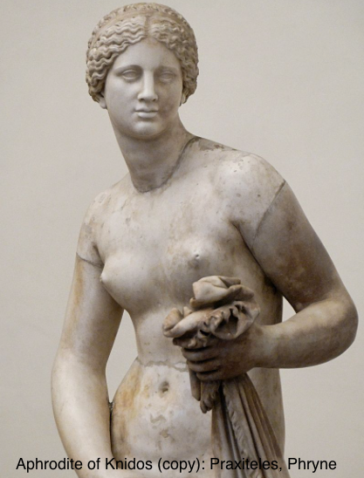

“Ancient” Ain’t “Primitive” or “Unsophisticated”, Is It?
Could we teach:
Themistokles or Augustus much about politics?
Homer much about writing poetry?
Gaius Julius Caesar or Leonidas much about generalship?
Sophokles much about drama?
Phryne much about presentation-of-self-as-celebrity?
Michelangelo di Lodovico Buonarroti Simon much about painting ceilings?
Praxiteles much about sculpture?
Johann Sebastian Bach much about music?

Slide 27

The Default State? How Was It Exited?
Malthusian Agrarianism—near-stagnation—as the default state of post-Neolithic humanity?
Exit:
Industrial Revolution
Modern Economic Growth
Reentry?
Astronomy and the Fermi Paradox: The Great Filter
Notes?

Slide 28
Readings for January 23…
Jared Diamond (1987), “The Worst Mistake in the History of the Human Race,” Discover <http://discovermagazine.com/1987/may/02-the-worst-mistake-in-the-history-of-the-human-race> <https://www.icloud.com/keynote/0zxW4kbYZdg4IxjhmsLaOJDhA>
Richard Steckel (2008), "Biological Measures of the Standard of Living," Journal of Economic Perspectives 22:1 Winter), pp. 129-52 <http://www.aeaweb.org/articles.php?doi=10.1257/jep.22.1.129> <https://www.icloud.com/keynote/0bb0qK4PFlXfY2xlQmUZl1rjQ>
Gregory Clark (2005), “The Condition of the Working Class in England, 1209–2004,” Journal of Political Economy 113 (December), pp. 1307–1340 <www.jstor.org/stable/pdfplus/10.1086/.pdf> <https://www.icloud.com/keynote/0528R1DULwv4FG3FC7l4LND6>

Slide 29
Jared Diamond: The Worst Mistake in the History of the Human Race
“The mix of wild plants and animals in the diets of surviving hunter-gatherers provides more protein and a better balance of other nutrients…”
“Bushmen’s average daily food intake (during a month when food was plentiful) was 2,140 calories and 93 grams of protein, considerably greater than the recommended daily allowance for people of their size…”
“It’s almost inconceivable that Bushmen, who eat 75 or so wild plants, could die of starvation the way hundreds of thousands of Irish farmers and their families did during the potato famine of the 1840s…”
“Skeletons from Greece and Turkey show that the average height of hunger-gatherers toward the end of the ice ages was a generous 5' 9'' for men, 5' 5'' for women. With the adoption of agriculture, height crashed, and by 3000 B. C. had reached a low of only 5' 3'' for men, 5' for women…”
“Besides malnutrition, starvation, and epidemic diseases, farming helped bring another curse upon humanity: deep class divisions…”
<https://www.icloud.com/keynote/0zxW4kbYZdg4IxjhmsLaOJDhA>

Slide 30
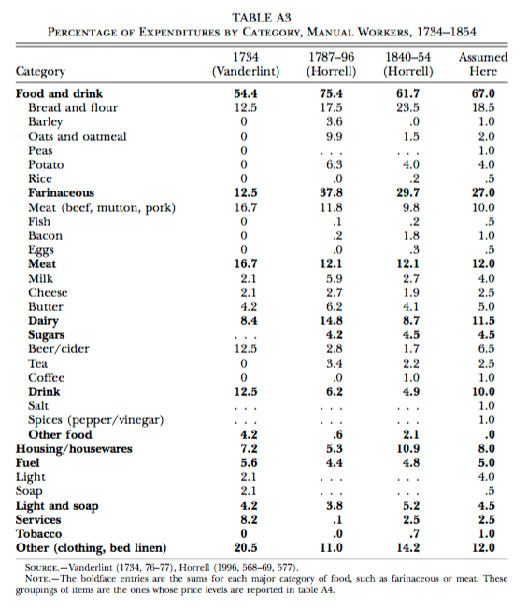
Gregory Clark: The Condition of the Working Class in England, 1209–2004
What did the working-class spend its money on in the past?
Even in the 1880s, the U.S. working class—the richest in the world—was spending something like 40% of marginal income dollars on simply getting more calories.
A still-remarkable degree of nutritional stress

Slide 31
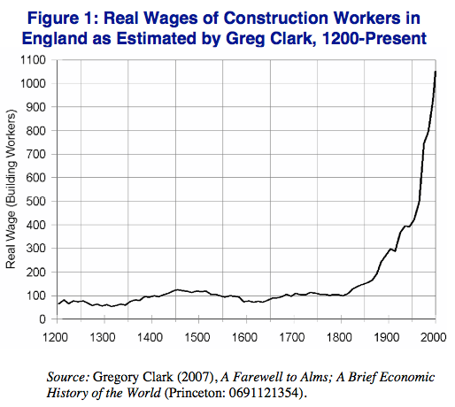
Greg Clark: Direct Estimates of Long-Run Real Wage Trends
We know what monks paid their construction workers.
We know what bread and other staples cost.
Questions about whether and in what sense these workers are in representative of broader populations…
<https://www.icloud.com/keynote/0528R1DULwv4FG3FC7l4LND6A>

Slide 32
Notes…
Hunters and Gatherers: Background <https://www.icloud.com/keynote/0gpMaqZkyvrfqgrfeFkSdZhrA>
Humans as an Anthology Intelligence <https://www.icloud.com/keynote/0mXqcK7TUGGJGZdud0ODZJjSg>
Historical Patriarchy <https://www.icloud.com/keynote/00hc0TFwhajEqn5JFBPhNbTog>
Malthusian Economic Growth <https://www.icloud.com/keynote/0Dy-Qg7Z__2fBvaECGbKVCvIg>
The Figure < https://www.icloud.com/keynote/0ysTdN41E5B7qCmwuB35WJtOQ>

Slide 33
Catch Our Breath…
Ask a couple of questions?
Make a couple of comments?
Any more readings to recommend?

Slide 34
Readings for January 30: Commercial Revolutions…
A brief introduction…
Four papers:
Moses Finley (1965), "Technical Innovation and Economic Progress in the Ancient World," Economic History Review NS 18:1, pp. 29-45 http://www.jstor.org/stable/2591872
Michael Kremer (1993), "Population Growth and Technological Change: One Million B.C. to 1990," Quarterly Journal of Economics 108:3 (August), pp. 681-716 http://www.jstor.org/stable/2118405
Jeremiah E. Dittmar (2011), “Information Technology and Economic Change: The Impact of the Printing Press,” Quarterly Journal of Economics 126 (August), pp. 1133–1172. http://qje.oxfordjournals.org/content/126/3/1133.abstract
J. Bradford DeLong and Andrei Shleifer (1993), “Princes and Merchants: European City Growth before the Industrial Revolution,” Journal of Law & Economics 36, pp. 671-702. http://www.jstor.org/stable/725804
<https://www.icloud.com/keynote/0vWsOF2kY_DRIbVaPsy6YqOLg>

Slide 35
Memo Question for Commercial Revolutions
Commercial Revolutions: Memo Question for January 30 Class: Between the discovery of agriculture and the year 1500 or so, in the large we see an economic world in which (a) total factor productivity growth was very, very slow, and (b) as a result the overwhelming effect of technological progress was not to raise standards of living above "bare subsistence" but rather to increase human numbers.
For this week we have four readings:
one on why technological progress was so slow,
one on how it was nearly inevitable that sooner or later it would start to accelerate,
and two on key societal innovations:
the printing press on the one hand
merchant-governed city-states plus (later) semi-representative larger polities.
Pick one of these four papers and examine what you think is the weakest link in its chain of argument. How weak is that link? How much of a difference does the weakness of that link make?

Slide 36
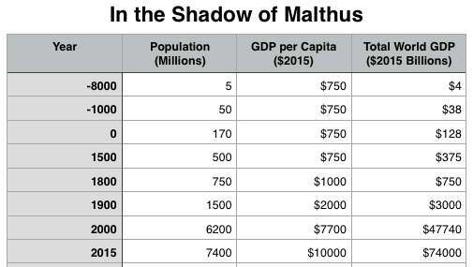
The Commercial Revolution Era
0-1500: ln(3)/1500 = 1.1/1500 = 0.0007 = 0.07%/year
1500-1800: ln(2)/300 =0.7/300 = 0.0023 = 0.23%/year…

