Slide 1
Lecture 23b:
6.3. Growth and Fluctuations
Brad DeLong
Department of Economics & Blum Center, U.C. Berkeley; & WCEG
last revised: Su 2020-04-22
for presentation: Th 2020-04-28
Original course by Melissa Dell (Harvard Econ 1342), revised by Brad DeLong
<https://github.com/braddelong/public-files/blob/master/econ-135-lecture-23b.pptx>
<https://www.icloud.com/keynote/084re518a99VkRd-NbEHkMMmw>

Slide 2

Final Paper

Slide 3
Discussion
Growth and Fluctuations:
What strikes you as important here?

Slide 4
Growth and Fluctuations
Tu Apr 28: 6.3. Growth and Fluctuations:
Read Before: Barry Eichengreen (2015): Hall of Mirrors: The Great Depression, The Great Recession, and the Uses-and Misuses-of History, selections <https://github.com/braddelong/public-files/blob/master/readings/book-eichengreen-selections-mirrors.pdf>
Read Before: Brad DeLong (2020): The Near-Second Great Depression <https://github.com/braddelong/public-files/blob/master/econ-115/Slouching%3F%2024%20The%20Near-Second%20Great%20Depression%202019-09-01.pdf>
Slides: <https://github.com/braddelong/public-files/blob/master/econ-135-lecture-23b.pptx>
Discussion Thread: <https://bcourses.berkeley.edu/courses/1487685/discussion_topics/5756990>

Slide 5
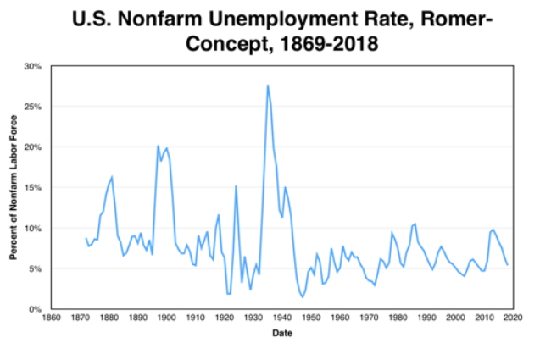
The Size of the Great Depression
The Great Depression stands out:
Is it drawn from the same distribution as the rest—is it the same processes at work, but just the first order statistic of data realizations?
Or is it a unique eruption from some other distribution, produced by other causes than those that produced “normal” business cycles
And what about the Grover Cleveland recession?
4:00

Slide 6
The Roots of Macro I: Destructive Price Signals
A market economy has nominal wages (and prices) and nominal debts:
Both can send “shutdown” signals
If real wage is too high, workers aren’t worth employing
If real debts are too high, firms aren’t worth financing
Both real wages and real debt levels are valuable microeconomic signals
But macroeconomic distress can lead a lot of wrong signals being sent all at once
The kicker: more flexible downward wages mean fewer “w/p shutdown” signals sent, and more “D/p” shutdown signals sent

Slide 7
The Roots of Macro II: Say’s Law
Does “supply create its own demand”?:
Can there be a “general glut”?
Say (1803) said: “no”. Excess supply for one commodity is excess demand for another
Part of the work of economic adjustment to an optimal configuration
Malthus (1820) said: “WTF!?”. Kamschatka
Say (1829) said: “yes”.
Mill (1829) said: excess demand for money is excess supply for pretty much all currently-produced goods-and-services, and for labor
Why is money special?
When there is excess demand for some other commodity, you try to buy more of it…
When there is excess demand for money, you can try to buy more of it—by working harder and selling more stuff—but the easiest, quickest, and most effective way to satisfy your excess demand for money is to spend less.
And your spending is someone else’s income
Why can’t the excess demand for money be satisfied by banks’ making it? Sometimes it can. But we are concerned with those times when it can’t…

Slide 8
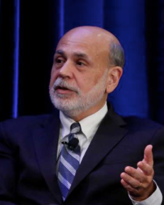
Ben Bernanke
The Macroeconomics of the Great Depression: A Comparative Approach:
<https://github.com/braddelong/public-files/blob/master/readings/article-bernanke-macroeconomics-great-depression.pdf>
Bernanke’s view seems to be that two prices need to be “right”:
w/p
r = i - π + ρ
w is, for reasons that Bernanke finds mysterious, “sticky”
falls in the wage and price levels that might restore w/p and M/p to full employment levels drive ρ through the roof
Fix a Great Depression by boosting M
This view now looks rather naive…
Bernanke also of interest because he was in the hot seat over 2008-2014…

Slide 9
The Problem with Bernanke
He tried to apply his view of the world in the Great Recession:
And money turned out to be pretty damned near neutral…

Slide 10
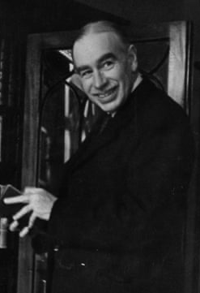
International Evidence on M & Y
Bernanke regards this as conclusive:
“Much of the worldwide monetary contraction of the early 1930s was… the largely unintended result of an interaction of poorly designed institutions, shortsighted policy-making, and unfavorable political and economic preconditions…”
“Countries that left gold were able to reflate…”
“Countries remaining on gold were forced into further deflation…”
“Countries that left the gold standard recovered from the Depression more quickly than countries that remained on gold…”
“The strong dependence of the rate of recovery on the choice of exchange-rate regime is further, powerful evidence for the importance of monetary factors…”
1:00

Slide 11
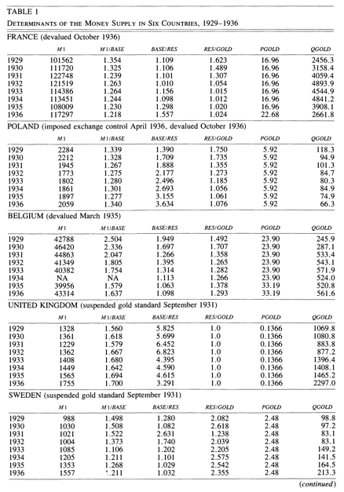
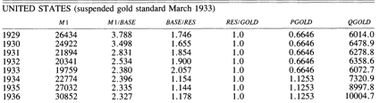
Sources of Declines in M
A multiple-equilibrium story:
“In 1931 and subsequently, the large declines in the money-gold ratio… did not reflect anyone's consciously chosen policy…”
“Under the gold standard as it operated during this period, there appeared to be multiple potential equilibrium values of the money supply…”
M/GOLD = (M/BASE)(BASE/RES)(RES/GOLD)
“Banking panics and exchange-rate crises… by leading to rises in aggregate currency-deposit and bank reserve-deposit ratios, banking panics typically led to sharp declines in the money multiplier, M/BASE… led central banks to substitute gold for foreign exchange reserves… reduced the ratio of total reserves to gold, RES/GOLD… central banks attempted to increase gold reserves and coverage ratios… induced continuing declines in BASE/RES…”
No banking crises and financial panics, no shifts in any of:
M/BASE—multiplier
BASE/RES—cash plus securities to stuff that’s in central bank vaults
RES/GOLD—cover
1:00

Slide 12
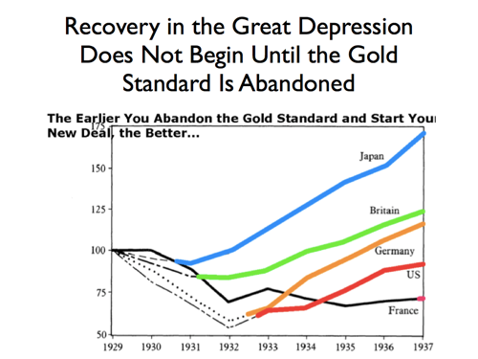
“New Deals” and Economic Recovery
Among the major industrial powers:
Correlation one-for-one:
Takehishi Korekiyu in Japan
Montagu Norman’s nervous breakdown in Britain
Adolf Hitler in Germany
Franklin Delano Roosevelt in America
Leon Blum in France
Confirmed by a broader panel
Problem with Bernanke’s interpretation: fiscal headroom and international-financial benefits of abandoning your exchange rate peg as well

Slide 13
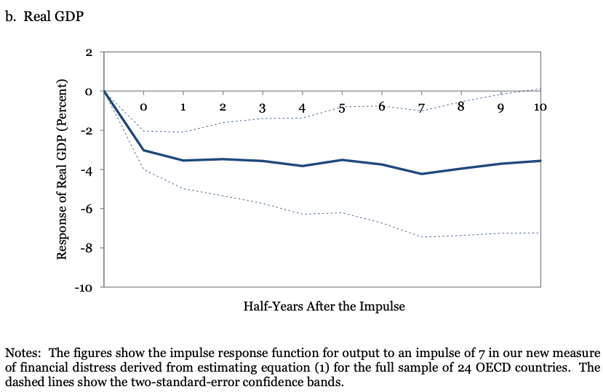
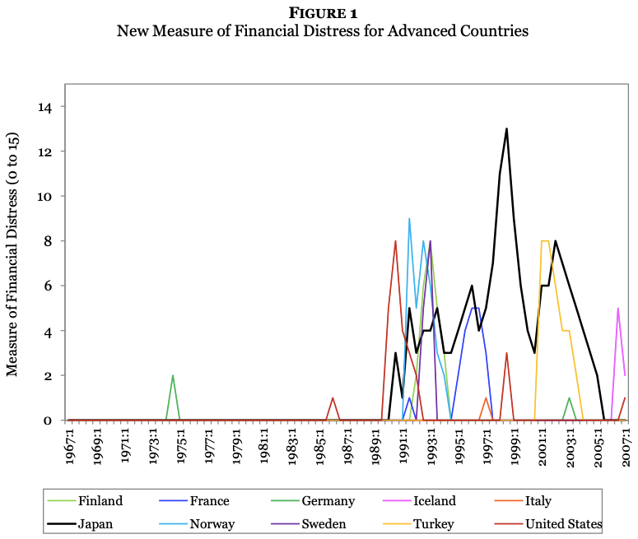
Long-Term Growth Damping from Financial Distress 1967-2007
Christina D. Romer & David H. Romer: New Evidence on the Impact of Financial Crises in Advanced Countries:
<https://github.com/braddelong/public-files/blob/master/readings/article-romer-romer-new-evidence.pdf>:
Output declines following financial crises in modern advanced countries are highly variable, on average only moderate, and often temporary. One important driver of the variation in outcomes across crises appears to be the severity and persistence of the financial distress itself…
In the forty years before the 2008 global financial crisis, the output declines following financial crises in advanced countries were on average moderate and largely temporary…
For GDP, the effects are more persistent… driven entirely by the experience of Japan, which had a large and prolonged slowdown in GDP growth starting around the same time as its financial distress…
1:00

Slide 14
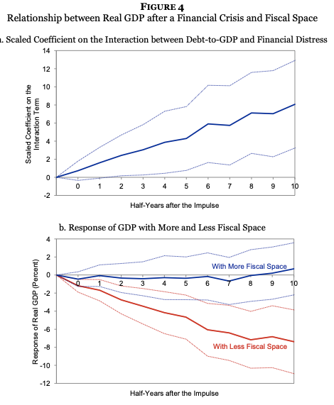
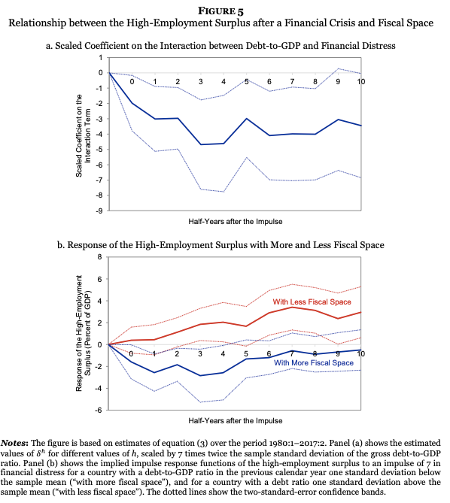
Choosing Austerity
Christina D. Romer & David H. Romer: Fiscal Space and the Aftermath of Financial Crises: How It Matters and Why:
<https://github.com/braddelong/public-files/blob/master/readings/article-romer-romer-fiscal-space.pdf>:
In OECD countries over … 1980–2017, countries with lower debt-to-GDP ratios responded to financial distress with much more expansionary fiscal policy and suffered much less severe aftermaths….
Contemporaneous accounts… show a number of cases where shifts to austerity were driven by problems with market access…
but [in] at least as many… shifts resulted from policymakers’ choices…
1:00

Slide 15
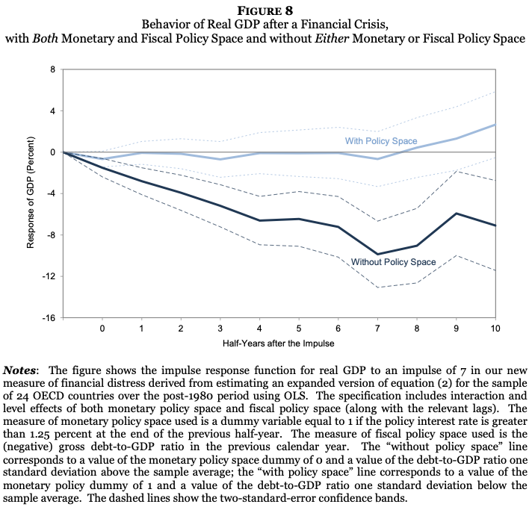
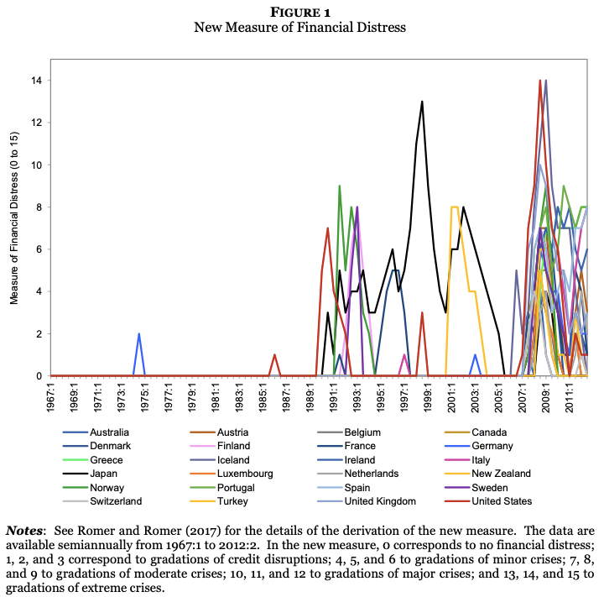
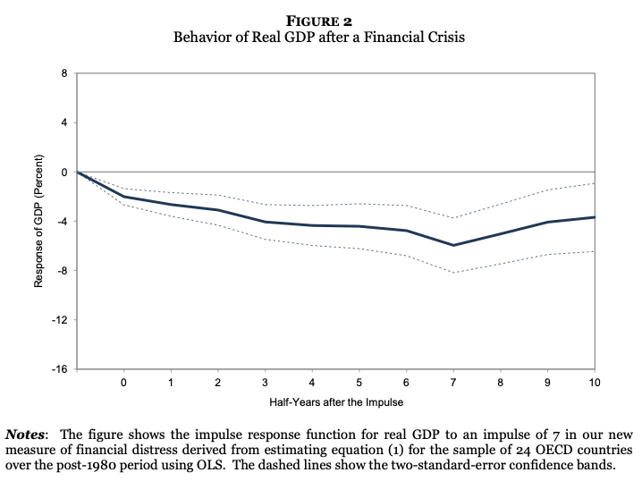
“Policy Space” & Long-Term Growth Damping 1980-2015
Christina D. Romer & David H. Romer: Why Some Times Are Different: Macroeconomic Policy and the Aftermath of Financial Crises:
<https://github.com/braddelong/public-files/blob/master/readings/article-romer-romer-times-different.pdf>:
24 advanced economies in the postwar period…. The degree of monetary and fiscal policy space prior to financial distress… greatly affects the aftermath of crises. The decline in output… is less than 1 percent when a country possesses both types of policy space, but almost 10 percent when it has neither…. Monetary and fiscal policy are used more aggressively when policy space is ample. Financial distress… is… less persistent when there is policy space…
1:00

Slide 16
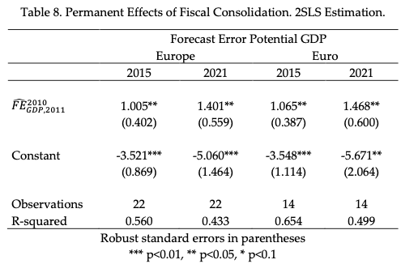
At Least Some Depressions Cast Very Long Shadows
Antonio Fatás & Lawrence H. Summers: The Permanent Effects of Fiscal Consolidations:
<https://github.com/braddelong/public-files/blob/master/readings/article-fatas-permanent-consolidations.pdf>
“It suggests that not only the temporary effects of fiscal consolidation do not die out over time but that the long-term effects are likely to be larger than the initial ones. Every 1% fiscal-policy-induced decline in GDP during the years 2010-11 translated into a 1% decline in potential output by 2015 and even more for 2021…”
This came as a surprise: the expectation was that depressions would be followed by a bounce-back to near the old potential…
But in the past—before 2010—central banks had not been out of ammunition, and had thought that they should direct monetary policy so as to bring the economy back to the previous potential growth line
But in 2010 they were out of ammo
And fiscal authorities did not fill in the gap—did not spend, but rather pursued policies of “austerity” because they feared the consequences of having outsized government debts.
1:00

Slide 17
“Many Zeroes”
John Maynard Keynes: General Theory of Employment, Interest and Money:
<https://github.com/braddelong/public-files/blob/master/readings/book-keynes-general-theory.pdf>:
“Whilst, therefore, the enlargement of the functions of government, involved in the task of adjusting to one another the propensity to consume and the inducement to invest, would seem to a nineteenth-century publicist or to a contemporary American financier to be a terrific encroachment on individualism, I defend it, on the contrary, both as the only practicable means of avoiding the destruction of existing economic forms in their entirety and as the condition of the successful functioning of individual initiative.
“For if effective demand is deficient, not only is the public scandal of wasted resources intolerable, but the individual enterpriser who seeks to bring these resources into action is operating with the odds loaded against him. The game of hazard which he plays is furnished with many zeros, so that the players as a whole will lose if they have the energy and hope to deal all the cards. Hitherto the increment of the world’s wealth has fallen short of the aggregate of positive individual savings; and the difference has been made up by the losses of those whose courage and initiative have not been supplemented by exceptional skill or unusual good fortune. But if effective demand is adequate, average skill and average good fortune will be enough…
1:00

Slide 18
Readings
Required:
Barry Eichengreen (2015): Hall of Mirrors: The Great Depression, The Great Recession, and the Uses-and Misuses-of History, selections <https://github.com/braddelong/public-files/blob/master/readings/book-eichengreen-selections-mirrors.pdf>
Brad DeLong (2020): The Near-Second Great Depression <https://github.com/braddelong/public-files/blob/master/econ-115/Slouching%3F%2024%20The%20Near-Second%20Great%20Depression%202019-09-01.pdf>
Optional:
Antonio Fatás & Lawrence H. Summers: The Permanent Effects of Fiscal Consolidations <https://github.com/braddelong/public-files/blob/master/readings/article-fatas-permanent-consolidations.pdf>
John Maynard Keynes (1936): The General Theory of Employment, Interest and Money <https://github.com/braddelong/public-files/blob/master/readings/book-keynes-general-theory.pdf>
Christina D. Romer & David H. Romer: Fiscal Space and the Aftermath of Financial Crises: How It Matters and Why <https://github.com/braddelong/public-files/blob/master/readings/article-romer-romer-fiscal-space.pdf>
Christina D. Romer & David H. Romer: New Evidence on the Impact of Financial Crises in Advanced Countries <https://github.com/braddelong/public-files/blob/master/readings/article-romer-romer-new-evidence.pdf>
Christina D. Romer & David H. Romer: Why Some Times Are Different: Macroeconomic Policy and the Aftermath of Financial Crises <https://github.com/braddelong/public-files/blob/master/readings/article-romer-romer-times-different.pdf>

Slide 19
Big Ideas: Lecture 23b: Growth and Fluctuations
Takeaways from this class:

Slide 20
Catch Our Breath…
Ask a couple of questions?
Make a couple of comments?
Any more readings to recommend?

Slide 21

Notes, etc.…

Slide 22
The Great Depression and the Great Recession
Barry Eichengreen (2015): Hall of Mirrors: The Great Depression, The Great Recession, and the Uses-and Misuses-of History:
<https://github.com/braddelong/public-files/blob/master/readings/book-eichengreen-selections-mirrors.pdf>:
“The lessons of the Great Depression,” shaped the response to the events of 2008–09…
Because those events so conspicuously resembled the 1930s, that earlier episode provided an obvious lens through which to view them…
As a result of the lessons policy makers drew, they prevented the worst…
In doing so, their decisions were powerfully informed by received wisdom about the mistakes of their predecessors. Governments in the 1930s:
succumbed to the protectionist temptation…
cut public expenditure at the worst possible time…
Not only did their measures worsen the slump, but they failed even to restore confidence in the public finances…
Central bankers, for their part, were in thrall to the real bills doctrine…
In 2008, heeding the lessons of this earlier episode, policy makers vowed to do better…
Because policy was better, the decline in output and employment, the social dislocations, and the pain and suffering were less…
:

Slide 23
This Happy Narrative Is Wrong
Economics did badly; policymakers did badly:
The economics profession as a whole issued only muted warnings…
Policy makers… miss[ed] the consequences of permitting Lehman Brothers to fail…
Postcrisis recovery in the United States was lethargic…. Europe did even worse…
Starting in 2010 the United States and Europe took a hard right turn toward austerity…
Central banks, having taken a variety of exceptional steps in the crisis, were similarly anxious to resume business as usual…
Much may have been learned about the case for fiscal stimulus from John Maynard Keynes and other scholars whose work was stimulated by the Great Depression, but equally much was forgotten…
The most powerful factor of all in this turn to austerity was surely that policy makers prevented the worst…
Democracy survived, unlike the 1930s…
1:00

Slide 24
This Happy Narrative Is Wrong
Economics did badly; policymakers did badly:
There has been much debate about who was right and who was wrong in this contest between the proponents of direct pressure and higher interest rates. In the light of recent experience, the answer is clear. We now understand that the best response for a central bank confronted with this kind of dilemma is to assign monetary policy, in this case its lending rate, to the needs of the economy while using regulatory tools like ceilings on loan-to-value ratios for home mortgages and limits on lending to particular sectors (what we would now call macroprudential policy) to address financial risks. This was precisely the intuition of those who advocated direct pressure in 1929: leave interest rates at a level appropriate for the economy and use other tools to limit lending to the stock market.
We now better appreciate the value of that intuition, because this is pre- cisely what the Fed and other US agencies neglected to do in 2005–06, when they failed to use macroprudential policy to clamp down on the flow of credit into US housing markets. Here is a clear case where the events of 2007–08 change how we think about 1929. Real bills may be a discredited doctrine, but the macroprudential policies espoused by Adolph Miller look considerably more sage and sensible in this light.
The problem in 1929 was implementation. It was that the central bank’s macroprudential tools were weak. The Fed could apply direct pressure only to member banks, leading to the substitution of nonmember and nonbank credit for bank credit to the stock market. This is a problem for modern mac- roprudential policy as well: when the authorities attempt to limit bank lend- ing to a particular market, the property market for example, they see some substitution of nonbank credit for bank credit.28 The solution is to give the macroprudential policy maker regulatory authority over nonbank providers of credit—over insurance companies and the like—as well as over banks. It is to set the “regulatory perimeter” as wide as possible….
Fed Governor Ben Bernanke gave a speech in 2002 in which he warned against using monetary policy to prick a bubble, pointing to the catastrophic implications of the Fed’s attempt to do so in 1929. But he then went on, curiously, to also dismiss the 1920s policy of direct pressure as ineffectual.29 A better approach, he implied, was for the central bank not to attempt to lean against a bubble but rather to flood the markets with liquidity if it bursts. We now know that flooding the market with liquidity, or at least flooding the part of the market the Fed is capable of flooding, may not be enough to avert the worst. Better is to strengthen tools like direct pressure rather than to dismiss them because their effects are weak. But this was a lesson that the Bernanke Fed would have to learn the hard way.
1:00

Slide 25
This Happy Narrative Is Wrong
Economics did badly; policymakers did badly:
Glass-Steagall was finally euthanized by Gramm-Leach-Bliley, which repealed residual restrictions on combining commercial banking, investment banking, and insurance underwriting, in November 1999. Weill proudly mounted a four-foot slab of wood on his office wall, etched with his portrait and the words “The Shatterer of Glass Steagall.” Much later, in 2012, reflecting on the crisis, he acknowledged that removal of the Glass-Steagall restrictions had been a terrible mistake.13
The abolition of Glass-Steagall closed a chapter in US financial history. But it was also indicative of a broader deregulatory trend. Other manifestations included the Riegle-Neal Interstate Banking and Branch Efficiency Act of 1994, which repealed prohibitions on cross-state branching and opened the door to mega-banks. Likewise, the Commodity Futures Modernization Act (CFMA) of 2000 eliminated federal and state regulatory oversight of financial derivatives. CFMA relieved issuers of credit default swaps from having to hold reserves against the possibility that they would actually have to make pay- ments to purchasers of those instruments. Credit default swaps (CDS) had been designed to allow investors in mortgage-backed securities to insure themselves against default on the mortgages in the underlying pool. Now, however, CDS were purchased by buyers who did not also purchase the asset against whose default the insurance was written but simply wished to bet against the hous- ing market. The decision in 2000 to relieve issuers of the obligation to hold reserves against liabilities associated with these contracts would have momen- tous implications for what followed.
And where deregulation could not be achieved by legislation, it proceeded by fiat. The activist chair of the Commodity Futures Trading Commission, Brooksley Born, was forced out in 1999 by a hostile Fed chairman and treasury secretary after recommending against further deregulation of derivatives. The Securities and Exchange Commission (SEC), under the more accommodating Harvey Pitt and William Donaldson, then loosened its rules for the financial reserves that had to be held by the brokerage units of banks.
Nor was deregulation limited to the United States
1:00

Slide 26
This Happy Narrative Is Wrong
Economics did badly; policymakers did badly:
no one factor explains the deregulation of banking and financial services. Memories of how banks had collapsed in the 1930s faded with time. Foreign competition created pressure to eliminate restrictions on the range of permis- sible bank activities. Financial innovation, from development of new lending instruments to establishment of money market mutual funds, undermined the effectiveness of existing regulation
The result of these measures was a massive increase in the size, complexity, and leverage of US financial institutions. After having remained stable for more than two decades, the share of the financial-services industry in GDP more than doubled from 4 percent in the early 1970s to 8.3 percent in 2006.19 Some of this growth was natural recovery from the turbulent 1930s and post–World War II years. It can be seen as the financial sector reasserting its role in helping to allocate resources in a complex modern economy. But the remainder, and especially the breakneck financialization of the years leading up to the crisis, is not adequately explained by standard models of the efficiency advantages of a well-functioning financial sector.
Moreover, the growth of the sector was financed to a considerable extent not with equity—not by banks raising more capital—but with debt. The debt in question was incurred by borrowing for a fixed, typically short term from corporations, mutual funds, state and municipal governments, government agencies, and not least other banks. Large banks had the best access to this so-called wholesale money market.20 Having diversified their business and invested in internal controls, they could argue that they were in the best posi- tion to manage the risk of relying on borrowed funds.
Large banks were also in the best position to create the special purpose vehicles used to shift risky assets off balance sheet, minimizing the amount of capital the parent institution had to raise. They were further incentivized to reduce their capital ratios and increase their leverage by the knowledge that they were systemically significant. Because they were too big to fail, they were apt to be bailed out in the event of trouble. This in turn encouraged them to take on additional leverage and risk.
And what was true of banks in the United States was similarly true of banks elsewhere, notably in Europe
The extreme cases were broker-dealers like Bear Stearns and Lehman Brothers, whose traditional business was trading securities on behalf of their customers. Historically, these firms had maintained large reserves and lim- ited the riskiness of their investment portfolios. Under pressure from com- mercial bank competitors, they now moved from one extreme to the other.
by legislation or fiat 73
In 2007 the typical US commercial bank had a leverage ratio on the order of 12 to 1, measured as the unadorned ratio of assets to shareholders’ equity. Lehman Brothers, by comparison, had a leverage ratio of 30, Bear Stearns 33.21 A leverage ratio of 33 meant that a decline in asset values of just 3 percent could wipe out shareholders’ equity and therefore the firm itself if it was forced to acknowledge those losses.22 As subsequent events would reveal, this was a tenuous position for any financial institution
1:00

Slide 27
This Happy Narrative Is Wrong
Economics did badly; policymakers did badly:
Over time, technological change—development of expensive new computer technology to process transactions, for example—heightened the advantages of scale and made the private partnership model, where the size of the bank was limited by the capital resources of the partners, problematic. It doesn’t take much effort to imagine whose lobbying caused the ban on public listing to be removed in 1970. (Answer: the investment banks.) Merrill Lynch was the first big broker-dealer to go public in 1971, followed by Bear Stearns, Morgan Stanley, Lehman Brothers, and Goldman Sachs, the four other members of what collectively came to be known as “the Big Five.”
Now the CEO, as head of a public company, and those who worked for him, answered (if at all) to the chief risk officer. Management’s interest in the firm was neither illiquid nor long-term. If their risky bets paid off, they earned enormous bonuses. And if big payoffs today were followed by big losses tomorrow, there was no provision for clawing back yesterday’s bonuses (a prac- tice that regulators and shareholders sought to change only after 2008). In principle, the board of directors, representing the shareholders, was supposed to push back against excessive risk taking. But outside directors had limited information and, in many cases, limited ability to assess it. In practice, no one was watching the store.
Regulators, for their part, were no better positioned to restrain risk taking and leverage. They took their cue from the banks rather than the other way around. The SEC loosened capital requirements for broker-dealers in 2004 in response to similar action by the European Union and lobbying by the Big
74 hall of mirrors
Five, whose members feared losing ground to their foreign rivals.
1:00

Slide 28
This Happy Narrative Is Wrong
Economics did badly; policymakers did badly:
Other evidence is less supportive of the indictment. Between 2003 and 2006, the share of mortgages purchased by Freddie Mac and Fannie Mae fell back from 50 to 30 percent.15 In 2003, Freddie Mac revealed that it had mis- stated its earnings by nearly $5 billion. Similar accounting problems then came to light at Fannie Mae. The scandal forced Raines to resign in December 2004.16 In response to these scandals, regulators imposed tighter limits on the GSEs’ lending activities. The share of mortgages held in the form of the asset-backed securities of entities other than Fannie and Freddie then tripled in the three years from 2003, as other financial institutions stepped into the breach. In the late stages of the boom, it was not the GSEs but other financial institutions that were driving the process.
What was true of the market in general was true of its subprime seg- ment in particular. The share of subprime and near-subprime (Alternative A or Alt-A) mortgages originated and securitized by financial institutions other than Fannie Mae and Freddie Mac quadrupled over the period. Between 2004 and 2006, Fannie and Freddie went from holding nearly half of subprime mortgages securitized and sold into the market to holding less than a quarter. At the height of the housing boom, in other words, a growing share of mort- gage credit, in general and to the subprime segment in particular, was being drawn from other sources—that is, from hedge funds, investment banks, and foreign banks that loaded up on mortgage-linked CDOs.
If one wishes to blame Fannie and Freddie for the housing boom, then a more convoluted logic is required. It could be that the private sector, squeezed
82 hall of mirrors
out of the conventional mortgage market by the GSEs, responded by mov- ing into riskier mortgages. Alternatively, it might be argued that Fannie and Freddie’s portfolios had grown so large that their collapse would have desta- bilized the housing market and the economy, something that the George W. Bush administration, its free-market coloration notwithstanding, was anxious to avoid. The Fed, as the administration’s agent, could therefore be expected to do whatever it took to prevent a significant decline in housing prices. This encouraged investors, aware of the situation, to dive headfirst into the deep end of the mortgage securitization pool.
But if the idea was that the “Greenspan-Bernanke put” would place a floor under not just the stock market but also housing prices, then this expectation would prove dreadfully wrong.
.
1:00

Slide 29
This Happy Narrative Is Wrong
Economics did badly; policymakers did badly:
Unfortunately, almost everyone making the connection between Chinese saving and US interest rates focused on what would happen if China’s willing- ness to finance US current account deficits evaporated abruptly, much as US willingness to finance German deficits had evaporated in 1928. US interest rates would shoot up. Cheap foreign finance no longer being available, the US current account deficit would have to be eliminated at a stroke. The dollar, no longer receiving foreign support, would collapse on the foreign exchange market.
We know from subsequent events that the critics were right to worry. But they were wrong to focus on risks to exchange rates and the balance of pay- ments. It was in housing and securitization, and not the foreign-exchange mar- ket, that the critical imbalances built up. Unfortunately, few of those who raised questions about sustainability focused their attention there.
1:00

Slide 30
This Happy Narrative Is Wrong
Economics did badly; policymakers did badly:
But if Harrison and his colleagues understood the need to respond quickly to the financial distress caused by the stock market crash, they understood less well how to respond to subsequent events. So long as the problem was financial distress, they understood it was their responsibility to provide emer- gency liquidity, in contemporary parlance an elastic currency. That the stock market crash placed New York banks at risk was something the directors of the New York Fed readily grasped.
But once the problem became deflation and depression, there was less agree- ment on what to do, if anything. The Federal Reserve System had been created to prevent spikes in interest rates. Its officials knew how to respond when, as a result of financial dislocations, credit temporarily grew scarce relative to the needs of business. There was no consensus, however, about what to do if the price level showed a tendency to fall for a period of time. The US price level had trended downward before, in the 1870s and 1880s and again in the aftermath of World War I, without producing a full-blown financial crisis. For Federal Reserve governors, their views informed by this historical experience, it was not obvious that the downward movement in prices was a problem now.
As stringency in the money market ebbed and interest rates normalized, action therefore was perceived as less urgent. The views of Harrison and his directors now aligned with those of the board of governors. The New York bank no longer resisted the instructions of Washington, D.C. To the contrary, it became entirely willing to cease and desist from open market purchases.²⁴ The economy would quickly pay the price.
1:00

