Slide 1
Algorithms as a solution for traffic
Juan David Valencia Torres
David Jose Cardona Nieves
Medellín, 01/06/2021

Slide 2
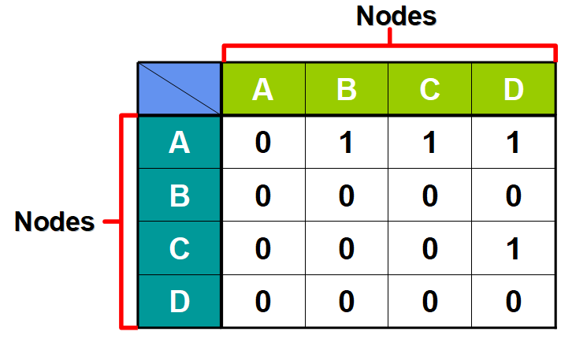
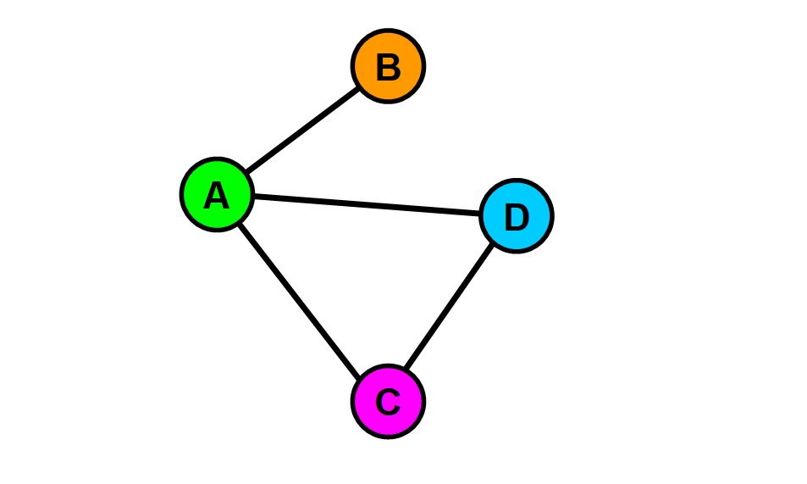
Data Structures
Figure 1: Basic representation of the Adjacency Matrix used in the solution.

Slide 3
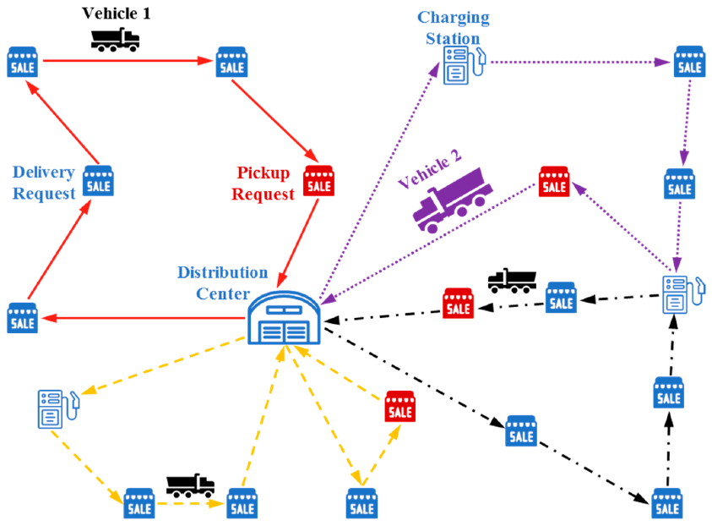
Algorithm and Complexity
Proceso | Complejidad
Creación matriz | O(n^2)
Búsqueda y acceso | O(1)
Búsqueda vecinos | O(n)
Creación rutas | O(n^3)
COMPLEJIDAD TOTAL | O(n^3)
Figure 2: eVRP example solved using the algorithm.
Table 1: Time complexity of the algorithm being n the amount of nodes.

Slide 4
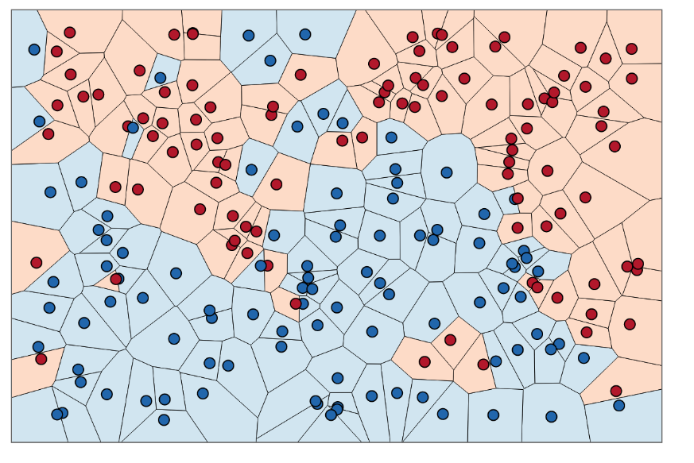
Algorithm design criteria
Our algorithm was designed under the premise of obtaining good results with lower processing costs than those offered by other types of algorithms such as genetic algorithms, brute force, among others.
It is for this reason that the algorithm chosen as the fundamental base of our project is the NNA (Nearest Neighbor Algorithm) given the demand for optimization in the processes of product distribution and the particular needs of potential customers.

Slide 5
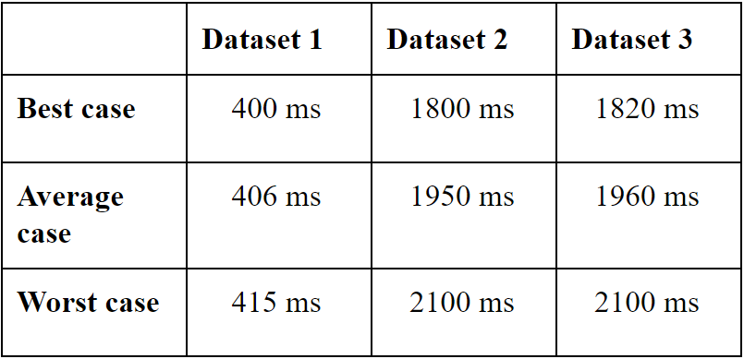
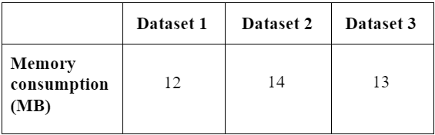
Time and Memory Consumption
Figure 3 & 4 : Time and memory consumption of the algorithm

Slide 6
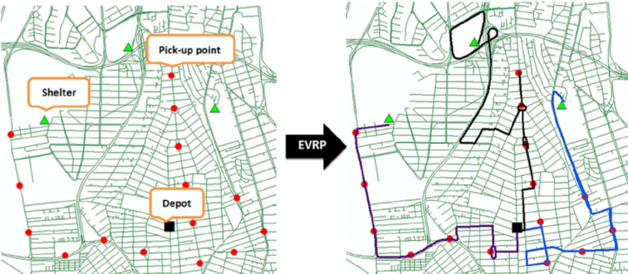
Software prototype
Extracted from https://bit.ly/2TumiiN
Figure 4: Functional use representation of the algorithm

Slide 7
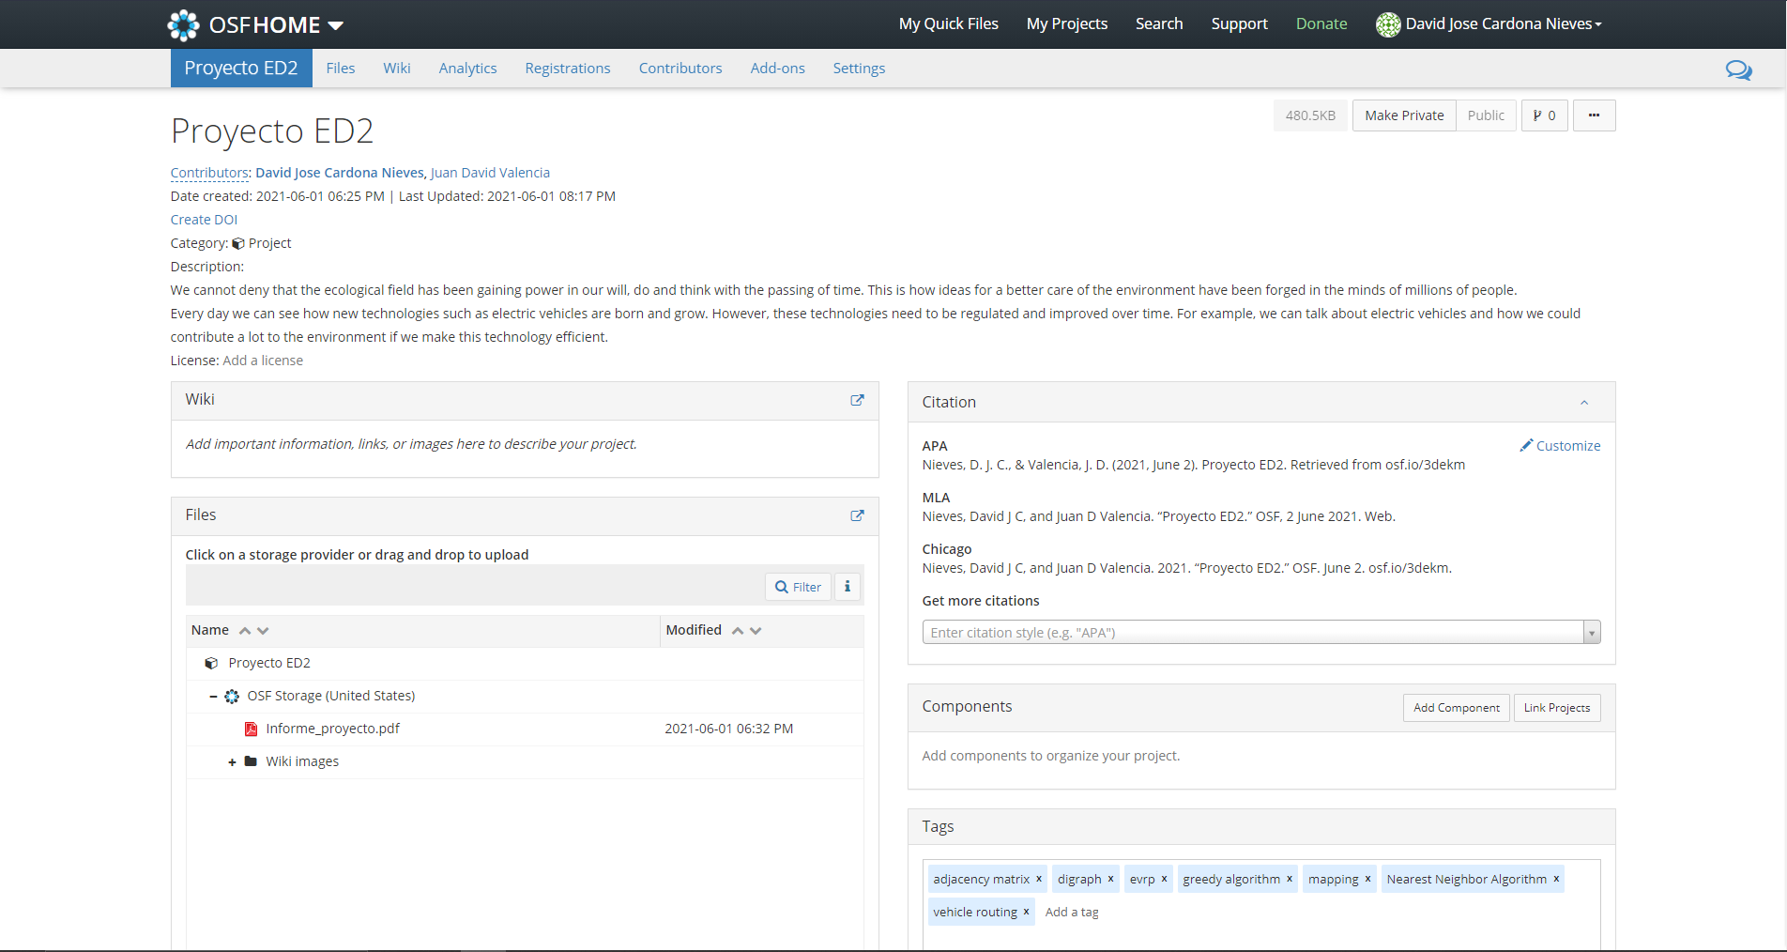
Report uploaded to osf.io
Nieves, D. J. C., & Valencia, J. D. (2021, June 2). Proyecto ED2. Retrieved from osf.io/3dekm

