Slide 1
TET

Slide 2
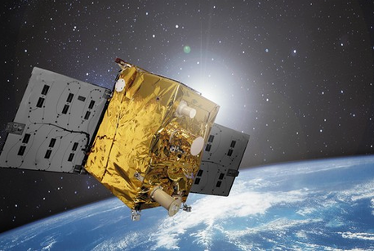
FireBIRD Mission
Constellation of 2 tilting satellites :
TET-1 (launch July 2012),
BIROS (launch June 2016)
Orbit (sun-sychronus)
TET-1: 438 km (asc.), LTAN 13:50 UCT
BIROS: 510 km (desc.), LTAN 21:40 UCT
Repetition rate:
< 5 days (TET-1)
< 3,5 (TET-1 + BIROS)
Depending on location images on several consecutive days possible

Slide 3
FireBIRD-Data an Acquisition Modes
Sensors:
2 Infrared cameras with staggered detectors
One 3-channel VIS/ NIR - camera
Band No. | Spectral characteristic | Wavelength (nm) | Looking angle (degree)
1 | Green | 460 - 560 | 6 ° forward
2 | Red | 565 - 725 | nadir
3 | Near Infrared (NIR) | 790 - 930 | 6 ° backward
4 | Mid Infrared (MW) | 3400 - 4200 | nadir
5 | Long wave Infrared (LW) | 8500 - 9300 | nadir

Slide 4
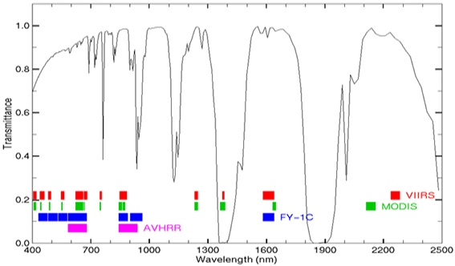
Thermal Missions
FireBIRD

Slide 5
FireBIRD Data and Acquisition Modes
 |  | Spatial resolution* (m) Size of scene (km)
Acquisition Mode |  |  | Green | Red | NIR | MW | LW | width | length
Fire Mode (day) |  |  | 156 | 156 | 156 | 165 | 165 | 167 | 1120
Fire Mode (night) |  |  |  |  |  | 165 | 165 | 167 | 3000
VIS 1 - Green |  |  | 39 |  |  | 165 | 165 | 167 | 400
VIS 1 - Red |  |  |  | 39 |  | 165 | 165 | 167 | 400
VIS 1 - NIR |  |  |  |  | 39 | 165 | 165 | 167 | 400
VIS 3 |  |  | 39 | 39 | 39 | 165 | 165 | 83 | 400
* Pixel size depending on acquiusition angle and orbit hight (= sampling distance)
pixel resolution MIR /TIR ~ 356 m (= ground resolution)
Dynamic Range: 14-bit except for TET-1 VIS-3 Mode: 8 bit

