Slide 1





Using Cucumber JVM and Selenium in Eclipse
By David Lehmann, TINF 16B4

Slide 2
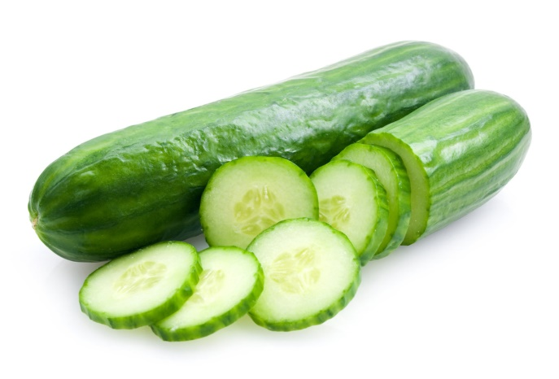
Structure
General Infos on Cucumber and Selenium
What is Behavior Driven Development ?
Setup of Cucumber and Selenium
Gherkin Language
Example

Slide 3

General Infos:
Software tool to test other software
Developed by Aslak Hellesoy, Joseph Wilk, Matt Wynne, Gregory Hnatiuk, Mike Sassak
Originally written in Ruby for exclusive Ruby testing
Runs automated acceptance tests
Uses the programming language Gherkin
→ But: Cucumber doesn‘t provide browser automation

Slide 4
General Infos: Selenium
Software-testing framework for web applications
Written in Java
Provides domain-specific language Selenese
Consists of mulitple components:
→ Selenium IDE
→ Selenium client API
→ Selenium Web Driver

Slide 5
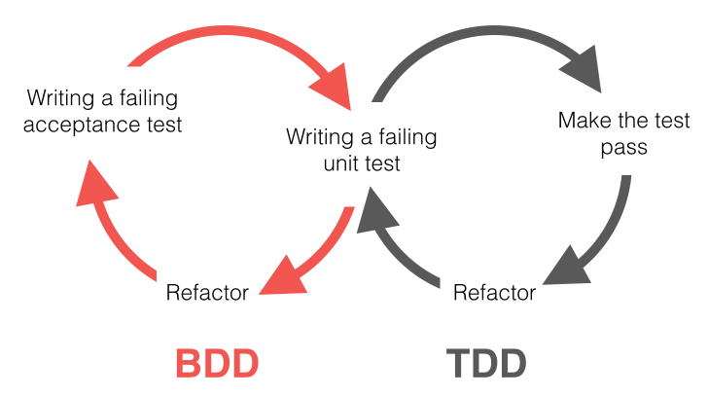
Behavior-Driven-Development (BDD)
Describes software development process
Combines principles of test-driven development (TDD) with domain driven design
Often uses simple domain-specific languages
Principles of BDD similar to TDD

Slide 6
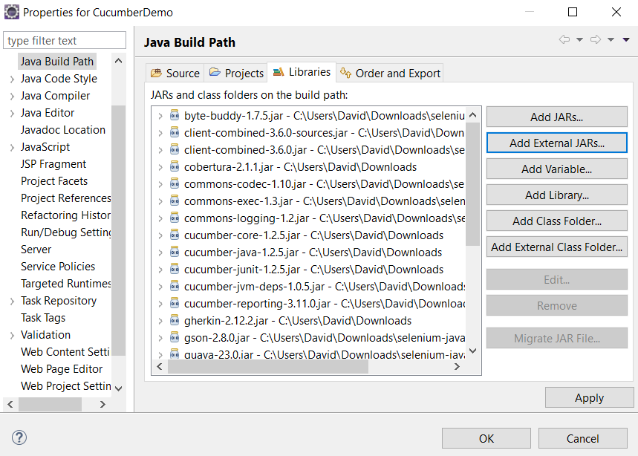
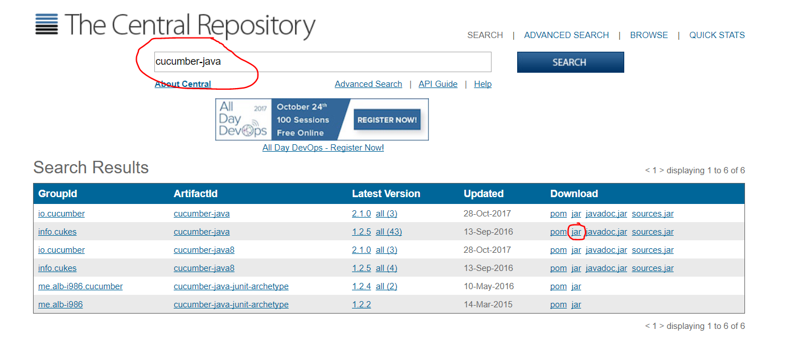
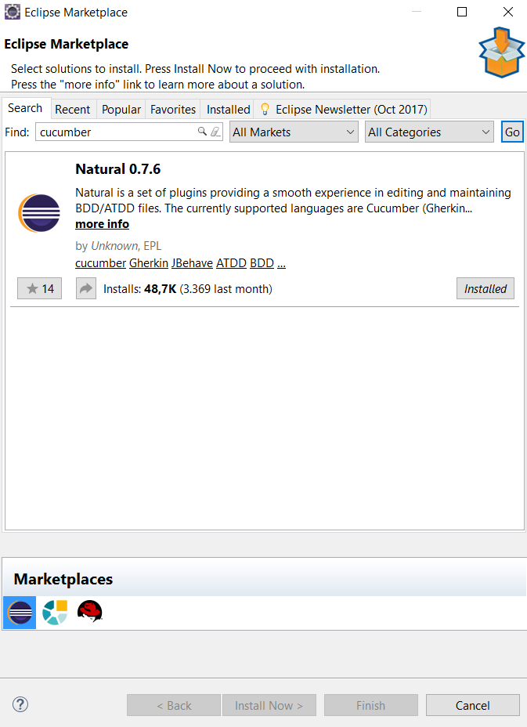
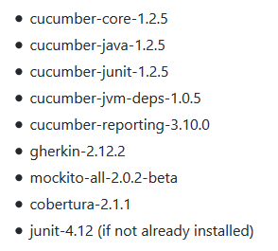
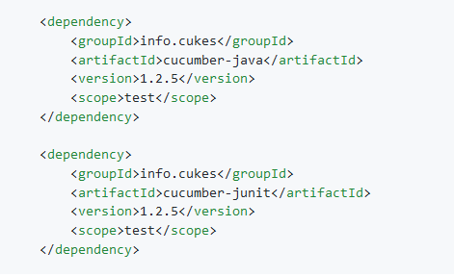
Setup of Cucumber-JVM
No pre-configured setup
→ Manual Installation
Functionality split up into multiple jars/modules
Two methods of installation:
→ Build Tool (Maven, Gradle, etc.)
→ Adding jars manually
Important: Be careful with file versions!

Slide 7
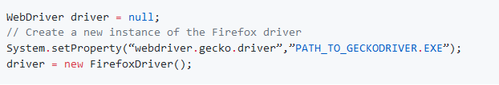
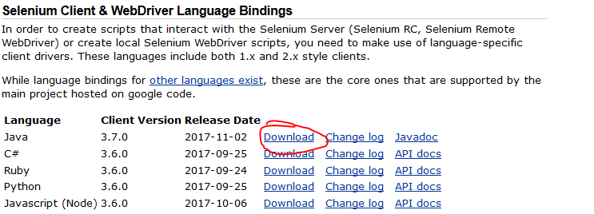
Setup of the Selenium Web Driver
Similar to Cucumber JVM
→Download files (http://www.seleniumhq.org/download/)
→Add them to project library
Download Browser Driver
(https://github.com/mozilla/geckodriver/releases)
Setup Driver in the Code

Slide 8

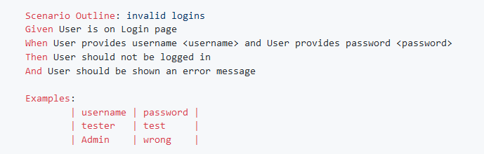
Gherkin
Programming language used in Cucumber
→ Designed to be non-technical
→ human readable
Line oriented
Stored in .feature files
Three general parts:
→ Feature
→ Scenarios
→ Steps

Slide 9
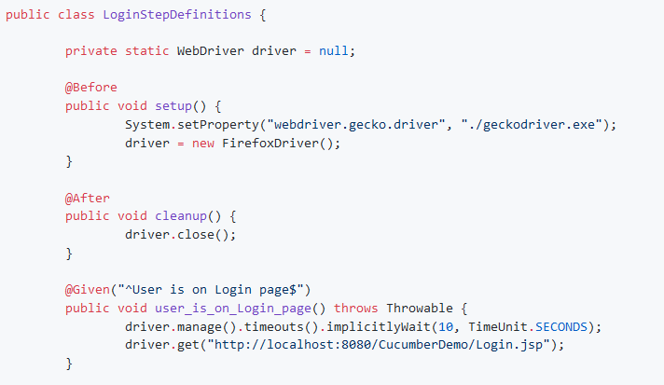
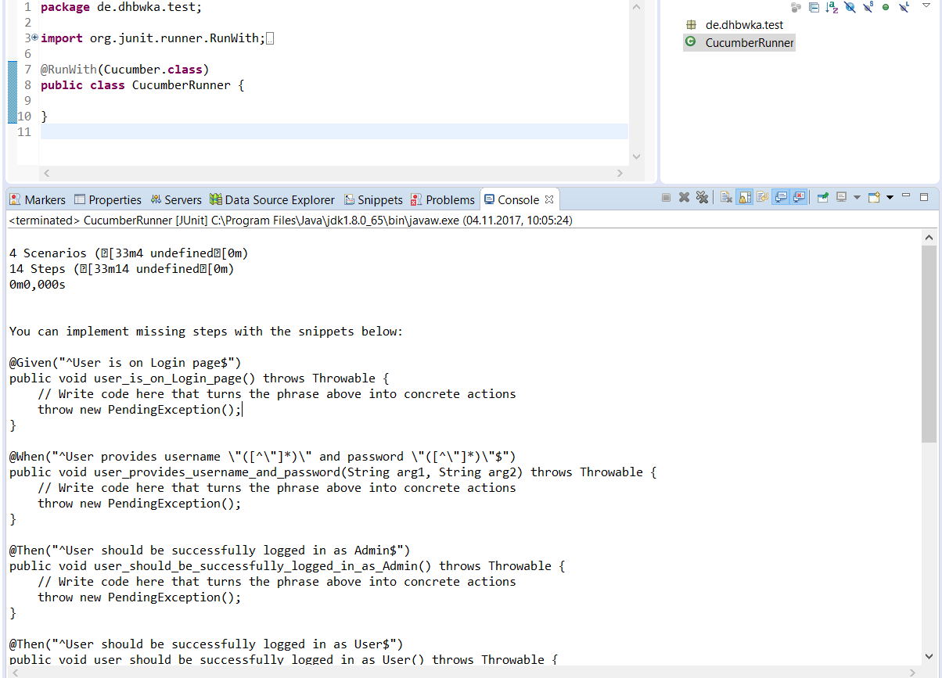
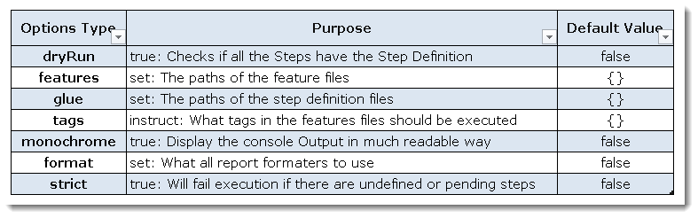
Running tests
Define a runner-class
→ JUnit-Runner
→ Create class with @RunWith(Cucumber.class)
Run as JUnit-Test-Application
Implement Step Definitions

Slide 10
Live Demo

Slide 11
Thanks for listening!
Questions ?

