Slide 1
NFL: Positional Spend vs. Performance
2013-2018
Notes:
As an avid NFL Fan, I wanted to examine how NFL teams allocated their $$ across different positional groups
From there, I would look at Win Pct data over those years and look for correlations in Spend % by positional group vs. Team Performance

Slide 2
Webscraping Sources
Spotrac NFL
NFL Salary Cap Data
Pro Football Reference
NFL Win/Loss Data
Notes:
After many google searches and examination websites, I chose to use Spotrac.com/NFL to obtain salary cap data, and Pro Football Reference to obtain Win/Loss data
Spotrac was the only viable NFL Salary cap source I found and complete data was listed from 2013-present.
While other sports’ Salary cap data is more readily available historically, the NFL seems to not be as easy to find
Pro Football Reference has loads of Stats across sports. With having salary cap data back to 2013, I chose to scrape W/L Data back to 2013 as well. There are 32 teams in the NFL and I obtained 6 years of data.

Slide 3

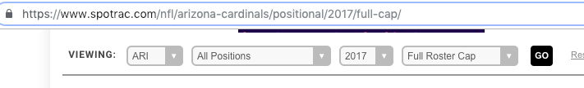
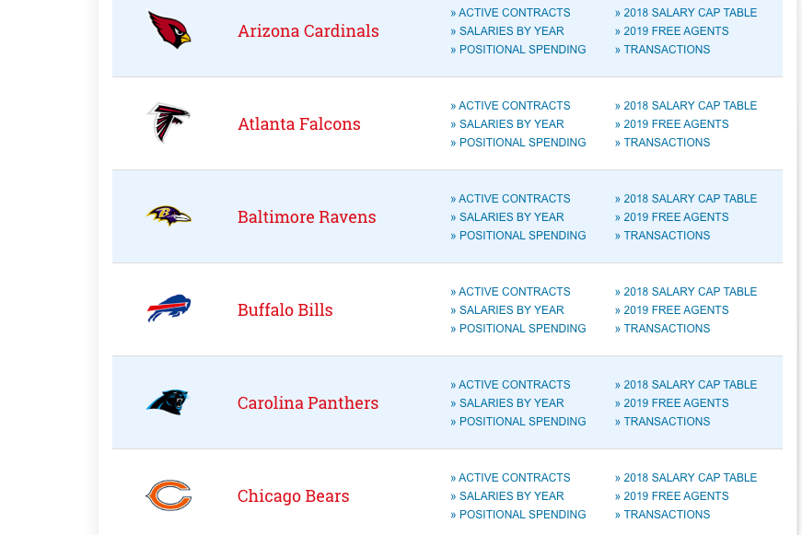
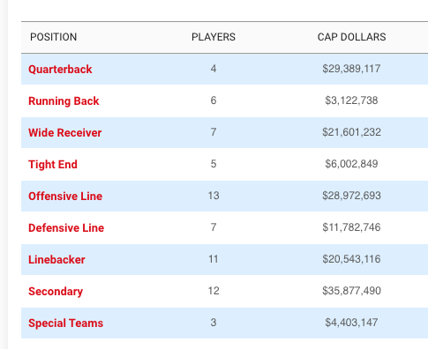
Spotrac.com/NFL
Notes:
The page on the left hand side is Spotrac’s NFL team list, which gives options to click into regarding each teams salary cap related items.
On the right is the team page, which also has a dropdown for year. I wrote a loop in my spider to loop through the URLs for each team name, as well as each year.
One challenge I ran into when examining the webpage was the complexity of the NFL salary cap. I chose to include all salary cap dollars spent, with the exception of “Dead” Cap. “Dead” cap is money that a team has spent on a player or players that are no longer on the team, either have retired or been released.
I chose to not include this data as I wanted to analyze spend by position for players that were actually on the field contributing.

Slide 4
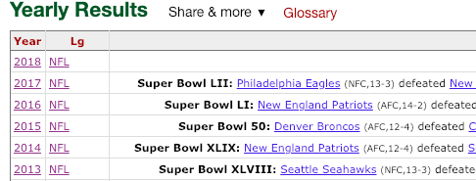
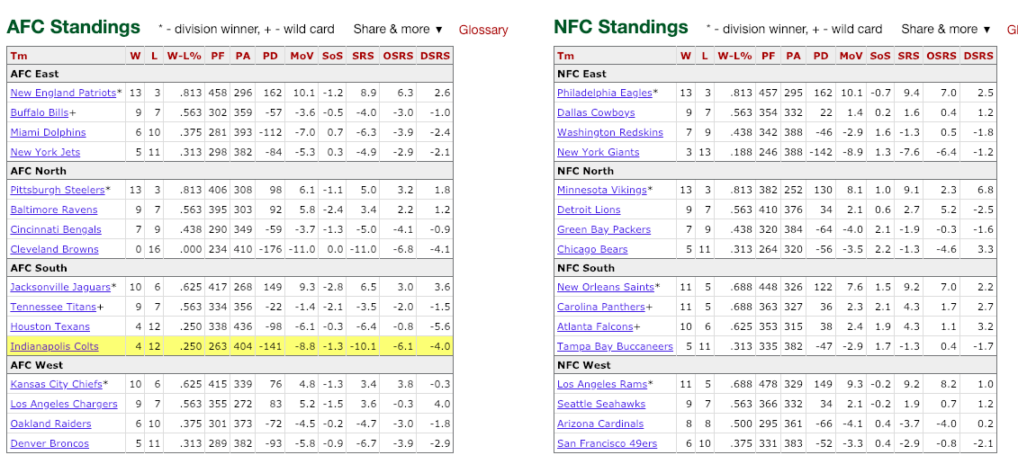
Pro-Football-Reference
Notes:
This is the Pro-football-reference website. On the left side, season results are listed by year. Since the full URL for each page I wanted to scrape from was years/ “Year” I added a for loop to the end of my “Start_url” as seen on the next slide.
The Data I wanted to pull in regarding performance was W-L%, Points For and Points Against.

Slide 5
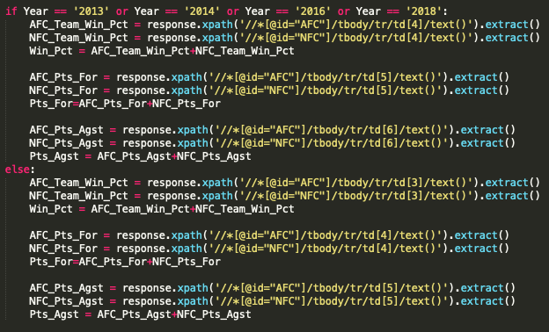
Scrapy Spider: Pro-Football-Reference
Notes:
On the right side is my code to define the xpaths for each associated piece of data. The main hiccup with this scrape, was that 4 of the 6 years I was scraping in had a “tie” column in the record, while the other 2 didn’t. To solve this, I used an if statement while pointing to the xpaths to differentiate the column number for the different configurations.

Slide 6




Python: CSV Merge and Data Cleansing
Step 1
Step 2
Step 3
DF.head()
DF.tail()
Notes:
Now that I had both CSV’s files written, I merged them into a datafram in Jupyter notebook, Merging “ON” Year and Team_Name, which were the 2 common columns in both data sets.
Once I had the files merged, I sorted the combined file by Year and examined the data. On the lower left is a screenshot of the Head of my dataframe, while the right side is the tail of my dataframe. My combined CSV, before further addition of columns, had 192 rows and 15 columns.

Slide 7
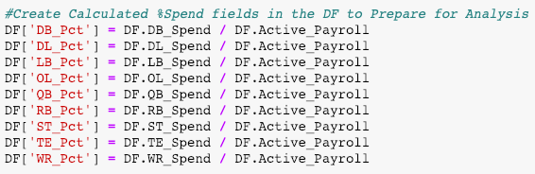
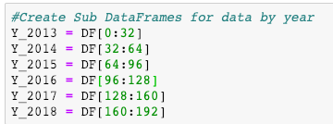
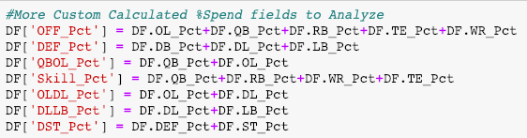
Python: CSV Merge and Data Cleansing
Notes:
To further setup my DF for analysis, I created more columns which are calculated fields of other items in the dataframe.
Also, I created 2 sub-data frames, One of which for just the Spend Pct by year, and another for Year by Year data.

Slide 8

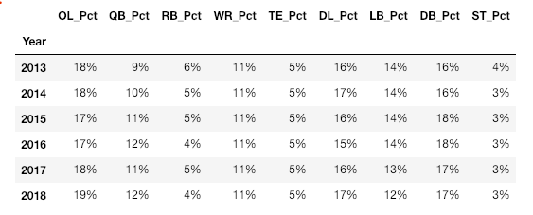



Python: Data Analysis & Visualization
Correlation Matrices (vs. Win %)
% Spend By Position By Year
Offense/Defense/Special Teams
Positional Offense
Positional Defense
Positional “Stacks”
Notes:
My initial findings surprised me. I thought in an ever-changing NFL landscape, positional spend allocation by position each year would vary. However, as shown on the left, teams average allocations have been extremely consistent over the past 6 years.
Also, where I thought I may find significant correlations between positional spend vs. performance, I didn’t.
On the right hand side, I generated 4 correlation matrices. The first summarizing Off, Def, ST. The Second going position by position on offense. Then position by position for defense. And finally what I called positional “Stacks”
I combined different groups such as QB/OL, OL/DL, DLLB and SKILL players. However, across all of these calculations, the ‘Greatest’ absolute correlation I found was -.11 for OL vs Win Pct. Thus, what I found was that positional spend allocation had little to no impact on success.

Slide 9
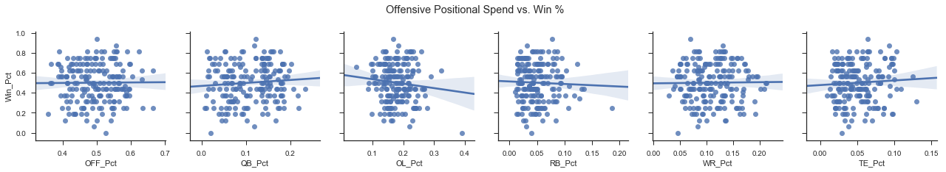
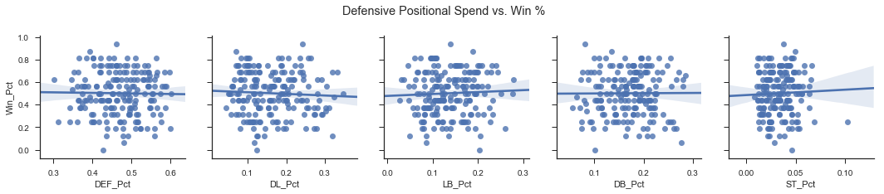
Python: Data Analysis & Visualization
Notes:
This slide shows scatter plots made using Seaborne.
The plots on the top compare Offensive positional spend % to Win % on the top, starting with total offense and going position by position.
The plots on the bottom compare Defensive positional spend % to win %, starting with total defense and going position by position.
Once again this demonstrates a lack of correlation across the board

Slide 10
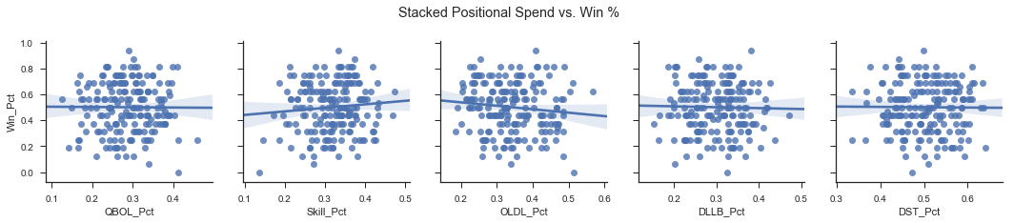
Python: Data Analysis & Visualization
Notes:
And finally my scatter plots for stacked positions. This is a further demonstration of that lack of correlation between positional group spend vs. win pct over 2013-2018.

Slide 11

Challenges
NFL Stats scrape
Pro-Football-Reference dynamic site structure
Scrapy vs. Sellenium
Notes:
What challenges did I run into?
Last week, I thought about adding another layer to my project which would examine nfl team stats by position vs salary, then compare both to success. Since I had already scraped NFL-Reference, I thought this might be a somewhat simple process since the team stats were on the same “Year by Year” page
This ended up being impossible since the website was dynamically built and the stats data could not be obtained the same way I scraped the standings data
Across other NFL statistical websites I examined, I couldn’t use scrapy on any of them. Sellenium would have been doable for a few, but I would have needed more time.
Which brings me to my next point… What would I do if I had more time? How can I expand?

Slide 12
Scrape team statistical data
Analyze more scenarios
Run regression analysis on team stat metrics vs positional spend vs. win pct
Why is the variance in allocation %’s by position each year so small???
Additional Exploration and Final Thoughts
Notes:
As I just mentioned I could scrape team statistical data. I could analyze more scenarios that I didn’t get into in this project. For example, How did allocations change in some of the biggest ‘turnaround seasons’. IE in 2016 the rams were 3-13. In 2017 they were 11-5. Is there any pattern?
Finally, what might have struck me the most about my analysis was how small the variance was in allocation % across years. I look forward to expanding on this project in the future and continuing to examine asset allocation trends in the NFL.

Slide 13
QUESTIONS??
Notes:
I’ll open up the floor for any questions…

