Slide 1
NFL: Positional Spend vs. Performance
2013-2018
Notes:
As an avid NFL Fan, I wanted to examine how NFL teams allocated their $$ across different positional groups
From there, I would look at Win Pct data over those years and look for correlations in Spend % by positional group and Team Performance

Slide 2
Webscraping Sources
Spotrac NFL
NFL Salary Cap Data
Pro Football Reference
NFL Win/Loss Data
Notes:
Spotrac only has complete NFL Salary cap data by position back to 2013
While other sports’ Salary cap data is more readily available historically, the NFL seems to not be as easy to find
Pro Football Reference has loads of Stats across sports. While I was able to use Scrapy to scrape Standings today, statistical data could not be obtained using the same method since they had a dynamic webpage.
In having salary cap data back to 2013, I chose to scrape W/L Data back to 2013 as well. 32 teams and 6 years of data.

Slide 3
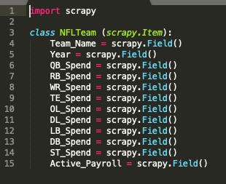
Scrapy: NFL Salary Cap Data
Scrapy startproject spidernfl
Define Items as a class
Notes:
Spotrac has a lot of data regarding NFL salary cap, broken down by different types of salary cap spend and allocations by position. Since ‘Dead’ Cap is $$ spent towards players that were released or retired, I chose to omit Dead cap figures.
Listed here are the categories I chose, as far as relevant datapoints I wanted to pull in.

Slide 4
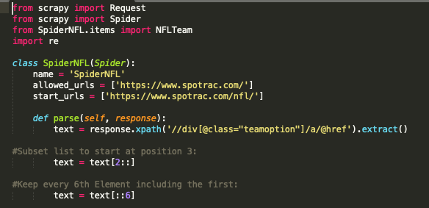
Scrapy Spider: NFL Salary Cap Data
Setup Spider
Test xpaths via scrapy shell
Notes:
The top is an xpath call in my scrapy shell which was returning a list of URL’s with every team and options for what type of salary cap data you wanted.
In my case, I wanted positional data. Given the list as is, I used Python list slicing to extract the URL’s I wanted- 1st starting at position 3, then keeping every 6th element after that (there were 5 other categories of cap data}

Slide 5
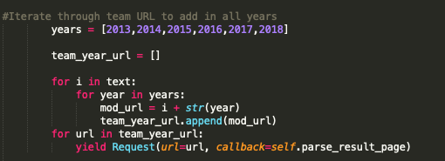
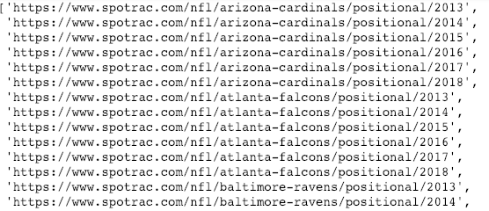
Scrapy Spider: NFL Salary Cap Data
Iterate through years 2013-2018 years to generate URLs for all relevant pages
Notes:
I next wanted to iterate through a list of years to append to the URL in order to generate a complete list of all URL’s I wanted to scrape from. To do this, I used 2 for loops as seen here.

Slide 6
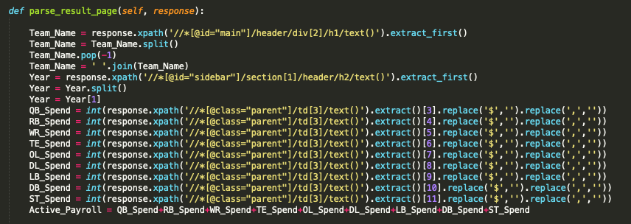
Scrapy Spider: NFL Salary Cap Data
Test xpaths in scrapy shell- apply list altering methods when necessary

Slide 7
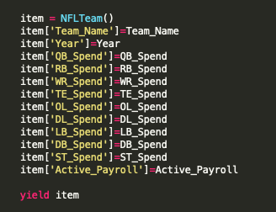
Scrapy Spider: NFL Salary Cap Data
Initialize a new item in each iteration of the loop
Assign the values to corresponding keys & yield item
Notes:
After telling my spider to loop through each unique URL in the list I formulated, I then instatiated a new item, with values corresponding to the keys I defined earlier on the items page.
I then ran my Spider. I only encountered minor issues such as spacing which corrected and was able to get a satisfactory CSV file.

Slide 8
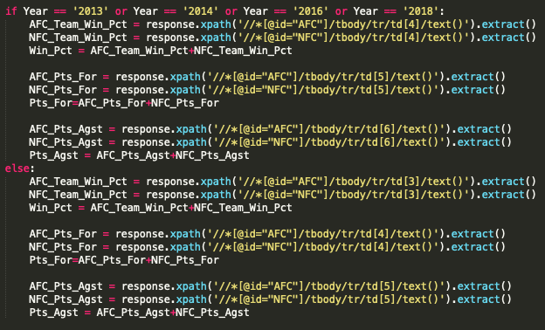
Scrapy Spider: NFL Win/Loss Data
Notes:
I then worked on setting up my scrapy spider to pull win/loss data from NFL reference.
For the Code on the left, at the top I made a list of Years,2013-2018 which I then appended to the start_url for each of those years.
That gave me a list of complete URLs, which was short since the data was organized on each yearly page.
On the right side is my code to define the xpaths for each piece associated piece of data. The main hiccup with this scrape, was that 4 of the 6 years I was scraping in had a “tie” column in the record, while the other 2 didn’t. To solve this, I used an if statement while pointing to the xpaths.

Slide 9
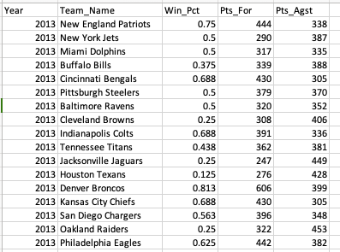
Scrapy Spider: NFL Win/Loss Data
Notes:
The last piece for the spider once again was instantiating an item with the fields of data I aimed to scrape. In this case with how I built the scraper, I iterated 32 times (range 0-32) over the Team_Name, Win_Pct, Pts_For and Pts_Agst fields in order to grab every team from every year.
After running the scraper, it returned the CSV file shown.

Slide 10




Python: CSV Merge and Data Cleansing
Step 1
Step 2
Step 3
DF.head()
DF.tail()
Notes:
Read CSV files and merge them on the Year and Team Name columns which were common across both CSVs.

Slide 11
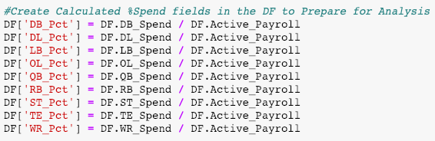
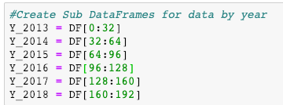
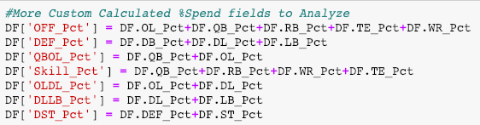
Python: CSV Merge and Data Cleansing
Notes:
To further setup my DF for analysis, I created more columns which are calculated fields of other items in the dataframe.
Also, I created 2 sub-data frames, One of which for just the Spend Pct by year, and another for Year by Year data.

Slide 12

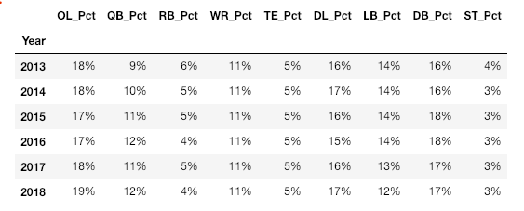



Python: Data Analysis & Visualization
Correlation Matrices (vs. Win %)
% Spend By Position By Year
Offense/Defense/Special Teams
Positional Offense
Positional Defense
Positional “Stacks”

Slide 13
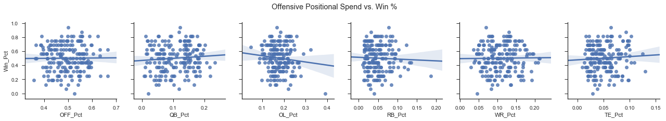
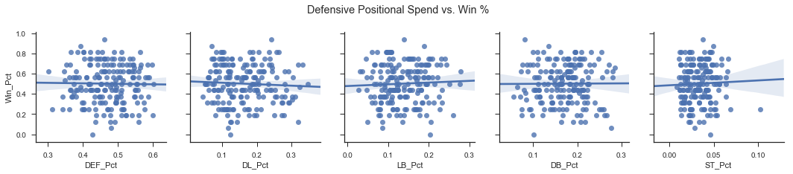
Python: Data Analysis & Visualization
Notes:
This slide shows scatter plots made using Seaborne.
The plots on the top compare Offensive positional spend % to Win % on the top, starting with total offense and going position by position.
The plots on the bottom compare Defensive positional spend % to win %, starting with total defense and going position by position.

Slide 14
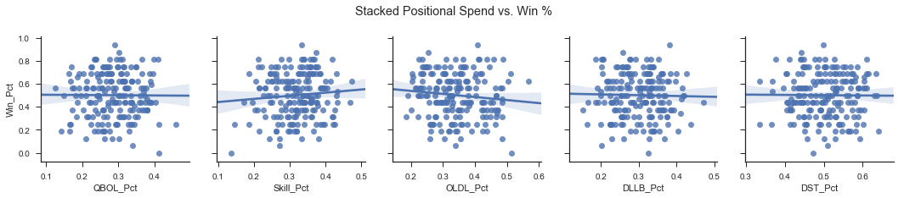
Python: Data Analysis & Visualization
Notes:
This slide shows scatter plots made using Seaborne.
The plots on the top compare Offensive positional spend % to Win % on the top, starting with total offense and going position by position.
The plots on the bottom compare Defensive positional spend % to win %, starting with total defense and going position by position.

Slide 15
Scrape team statistical data
Analyze more scenarios
Run regression analysis on team stat metrics vs positional spend vs. win pct
Why is the variance in allocation %’s by position each year so small???
Additional Exploration and Final Thoughts

