Slide 1
A Tool to Extract Accumulated Technical Debt in Data Science Software
Undergrad Research Presentation
David OBrien

Slide 2


Background
“Technical Debt” is a metaphor coined by Ward Cunningham to describe “cost” of reworking software due to design decisions made earlier in production
Time to market may have been more valuable earlier in production, but extending hastily made code can prove difficult
Like normal financial debt, there is a concept of “interest” involved, and it needs to be paid off in time. The method to pay technical debt is time.

Slide 3
Background
Technical Debt can affect the readability of software, the user’s understanding, the number of features included, testing quality, improvability of the code
Multiple studies done on “Technical Debt Taxonomy”, findings reveal categories of Technical Debt such as:
Code Comprehension Debt
Architecture Debt
Documentation Debt
Requirement Debt
Software Testing Debt

Slide 4
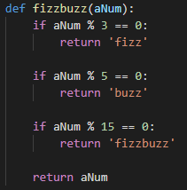
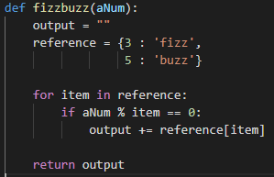
FizzBuzz Implementations
What happens if we try to extend both implementations?

Slide 5


Technical Debt Resolutions
What are the fixes?
Depends on the type of debt
Reworking code to become more readable
Reworking code to meet requirements
Replacing code entirely to meet new requirements
Adding new features
Removing deprecated / outdated code
Modularizing code more effectively
Adding in documentation files / code comments

Slide 6
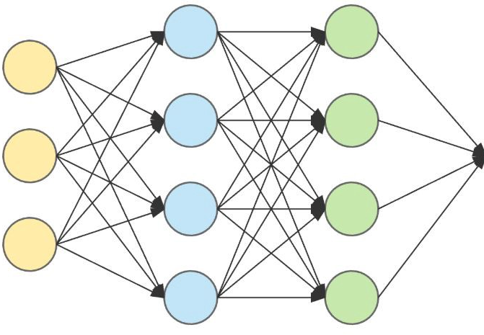
Machine Learning / Data Science
“Machine Learning” is the umbrella term used to describe mathematical ways for computers to “learn” how to solve problems by finding patterns in data that isn’t as explicit to the human eye.
“Data Science” has become an industry term for Machine Learning that also encapsulates data storage techniques, data visualizations, and other data-driven business solution techniques.

Slide 7
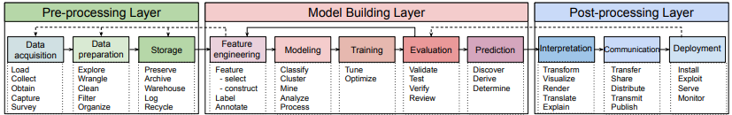
Technical Debt in Data Science
The process of creating Data Science systems is very expensive time-wise, there are multiple steps involved in deploying models to be used by the public.
Machine Learning Software not only can incur the same Technical Debts from traditional software practices. Furthermore, because of the unique steps involved in their pipeline they also can contract new Data Science-specific Technical Debts.

Slide 8



Example of DS-Specific Technical Debt
Direct or Hidden Feedback Loops
The key feature of online ML systems is that they update their learning live.
However, a model’s influence on its own training can be costly.
Example:
Social Media trains a model to decide on what ads to give to differing audiences.
A
B

Slide 9
Related Works
D. Sculley et al. presented work revealing that there are new debt types exclusive to Data Science software.
Tang et al. will be presenting an empirical study on Machine Learning refactorings and the new Machine Learning-specific debt types that are revealed from these in the upcoming ICSE ‘21.
Huang et al. has created a Machine Learning model that is able to detect normal Technical Debts from source code comments.

Slide 10
Project Goal
Using similar methods to Tang et al. the goals of my undergraduate research project was:
Train a Machine Learning model to be able to identify if a source code comment represents:
No Technical Debt
Technical Debt
Data Science-Specific Technical Debt
Implement a tool that traverses a given directory, finds all the Python files, extracts the comments, and outputs the above model’s predictions on each comment in order to assist Data Science Developers locate the TD and DSTD that exists within their projects.

Slide 11

Process
Developers will often lead comments in their code indicating a known TD, and possibly an implied fix.
This has been referred to as “Self-Admitted Technical Debt”
Examples of a comments indicating SATD
Examples of a comments indicating self-admitted Machine Learning TD

Slide 12


Process
All Comments Extracted from MLVerse using Boa
(1,033,125 Comments)
Comments Containing Keyword
(16,265 Comments)
Comments Detected by SATD Classifier [6]
(14,455 Comments)
Union of Classified and Keyword Sets
(22,114 Comments)
1,037 Comments Manually Labelled

Slide 13
Process
Choosing features (inputs) to our model
Presence / Absence of a word in a comment
Idea is:
Have a list of words that are important to determining what label a comment should receive
Intuition is that ML model can learn what prevalent / absent words cause a comment to represent one of the three labels.
todo
fixme
model
error
Todo: fix directory path
1
0
0
0
TD
Fixme: edit model’s hyperparameters
0
1
1
0
DSTD
This is not technical debt
0
0
0
0
No TD

Slide 14

Process
How to find which words to use?
Using the Information Gain formula on our training data allows us to figure out a “score” for how important a word is in determining its label!
Words like “model”, “image” are at the top since they differentiate DSTD from TD in many cases in the training data
Words such as “todo” and “fixme” are also at the top because it differentiates DSTD / TD from non-TD comments
Used the top 15% of words to prevent overfitting / lower storage costs

Slide 15
Process
Both training data and inferential data is preprocessed using the following steps:
Lemmatization ( “train”, “training”, “trained” -> “train” )
Threw out stop words and bad characters ( “tf.TruncatedSVD” -> “tf TruncatedSVD” )
Vectorized into vectors of 0s and 1s indicating if the comment contains Feature Word
Using a sklearn, a Python library that provides “off-the-shelf” models, I trained a Multi-Layered Perceptron on the 80% of training data described
Tested model’s performance on remaining 20%
Achieved an accuracy of ~89% correct classification

Slide 16
Process
Also using Python, wrote a function that takes in two inputs:
path – The directory of software repository that user wants to extract comment information from
output_location – The location on the user’s computer where the output file describing comment information should be placed
Demonstration

Slide 17
Conclusion
With the tool created in this project, developers now have an available method to locate all the TD comments that may have been forgotten about in their software repositories.
The comments discovered are also categorized into previously known Technical Debts, or Data Science specific Technical Debts.
Because of this, the process of creating improvable Machine Learning software by locating Technically Indebted components within a system has been automated.

