Slide 1

Crime: what is it good for?
David Stern, Kira S., Megan Johns, Dave Durnell

Slide 2
Question: What is the characterization of victims of crimes against individuals, and does it change over time?”

Slide 3
Questions:
Who is most victimized: gender, ethnicity, age, etc?
What are the types of crime?
Does it change over time?
Did the 2008/2009 recession have any impact?
Why?:
Are certain people more at risk than others?
Conclusions:
Few people use victim services
There was less reported crime during the recession. One can only speculate why.
Most crimes don’t involve injury.

Slide 4
Data:
Source: csv file containing data from 1995 to 2018: https://www.bjs.gov/developer/ncvs/index.cfm
Index of terms: https://www.bjs.gov/developer/ncvs/personalFields.cfm
Cleanup:
The raw data consisted of integer values based on dictionaries, so we inserted the dictionary values to facilitate human thought.
https://github.com/DavidMStern/ProjectOne/blob/master/1993%20to%202018%20formatting.ipynb
The 1995 data seemed incomplete so was usually excluded in analysis.

Slide 5
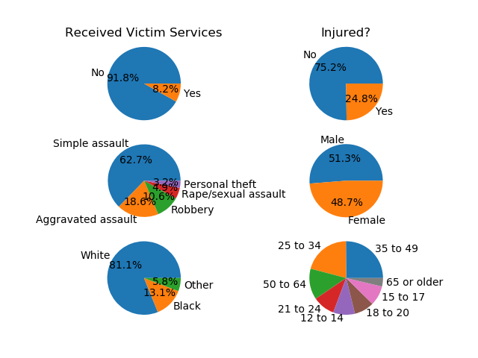
Does this change
over time?

Slide 6
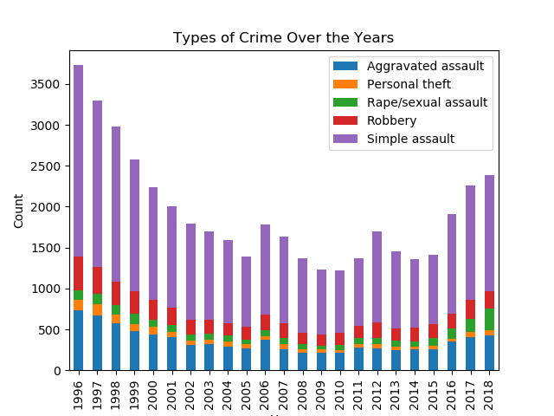
Percentages seem consistent over the years
The lowest point was during the recession and shortly after
We should correlate with alcohol consumption
https://github.com/DavidMStern/ProjectOne/blob/master/testing/dvd_analysis.ipynb

Slide 7
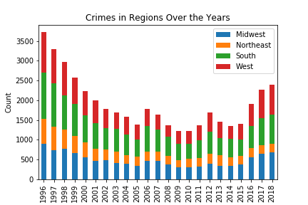
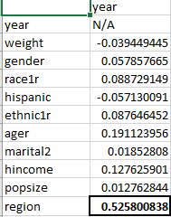
Region and Year?
corr = df.corr(method ='pearson')

Slide 8
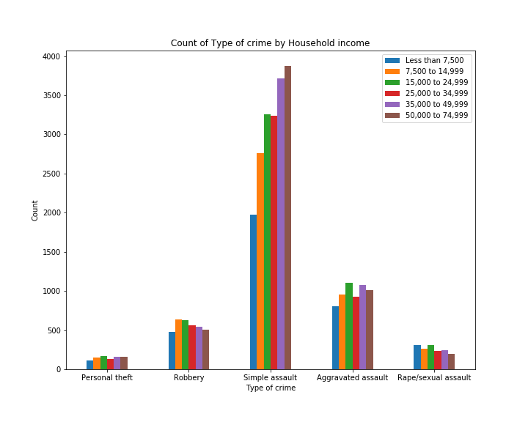
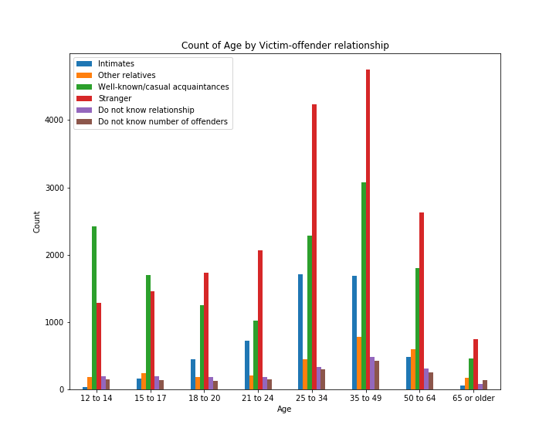
Some Demographics Data
While most crimes increase or decrease with wealth shallowly, simple assault see a much sharper increase.
A shift from crimes by acquaintance being more common at young ages to crimes by strangers at older ages

Slide 9
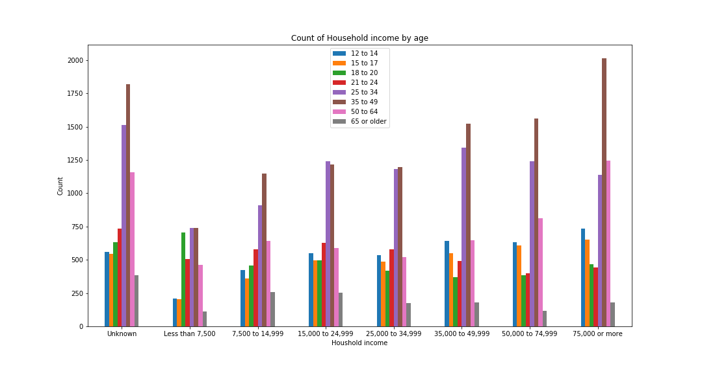
Demographics continued

Slide 10

Crime Type Analysis

Slide 11
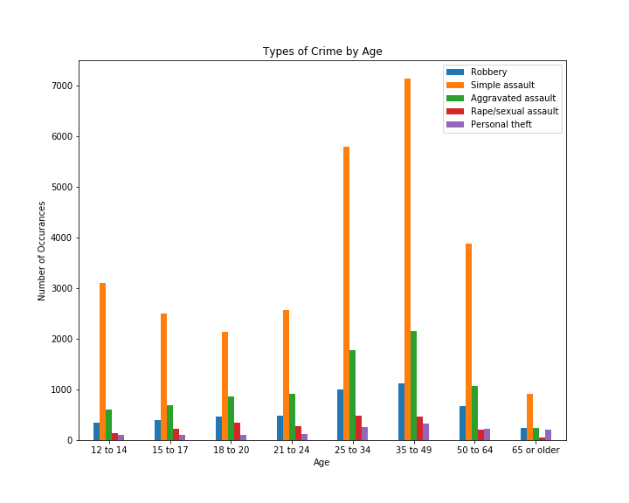
Types of Crime by Age
Between the ages of 25 and 50 are when the majority of crimes take place.
Simple Assault takes precedence over the types of crime, followed my Aggravated Assault.
What comparisons could be drawn to narrow it down to motive?

Slide 12
Summary:
Who is most victimized: gender, ethnicity, age, etc?
It is hard to say. A more thorough analysis of population density would help. Age and income do seem to have a noticeable influence though
What are the types of crime?
Simple assault is by far the most prevalent.
Does it change over time?
The distribution seems the same over time, but the victim rate has changed significantly.
Did the 2008/2009 recession have any impact?
Crime seems to have lowered during that time. More analysis there is warranted
Correlation analysis indicates a slight dependence on region and crime.
Stacked chart shows that the south region crime size changed the least over time. It was significantly high.

