Slide 1
Реализације мрежне верзије рачунарске игре ,,Чистач мина“ применом Unity развојног окружења
Давид Манић

Slide 2






Истраживање мултиплејер решења

Slide 3
 | Unity | Photon | SpatialOS | Masterserver Framework | Forge | Dark Rift | Photon On-premise
Server Authority | ✓ | X | X | ✓ | ✓ | ✓ | ✓
Loadbalancing | ✓ | ✓ | ✓ | X | X | X | ✓
Headless | ✓ | ✓ | ✓ | X | X | ✓ | ✓
Matchmaking | ✓ | ✓ | ✓ | ✓ | poor | ✓ | ✓
Free CCU | 20 | 20 | Free Development | No limit | No limit | No limit | 100

Slide 4
Израда асета

Slide 5
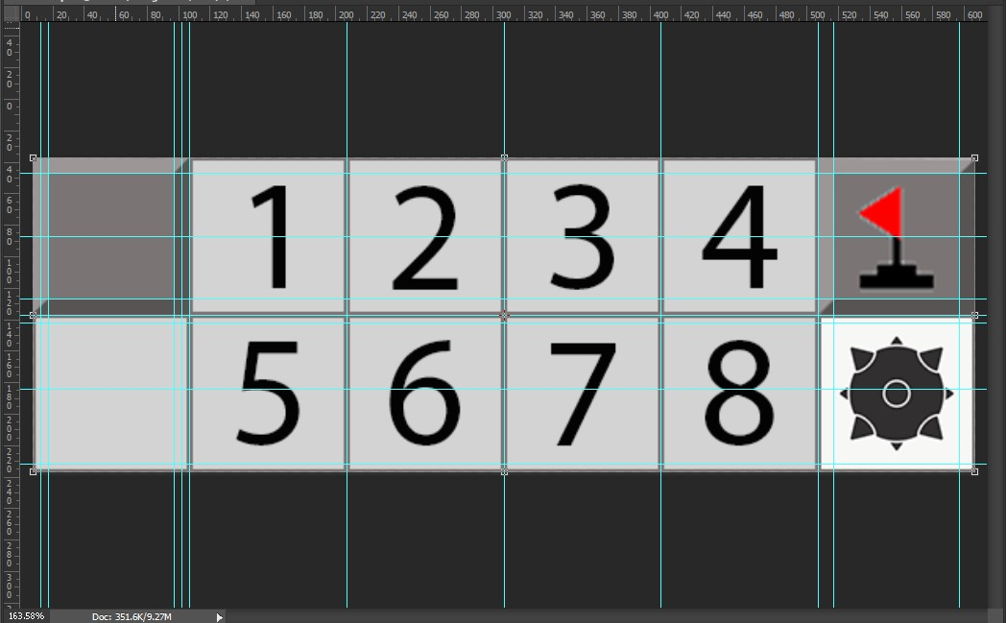
Израда Асета за игру

Slide 6


Израда Асета за главни мени
Клизач
Дугме

Slide 7
Израда менија

Slide 8
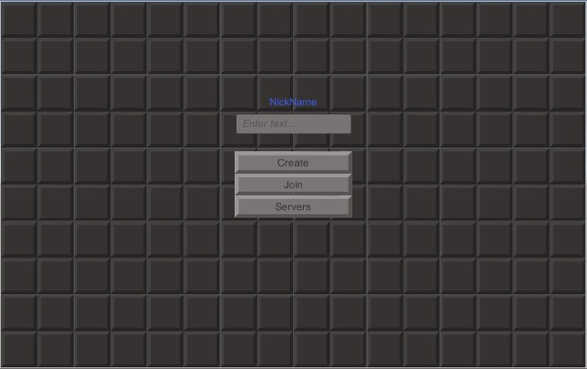
Главни мени

Slide 9
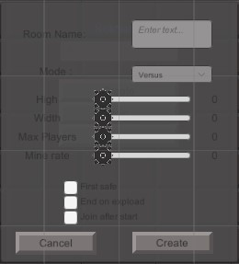
Панел за креирање игре

Slide 10
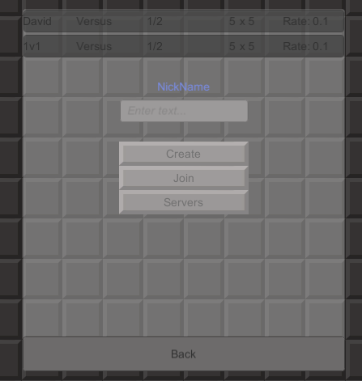
Панел са серверима

Slide 11
Израда мултиплејер сцене

Slide 12
Board class
public class Board : MonoBehaviour
{
float size = 1f;
float cameraSizeIndex = 1.7f;
public TileFactory factory;
GameObject[,] tiles;
bool[,] reveald;
bool[,] flags;
public int FlagCount { get; protected set; }
public int ExplodedCount { get; protected set; }
public int Hight { get; protected set; }
public int Width { get; protected set; }
public int MineCount { get; protected set; }
public delegate void MinesLeftChanged(int current);
public event MinesLeftChanged OnMinesLeftChanged;
}
public void MakeBoard(int hight, int width,int mineCount)
{
Hight = hight;
Width = width;
MineCount = mineCount;
OnMinesLeftChanged?.Invoke(MineCount);
tiles = new GameObject[hight, width];
reveald = new bool[hight, width];
flags = new bool[hight, width];
Vector3 pos = Vector3.zero;
for (int i = 0; i < hight; i++)
{
for (int j = 0; j < width; j++)
{
tiles[i, j] = factory.MakeBlank(pos);
tiles[i, j].name = "Tile_" + i + "_" + j;
tiles[i, j].transform.SetParent(transform);
pos.x = pos.x + size;
}
pos.y = pos.y - size;
pos.x = pos.x - size * width;
}
}

Slide 13
Board class metode
public void SetTile(int y, int x, int value)
{
if (value == 10)
{
factory.SetMine(tiles[y, x].GetComponent<SpriteRenderer>());
tiles[y, x].GetComponent<SpriteRenderer>().color = new Color(.5f, 0, 0);
MineCount--;
OnMinesLeftChanged?.Invoke(MineCount);
}
else
{
factory.ChangeTile(tiles[y, x].GetComponent<SpriteRenderer>(), value);
}
}
public void ToggleFlag(int y, int x, bool IsFlag)
{
if (IsFlag)
factory.SetFlag(tiles[y, x].GetComponent<SpriteRenderer>());
else
factory.SetNormal(tiles[y,x].GetComponent<SpriteRenderer>());
MineCount += IsFlag ? -1 : 1;
OnMinesLeftChanged?.Invoke(MineCount);
}

Slide 14
TileFactory
public class TileFactory : MonoBehaviour
{
[SerializeField]
GameObject Tile;
[SerializeField]
Sprite[] sprites;
[SerializeField]
Dictionary<string, Sprite> tiles = new Dictionary<string, Sprite>();
void Awake()
{
tiles.Clear();
foreach (Sprite s in sprites)
tiles.Add(s.name.Split('_')[1], s);
}
public GameObject MakeTile(int number,Vector3 position)
{
Sprite s;
if(tiles.TryGetValue(number.ToString(),out s))
{
GameObject g = Instantiate(Tile, position, Quaternion.identity);
g.GetComponent<SpriteRenderer>().sprite = s;
return g;
}
else
{
Debug.Log("Can't find card");
}
return null;
}
public GameObject MakeBlank(Vector3 position)
{
Sprite s;
if (tiles.TryGetValue("Normal", out s))
{
GameObject g = Instantiate(Tile, position, Quaternion.identity);
g.GetComponent<SpriteRenderer>().sprite = s;
return g;
}
return null;
}
public GameObject SetFlag(SpriteRenderer tile)
{
Sprite s;
if (tiles.TryGetValue("Flag", out s))
{
tile.sprite = s;
return tile.gameObject;
}
return null;
}
public GameObject SetNormal(SpriteRenderer tile)
{
Sprite s;
if (tiles.TryGetValue("Normal", out s))
{
tile.sprite = s;
return tile.gameObject;
}
return null;
}
public GameObject SetMine(SpriteRenderer tile)
{
Sprite s;
if (tiles.TryGetValue("Mine", out s))
{
tile.sprite = s;
return tile.gameObject;
}
return null;
}
public GameObject ChangeTile(SpriteRenderer tile, int number)
{
Sprite s;
if (tiles.TryGetValue(number.ToString(), out s))
{
tile.sprite = s;
return tile.gameObject;
}
return null;
}

Slide 15
InputController
public class InputController : MonoBehaviour
{
RaycastHit2D hit;
[SerializeField]
Board board;
[SerializeField]
NetworkController netowork;
[SerializeField]
GameObject escapeMenu;
Camera camera;
Vector3 start;
Vector3 end;
public bool forceMobile = true;
/// <summary>
/// Hight of the display
/// </summary>
private float displayHight { get { return (int)camera.orthographicSize * 2; } }
/// <summary>
/// Width of display
/// </summary>
private float displayWidth { get { return (int)camera.orthographicSize * 2*Camera.main.aspect; } }
/// <summary>
/// Difference in board Hight and display hight
/// </summary>
private float HightDifference { get { return (board.Hight - displayHight + 2) / 2; } }
/// <summary>
/// Difference in board width and display hight
/// </summary>
private float WidthDifference { get { return (board.Width - displayWidth + 2) / 2; } }
private Vector2 boardCentar = Vector2.zero;
public void Start()
{#endif
camera = Camera.main;
netowork.OnMatchBegin += OnMatchBegin;
}
/// <summary>
/// Called on begining of match
/// </summary>
private void OnMatchBegin()
{
Debug.Log("width: " + board.Width + " hight: " + board.Hight);
boardCentar = new Vector2(((float)board.Width - 1f) / 2, -((float)board.Hight - 1f) / 2);
camera.transform.position = new Vector3( boardCentar.x , boardCentar.y,camera.transform.position.z);
}

Slide 16
InputController
private void Update()
{
if (Input.GetKeyUp(KeyCode.Escape)) escapeMenu.SetActive(!escapeMenu.activeSelf);
if (Input.GetMouseButtonDown(0)) start = Input.mousePosition;
if (Input.GetMouseButtonUp(0))
{
if (Vector3.Distance(start, Input.mousePosition) > 50)
{
end = start - Input.mousePosition;
end = new Vector3(end.x / Screen.width * displayWidth, end.y / Screen.height * displayHight, end.z);
MoveCamera(end);
}
else
if (hit = Physics2D.Raycast(camera.ScreenToWorldPoint(Input.mousePosition), Vector2.zero))
{
if (hit.transform.tag == "Tile")
{
netowork.OpenTile(int.Parse(hit.transform.name.Split('_')[1]), int.Parse(hit.transform.name.Split('_')[2]));
Debug.Log("Request Opening Tile" + int.Parse(hit.transform.name.Split('_')[1]) + " " + int.Parse(hit.transform.name.Split('_')[2]));
}
}
}
if (Input.GetMouseButtonDown(1))
if (hit = Physics2D.Raycast(camera.ScreenToWorldPoint(Input.mousePosition), Vector2.zero))
{
if (hit.transform.tag == "Tile")
{
netowork.ToggleFlag(int.Parse(hit.transform.name.Split('_')[1]), int.Parse(hit.transform.name.Split('_')[2]));
}
}
if (Input.mouseScrollDelta.y != 0)
{
Zoom();
}
}

Slide 17
InputController
/// <summary>
/// Zoom with camera camera and readjust positioning
/// </summary>
private void Zoom()
{
camera.orthographicSize = Mathf.Clamp(camera.orthographicSize - Input.mouseScrollDelta.y, 5, 15);
if (displayHight < board.Hight || displayWidth < board.Width)
{
float WidthDifference = displayWidth - board.Width;
float HightDifference = displayHight - board.Hight;
WidthDifference = WidthDifference < 0 ? 0 : WidthDifference;
HightDifference = HightDifference < 0 ? 0 : HightDifference;
camera.transform.position = new Vector3(displayWidth < board.Width ? NormalizeWidth(camera.transform.position.x) : camera.transform.position.x,
displayHight < board.Hight ? NormalizeHight(camera.transform.position.y) : camera.transform.position.y,
camera.transform.position.z);
}
}
/// <summary>
/// Move camera for move amount
/// </summary>
/// <param name="move"></param>
private void MoveCamera(Vector3 move)
{
if (displayHight < board.Hight || displayWidth < board.Width)
{
camera.transform.position = new Vector3(displayWidth < board.Width ? NormalizeWidth(camera.transform.position.x + move.x) : camera.transform.position.x,
displayHight < board.Hight ? NormalizeHight(camera.transform.position.y + move.y) : camera.transform.position.y,
camera.transform.position.z);
}
}

Slide 18
Израда сервера

Slide 19
PluginFactory
public class MineSweepersFactory : IPluginFactory
{
public IGamePlugin Create(IPluginHost gameHost, string pluginName, Dictionary<string, string> config,
out string errorMsg)
{
gameHost.LogInfo("Name" + pluginName);
PluginBase plugin = new PluginBase();
switch (pluginName)
{
case "MineSweepersCoop":
plugin = new MineSweepersCoop();
break;
case "MineSweepersVersus":
plugin = new MineSweepersVersus();
break;
default:
break;
}
if (plugin.SetupInstance(gameHost, config, out errorMsg))
{
gameHost.LogError(config);
gameHost.LogError(config.Keys);
return plugin;
}
return null;
}
}

Slide 20
Board
public class Board
{
private int width = 10;
private int hight = 10;
private int mineCount = 10;
private int explodedCount = 0;
private int revealdCount = 0;
private bool firstSafe = false;
public int Width { get { return width; } }
public int Hight { get { return hight; } }
public int MineCount { get { return mineCount; } }
public int ExplodedCount { get { return explodedCount; } }
public int RevealdCount { get { return revealdCount; } }
private int[,] mines;
private bool[,] reveald;
private bool[,] flags;
public Board(int hight, int width, int mineCount) {
this.hight = hight;
this.width = width;
this.mineCount = mineCount;
mines = new int[hight, width];
reveald = new bool[hight, width];
flags = new bool[hight, width];
PlaceMines();
CalculateTiles();
}
public int GetStartX(int x) => (x - 1) < 0 ? 0 : x - 1;
public int GetStartY(int y) => (y - 1) < 0 ? 0 : y - 1;
public int GetEndX(int x) => (x + 1) >= width ? width - 1 : x + 1;
public int GetEndY(int y) => (y + 1) >= hight ? hight - 1 : y + 1;
}
private void PlaceMines()
{
int count = 0;
Random r = new Random();
while (count < mineCount)
{
int x = r.Next(width);
int y = r.Next(hight);
if (mines[y, x] != 10)
{
mines[y, x] = 10;
count++;
}
}
}
private void CalculateTiles()
{
for (int i = 0; i < hight; i++)
for (int j = 0; j < width; j++)
{
if (mines[i, j] != 10)
mines[i, j] = NumOfMines(i, j);
}
}
public int NumOfMines(int y, int x)
{
int count = 0;
for (int i = GetStartY(y); i <= GetEndY(y); i++)
for (int j = GetStartX(x); j <= GetEndX(x); j++)
{
if (mines[i, j] == 10) count++;
}
return count;
}

Slide 21
Board
public int GetTile(int y, int x) => mines[y, x];
public bool IsReveald(int y, int x) => reveald[y, x];
public bool IsFlag(int y, int x) => flags[y, x];
public bool IsMine(int y, int x) => mines[y, x] == 10;
public void Reveal(int y , int x)
{
if (!reveald[y, x])
revealdCount++;
if (mines[y, x] == 10) explodedCount++;
reveald[y, x] = true;
}
public void ToggleFlag(int y, int x)
{
flags[y, x] = !flags[y, x];
}
public int NumOfFlags(int y, int x)
{
int count = 0;
for (int i = GetStartY(y); i <= GetEndY(y); i++)
for (int j = GetStartX(x); j <= GetEndX(x); j++)
if (flags[i, j])
count++;
return count;
}
public List<Dictionary<byte, object>> OpenRest(int y, int x)
{
List<Dictionary<byte, object>> tiles = new List<Dictionary<byte, object>>();
tiles.Add( new Dictionary<byte, object>());
int current = 0;
byte index = 0;
for (int i = GetStartY(y); i <= GetEndY(y); i++)
for (int j = GetStartX(x); j <= GetEndX(x); j++)
if (!IsReveald(i, j) && !IsFlag(i, j))
{
Reveal(i, j);
tiles[current].Add(index++, i);
tiles[current].Add(index++, j);
tiles[current].Add(index++, mines[i, j]);
if (mines[i, j] == 0)
tiles.AddRange(Expand(i, j,ref tiles,ref current,ref index));
}
return tiles;
}
public List<Dictionary<byte, object>> Expand(int y,int x)
{
List<Dictionary<byte, object>> tiles = new List<Dictionary<byte, object>>();
tiles.Add(new Dictionary<byte, object>());
int current = 0;
byte index = 0;
Expand(y, x, ref tiles, ref current, ref index);
return tiles;
}
public int SwapMine(int y,int x)
{
Random r = new Random();
while (true)
{
int newX = r.Next(width);
int newY = r.Next(hight);
if (mines[newY, newX] != 10 && !reveald[newY,newX])
{
mines[newY, newX] = 10;
UpdateNeighbourTiles(newY, newX);
mines[y, x] = NumOfMines(y, x);
UpdateNeighbourTiles(y, x);
return mines[y, x];
}
}
}
private void UpdateNeighbourTiles(int y,int x)
{
for (int i = GetStartY(y); i <= GetEndY(y); i++)
for (int j = GetStartX(x); j <= GetEndX(x); j++)
if (mines[i, j] != 10)
mines[i, j] = NumOfMines(i, j);
}
public bool CheckIfComplete()
{
if ((revealdCount + mineCount-explodedCount )== width * hight)
return true;
else
return false;
}
}
}

Slide 22
Board
private List<Dictionary<byte, object>> Expand(int y, int x, ref List<Dictionary<byte, object>> tiles, ref int current, ref byte index)
{
for (int i = GetStartY(y); i <= GetEndY(y); i++)
for (int j = GetStartX(x); j <= GetEndX(x); j++)
if (!IsReveald(i, j))
{
Reveal(i, j);
tiles[current].Add(index++, i);
tiles[current].Add(index++, j);
tiles[current].Add(index++, mines[i, j]);
//tiles.Add((i, j,mines[i,j]));
if (index >= 255)
{
tiles.Add(new Dictionary<byte, object>());
current++;
index = 0;
}
if (mines[i, j] == 0)
Expand(i, j, ref tiles, ref current, ref index);
}
return tiles;
}
public List<Dictionary<byte,object>> AllReveald()
{
List<Dictionary<byte, object>> tiles = new List<Dictionary<byte, object>>();
tiles.Add(new Dictionary<byte, object>());
int current = 0;
byte index = 0;
for (int i = 0; i <= hight; i++)
for (int j = 0; j <= width; j++)
if (IsReveald(i, j))
{
tiles[current].Add(index++, i);
tiles[current].Add(index++, j);
tiles[current].Add(index++, mines[i, j]);
if (index >= 255)
{
tiles.Add(new Dictionary<byte, object>());
current++;
index = 0;
}
}
return tiles;
}
public List<Dictionary<byte, object>> AllFlags()
{
List<Dictionary<byte, object>> tiles = new List<Dictionary<byte, object>>();
tiles.Add(new Dictionary<byte, object>());
int current = 0;
byte index = 0;
for (int i = 0; i <= hight; i++)
for (int j = 0; j <= width; j++)
if (IsFlag(i, j))
{
tiles[current].Add(index++, i);
tiles[current].Add(index++, j);
if (index >= 254)
{
tiles.Add(new Dictionary<byte, object>());
current++;
index = 0;
}
}
return tiles;
}

Slide 23
MineSweepersPlugin
public abstract class MineSweepersPlugin : PluginBase
{
protected Board board;
int NumberOfPlayers = 2;
int startDuration = 200;
protected bool firstSafe = false;
protected bool endOnExpload = false;
protected bool joinAfterStart = false;
public bool IsGameStarted { get; protected set; } = false;
public override void OnCreateGame(ICreateGameCallInfo info)
{
info.Continue(); // same as base.OnCreateGame(info);
System.Collections.Hashtable hashtable = info.OperationRequest.Parameters[248] as System.Collections.Hashtable;
int hight = (int)hashtable["hight"];
int width = (int)hashtable["width"];
NumberOfPlayers = (int)hashtable["maxPlayers"];
firstSafe = (bool)hashtable["firstSafe"];
endOnExpload = (bool)hashtable["endOnExpload"];
joinAfterStart = (bool)hashtable["joinAfter"];
float mineRate = 0.1f;
if (hashtable.ContainsKey("mineRate"))
mineRate = (float)(int)hashtable["mineRate"] / 100;
int mineCount = (int)(hight * width * mineRate);
board = new Board(hight, width, mineCount);
} }
public override void OnJoin(IJoinGameCallInfo info)
{
base.OnJoin(info);
if (IsGameStarted && !joinAfterStart)
{
PluginHost.RemoveActor(info.ActorNr, "Game already started");
return;
}
if (PluginHost.GameActors.Count > NumberOfPlayers)
PluginHost.RemoveActor(info.ActorNr, "Room is full");
if (IsGameStarted)
{
SyncPlayer(info);
}
else
if ((PluginHost.GameActors.Count >= 2 && joinAfterStart) || (PluginHost.GameActors.Count >= NumberOfPlayers && !joinAfterStart))
PluginHost.CreateOneTimeTimer(
() => StartGame(),
startDuration);
}
private void SyncPlayer(IJoinGameCallInfo info)
{
PluginHost.BroadcastEvent(new List<int> { info.ActorNr }, 0, (byte)Event.GameStart, new Dictionary<byte, object>() { { (byte)0, board.Hight }, { (byte)1, board.Width } }, CacheOperations.DoNotCache);
foreach (Dictionary<byte, object> dic in board.AllReveald())
PluginHost.BroadcastEvent(new List<int> { info.ActorNr }, 0, (byte)Event.SyncFields, dic, CacheOperations.DoNotCache);
foreach (Dictionary<byte, object> dic in board.AllFlags())
PluginHost.BroadcastEvent(new List<int> { info.ActorNr }, 0, (byte)Event.SyncFlags, dic, CacheOperations.DoNotCache);
}

Slide 24
MineSweepersPlugin
public override void OnLeave(ILeaveGameCallInfo info)
{
base.OnLeave(info);
if (IsGameStarted)
{
scoreManager.RemovePlayer(info.ActorNr);
}
}
public abstract void StartGame();
public abstract void EndGame();
protected abstract void OnOpen(IRaiseEventCallInfo info);
protected abstract void OnToggleFlag(IRaiseEventCallInfo info);
public override void OnRaiseEvent(IRaiseEventCallInfo info)
{
switch ((Event)info.Request.EvCode)
{
case Event.Move:
OnOpen(info);
info.Continue();
break;
case Event.ToggleFlag:
OnToggleFlag(info);
info.Continue();
break;
default:
info.Cancel();
break;
}
}
protected void OpenTile(int y, int x, int val)
{
if (!board.IsFlag(y, x))
{
if (val != 0)
{
if (board.RevealdCount < 1 && firstSafe && val == 10)
val = board.SwapMine(y, x);
board.Reveal(y, x);
BroadcastEvent((byte)Event.ReceiveMove, new Dictionary<byte, object>() { { (byte)0, y }, { (byte)1, x }, { (byte)2, val } });
if (val == 10 && endOnExpload)
EndGame();
} else Expand(y, x);
}
}
protected bool TryOpenRest(int y, int x)
{
if (board.GetTile(y, x) == board.NumOfFlags(y, x))
{
foreach (Dictionary<byte, object> dic in board.OpenRest(y, x))
if (dic.Count > 0)
BroadcastEvent((byte)Event.ReceiveMove, dic);
else
return false;//Clickd on tile that is already expended or there is no tiles to open near by
return true;
}
return false;
}
protected void Expand(int y, int x)
{
foreach (Dictionary<byte, object> dic in board.Expand(y, x))
BroadcastEvent((byte)Event.ReceiveMove, dic);
}

Slide 25
MineSweeperVersus
protected override void SyncPlayer(IJoinGameCallInfo info)
{
base.SyncPlayer(info);
scoreManager.AddPlayer(info.ActorNr, 0);
}
public override void OnLeave(ILeaveGameCallInfo info)
{
base.OnLeave(info);
if (IsGameStarted)
{
scoreManager.RemovePlayer(info.ActorNr);
}
}
public override void EndGame()
{
BroadcastEvent((byte)Event.GameEnd, scoreManager.GetResult());
}
public class MineSweepersVersus : MineSweepersPlugin
{
public override string Name { get { return "MineSweepersVersus"; } }
protected TurnManager turnManager;
protected ScoreManager scoreManager;
public override void StartGame()
{
turnManager = new TurnManager(PluginHost.GameActors, PluginHost, 500);
scoreManager = new ScoreManager(PluginHost.GameActors, PluginHost);
BroadcastEvent((byte)Event.GameStart, new Dictionary<byte, object>() { { (byte)0, board.Hight }, { (byte)1, board.Width }, { 2, board.MineCount } });
IsGameStarted = true;
turnManager.Start();
scoreManager.Start();
}
}

Slide 26
MineSweeperVersus
protected override void OnOpen(IRaiseEventCallInfo info)
{
Dictionary<byte, object> data = info.Request.Data as Dictionary<byte, object>;
int y = (int)data[0];
int x = (int)data[1];
int val = board.GetTile(y, x);
if (!board.IsReveald(y, x))
{
OpenTile(y, x, val);
if (!board.IsFlag(y, x))
scoreManager.AddPoints(turnManager.Actors.Find(a => a.ActorNr == info.ActorNr), val == 10 ? -5 : 3);
}
else
if (TryOpenRest(y, x))
scoreManager.AddPoints(turnManager.Actors.Find(a => a.ActorNr == info.ActorNr), 2);
if (board.CheckIfComplete())
EndGame();
}
protected override void OnToggleFlag(IRaiseEventCallInfo info)
{
PluginHost.LogError("SetFlag");
Dictionary<byte, object> data = info.Request.Data as Dictionary<byte, object>;
int y = (int)data[0];
int x = (int)data[1];
if (board.IsFlag(y, x) || board.IsReveald(y, x)) return; //Can not remove flag
if (board.IsMine(y, x))
board.ToggleFlag(y, x);
scoreManager.AddPoints(turnManager.Actors.Find(a => a.ActorNr == info.ActorNr), board.IsMine(y, x) ? 5 : -5);
if (board.IsMine(y, x))
BroadcastEvent((byte)Event.ReceiveToggleFlag, new Dictionary<byte, object>() { { (byte)0, y }, { (byte)1, x }, { (byte)2, board.IsFlag(y, x) } });
else
OpenTile(y, x, board.GetTile(y, x));
}

Slide 27
Умрежавање

Slide 28
NetworkController
public class NetworkController : MonoBehaviourPunCallbacks, IOnEventCallback,IInRoomCallbacks
{
[SerializeField]
Board board;
[SerializeField]
StatusPanel statusPanel;
public delegate void PlayerChanged(Player player);
public delegate void MatchBegin();
public delegate void MatchEnd(List<(int, Player, int)> leaderBoard);
public MatchBegin OnMatchBegin;
public MatchEnd OnMatchEnd;
public PlayerChanged OnPlayerLeft;
public PlayerChanged OnPlayerEnter;
public bool IsGameActive { get; protected set; }
public enum Event { GameStart = 1, GameEnd = 2, StartTurn = 10, EndTurn = 11, Move = 12,
ToggleFlag = 13, ReceiveMove = 20, ReceiveToggleFlag = 21, CurrentPlayerChanged = 30,
scoreSet = 31, scoreUpdate = 32, SyncFields = 90, SyncFlags = 91 }
public void OpenTile(int y, int x)
{
Dictionary<byte, object> data = new Dictionary<byte, object>() { { 0, y }, { 1, x } };
PhotonNetwork.RaiseEvent((byte)Event.Move, data, RaiseEventOptions.Default, SendOptions.SendReliable);
}
public void ToggleFlag(int y, int x)
{
Dictionary<byte, object> data = new Dictionary<byte, object>() { { 0, y }, { 1, x } };
PhotonNetwork.RaiseEvent((byte)Event.ToggleFlag, data, RaiseEventOptions.Default, SendOptions.SendReliable);
}
public void OnEvent(EventData photonEvent)
{
Debug.Log("EVENT: " + (Event)photonEvent.Code+ " code: "+photonEvent.Code);
Dictionary<byte, object> content = photonEvent.Parameters as Dictionary<byte, object>;
Debug.Log(content.Count);
switch ((Event)photonEvent.Code)
{
case Event.GameStart:
OnGameStart(content);
break;
case Event.ReceiveMove:
OnReciveMove(content);
break;
case Event.ReceiveToggleFlag:
OnReceiveToggleFlag(content);
break;
case Event.scoreUpdate:
OnScoreUpdate(content);
break;
case Event.scoreSet:
OnScoreSet(content);
break;
case Event.GameEnd:
OnGameEnd(content);
break;
case Event.SyncFields:
OnSyncFields(content);
break;
case Event.SyncFlags:
OnSyncFlags(content);
break;
default:
break;
}
}

Slide 29
NetworkController
private void OnGameStart(Dictionary<byte, object> content)
{
IsGameActive = true;
Debug.Log("OnGameStart");
int hight = (int)content[0];
int width = (int)content[1];
int mineCount = (int)content[2];
board.MakeBoard(hight, width,mineCount);
OnMatchBegin?.Invoke();
}
private void OnGameEnd(Dictionary<byte, object> content)
{
List<(int,Player,int)> leaderBoard = new List<(int, Player, int)>();
byte i = 0;
int place = 1;
while (i < content.Count)
{
leaderBoard.Add((place++,PhotonNetwork.CurrentRoom.GetPlayer((int)content[i++]), (int)content[i++]));
}
IsGameActive = false;
OnMatchEnd?.Invoke(leaderBoard);
Debug.Log("Game have ended");
Invoke("LeaveRoom", 3f);
}
private void OnReciveMove(Dictionary<byte, object> content)
{
Debug.Log("Recive for opening: " + content.Count);
int y = (int)content[0];
int x = (int)content[1];
int val = (int)content[2];
board.SetTile(y, x, val);
if (val == 10)
GetComponent<AudioSource>().Play();
Debug.Log("Recive Open:" + y + " : " + x + " value: " + val);
if (content.Count > 3)
OpenRest(content);
}
private void OpenRest(Dictionary<byte, object> content)
{
byte i = 3;
while (i < content.Count)
{
int y = (int)content[i++];
int x = (int)content[i++];
int val = (int)content[i++];
board.SetTile(y, x, val);
}
}

