Slide 1

Entrophy
David Marciel Pariente
30/1/2016

Slide 2

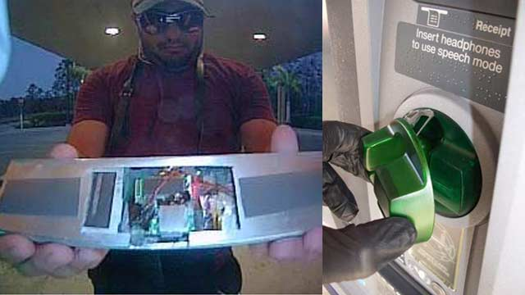
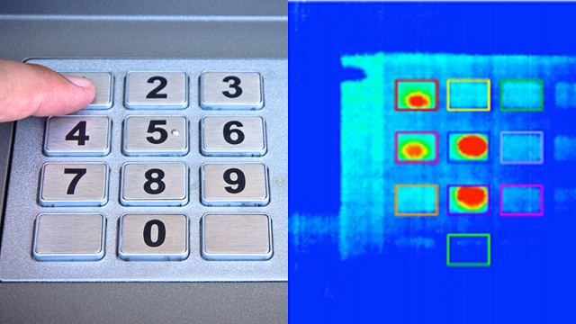
PROBLEM
Today many threats made easy get your password while typing it.
Current devices make it easy to find out personal passwords due to the fixed position of characters in the screen/keyboard

Slide 3
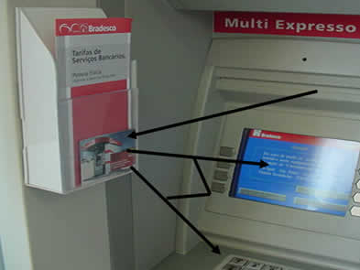
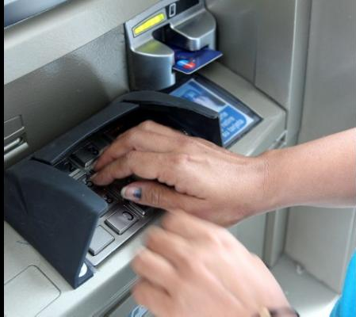
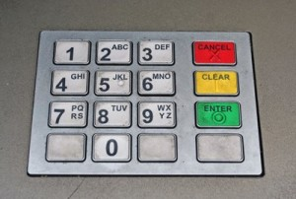
PRODUCT | ACTUAL
Example:
Alice uses her credit card in a cash machine
A thief (Bob) has placed a camera and a card reader at the cash machine.
When Alice uses her password, the camera will record it. The same will happen with her credit card, so Bob will know her credentials.
From that moment on Bob could use her credentials as he wants.
Alice knows the situation can happen and she feels unsafe.

Slide 4
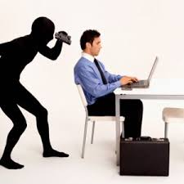
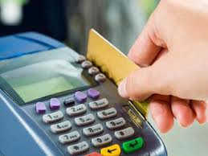
PRODUCT | ACTUAL
Example 2:
Alice uses her mobile phone/computer and connects to her bank account. She writes her password while Bob is present.
Bob takes advantage of the situation and spies her password.
Bob takes control of Alice account.
The same will happen if Alice uses the Dataphone at Bob’s shop.
And it happens just because we can not crypt passwords given by a user to a server.
The first node (dataphone/mobile phone) always gets the information unencrypted.

Slide 5
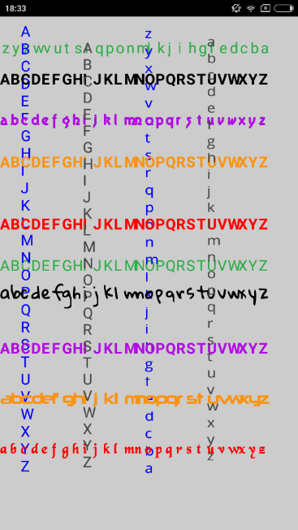
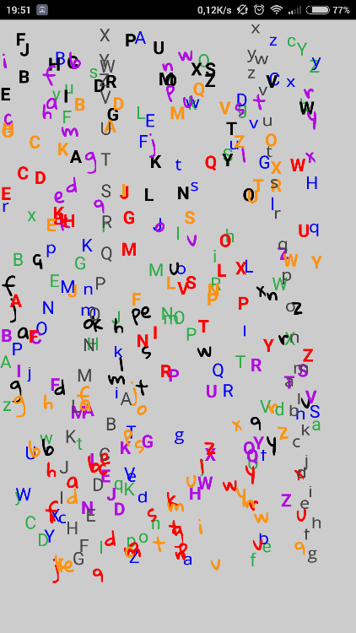
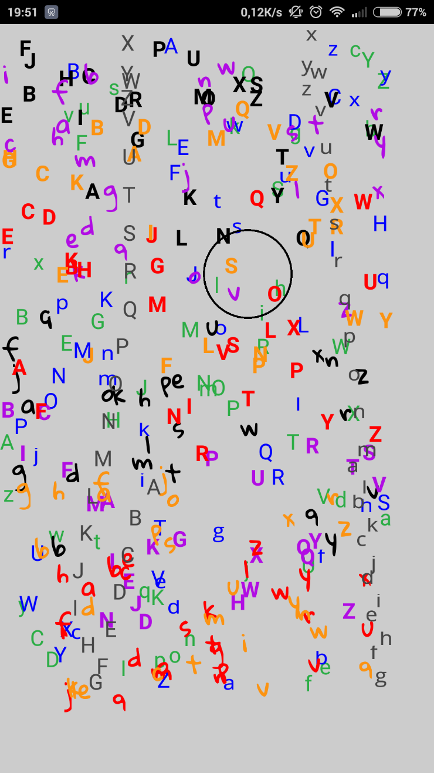
1
2
PRODUCT | ENTROPHY
3
How it works:
Sorted information is shown in the screen (image 1).
After touching the screen, the letters start to shuffle (image 2).
Now you have to press on your password letters. For example, if our first password letter is a yellow “S” you would press near to the yellow “S” location.
Any letter close to the place we have pressed is a solution candidate (image 3).
If each candidate collection contains the solution letter for it’s position, the user gets authorization.
In this way we get some random passwords (in addition to our real one).
Observers (people, hackers and cameras) aren´t able to know which is the right one.

Slide 6
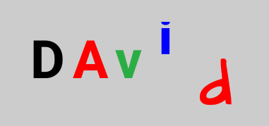

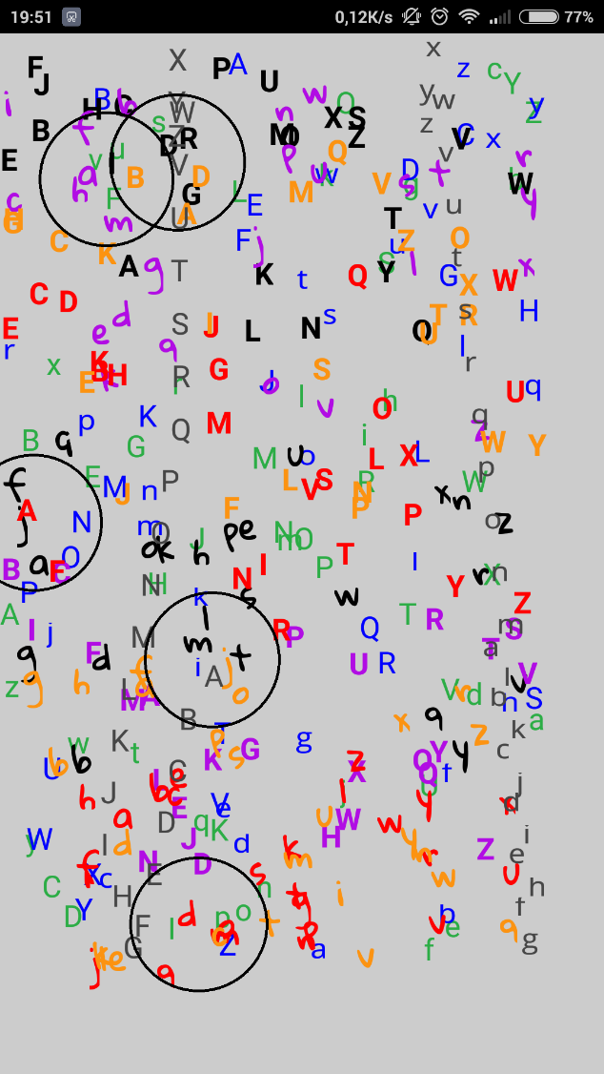
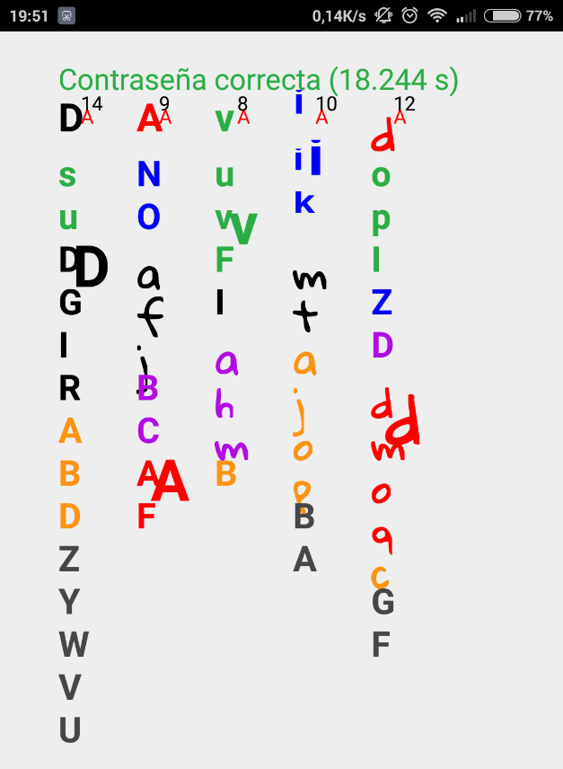
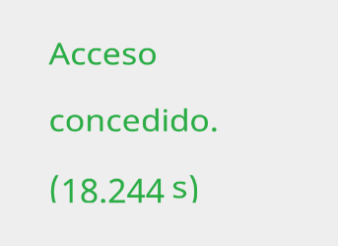
1 Choose your password:
PRODUCT | ENTROPHY
4 System gets the following information:
2 Program shuffles the letters:
3 Press on you password letters (in order)
5 System response:

Slide 7
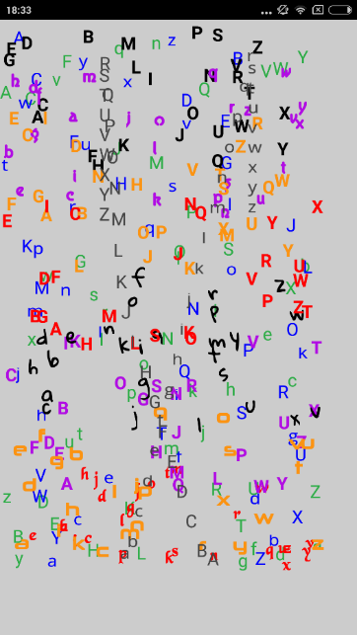
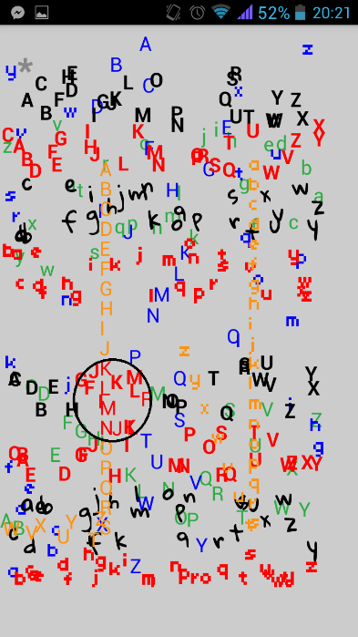
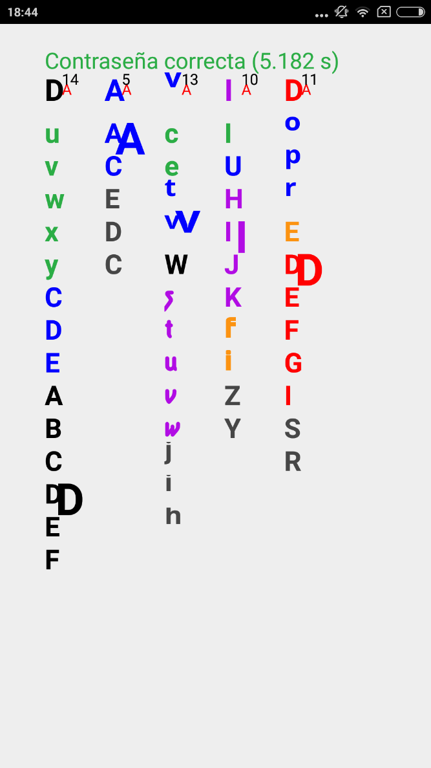
PRODUCT | ENTROPHY
Example:
Alice uses her credit card in a cash machine
In that cash machine Bob has placed a camera and a card reader.
When Alice uses the cash machine Bob gets her password and her credit card information.
Bob will try to write Alice’s password but he wont know wich one is (14*5*13*10*11 = 100.100 possible combinations)
Bob doesn’t know Alice’s password
Alice knows it and she feels safe.
Candidate letters for each position
Attackers don’t see a single password
But just a single one is valid

Slide 8
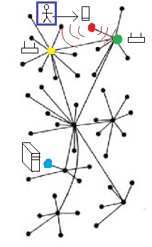
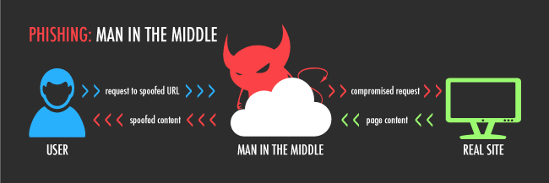
ENTROPHY | TECNOLOGY
Entrophy prevents outside observers from finding out our password.
Even if someone observes Alice writing her password and gets all the information (by recording her, hacking her information or modifying the dataphone) her password would remain safe and the observer would have no chance observe again the same keystrokes.
Encryption happens in the head of the user not in the device
Preventing password theft
even if we are hacked or recorded

Slide 9
ENTROPHY | TECNOLOGY
The program is full customizable, you can change the number of alphabets, colors, fonts, waiting times, letters in the password…
Everything is as customer preferences.
Dynamic mode (the one used in the presentation) contains 378 letters and the average number of candidate letters is 11.77
There are more than 34.000.000 total possible combinations, and in case you are been spied there are still too many possible combinations (around 100.000)
Even when the communication is known brute forcé attacks are inviables.

Slide 10
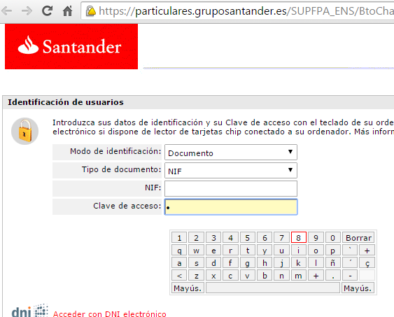
BUSINESS APPLICATIONS
Increase your perceived security while increasing your real security
Nowadays there are no competitor products using
Entrophy advantages.
It prevents “Shoulder surfing”
It prevents the insecurity of been recorded
It offers human-server instead client-server encryption
It does not reveal passwords
It makes imposible to repeat previous observations
Clients won’t feel unsafe anymore
It can be used in cash machines, dataphones, mobile devices and any other haptic screen

Slide 11

CONTACT
David Marciel Pariente
Tlf: 616980969
davidmarciel@hotmail.com
https://es.linkedin.com/pub/david-marciel/1b/805/803

